Slide 1
More Fun with Floats

Slide 2
Fast Inverse Square Root Algorithm
float Q_rsqrt( float number )
{
long i;
float x2, y;
const float threehalfs = 1.5F;
x2 = number * 0.5F;
y = number;
i = * ( long * ) &y; // evil floating point bit level hacking
i = 0x5f3759df - ( i >> 1 ); // what the fuck?
y = * ( float * ) &i;
y = y * ( threehalfs - ( x2 * y * y ) ); // 1st iteration
// y = y * ( threehalfs - ( x2 * y * y ) ); // 2nd iteration, this can be removed
return y;
}

Slide 3
Implementing Fast Inv. Sqrt. on ARM64
Step 1: Typecasting. We need to take the float and pretend it’s an integer. In the original code, long means 32 bit integer.
i = * ( long * ) &y;
Assembly instruction:
FMOV w0,s0
This takes the bit pattern found in s0 and copies it to the integer register w0. No data conversion happens.

Slide 4
Implementing Fast Inv. Sqrt. on ARM64
Step 2: Magic Constant Subtraction
i = 0x5f3759df - ( i >> 1 );
Assembly instructions:
//w0 has int typecast from step 1
MOV x1,=magic32 //loads address of magic32 constant 0x5f3759df
LDR w2,[x1] //loads magic32 to S2
LSR w0,w0,#1 //shift s0 right by one position
SUB w0,w2,w0 //subtract shifted number from magic constant

Slide 5
Implementing Fast Inv. Sqrt. on ARM64
Step 3: Typecast again
y = * ( float * ) &i;
Assembly instructions:
//w0 has result of subtraction from magic constant in step 2
FMOV s0,w0
Step 4: Newton Iteration to improve estimate
Step 5: Print
FCVT d0,s0 //extend s0 to double since printf wants it
LDR x0,=fmtstr //load pointer to format string
BL printf //print

Slide 6
Testing
Let’s program this and test.

Slide 7
FRSQRTE and FRSQRTS
FRSQRTE sn|dn //produces estimate of inverse square root
FRSQRTS sn|dn //performs Newton iteration to improve estimate
The FRSQRTE function does not implement the magic constant subtraction (I don’t think). I’ve sent ARM an email asking for how it works.
In casual testing, it is better than the magic constant method.
FRSQRTS does the standard Newton iteration for inverse square roots to improve the estimate.

Slide 8
SIMD
Single Instruction, Multiple Data

Slide 9
SIMD
The S and D registers can be thought of as themselves being part of V (for vector) registers.
V0-V31 are 128 bit registers, that can be subdivided into
2 double precision or
4 single precision or
8 half precision or
16 bytes

Slide 10
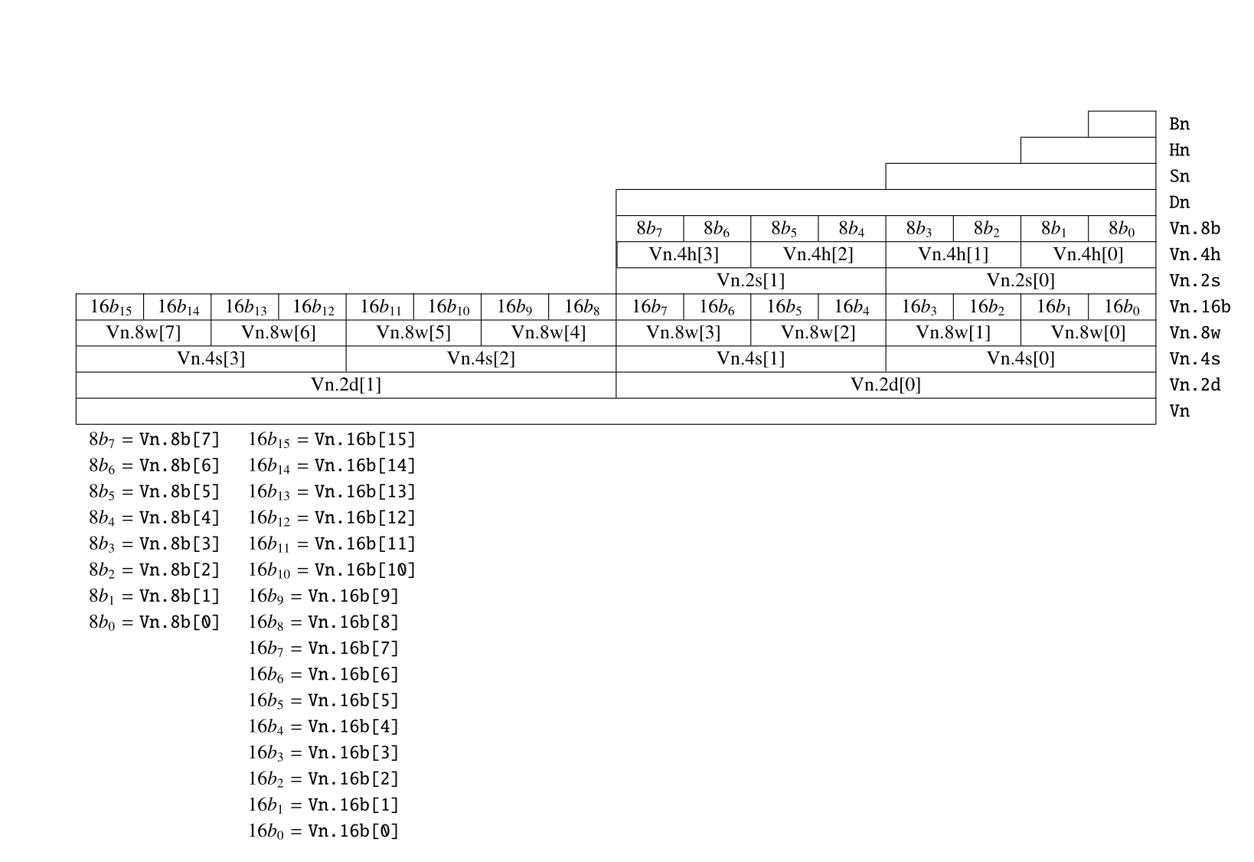
SIMD/NEON Registers

Slide 11
SIMD
Example: Compute the dot product of two vectors, composed of singles. Let’s take two vectors: a=(1,2,3,4) and b=(4,3,2,1). The dot product is 1*4+2*3+3*2+4*1 = 30.
Step 1: Load data.
vec1: .word 0x3F800000 //float32 for 1
      .word 0x40000000 //float32 for 2
      .word 0x40400000 //float32 for 3
      .word 0x40800000 //float32 for 4

Slide 12
SIMD
vec2 is defined similarly.
Step 2: Load data into V registers:
ldr x0,=vec1
ldr x1,=vec2
ld1 {v16.4s},[x0]
ld1 {v17.4s},[x1]
So v16 holds the four floats for vec1, and v17 holds the four floats for vec2.

Slide 13
SIMD
Step 3: Multiply corresponding entries.
fmul v18.4s,v16.4s,v17.4s
This computes v16 times v17, entry by entry, putting each product in v18. One command, four multiplications!
Step 4: Add them up.
faddp v19.4s,v18.4s,v18.4s //adds v18 pairwise, stores in v19, but only lower two spots
faddp s0,v19.2s //adds v19 pairwise, stores in s0 //only .2s because we've already added pairwise

Slide 14
SIMD
Step 5: Output answer
fcvt d0,s0 //convert to double b/c printf is a princess
ldr x0,=prtstr
bl printf
Demo Time

