Slide 1
Mass Spectrometry Analysis

Slide 2
Workflow
User-inputted peptide.
User-inputted scan number.
User-inputted mzXML file.
Generate b/y ions from spectrum.
Ions = {‘b1’: 102…}
Parse mzXML file:
‘scan’ > ‘num’ > ‘peaks’
Extract mz & int vectors from peaks (“magic code”).
Match (mz, int) against spectrum (b_, y_, or non_):
b_mzs = [102.2, …],
b_ints = [140, …],
b_labels = [‘b2’, …]
Stem plots:
(b_mzs, b_ints)
(y_mzs, y_ints)
(non_mzs, non-ints)
Add labels:
Ax.text(mz, int, label)

Slide 3
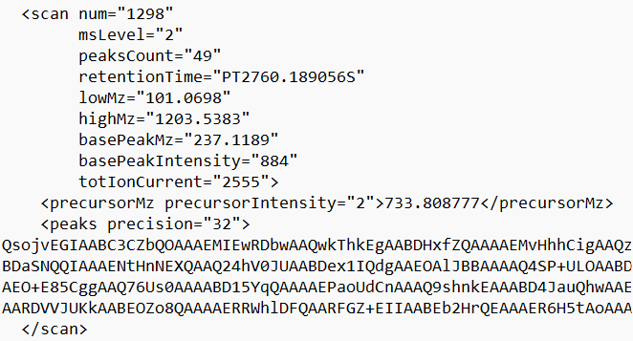
Element Tree Iterparse
ele.attrib.get(“num”) ← No namespace needed for attrib.
ele.tag == ns+“scan”
peakselt = ele.find(ns+ “peaks”)
peakselt.text

Slide 4
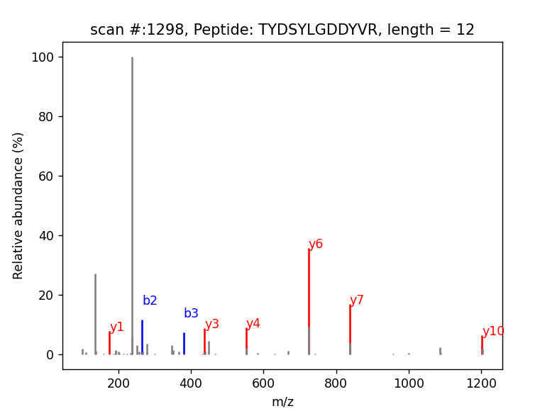
matplotlib.pyplot output
Plotted 3 ax.stem graphs.
Blue peaks match b-ions.
Red peaks match y-ions.
Grey peaks don’t match.
Tags for b/y ions (b above y).
Cutoffs:
Abs(mz – ion) < 0.3
Intensity > 5% of max intensity
Title includes length to facilitate search of mirrored b/y pairs.

Slide 5
Other modules used
b64decode: Turned the 64bit encoded peakselt.text into binary.
array: Sent the decoded binary output from 64bit into a float array.

Slide 6
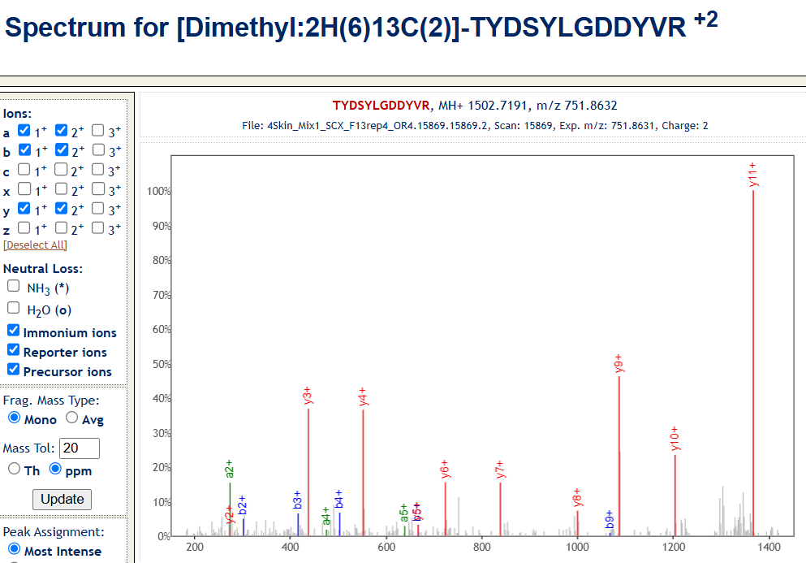
Testing the program
Printing intermediate outputs (ions dictionary, etc…).
PeptideAtlas to test output specta. https://peptideatlas.org/
https://db.systemsbiology.net/sbeams/cgi/PeptideAtlas/ShowObservedSpectrum?atlas_build_id=572&spectrum_identification_id=30229674&peptide=[Dimethyl:2H(6)13C(2)]-TYDSYLGDDYVR&assumed_charge=2&chimera_level=1&sample_id=4923&spectrum_name=4Skin_Mix1_SCX_F13rep4_OR4.15869.15869.2

Slide 7
Scientific tradeoffs
Cutoff selection is critical.
Proper mz cutoff depends on:
Technology (different mass measurement accuracies) (Lieu et al.; 2007).
Preference in balancing false discovery rate with true positive discovery (Lieu et al.; 2007).
Intensity cutoff:
Filters out noise- signal to noise ratio increases with intensity (Du et al.; 2008).
Reduce amount of data in large scan outputs (focus on just the prominent peaks).
Abundant peaks are more important in determining the peptide match.

Slide 8
Other notable details
Using non-rounded molecular weight values mattered.
MW = {'A': 71.04, 'C': 103.01, 'D': 115.03, 'E': 129.04, 'F': 147.07, 'G': 57.02, 'H': 137.06, 'I': 113.08, 'K': 128.09, 'L': 113.08, 'M': 131.04, 'N': 114.04, 'P': 97.05, 'Q': 128.06, 'R': 156.10, 'S': 87.03, 'T': 101.05, 'V': 99.07, 'W': 186.08, 'Y': 163.06 }
Break line to prevent multiple ions matching a single mz (not used).
Plotting graphs is computationally expensive.

Slide 9
Learnings
Familiarity with element tree and iterparse.
Practice with matplotlib.
Introduction to b64decode.
Understanding of mass spectrometry.

Slide 10
References
Du P, Stolovitzky G, Horvatovich P, Bischoff R, Lim J, Suits F. A noise model for mass spectrometry based proteomics. Bioinformatics. 2008 Apr 15;24(8):1070-7. doi: 10.1093/bioinformatics/btn078. Epub 2008 Mar 18. PMID: 18353791.
Liu T, Belov ME, Jaitly N, Qian WJ, Smith RD. Accurate mass measurements in proteomics. Chem Rev. 2007 Aug;107(8):3621-53. doi: 10.1021/cr068288j. Epub 2007 Jul 25. PMID: 17649984; PMCID: PMC2713049.

