Slide 1
Building a market dashboard for video games
Team
Christi Brag, Dustin Combs, Lydia Field,
Shelly Nixon, Rodrigo Reyes, Lowell Vaughen

Slide 2
Project Goals:
Tool:
Build a market dashboard with gaming information from across the web
Cover more than one gaming platform
Goal:
Support exploration of feature/genre content value
Support player profiling for design/marketing awareness
Target users:
Product designers, marketing managers, and publishing development

Slide 3
Why build such a tool?
$$$ Gaming revenues expected to exceed $159 billion in 2020
Data problem: No quality sales data
Movies have box office, Music has digital sales/usage rates, …
It’s getting worse…
Increasing sales from private platform holders (Sony PS, Microsoft, Nintendo, …)
Games are shifting from upfront sales to micro-transaction sales
* https://www.reuters.com/article/esports-business-gaming-revenues/report-gaming-revenue-to-top-159b-in-2020-idUSFLM8jkJMl

Slide 4

Profiting from the information gap

Slide 5


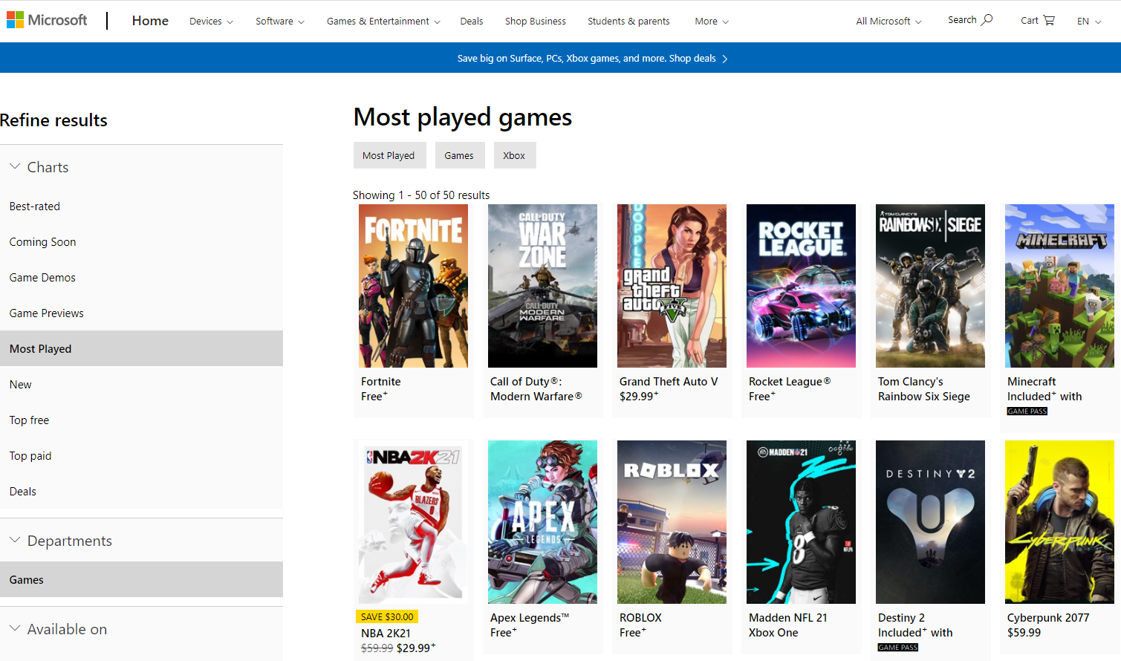
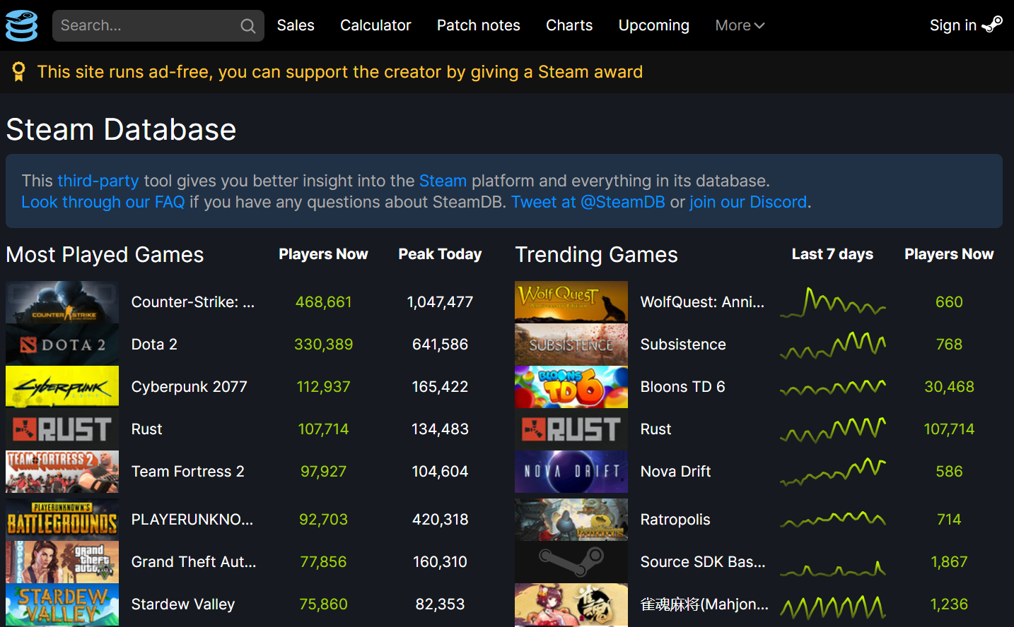
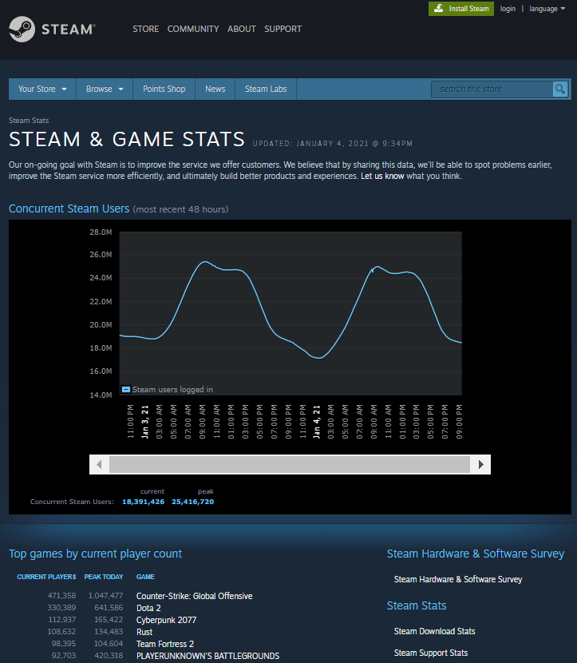
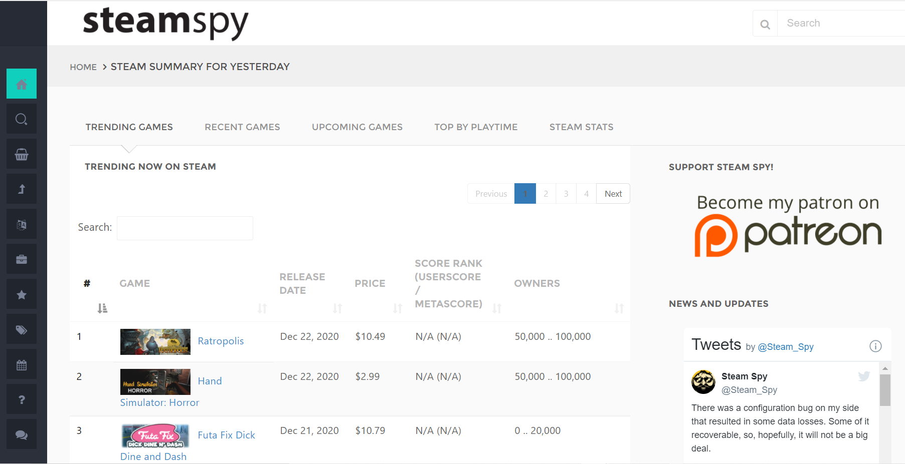
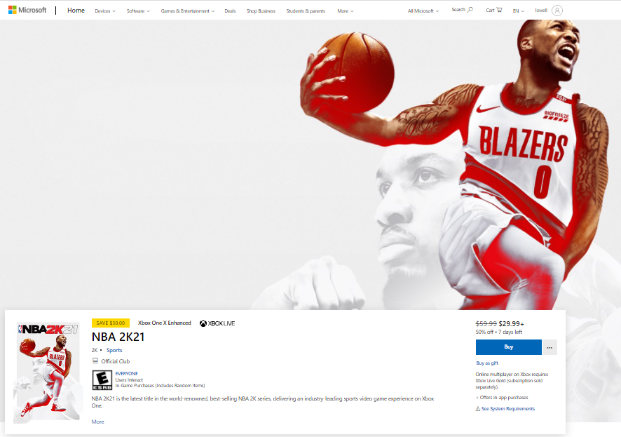
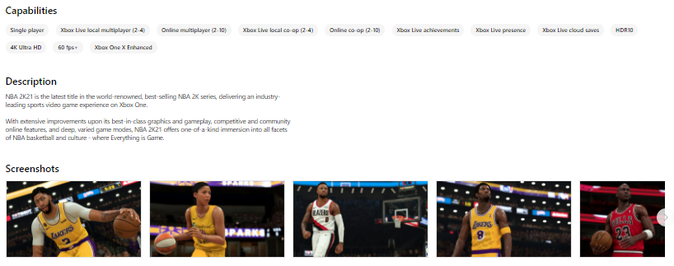
Data Sources for our project:

Slide 6
Process: Getting Data
Scrapping Steam
top 100 games
continuous scraping of current data
API calls:
from Steam: game index
from SteamSpy: game data
Scraping store data:
15+ country pages, top 50 most played
Product information for top games

Slide 7
Process: MongoDB tables
Key table
Product table
Current played games table
Country store table
Product table

Slide 8
Process: Visualization resources
Country Mapping
Heat Map

Slide 9
Process: Webpage design
Global data
Trending (popularity, time usage)
Product data

Slide 10
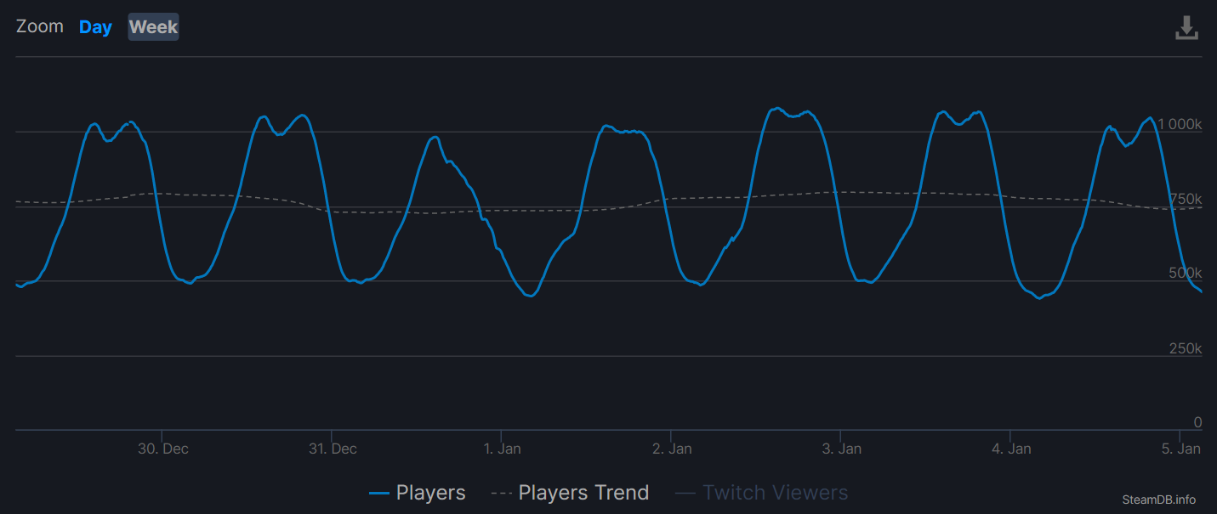
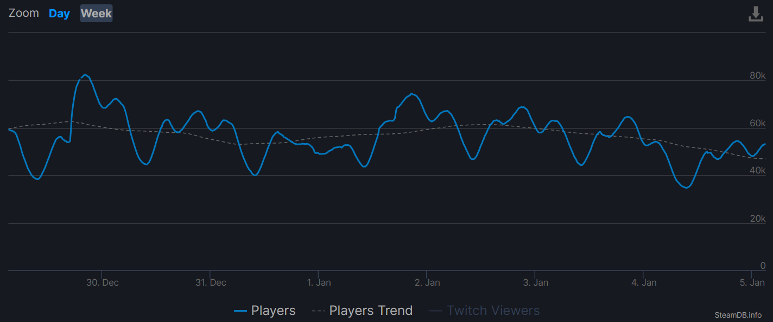
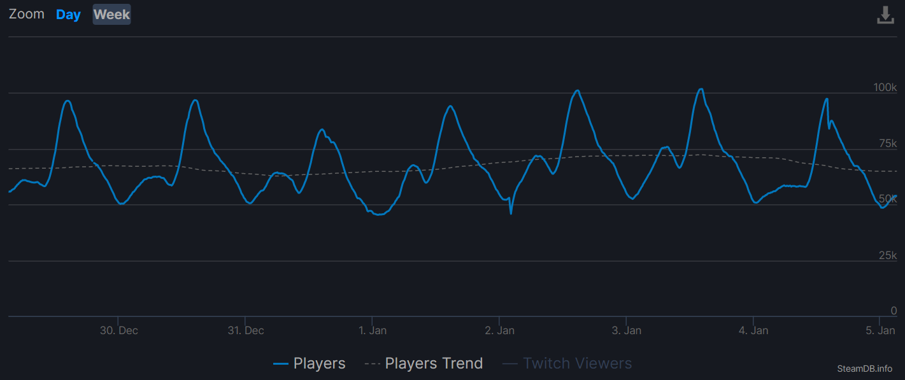
Process: Learnings
Who is the player?
UTC timing shifts
Region specifics - language

Slide 11
Future: Applying Machine Learning
What game experiences matter?
Tags vs product success
Future machine learning application

Slide 12
Project challenges:

Slide 13
Expanding the project:
More data:
More time sampling
Steam top sellers
New sources:
Epic Games Store, Windows store, EA Origin, GOG games
Sony PlayStation, Nintendo Store popularity data
Discord server scrapping
Can You Run it?

Slide 14
Questions

Slide 15
Appendix

Slide 16
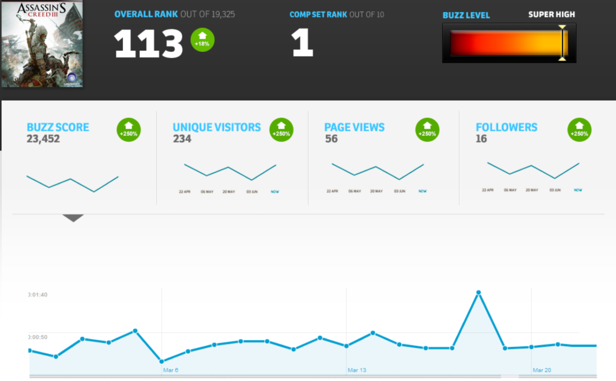
Cutting edge: late 1990’s – early 2000s
Movement of players to web for information seeking
You could see all games, every asset release and community response to content
Learn best practices for content value
Recognize extreme demand
Doesn’t work players have shifted to Youtube

Slide 17
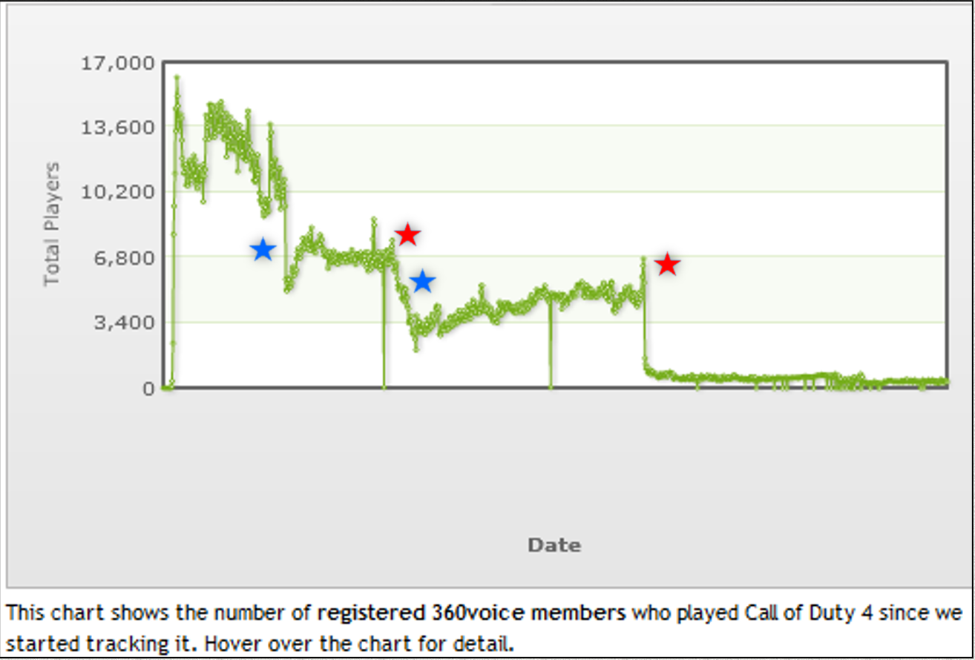
Cutting edge: Game Community APIs (early 2000s – mid 2000s)
See player behavior in a specific game
Best practices:
Content relationship to sustained engagement

Slide 18
Constant race: - insightful data before everyone else, - before it gets shut down - almost all gathered, combined by hand
Cutting edge last 5 years: private data sites

Slide 19
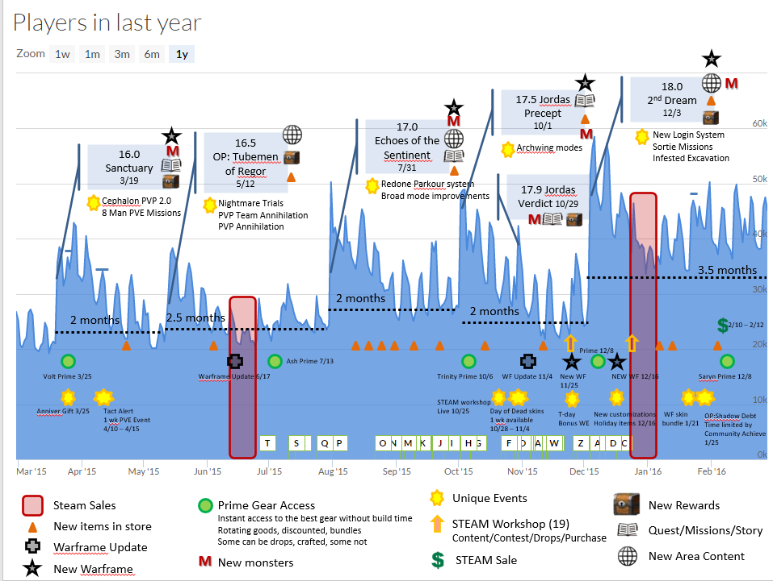
As IP/platform holders realize quality
API’s get constrained

Slide 20
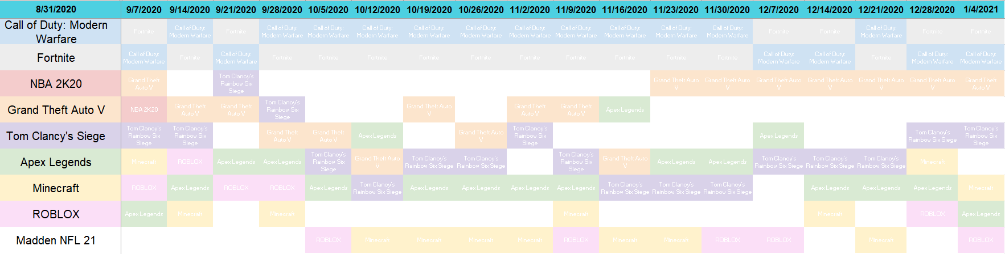
Learnings – digging into rank changes

Slide 21
Information seeking is ongoing…
Source the web for crowd sourced valuable information
Way back machine for filling in historical data
Find ways to automate data scraping and aggregation
Tease out directional insights over time
Everything confidential, tell no one

