Slide 1
World Happiness
PROJECT MEMBERS:
HANNAH BRIDGES
LOWELL VAUGHEN
AKILAH HUNTE
CHRISTI BRAGG
CARLISLE WILLARD
SHELLY NIXON
Descriptive & Comparative Analysis
Years 2015-2019

Slide 2
What Makes a Country Happy?
Dependent Variable: Country Happiness
World Gallup Poll:
Think of a ladder with the best possible life being a 10, the worse possible life being a 0.
Rate your own life on this scale.

Slide 3
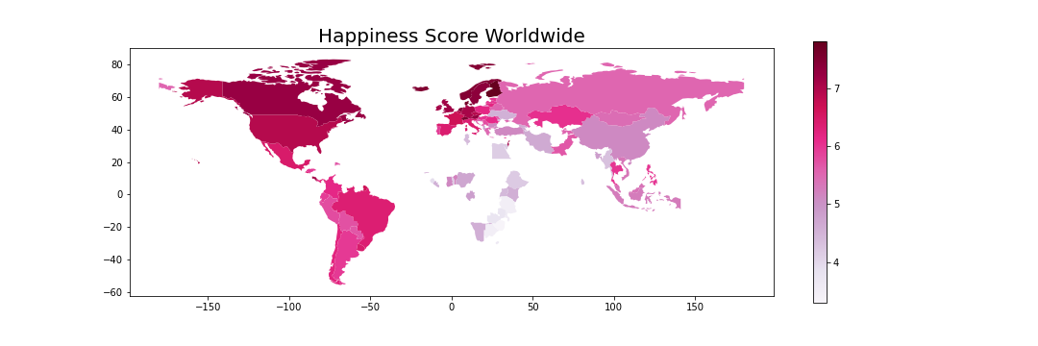
Happiness Across the World

Slide 4
Data Selection
Independent Variables
World Happiness Data Set
Added Factors
Economic (Log GDP per capita)
Family (Social support)
Health (Life expectancy)
Freedom (of life choices)
Trust (absence of corruption)
Generosity (donation to charity)
Income Inequality (Gini coefficient)
Gender balance (workforce participation ratio)

Slide 5
Data Cleanup
Gini Index and Gender Workforce Participation Data:
required renaming, removal of null values, creation of aggregate data
merging outside data required significant country naming correction to enable joining on country name
World Happiness Data:
deviations in yearly data sets required renaming, reordering, aggregating data by country, year

Slide 6
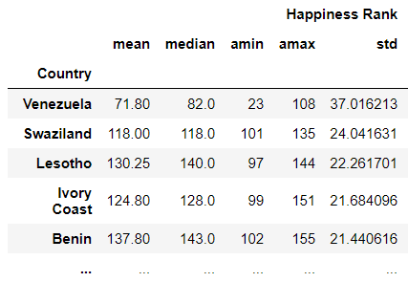
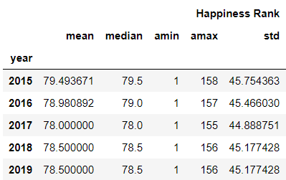
Data Exploration by Variable
Analysis of variable descriptive statistics, by country, by year
Sorting to see extremes:

Slide 7
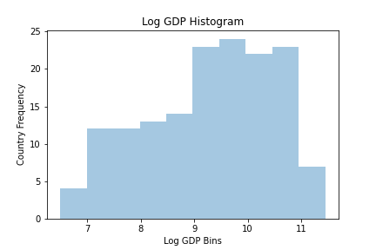
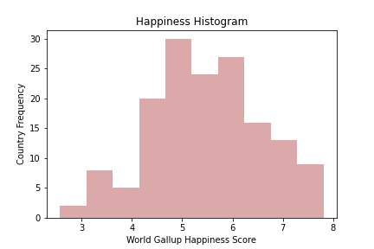
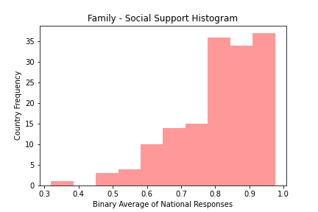
Data Exploration by Variable
Analysis of Variable Distribution

Slide 8
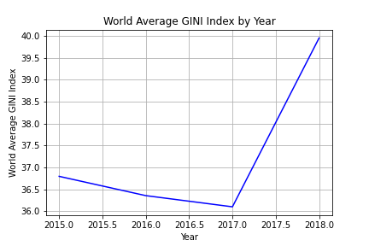
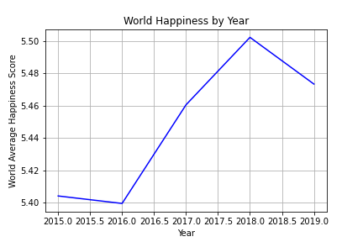
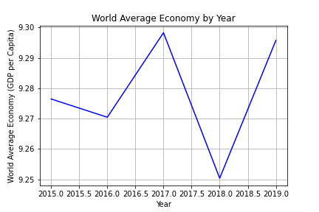
Data Exploration by Variable
Analysis of Trends for World Variables

Slide 9
Data Exploration Learnings
Top countries have multiple high scores in addition to GDP.
High values for family (Latin and S. America) drive higher than expected Happiness scores.
You can recognize world events impacting Happiness:
Afghanistan declines from 4.75 (2010) to 2.69 (2018).
There is data loss in from countries with civil turmoil:
Syria has one year of data (2015), Burundi (2018).
Highest happiness countries have stable happiness scores. (Primarily 1st world countries)

Slide 10
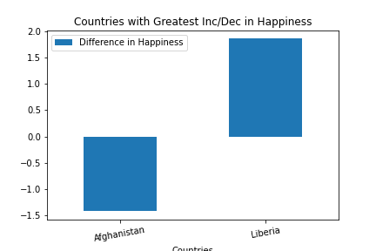
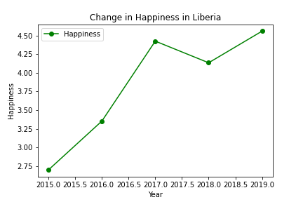
Changes in Happiness
Liberia & Afghanistan identified as Countries with greatest increase and decrease in happiness over time frame
Country with Greatest Increase in Happiness over time frame: Liberia
2017: First fully democratic transition in 74 years
2018: Became a member of the World Trade Organization

Slide 11
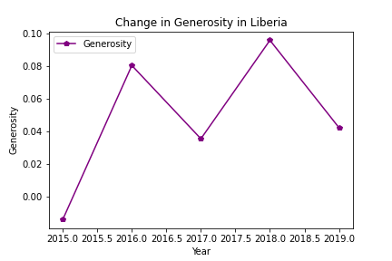
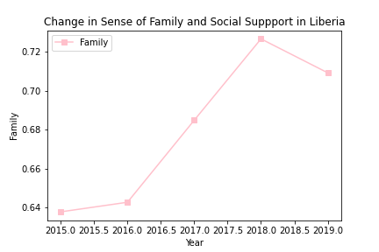
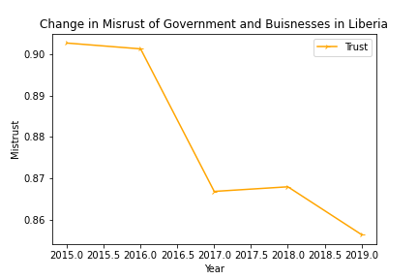
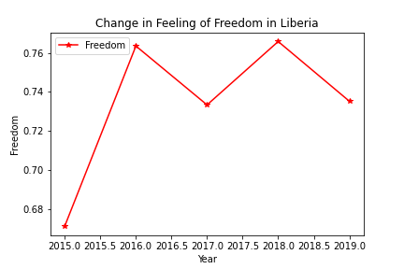
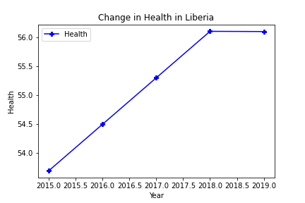
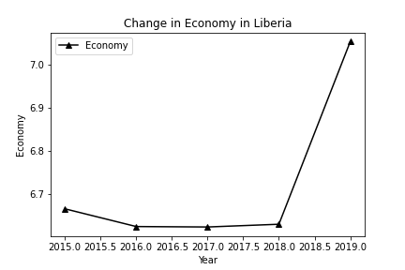
Data Analysis - Greatest Improvement
Liberia
Notes:
Delay in Economic change compared to other variables - Economy is correlated strongly with Happiness because both are influenced by the other variables

Slide 12
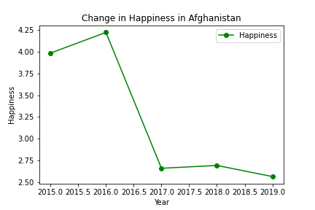
Greatest Decrease in Happiness: Afghanistan
2014: Residual effects from the withdrawal of international troops from the area
2016: Failed peace talks with Taliban and surveyed lack of confidence in the government, economy, and overall safety and security

Slide 13
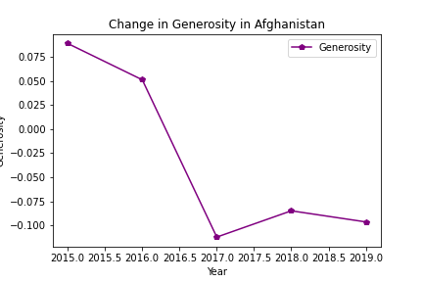
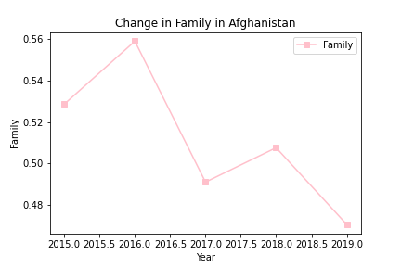
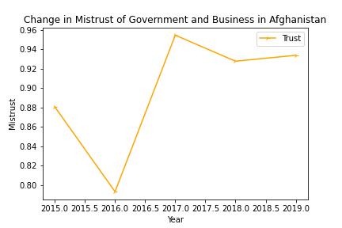
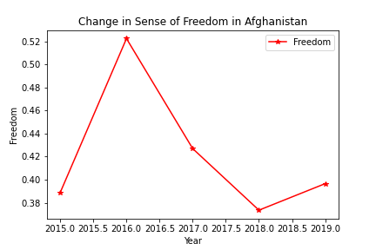
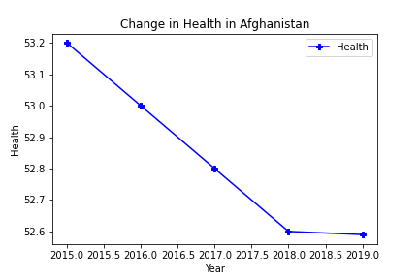
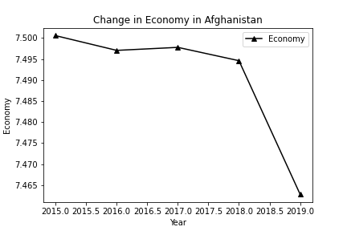
Data Analysis - Greatest Decrease
Afghanistan

Slide 14
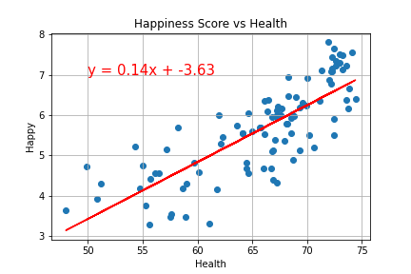
Data Analysis - Single Variable
Generated scatter plots of 5 year average happiness score vs. 5 year average variable per country.
Performed linear regression on scatter plots and ranked by correlation coefficient:
Health: 0.794
Economy: 0.790
Family: 0.757
Freedom: 0.485
Trust: -0.436
Gini Index: -0.390
Generosity: 0.0739
Workforce ratio: 0.0736

Slide 15
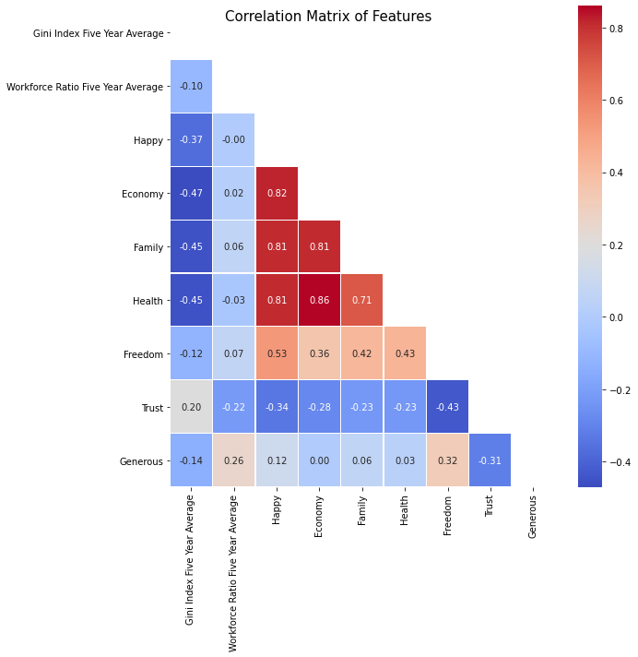
Data Analysis - Multiple Variable
Generated Spearman’s correlation matrix to examine multicollinearity of multiple variable regression model.
Economy, Family, Health and Happiness are correlated with each other so need to consider interaction effects.

Slide 16
Data Analysis - Multiple Variable
Interaction Effects
Workforce gender ratio interactions were significant with:
Gini Index
Economy
Generosity
Gini Index, Health, Economy, and Gender Ratio interactions were the most significant factors influencing Happiness
Final model Economic coefficient was negative.
Growth in economy only translated to increases in Happiness if the gender ratio was high.

Slide 17
How to Improve a Country’s Happiness:
Multivariable Analysis:
Single Variables Most Correlated with Happiness:
Health: 0.794
Economy: 0.790
Family: 0.757
Large GDPs focus on:
Gender Equality in the workforce
Income inequality
Health (life expectancy)
Small GDPs focus on:
Income inequality
Gender equality then economic growth (increase GDP)
Health (life expectancy)

Slide 18
Questions?

Slide 19
Appendix:

Slide 20
Appendix: Data Set Clarity
GDP per capita: adjusted to 2011 international dollars, taken from World Development Indicators released from the World Bank.
Healthy life expectancy at birth based on World Health Organization
Social support, national average of binary responses to Gallup World Poll (GWP), “If you were in trouble, do you have relatives or friends you can count on to help you whenever you need them, or not?”
Freedom to make life choices, national average of binary responses to GWP, “ Are you satisfied or dissatisfied with your freedom to choose what you do with your life?

Slide 21
Appendix: Data Set Clarity (cont.)
Generosity, residual of regressing the national average of GWP reponses, “Have you donated money to a charity in the past month?”
Trust, average of binary answers to two GWP questions: “Is corruption widespread throughout the government or not?” and “Is corruption widespread within businesses or not?”
Ratio of gender participation in the workforce - % of
Gini coefficient - a measure of income inequality that condenses income distribution for a country into a single number between 0 and 1. Higher number means the greater degree of income inequality.

Slide 22
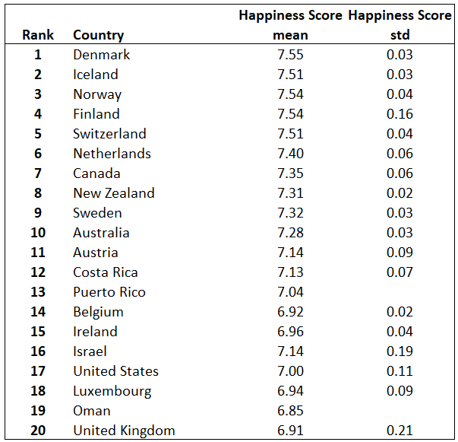
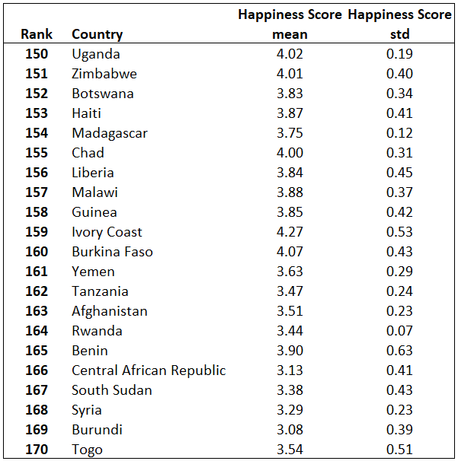
Appendix: Stability of Happiness by Rank

Slide 23
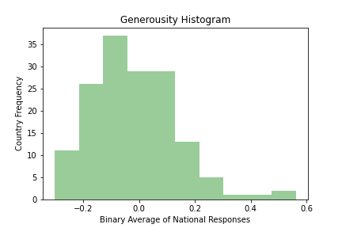
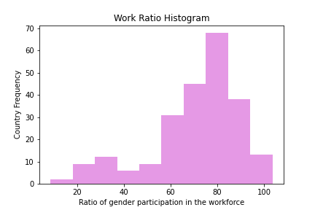
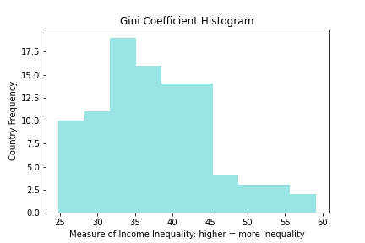
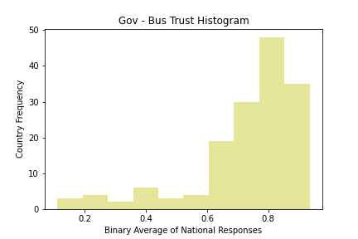
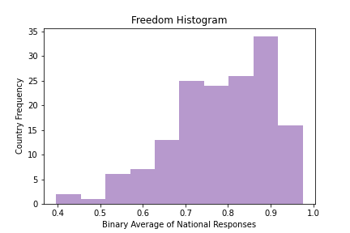
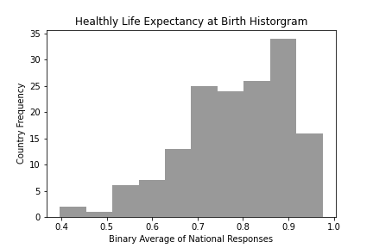
Appendix: Variable Histograms

Slide 24
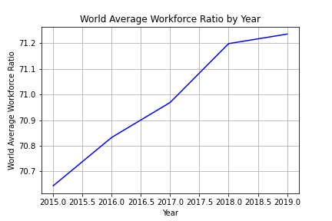
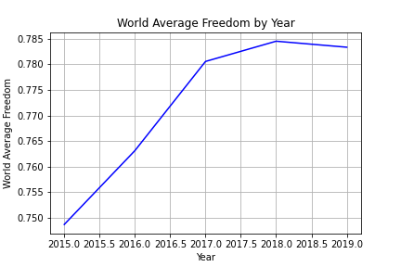
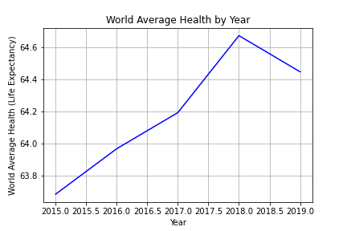
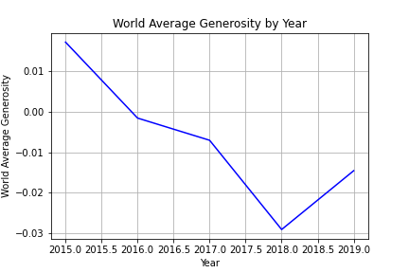
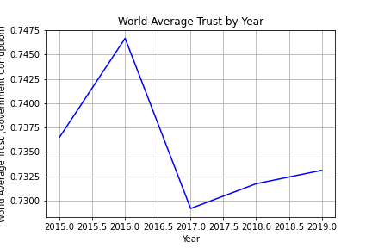
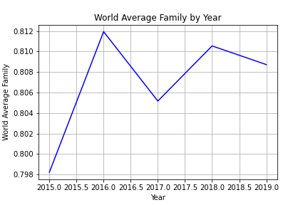
Appendix: Variable Yearly Trends

Slide 25
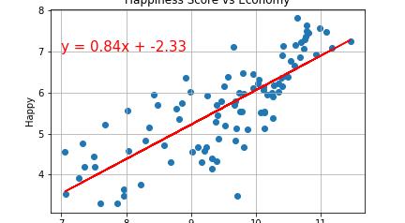
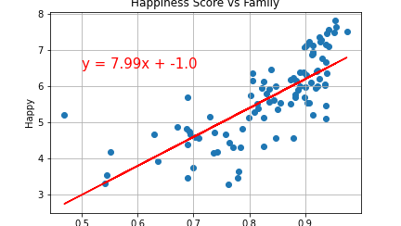
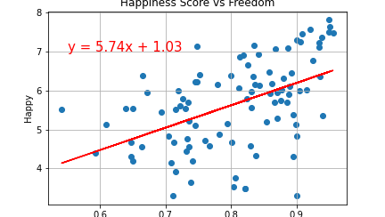
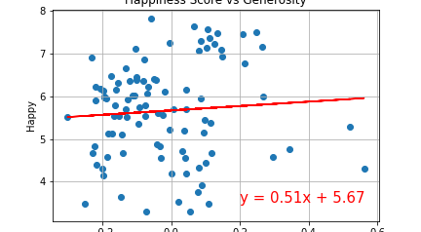
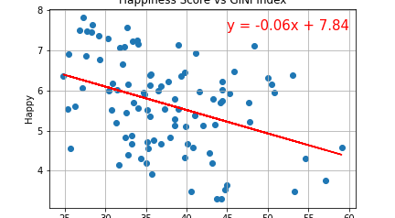
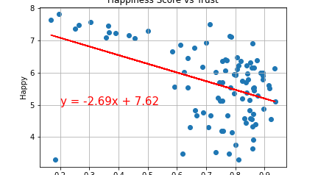
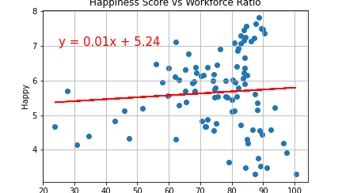
Appendix: Scatter Plots and Regressions

