Slide 1
Final Presentation
Collin Brehmer, Molly Hischke, Kyle Hancock, Nikki Johnson

Slide 2
Research Question
What positions on the Jeopardy board are most likely to be a Daily Double by round and across years?

Slide 3
Introduction
Importance to the game
Arthur Chu (2014)
James Holzhauer (2019)
Previous analyses
None across years
Challenge of finding position
Visual representation of results

Slide 4
Methods
Only included episodes from dates beyond November 26, 2001
Finding x position of daily double (filtered to episodes with 12 categories)
Finding y position of daily double (Weighted across missing values)

Slide 5
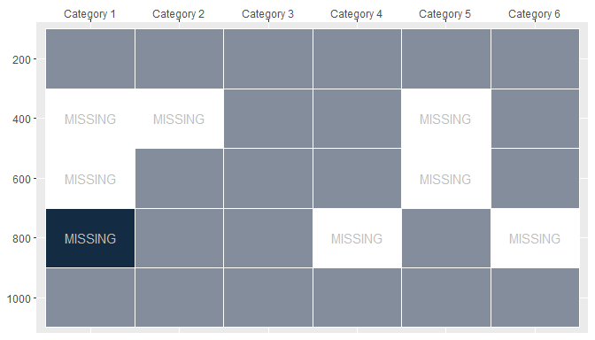
Methods

Slide 6
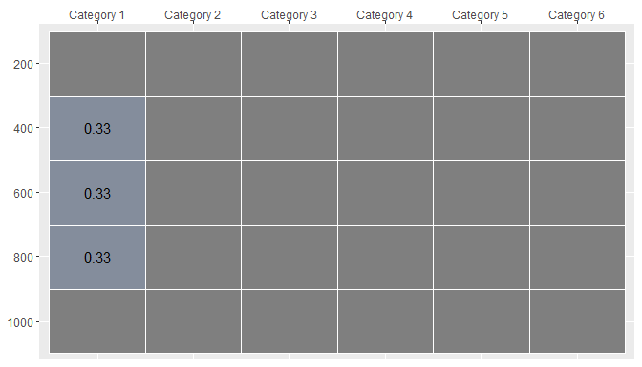
Methods

Slide 7
Results
Flex Dashboard:
Daily Double Round 1 since 2001
Daily Double Round 2 since 2001
Daily Double Location by year
Daily Doubles are not evenly distributed across the board
No differences in daily double location between Round 1 and Round 2
15 out of 19 years had the most daily doubles within the 800/1600 row

Slide 8
Conclusions
Similar to previous analyses
https://flowingdata.com/2015/03/03/where-to-find-jeopardy-daily-doubles/
Shift in location in 2016
Arthur Chu and subsequent analyses
Future locations (pattern or random)

Slide 9
Overview of Approach
Nest data by air date
Pull out subsets of that data
Modify subsets by:
Adding additional information (i.e. weight, x/y position)
Manipulating data (i.e. expanding, further subsetting)
Rejoin dataframes to get desired information
Create tidy dataset for plots

Slide 10
Interesting Packages or Techniques
Creating perfect data frame
Package: tidyr
Function(s): expand()
Mapping
Package: purrr
Function(s): map(), map2()
Joining
Package: dplyr
Function(s): right_join(), full_join(), left_join()
Plotting
Package: plotly
Function(s): plot_ly()

Slide 11
Examples
Input
categories_unique: categories asked in each episode
categories_asked: information about asked questions
mutate(categories_unique = map(categories_unique, ~ rownames_to_column(., var = "x_pos")), perfect_pos = map2(categories_unique, categories_asked, ~ full_join(.x, .y)), perfect_pos = map(perfect_pos, ~ group_by(., round)), perfect_pos = map(perfect_pos, ~ expand(., x_pos, value)))
Output
categories_unique: x position assigned to each category
perfect_pos: perfect df for each game

Slide 12
Examples
Input
dd_perfect: perfect DD df
dd_weight: df containing the weight to be assiged to DD questions
mutate(dd_perfect = map2(dd_perfect, dd_weight, ~ full_join(.x, .y, by = "category")), dd_perfect = map(dd_perfect, ~ mutate(., daily_double = case_when( is.na(daily_double) == TRUE ~ weight, is.na(daily_double) == FALSE ~ daily_double))))
Output
dd_perfect: perfect DD df with weights added

Slide 13
Examples
daily_double_year %>% unnest() %>% plot_ly( x = ~ x_pos, y = ~ y_pos, z = ~ Percent, frame = ~ year, hovertemplate = paste("Daily Double Percent: %{z:,}%<br>", "<extra></extra>"), colors = "Blues", type = 'heatmap' ) %>% layout(title = list(text = ""), xaxis = list(title = "", side = 'top'), yaxis = list(title = ""))

Slide 14
Lessons Learned
Seemingly simple problems may not be simple to answer.
Pros/cons of ggplot() vs plot_ly()
Project organization and GitHub
Writing other code before data is completely clean is beneficial.

