Slide 1
Linguistic Characteristics of Censorable Language on SinaWeibo
Kei Yin Ng, Anna Feldman, Jing Peng, Christopher Leberknight
Montclair State University
New Jersey, USA

Slide 2
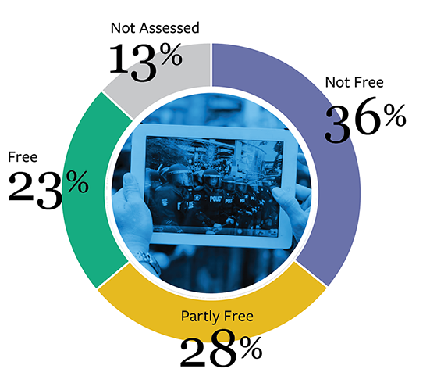
Problem
As of 2017, over 50% of the world’s Internet users have restricted access to certain Social Media platforms
(e.g. Twitter, Facebook, Youtube)
Souce: Freedom House (http://freedomonthenet.org)

Slide 3
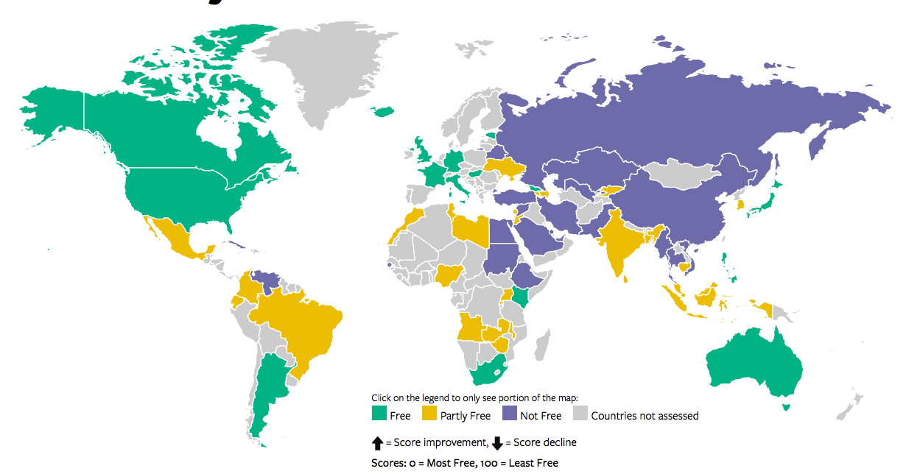
Our Focus
Mainland China
One of the regions with the most serious censorship
Largest population in the world (~1.4 billion)
Weibo
Chinese equivalent of Twitter
> 300 million active monthly users
Notes:
Why Mainland China and Weibo are our focus

Slide 4
Censorship on Weibo
Published content is subject to scrutiny ➜ would possibly be censored or deleted if it is considered to have violated Weibo’s policies (e.g. not to publish content that hurts the country’s or the government’s reputation)
Discussions on sensitive topics SOMETIMES get censored, but NOT ALWAYS (such tweets are accessible on the platform e.g scandals of Chinese officials and the Chinese government)

Slide 5
Related Work
Predicting censorship
King et al. (2013) claim that negative comments about the state do not always lead to censorship. Rather, the presence of Collective Action Potential (the potential to cause collective action in real life) does.
Bamman et al.(2012) find that the presence of a set of politically sensitive keywords in a Weibo blogpost contribute to higher chance of the post being censored.
Evading censorship
Hiruncharoenvate et al. (2015) propose that use of homophones of sensitive keywords could help extend the time a post could remain available online.
Lee (2016) claims that parodic satire could most likely survive censorship as it relies heavily on users’ and censors’ ability to detect sensitive topics based on context.
Notes:
King et al. (2013), Lee (2016), and Hiruncharoenvate et al. (2015)’s work relies on a significant amount of human effort to interpret and annotate texts.
Bamman et al. (2012)’s findings focus only on presence of keywords, instead of linguistic characteristics.
King et al. (2013), Lee (2016), and Hiruncharoenvate et al. (2015): Time- and labor-intensive methods might not be efficient enough to inform Internet users the latest censorship environment.

Slide 6
Our Work
Collect a corpus of censored and uncensored blog posts on sensitive topics (but not necessarily on politics)
Study the linguistic components of both the censored and uncensored posts on those topics (not just sensitive keywords)
We build a classifier that predicts censorship decisions independent of discussion topics

Slide 7
Hypotheses
Censored and uncensored texts should have their own unique linguistic characteristics even on the same topic.
Inspired by Sali et al. 2016 on frequency effect in information selection.
Uncensored content is easier for readers to process than censored content
Lewandowsky et al.(2012): rejecting information requires cognitive effort whereas accepting information as truth is easier;
Schwartz et al. (2008): people tend to make judgments based on their subjective feelings of how easy it is to recall or process information;
→ We see censorship as an agent that creates misinformed online experiences by eliminating certain content and presenting events and opinions in a biased way
Notes:
H2: Censorship is a tool of propaganda. Censors try to keep posts that will help them spread the propaganda. Research in psychology shows that content presentation affects processing and memory → we use readability as a measure of “text easiness”.

Slide 8
Data Sources
Topics Covered
Uncensored Sina Weibo
Censored Freeweibo and WeiboScope
Pollution and Food Safety - The use of Gutter Oil as cooking oil in mainland China reported in 2010 - The Milk Scandal in 2008 when milk and infant formula made in China were found to be adulterated with melamine to make the products appeared to have high protein content.
- The ongoing severe Air Pollution problem in some cities in mainland China.
Internet Censorship and Propaganda
The ”fifty-cent party”(五毛党), a group of commentators that is believed to be hired by the Chinese authorities to manipulate public opinion in favor of the Communist Party.
Bo Xilai
A former Communist Party chief who was found guilty of corruption
Kindergarten Abuse RYB(红黄蓝) Kindergarten Abuse in Beijing in 2017
Notes:
Uncensored Source: content that can be found on Sina Weibo has already passed the censorship mechanisms and is regarded as uncensored.
Censored Source: Both sources tracked censored blogposts from Sina Weibo and make them available to the public

Slide 9
Data Selection & Preprocessing
Only blogposts that do not contain any images, hyperlinks or reblogged content are selected.
Name of author, friend tags and hashtags are removed from all data.
Since availability of censored data is generally lower, we first collect all available censored blogposts, and then based on the quantity of censored blogposts we collect corresponding number of uncensored blogposts that were published in the same date range as the censored counterpart.
A word segmenter called Jieba has been used to segment all the data and the performance of Jeiba on our data has been manually checked.

Slide 10
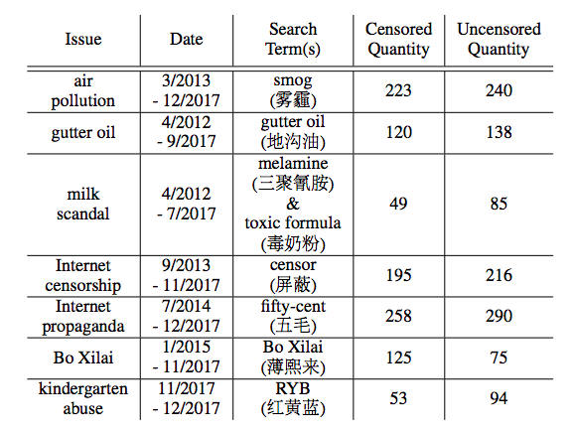
The Corpus
Sub-corpus 1 Pollution &
Food Safety Issues
Sub-corpus 2 Internet Censorship &
Propaganda Issues
Sub-corpus 3
Bo Xilai Scandal
Sub-corpus 4
Kindergarten Abuse
TOTAL 1023 1138

Slide 11
Sample Data
Censored - Kindergarten Abuse 国外震怒，气炸了肺。 国内红黄蓝保留追究造谣者责任的权利。 (Overseas is furious. Here within the country RYB reserves the rights to hold people responsible for spreading rumors. )
Uncensored - Kindergarten Abuse 从携程亲子园到红黄蓝幼儿园，“虐童”案再次成为焦点，只希望类似的事件从此不会发 生，希望澄清的一切都是事实的真相，希望所有的小朋友都在阳光下健康成长。 (From Ctrip Day Care to RYB Kindergarten, ”child abuse” has once again become the news highlight. I just hope nothing similar will happen again, and all the clarifications are the truth. I hope all children can grow up healthily under the sun.)

Slide 12
Feature Sensitive Keywords
Source 1 Wikipedia’s Chinese blacklisted keywords
Source 2 China Digital Times’s sensitive Sina Weibo search terms
As accessibility of search results change from time to time, China Digital Times tests the “searchability” of each keyword and records the date of testing for reference.
For each issue, we collect keywords that have been tested during the same time period as the published date of the blogposts
We count the frequency of keywords in each blogpost and normalize it with length of blogpost

Slide 13
Feature Sentiment
Sentiment analyzer of BaiduAI
Designed to gauge sentiment of ”comment type” short texts.
Outputs a set of sentiment scores for each blogpost - a positive sentiment percentage score and a negative sentiment percentage, which sum to 1.

Slide 14
Feature LIWC (Linguistic Inquiry and Word Count)
LIWC is a program that analyzes text on a word-by-word basis, calculating percentage of words that match each language dimension e.g. Pronouns, Function words, Social processes, Cognitive processes, Drives, Informal language etc.
It builds on previous research establishing strong links between linguistic patterns and personality/psychological state.
We use the Chinese LIWC to extract the frequency of 95 word categories in each blogpost

Slide 15
Features Character Frequency & Word Frequency
Character Frequency Based on the character frequency list of modern Chinese compiled by Da (2004).
Word frequency Based on Aihanyu’s CNCorpus of modern Chinese which consists of about 9.5 million Chinese words.
We calculate the average frequency of characters and words in each blogpost
Character and Word frequency provides a picture of how often a certain character or word is used in modern Chinese texts. ➜ The lower the frequency, the less commonly used a character or word is.
For words that appear very rarely (less than 50 times in the corpus), we count their frequency as 0.0001%.

Slide 16
Feature Semantic Classes
The Chinese Thesaurus 同义词词林 Divides words into 12 semantic classes (Human, Matter, Space and time, Abstract matter, Characteristics, Actions, Psychology, Human activities, States and phenomena, Relations, Auxiliary words, and Formulaic expressions).
A word might belong to more than one semantic class (more than one senses) e.g. the word 上 belongs to 7 classes: Space and time, Actions, States and phenomena etc. The more semantic classes a word belongs to, the more semantic variety it has.
We count the number of distinct semantic classes found in each post, normalize by dividing the number of words by the number of semantic classes

Slide 17
Feature Readability I
Inspired by Zheng (2005) and Sung et al. (2015), we take the mean of character frequency, word frequency and word count to semantic groups ratio as a score of text readability.
For each individual component, a lower score means a lower readability (more difficult to read and understand). Therefore, the lower the mean of the 3 components, the lower readability a text has.
Notes:
The components of our metric overlap with that of Sung et al. (2015) on the word level and semantic level. Their readability metric has been tested and validated to measure the readability of Chinese written texts for native speakers.

Slide 18
Features Idioms & Readability II
Idioms are annotated by Jieba’s POS tagger.
We normalize the raw count of idioms by the number of words in the blogpost.
We find a negative correlation between the Readability I score and idioms ➜ suggests the higher the number of idioms in a text, the lower its readability.
We incorporate the inverse of normalized idioms into Readability I to create a second version of the readability score (Readability II)

Slide 19
Feature Word Embeddings & Eigenfeatures
Train word vectors using the word2vec tool (Mikolov et al., 2013a; Mikolov et al., 2013b) on 300,000 Chinese articles provided by Wikipedia.
Remove stop-words from each blogpost in our censorship corpus and compute a 200 dimensional vector for each blogpost.
Compute the 200x200 covariance matrix for each document and determine the eigen decomposition of this matrix. The eigenvectors are the directions in which the data varies the most.
The last 40 eigenvalues capture about 85% of total variance and are therefore used as features.

Slide 20
Automatic experiments
107 linguistic features (standardized as a z-score) and 40 eigenvalues for each blogpost.
Standard feature selection (IG, 10-fold cross-validation) with respect to class for each sub-corpus.
Experiment with Naive Bayes and SVM (with SMO) classifiers for each subcorpus:
eigenvalues only
linguistic features only
combination of both
best features

Slide 21
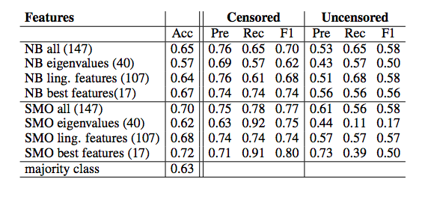
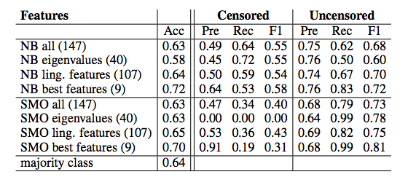
Classification Results
Bo Xilai subcorpus
Best performance: 72% accuracy
Kindergarten Abuse subcorpus
Best performance: 72% accuracy

Slide 22
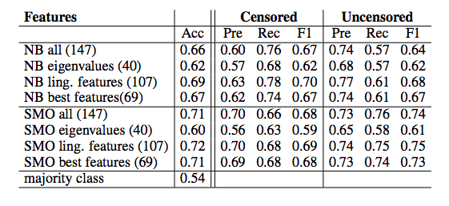
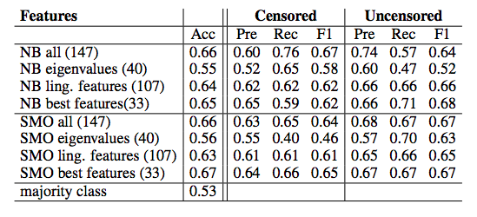
Classification Results
Pollution & Food Safety subcorpus
Best performance: 72% accuracy
Internet Censorship & Propaganda subcorpus
Best performance: 67% accuracy

Slide 23
Human Baseline (Crowdsourcing)
Crowdsourcing experiment on Amazon Mechanical Turk on the Bo Xilai data.
Participants decide whether they think a post has been censored (Yes) or has not been censored (No) on Sina Weibo.
Only responses that correctly answer all control questions are accepted and analyzed.
Each blogpost has been judged by 4 to 8 different participants. The average accuracy of the human judges is 63.51%. (compared to 72% of SVM classifier)
The inter-annotator agreement, however, is low (Cohen’s kappa = 0.07), which suggests that the task of deciding what blogpost has been censored is extremely difficult.
Notes:
Control questions 1. Which of the following sentences is in correct word order? A. 根据德国波恩大学发展研究中心的预算，全球人口将在同年增至98亿，到了2050年，全球粮食产量或会减少超过20%，但与此同时。 B. 根据德国波恩大学发展研究中心的预算，到了2050年，全球粮食产量或会减少超过20%，但与此同时，全球人口将在同年增至98亿。 C. 全球粮食产量或会减少超过20%，根据德国波恩大学发展研究中心的预算，但与此同时。全球人口将在同年增至98亿，到了2050年。 2. Which of the following describes the meaning of the idiom “无可奈何”? A. 指感到没有办法，只有这样了 B. 指某一件事专心致志，顾不上睡觉，忘记了吃饭 C. 指心地单纯，没有做作和虚伪 3. Bo Xilai committed which of the following crimes? A. Theft B. Corruption C. Rape 4. Which of the following person was not involved in the Bo Xilai scandal? A. 王立军 B. 韩正 C. 谷开来

Slide 24
Best Features
Across all topics:
Readability
WC
WC/Semantic Classes
Swear words (Informal Language)
Anger (Affective Processes) (hate, kill, annoyed)
Non-fluencies (Informal Language)
Social processes (non-1st pers. pronouns; human interaction)
Power (Drives) (superior, bully)
Causation (Cognitive processes) (because, effect)
Notes:
“Social processes include a large group of words that denote social processes, including all non­-first-­person­ singular personal pronouns as well as verbs that suggest human interaction (talking, sharing) ­­ many of these words do not belong to any of the Social processes subcategories. “

Slide 25
Best Features Readability I
Readability I (without idioms) and Word Count (WC) appear in all 4 sets of best features.
The average readability score of all uncensored blogposts is higher (=easier) than that of censored.
Readability I feature alone achieves comparable classification accuracies as using all features:
Bo Xilai subcorpus - 65% Kindergarten Abuse subcorpus - 65% Pollution & Food Safety subcorpus - 66% Internet Censorship & Propaganda subcorpus - 54%

Slide 26
Readability and WC
Suggests that censored content could be semantically less straightforward and/or use more uncommon words.
➜ Possible explanation:
uncensored content is easy to remember/easy to accept as truth/more influential?
➜ Possible recommendation:
To evade censorship simplify the language of your posts.
Uncensored blogposts on average are longer.
➜ Possible explanation: invites more attention?
➜ Possible recommendation: Make posts longer.
Each component of the readability metric did not perform as well as their combination.
Notes:
Suggests that various linguistic techniques might have been adopted in censored blogposts e.g. satire as suggested by Lee (2016), homophones as suggested by Hiruncharoenvate et. al (2015).

Slide 27
Linguistic Characteristics of Censored vs Uncensored
For each subcorpus, we compare the average score of each feature between the 2 classes (by subtracting the censored average from the uncensored average). A +ve value indicates stronger association with the uncensored class; a -ve value with the censored class.
Features that are more associated with the censored class across all 4 subcorpora: 1. third person plural pronoun (‘they’) (Social Processes) 2. swear words (‘fuck’, ‘damn’, ‘shit’ etc.) (Informal Language) 3. words that express anger (‘hate’, ‘annoyed’, ‘kill’ etc.) (Affective Processes: Negative Emotions) 4. words that express certainty (‘always’, ‘never’ etc.) (Cognitive Processes)
Features that are more associated with the uncensored class across all 4 subcorpora: 1. interrogatives (‘how’, ‘when’, ‘what’ etc.) (Other grammar) 2. Internet slang (‘lol’, ‘plz’, ‘thx’ etc.) (Informal Language) 3. words that talk about the present (‘today’, ‘now’ etc.) (Time Orientations) 4. words that talk about sadness (‘crying’, ‘grief’ etc.) (Affective Processes: Negative Emotions) 5. words that talk about vision (‘view’, ‘see’ etc.) (Perceptual Processes)

Slide 28
Linguistic Characteristics of Censored vs Uncensored
Censored blogpost: furious, cursing manner and with certainty Uncensored blogposts: more casual and appealing (the heavier use of the Internet slang), more focused on discussing or querying the current state of matter (interrogatives, present words, and vision words), or describe negative emotion in a less intimidating way
➜ Hypothesis I: Censored and uncensored texts should have their own unique linguistic characteristics even on the same topic

Slide 29
Censored texts’ characteristics and CAP (Collective Action Potential)
CAP - the potential to cause collective action in real life
Some of our findings show characteristics common with CAP – social engagement. 1. third person plural pronoun (‘they’) 2. swear words (‘fuck’, ‘damn’, ‘shit’ etc.) 3. words that express anger (‘hate’, ‘annoyed’, ‘kill’ etc.) 4. words that express certainty (‘always’, ‘never’ etc.)
Generally, the features typical of censored content convey social engagement, confidence and anger, and involve fewer words that refer to senses, but more words that describe cognitive processes.

Slide 30
Conclusion
We built a corpus that consists of censored and uncensored Weibo blogposts covering various topics
We have found linguistic features that characterize the two categories and built classifiers that achieve promising results.
We deliberately did not use topics as classification features because some censorable topics vary throughout time and across countries, but linguistic fingerprints should not.

Slide 31
References
David Bamman, Brendan O’Connor, and Noah A. Smith. 2012. Censorship and deletion practices in chinese social media. First Monday, 17(3).
Jacob Cohen. 1960. A Coefficient of Agreement for Nominal Scales. Education and Psychological Measurement, (20):37–46.
Jun Da. 2004. Title: A corpus-based study of character and bigram frequencies in chinese e-texts and its impli- cations for chinese language instruction. In Pu Zhang, Xie Tianwei, and Juan Xu, editors, The studies on the theory and methodology of the digitalized Chinese teaching to foreigners: Proceedings of the Fourth Interna- tional Conference on New Technologies in Teaching and Learning Chinese., pages 501–511. Beijing: Tsinghua University Press.
Chaya Hiruncharoenvate, Zhiyuan Lin, and Eric Gilbert. 2015. Algorithmically bypassing censorship on sina weibo with nondeterministic homophone substitutions. In Ninth International AAAI Conference on Web and Social Media.
Chin-Lan Huang, Cindy Chung, Natalie K. Hui, Yi-Cheng Lin, Yi-Tai Seih, Ben C.P. Lam, Wei-Chuan Chen, Michael Bond, and James H. Pennebaker. 2012. The development of the chinese linguistic inquiry and word count dictionary. Chinese Journal of Psychology, 54(2):185–201.
jia ̄ ju ̄ Me ́i. 1984. The Chinese Thesaurus.
George H. John and Pat Langley. 1995. Estimating continuous distributions in bayesian classifiers. In Eleventh Conference on Uncertainty in Artificial Intelligence, pages 338–345, San Mateo. Morgan Kaufmann.
S. Katti, D. Katabi, and K. Puchala. 2005. Slicing the onion: Anonymous routing without pki. Technical report,MIT CSAIL Technical Report 1000.
Gary King, Jennifer Pan, and Margaret E Roberts. 2013. How censorship in china allows government criticism but silences collective expression. American Political Science Review, 107(2):1–18, May.
J. Knockel, M. Crete-Nishihata, J.Q. Ng, A. Senft, and J.R. Crandall. 2015. Every rose has its thorn: Censorship and surveillance on social video platforms in china. In Proceedings of the 5th USENIX Workshop on Free and Open Communications on the Internet.
Christopher S. Leberknight, Mung Chiang, and Felix Ming Fai Wong. 2012. A taxonomy of censors and anti- censors: Part i-impacts of internet censorship. International Journal of E-Politics (IJEP), 3(2).
S. Lee. 2016. Surviving online censorship in china: Three satirical tactics and their impact. China Quarterly.
D. Levin, Y. Lee, L.Valenta, Z. Li amd V. Lai, C. Lumezanu, N. Spring, and B. Bhattacharjee. 2015. Alibi routing. In Proceedings of the 2015 ACM Conference on Special Interest Group on Data Communication.
Stephan Lewandowsky, Ullrich K. H. Ecker, Colleen M. Seifert orbert Schwarz, and John Cook. 2012. Misin- formation and its correction continued influence and successful debiasing. Psychological Science in the Public Interest, 13(3):106–131.

Slide 32
References
Richard McPherson, Reza Shokri, and Vitaly Shmatikov. 2016. Defeating image obfuscation with deep learning. arXiv preprint arXiv:1609.00408.
Tomas Mikolov, Kai Chen, Greg Corrado, and Jeffrey Dean. 2013a. Efficient estimation of word representations in vector space. In Proceedings of Workshop at ICLR.
Tomas Mikolov, Ilya Sutskever, Kai Chen, Greg Corrado, and Jeffrey Dean. 2013b. Distributed representations of words and phrases and their compositionality. In Proceedings of NIPS.
H. Peng, F. Long, and C. Ding. 2005. Feature selection based on mutual information criteria of max- dependency, max-relevance, and min-redundancy. EEE Transactions Pattern Analysis and Machine Intelligence, 27(8):1226–1238.
James W. Pennebaker, Ryan L. Boyd, Kayla Jordan, and Kate Blackburn. 2015. The development and psychome- tric the development of psychometric properties of liwc. Technical report, University of Texas at Austin.
James W. Pennebaker, Roger Booth, and M.E. Francis, 2017. Linguistic Inquiry and Word Count (LIWC2007).
John Platt. 1998. Fast training of support vector machines using sequential minimal optimization. In Advances in Kernel Methods - Support Vector Learning. MIT Press, January.
Iris Safaka, Christina Fragouli, , and Katerina Argyraki. 2016. Matryoshka: Hiding secret communication in plain sight. In 6th USENIX Workshop on Free and Open Communications on the Internet (FOCI 16). USENIX Association.
Anthony W. Sali, Brian A. Anderson, and Susan M. Courtney. 2016. Information processing biases in the brain: Implications for decision-making and self-governance. NeuroEthics, pages 1–13.
Norbert Schwarz, Hyunjin Song, and Jing Xu, 2008. When thinking is difficult: Metacognitive experiences as information, pages 201–223. Psychology Press, 12.
Y.T. Sung, T.H. Chang, W.C. Lin, K.S. Hsieh, and K.E. Chang. 2015. Crie: An automated analyzer for chinese texts. Behavior Research Method.
L. Tang and P. Yang. 2011. Symbolic power and the internet: The power of a ‘horse’. Media, Culture & Society, 33(5):675–691.
S Wang. 2012. China’s internet lexicon: The symbolic meaning and commoditization of grass mud horse in the harmonious society. First Monday, 7(1-2).
Zachary Weinberg, Jeffrey Wang, Vinod Yegneswaran, Linda Briesemeister, Steven Cheung, Frank Wang, and Dan Boneh. 2012. Stegotorus: A camouflage proxy for the tor anonymity system. Proceedings of the 19th ACM conference on Computer and Communications Security.
Jinquan Zheng. 2005. In The 6th Chinese Lexical Semantic Workshop
T. Zhu, D. Phipps, A. Pridgen, JR Crandall, and DS Wallach. 2013. The velocity of censorship: high-fidelity detection of microblog post deletions.

Slide 33
Sample Data with Readability scores
Censored - Kindergarten Abuse 对于这样的无耻机构，口水是淹不死他们的，打官司也罚不了几毛钱 。 唯一的办法就是，所有中国人立即无条件抵制红黄蓝，让这家机构彻底破产倒闭。 (For such shameless institution, condemnation won’t make them close down, and the lawsuit won’t be able to fine them a lot. The only way is for all Chinese to immediately and unconditionally boycott RYB, and make the institution go bankrupt.)
Uncensored - Kindergarten Abuse 红黄蓝回应: 开除涉事教师刘某某, 立刻免去新天地幼儿园园长职务; 立刻组织优秀教育管理团队进驻新天地幼儿园, 确保幼儿园正常运营 , 确保整个园所教师队伍的稳定. (RYB responds: fire the involved teacher Liu and the headmaster of New World preschool; organizing an excellent education management team immediately for New World preschool to ensure smooth operation of the school and a stable team of teachers. )
 | Censored (Standardized z-scores) | Uncensored (Standardized z-scores)
Readability | -0.44 | -0.40
Character Frequency | -0.12 | -0.19
Word Frequency | 1.01 | -0.73
Semantic class over WC | -0.44 | -0.40
Notes:
I might skip it.

Slide 34
Sample Data with semantic class examples
对于 (Duìyú) ‘for’’ (Auxiliary Words) 1
这样 (Zhèyàng) ‘such’ (Auxiliary Words) 1
的 (De) preposition/suffix/particle (Matter, Characteristics, Auxiliary Words) 3 无耻 (Wúchǐ) ‘shameless’ (Characteristic) 1
机构 (Jīgòu) ‘organization/mechanism’ (Abstract Matter) 1
组织 (Zǔzhī) ‘organize/organization’ (Abstract Matter) 1
优秀 (Yōuxiù) excellent’ (Characteristics) 1
教育 (Jiàoyù) ‘education’ (Abstract Matter, Human Activities) 2 管理 (Guǎnlǐ) ‘management’ (Human Activities) 1
团队 (Tuánduì) team (Abstract Matter) 1
Censored - Kindergarten Abuse 对于这样的无耻机构，口水是淹不死他们的，打官司也罚不了几毛钱 。 唯一的办法就是，所有中国人立即无条件抵制红黄蓝，让这家机构彻底破产倒闭。 (For such shameless institution, condemnation won’t make them close down, and the lawsuit won’t be able to fine them a lot. The only way is for all Chinese to immediately and unconditionally boycott RYB, and make the institution go bankrupt.)
Uncensored - Kindergarten Abuse 红黄蓝回应: 开除涉事教师刘某某, 立刻免去新天地幼儿园园长职务; 立刻组织优秀教育管理团队进驻新天地幼儿园, 确保幼儿园正常运营 , 确保整个园所教师队伍的稳定. (RYB responds: fire the involved teacher Liu and the headmaster of New World preschool; organizing an excellent education management team immediately for New World preschool to ensure smooth operation of the school and a stable team of teachers. )

