Slide 1
ML Decoders for
Quantum Error Correction
Team 22
Ali Moallin · Carson Brice · Daniel Kowalski · Nate Herman
Preliminary Design Review · 10/29/2026 · ECE 3906: Capstone Design 1
Notes:
Suggested presenter: Carson (~15 s).
We are Team 22. Our sponsor, Dr. Youngseok Kim, asked us to build machine-learning decoders for quantum error correction. In the next ten minutes: why decoding is hard, where the standard decoder falls short, and how we plan to close that gap.

Slide 2
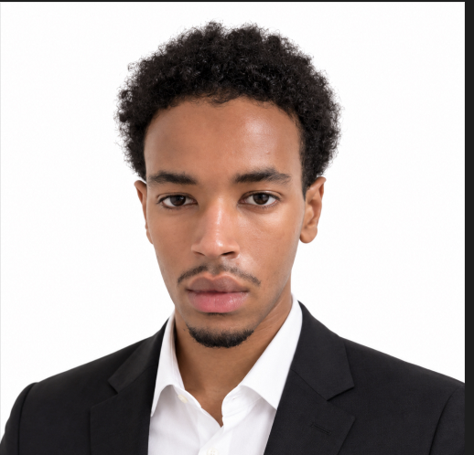
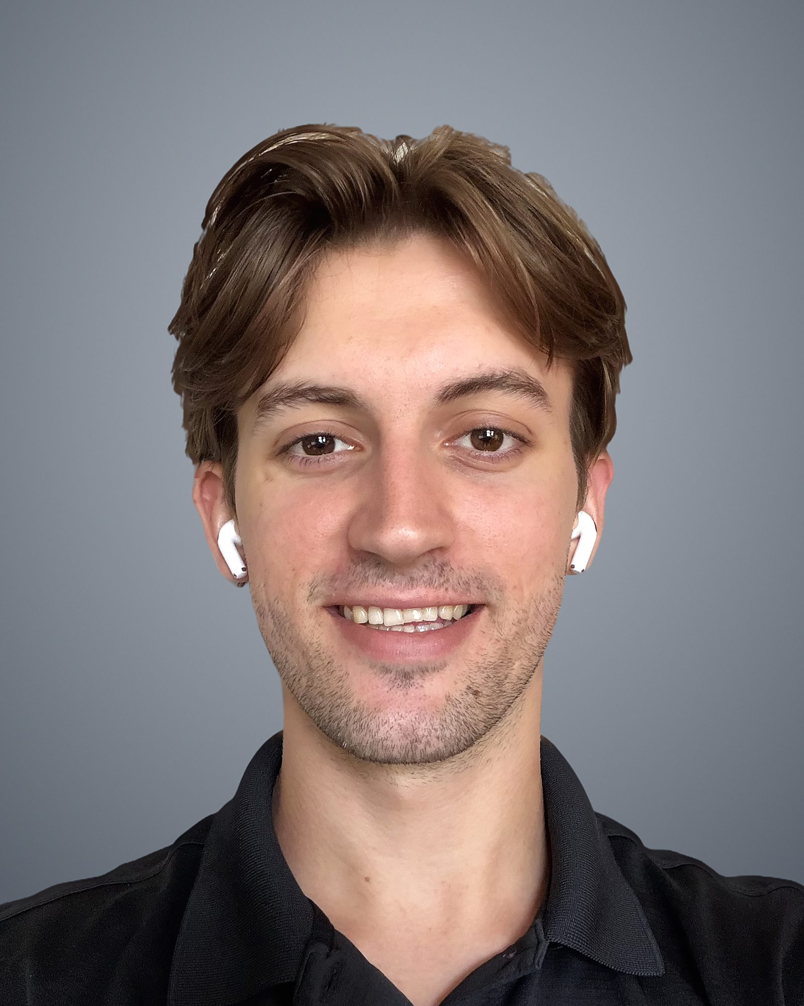


Meet Team 22
Ali Moallin
Carson Brice
Daniel Kowalski
Nate Herman
Data Pipeline Engineer
QEC & ML Theory Lead
Machine Learning Engineer
Data Scientist
Notes:
Each member introduces themselves and their role (~10 s each).

Slide 3

Quantum bits can't be protected the classical way: we can't copy them, look at them, or assume one error type
Classical bit: copy and vote
Qubit: α|0⟩ + β|1⟩
Can't copy
no-cloning theorem
0
→
0
1
0
→
0
0 → 000 → 010 → 0
Can't look
measuring collapses the state
✓ Works because we can copy, read, and only bit flips occur
Two error types
bit flip X and phase flip Z (Y = both)
Instead: measure parities of qubit groups, then decode the syndrome classically
Notes:
Suggested presenter: Carson (~45 s).
Classical memory protects a bit by copying it and taking a majority vote: if one copy flips, the other two outvote it. Qubits break all three steps. A qubit holds a superposition, alpha|0> + beta|1>, and the no-cloning theorem forbids copying an unknown state [3]. Reading a qubit collapses it, so we can't look at the data to check it. And there are two independent kinds of error: a bit flip (X) and a phase flip (Z), plus both at once (Y).
The fix is indirect: measure parities of groups of qubits. A parity tells us whether something changed without revealing the stored value. Those parity bits are the syndrome, and turning the syndrome into a correction is the decoder's job.

Slide 4
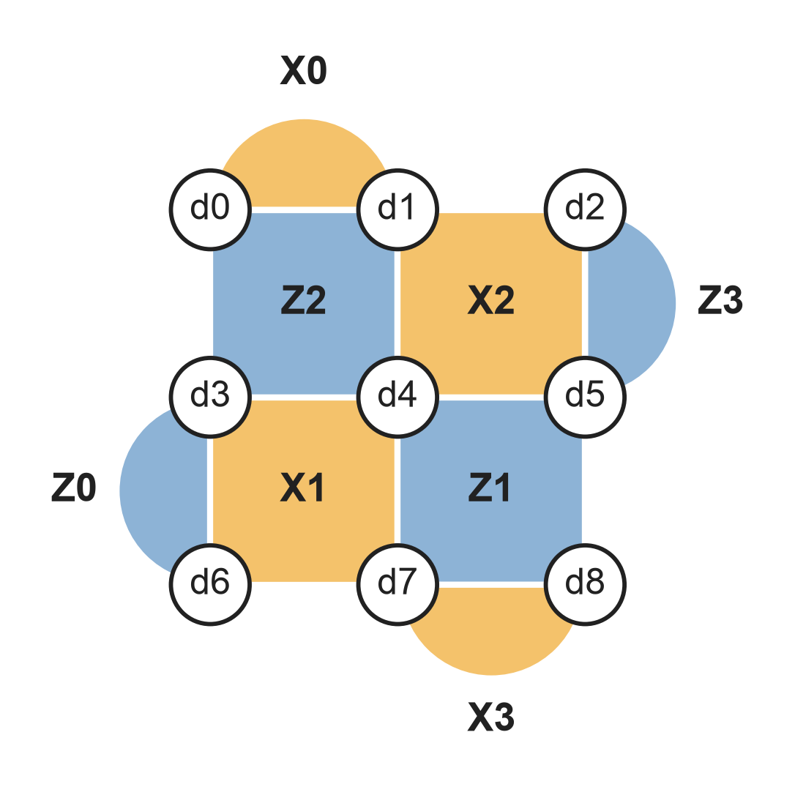

The d = 3 surface code stores one logical qubit in 9 data qubits watched by 8 parity checks
Data qubit (d0–d8)
holds the encoded information
X-check (X0–X3)
measures X parity → detects Z errors
Z-check (Z0–Z3)
measures Z parity → detects X errors
Every check, every round
~1 µs per round [7]; 20–100+ rounds
Notes:
Suggested presenter: Carson (~45 s).
This is the code we work with: the distance-3 rotated surface code [3]. Nine data qubits (white circles, d0 to d8) hold the information. Each colored tile is a check qubit that measures the parity of its 2 or 4 neighbors. Orange X-checks measure X parity, so they catch Z (phase) errors; blue Z-checks measure Z parity and catch X (bit) errors.
All 8 checks are measured every round, about once per microsecond on Google's hardware [7], for as long as the qubit is stored. Distance 3 means at least two faults are needed to cause a logical error. Our sponsor scoped the project to d = 3, with 20 to 100+ rounds per experiment.

Slide 5
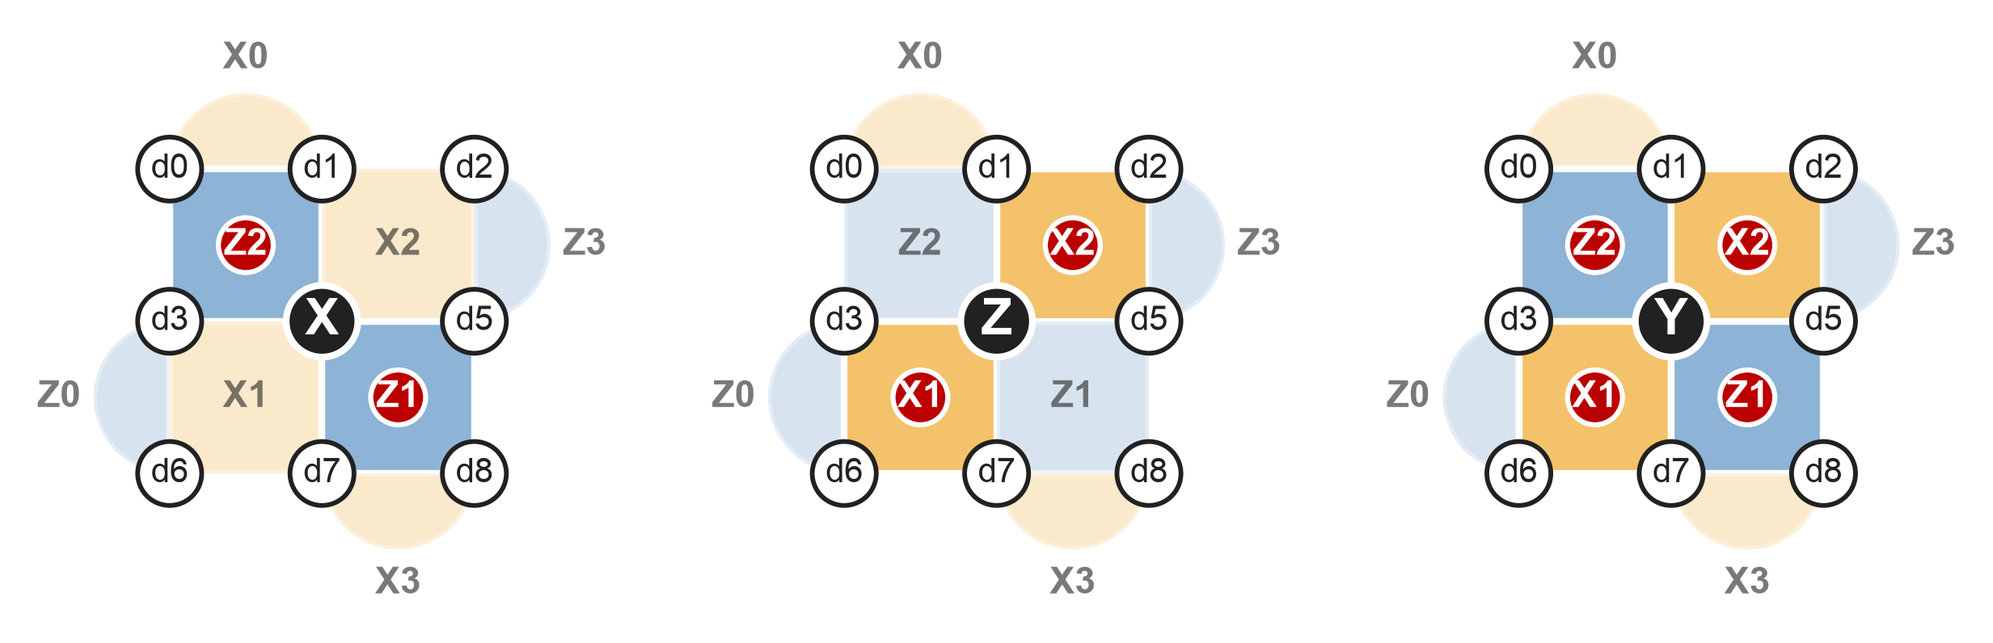
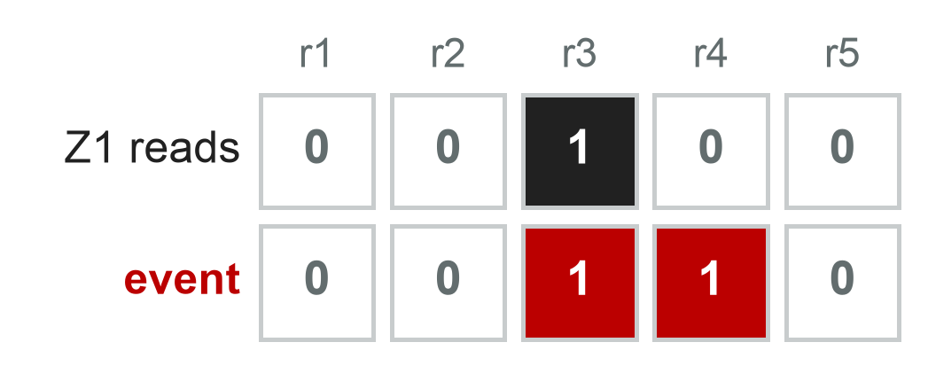
Each error type lights up its own pattern of checks, in space and in time
Misread check
One bad reading → two events, one round apart
X on d4
Z-checks fire
Z on d4
X-checks fire
Y on d4
both fire
Detection event = a check's result changed since the previous round
Notes:
Suggested presenter: Carson (~45 s).
Here the same lattice is hit by one error on d4. Red dots are checks whose parity flipped.
An X error on d4 flips the two Z-checks that touch it, Z2 and Z1. A Z error flips the two X-checks, X1 and X2. A Y error is X and Z at once, so all four fire. Notice the Y pattern is the union of the other two; that coupling between X and Z will matter later.
Checks themselves can be misread. On the right, Z1 reads 1 in round 3 only. We compare each check with its previous round, so a misread creates two detection events stacked in time. That's why decoding works on space-time patterns, not single snapshots.

Slide 6
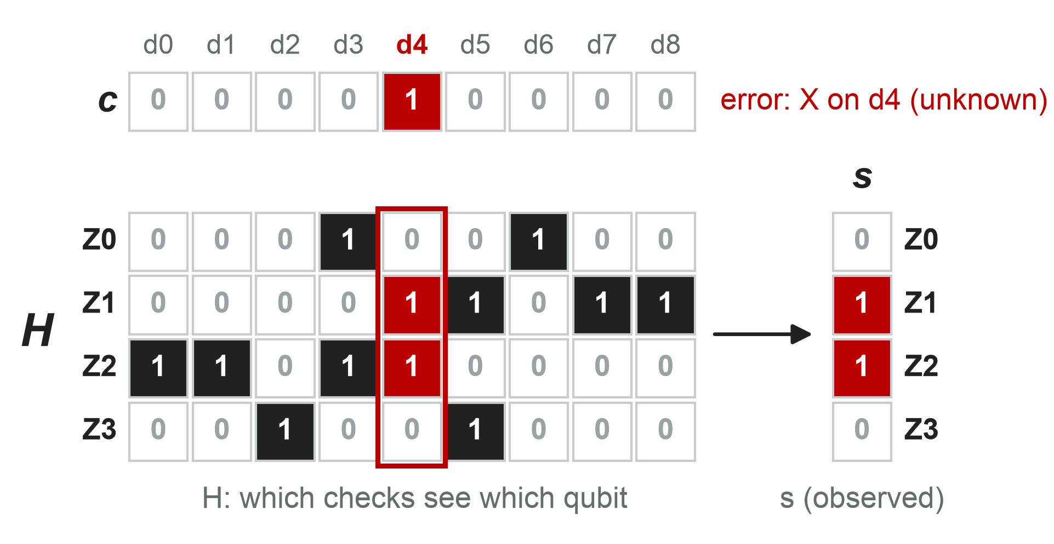
Decoding is a classical inference problem: the hidden error c is seen only through its syndrome s = Hc
Observed
syndrome s: plain classical bits
Unknown
error c: never measured
Wanted
one bit, l = Lc: did the logical qubit flip?
Full circuit noise, d = 3, 3 rounds: H is 24 detectors × 219 fault mechanisms [8], [S]
Notes:
Suggested presenter: Carson (~50 s).
Write the error as a bit vector c: one entry per possible fault. Here, X errors on the nine data qubits. The check matrix H says which checks see which qubit. Multiplying mod 2 gives the syndrome: an X on d4 picks out column d4 of H, so Z1 and Z2 fire. We observe s; we never observe c.
With full circuit noise over 3 rounds, H grows to 24 detectors by 219 independent fault mechanisms, taken from Stim's detector error model [8], [15].
Two points make this a classical problem. The inputs are plain bits, and we don't need c itself, only whether it flips the logical qubit, which is one bit l = Lc. Many different errors give the same answer; that's called degeneracy. So decoding is binary classification from a bit pattern, which is exactly the kind of problem ML is good at.

Slide 7
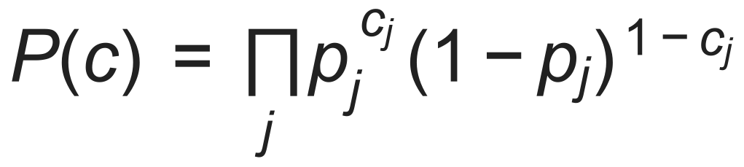
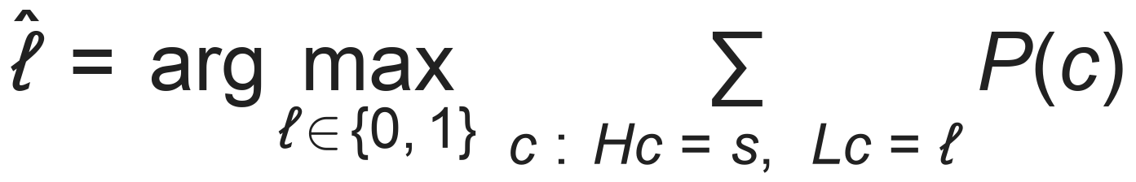
The optimal decoder sums the probability of every consistent error, which is intractable
1. Faults are independent random events
Terms per class
2¹⁹⁴
2. Pick the logical class with more total probability
≈ 10⁵⁸ (d = 3, 3 rounds)
Exact decoding is #P-hard in general [19]; we computed it exactly only at d = 3, 3 rounds, as a ceiling
Every term counts: many different errors give the same syndrome and the same logical flip (degeneracy).
Notes:
Suggested presenter: Carson (~50 s).
Model each fault mechanism j as an independent coin flip with probability p_j. That's the detector error model [15]. Hardware and circuit design work to keep noise local and stochastic, so independence is a good approximation, though not a perfect one.
Under that model the probability of an error pattern c is the product on top. The optimal decoder adds up the probability of every error consistent with the syndrome, split by which logical class it lands in, and picks the larger class.
The catch: at d = 3 with 3 rounds, each class contains 2^194 error patterns, about 10^58. In general, exact maximum-likelihood decoding is #P-hard [19]. We could compute it exactly only for d = 3, 3 rounds, by brute force over all 2^25 syndrome outcomes, and we use that as our ceiling.

Slide 8
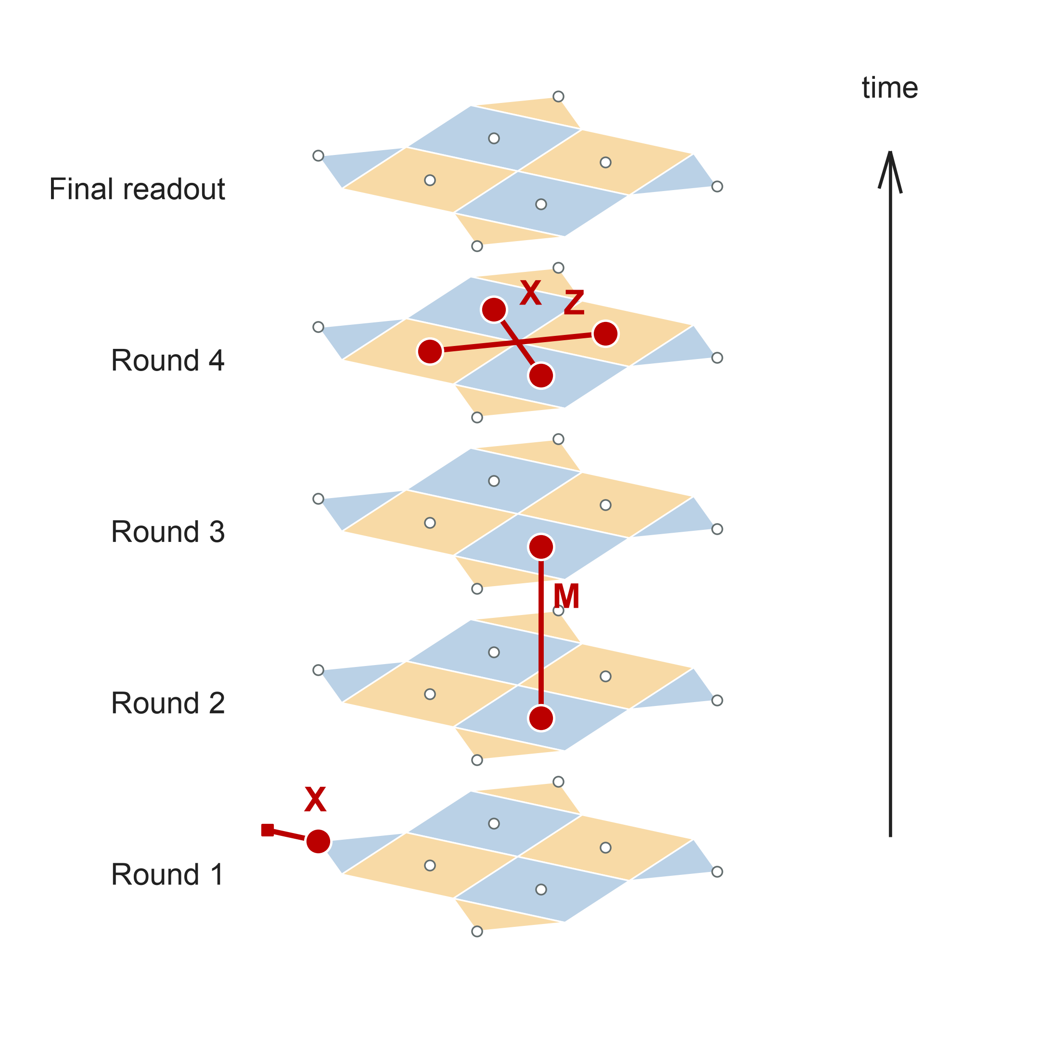
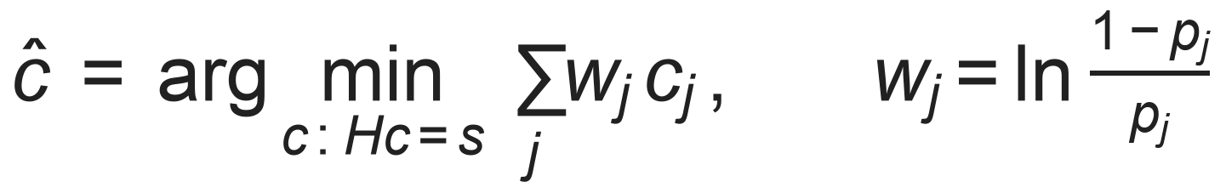
Two approximations turn decoding into a fast graph problem: minimum-weight perfect matching (MWPM)
Low error rate → one most-likely error dominates: max instead of sum
Graph-like faults → each flips ≤ 2 detectors, so each fault is an edge
Pair up lit detectors by cheapest total path: polynomial time via blossom algorithm [20]; ~10⁶ errors per core-second [10]
Real d = 3 Stim shot, decoded by PyMatching [4]. X/Z: data errors, M: misread
Notes:
Suggested presenter: Carson (~60 s).
Two facts about the surface code make a shortcut possible.
First, the error rate is low, so one most-likely error dominates the sum. Replace the sum with a max. Taking -log of the probability turns the max into a minimum total weight, where each fault costs w = ln((1-p)/p): rare faults are expensive.
Second, each check connects to only two kinds of data qubit, so most single faults flip at most two detectors. Each fault becomes an edge between two detectors, and the decoder pairs up the lit detectors along the cheapest paths. That is minimum-weight perfect matching, solvable in polynomial time by Edmonds' blossom algorithm [20]. PyMatching does it at about a million errors per core-second [4], [10].
On the right is a real Stim shot at d = 3 over 4 rounds, decoded by PyMatching. Red dots are detection events. X and Z edges are data-qubit errors within a round; the vertical M edge is a measurement error linking two rounds; the X edge at the bottom runs to the boundary. MWPM's strengths: fast, no training, and well understood. Its weakness is the next slide.

Slide 9
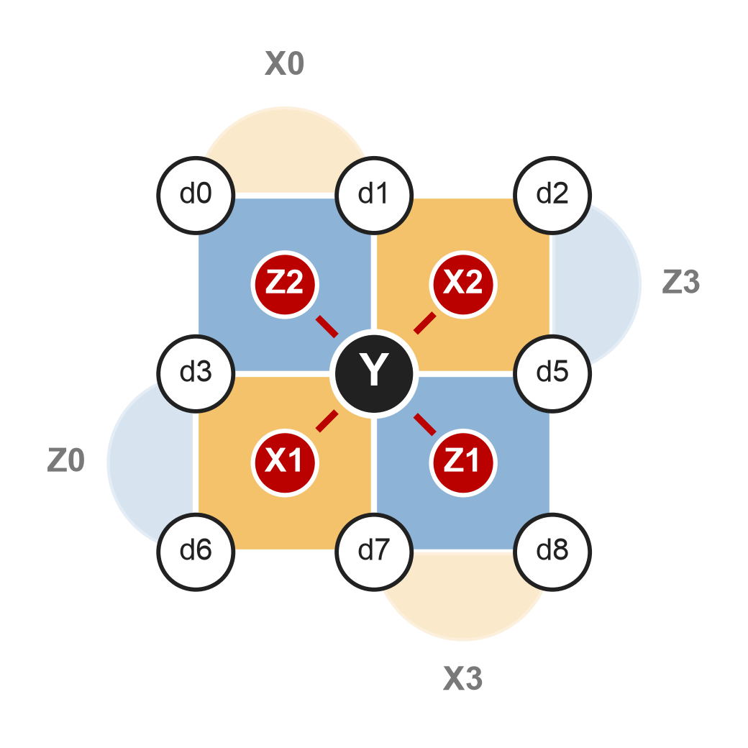
MWPM makes 19–26% more logical errors than optimal at d = 3; lost correlations cause ~95% of the gap
Y on d4 = X + Z together. MWPM splits it into 2 independent edges.
Target: an ML decoder that learns these correlations
Notes:
Suggested presenter: Carson (~60 s).
Graph-like isn't the whole story. At d = 3, 113 of the 219 fault mechanisms flip three or four detectors; they're hyperedges, not edges. The clearest case is a Y error: it lights two Z-checks and two X-checks at once. MWPM splits it into two edges and decodes them as if independent, so it throws away the fact that they happen together.
We measured how much that costs, exactly and without sampling, at d = 3 with 3 rounds. The chart shows each decoder's logical error rate divided by the optimal one. MWPM is 1.19 to 1.26 times optimal. If we keep MWPM's max but give it the true correlated model, it's within 2% of optimal. If we instead fix the max-vs-sum issue (degeneracy) but keep the graph model, it barely moves. So 92 to 96% of the gap is correlation [S].
That's the opening for ML: a model trained directly on syndromes can learn these correlations, and that's where we expect it to beat MWPM.

Slide 10





Our objective: two ML decoders that beat MWPM on the same data, within size and latency limits
›
›
›
1. Generate data
2. MWPM baseline
3. ML decoders
4. Compare
Labeled syndromes from Stim [8]
Reproduced ✓
FF / CNN, then RNN / Transformer
Same shots, ε per round
Train: Stim simulations
Test: Google Sycamore / Willow data [14], [7]
Stretch goal: compress and run on an FPGA at ~1 µs per round [6], [7]
Notes:
Suggested presenter: Daniel (~45 s).
That gap is our project. ML decoders like Google DeepMind's AlphaQubit already beat matching on real hardware data, cutting logical errors from 4.0% to 2.9% on Sycamore, but they are far too slow and large for real-time use [6].
Our sponsor, Dr. Kim, asked for two ML decoders that beat MWPM: a feed-forward or convolutional one, and a recurrent or transformer one. The work runs in four steps: generate labeled syndromes with Stim [8], build the MWPM baseline, train the two decoders, and compare on identical test shots. We train on simulation and test on public Google hardware data. Running a decoder on an FPGA at about 1 microsecond per round is a stretch goal.

Slide 11





Stakeholders range from our sponsor to QEC researchers
Dr. Kim
Team 22
Future students
Dr. Z
QEC researchers
Project sponsor
Capstone team
Dr. Kim & Dr. Gupta
Course instructor
Academia & industry
Proof-of-concept ML decoders
Graduation and new skills
Reusable code and data
On-time, quality work
Reproducible benchmarks
Notes:
Suggested presenter: Nate (~30 s).
Dr. Kim (project sponsor; quantum researcher): wants proof of concept of ML decoders in a real-time environment that surpass current hand-developed algorithms. The research can open new routes for researching and building a fault-tolerant quantum computer, including future collaboration with Dr. Jay Gupta on implementing a hardware-optimized algorithm on an FPGA board.
Team 22 (capstone design team): graduation, new technical skills, and professional experience; must deliver a working, well-documented result within the course schedule to pass.
Future students of Dr. Kim and Dr. Gupta (successors of Team 22's research): want reusable code, data, and documentation; otherwise they must rebuild the data pipeline and ML models.
Dr. Z (capstone course instructor): on-schedule progress, professional conduct, and high-quality technical writing; accountable for the team's successful completion of the approved and assigned project.
QEC researchers (academic and industry developers): reproducible benchmarks against MWPM; reproducible results open new gateways for research.

Slide 12
Needs Assessment: beating MWPM ranks first
RANK
NEED
STAKEHOLDERS
PRIORITY
1
Two ML decoders that beat MWPM
Dr. Kim, QEC researchers
Essential
2
Stim data-generating pipeline
Dr. Kim
Essential
3
Trustworthy MWPM baseline
Dr. Kim, QEC researchers
Essential
4
All capstone deliverables
Team 22, Dr. Z
Essential
5
Python code and documentation
Dr. Kim, future students, Dr. Z
Important
6
Strong understanding of MWPM
Team 22
Important
Notes:
Suggested presenter: Nate (~30 s).
Each need is ranked on two factors: how directly the need answers Dr. Kim's proposal and whether other needs are dependent on it.
1. Two ML decoders that surpass MWPM in accuracy (Dr. Kim, QEC researchers): answers the central question of the capstone proposal. The margin by which they must beat MWPM is currently undecided and will be based on MWPM's accuracy on the simulated datasets.
2. Data-generating pipeline using Stim (Dr. Kim): the data the models are trained on, so a bad dataset means a bad model.
3. Trustworthy MWPM baseline (Dr. Kim, QEC researchers): comparison against it provides proof of the ML decoders' efficacy.
4. Completion of all capstone deliverables (Team 22, Dr. Z): needed for graduation under course requirements.
5. Python code and documentation (Dr. Kim, future students, Dr. Z): facilitates easy hand-off of the research.
6. Strong understanding of MWPM (Team 22): MWPM can be implemented without it, but a stronger understanding helps find areas where MWPM fails.
For Dr. Kim, success at this stage means a validated MWPM baseline, a data-generating pipeline that accurately models physical quantum computers, and two ML decoders that outperform MWPM on simulated and experimental datasets.

Slide 13
Requirements Definition
Needs | Requirement | Units | Range | Ideal
Two ML models outperform MWPM | Two ML models outperform MWPM on the same test dataset that is statistically significant with a 95% confidence level. | % | >0% | TBD
Trustworthy MWPM | MWPM baseline produces similar logical error rates as published research | % | +/- 2% | +/- 1%
Simulated data matches physical computers | All datasets need to have realistic code distances and physical error rates | Code distance; error rate (%) | TBD | TBD
Written in Python | All code must be written and documented through Python | Programming Language | Python 3 | Python 3
Strong understanding of MWPM | A documented handwritten analysis of MWPM with explanations of what it succeeds in and what it fails at | - | TBD | TBD
Completion of all Capstone Deliverables | Must complete all capstone deliverables on time | Seconds and days | <0s late | > 1 day early
Notes:
Suggested presenter: Nate (~30 s).
Logical error rate is the fraction of test runs in which a decoder's correction leaves a logical error. Team 22 and Dr. Kim will set the values marked to be determined (TBD) after the MWPM baseline results are available.
Update since the problem statement: decoders will be compared on logical error per round (ε), fitted over 3–100 rounds, because per-shot error tends to 50% on long runs for every decoder. The exact d = 3 ceiling says at most a 16–21% reduction in logical errors is possible there.

Slide 14





No quantum hardware is our biggest constraint
Constraints
Assumptions
No quantum computer
Public datasets are labeled and similarly formatted
BIGGEST
Fixed course timeline
No high-power GPUs
Stim’s simulated noise ≈ real hardware
Based on AlphaQubit [6]
Python only
Required model types
Notes:
Suggested presenter: Nate (~25 s).
Constraints: time, compute, Python, no access to a physical quantum computer, and the required model types.
- Time: there is a fixed time period for this course.
- Compute: lack of availability of high-power GPUs to train the models on.
- Python and the required model types limit the available routes to take to achieve success.
- No physical quantum computer: the biggest constraint, because it limits the training and testing of the models' capabilities.
Assumptions:
- Public datasets are labeled and output in a similar format; without this, the accuracy tests on public datasets will be detrimental.
- Simulated noise generated by Stim models physical quantum computers closely enough to be effective. This is based on the AlphaQubit research [6], but when training on a smaller model or dataset it may no longer hold true.

Slide 15
Design: one Stim pipeline feeds MWPM and both ML decoders the same shots, so the comparison is fair
Simulation
Preprocessing
ML decoders
d, r, p, basis
seeded, SI1000 noise
space-time grid
+ 5 channels
#1 FF / CNN
#2 RNN / Transformer
Shots
Compare
detection events
+ 1 label bit each
ε per round ± CI
% of gap closed
Hardware data
Error graph
MWPM
Google Sycamore / Willow [14], [7]
edges from the same circuit's error model
PyMatching [4]
Owners: Ali – pipeline · Daniel – preprocessing & masks · Nate – input shapes · Carson – MWPM
Notes:
Suggested presenter: Ali (~45 s).
This is the system. Stim builds a noisy surface-code circuit from a config: distance, rounds, noise level, basis. Each sample, or shot, gives a row of detection events and one label bit, whether the logical qubit flipped. Google's public hardware data comes in the same format, so it slots in at the same point.
From there, two paths. The ML path preprocesses each shot into a space-time grid and feeds the decoders. The baseline path builds a matching graph from the same circuit's detector error model and runs PyMatching. Both predict the same bit on the same test shots, and we compare logical error per round with confidence intervals, plus how much of the MWPM-to-optimal gap the model closes.

Slide 16

Stim simulates realistic circuit noise at scale, but not every hardware effect
Models
Does not model
Random Pauli faults on every gate, reset, measurement, idle
Leakage out of the qubit states
Fast: 12-experiment sweep in ~40 s [S]
Coherent errors and drift
Same output format as hardware
Analog (soft) readout
→ test and fine-tune on hardware data
15 MB
1M shots, d = 5, stored as packed bits
2.9 GB
as float32 model input → store bits + seed; batch on the fly
Notes:
Suggested presenter: Ali (~45 s).
Stim [8] simulates the full measurement circuit with random Pauli faults after every gate, reset, measurement and idle step, and it's fast: our full 12-experiment sweep took about 40 seconds. Its output has exactly the hardware format: detection events plus the logical flip label.
What it can't model: leakage out of the qubit states, coherent errors, slow drift, and analog readout values. Those are what separate real data from simulation, so we follow the standard recipe: train on simulation, then test, and possibly fine-tune, on Google's public hardware data [6], [12].
Storage: we store compact bit-packed events and the generating config and seed, not float tensors. A million d = 5 shots is 15 MB packed versus 2.9 GB as a float32 model input, so batches are built on the fly. Train, validation and test sets use different seeds, so test shots are never seen in training.

Slide 17
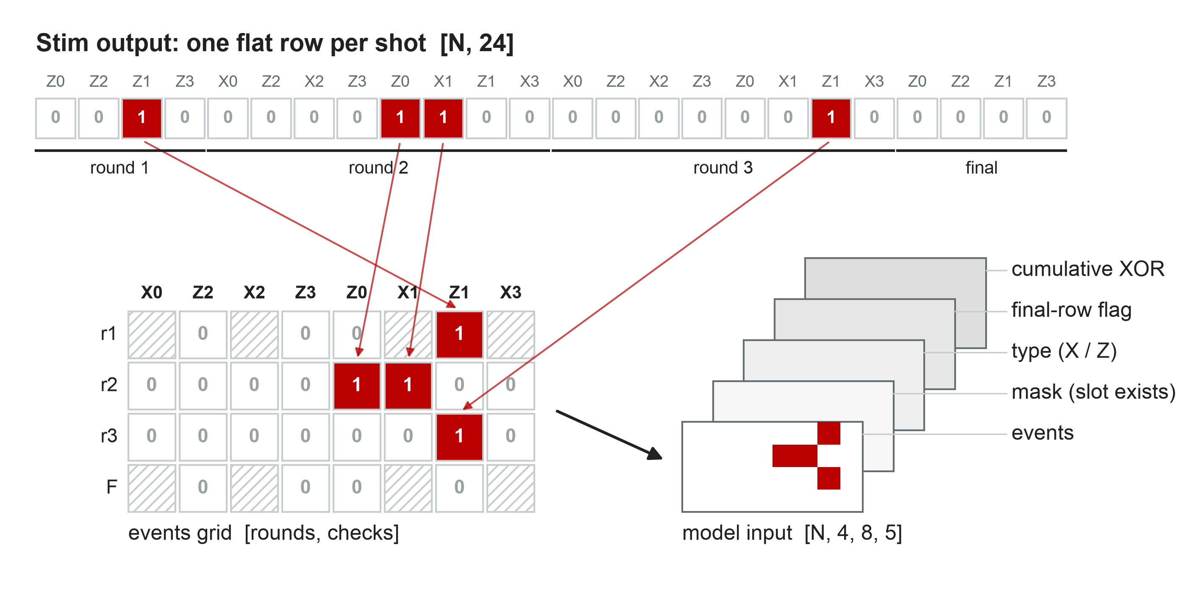
Preprocessing puts each check's history in one column, so a model can reuse weights across rounds
Notes:
Suggested presenter: Daniel (~50 s).
Stim gives one flat row of bits per shot, ordered however the circuit declared its detectors. For d = 3 with 3 rounds that's 24 bits. The order is irregular: Z1 is the third bit of round 1 but the seventh of round 2, and the first and last rounds only have Z-checks.
Step one maps every bit, using its space-time coordinates, into a grid of rounds by checks, so a column always means the same check. Missing slots are masked. Then we add channels: the events, a mask of which slots exist, the check type X or Z, a flag for the final row (which comes from reading the data qubits, not from a check), and a running XOR, which is the check's current value. AlphaQubit uses the same kinds of features [6].
Why bother? A recurrent or convolutional model reuses the same weights on every round, so column j has to mean the same thing in every row. A plain feed-forward network can use the flat row directly.

Slide 18
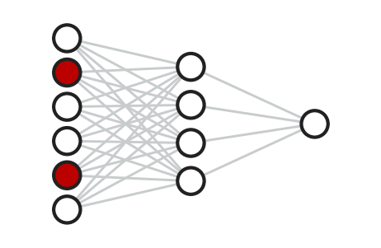
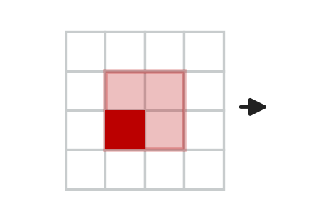
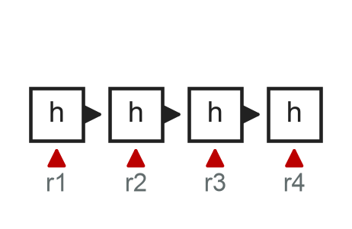
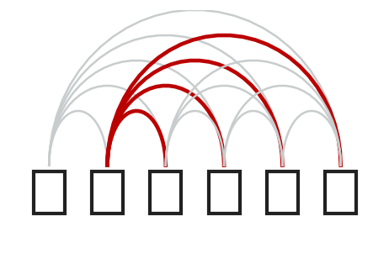
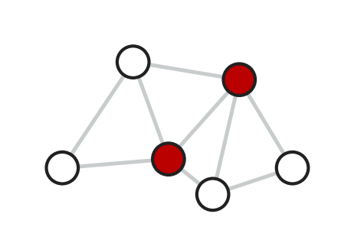
Each candidate architecture exploits a different structure in the syndrome data
Decoder #1
Decoder #1
Decoder #2
Decoder #2
Alternative
MLP
CNN
RNN / GRU
Transformer
GNN
flat [N, 24]
lattice image per round
one round at a time
token per check-round
graph of fired detectors
Every bit gets its own weight
Local patterns, anywhere on lattice
Memory across any number of rounds
Long-range correlations via attention
Sparse; uses only what fired
Next: choose one model for a proof of concept against MWPM by 12/4
Notes:
Suggested presenter: Nate (~60 s).
The data has two kinds of structure: space, meaning the lattice, and time, meaning the rounds. Each architecture uses them differently.
A feed-forward network (MLP) sees one flat vector: simple and fast, but it must relearn every pattern at every position, and its input size is fixed. A CNN slides one small kernel over the lattice, so a local pattern like two neighboring checks firing is learned once; that matches the surface code's locality. These two are the candidates for decoder #1.
A recurrent network (GRU or LSTM) reads one round at a time and carries a memory, so it handles any number of rounds; that matters because our runs are 20 to 100+ rounds [16]. A transformer lets every check-round attend to every other, so it can catch long-range correlations; AlphaQubit combines attention with a recurrent core [6], [12]. These are the candidates for decoder #2.
A graph network (GNN) works only on the detectors that fired, which suits sparse syndromes, and is a strong alternative [16].
We will pick one model for a December proof of concept against MWPM.

Slide 19
Progress: the MWPM baseline is reproduced, and its error per round holds steady from 3 to 100 rounds
Done
MWPM baseline reproduced
Exact optimal ceiling + gap split
Stim pipeline v1 (config-driven)
Preprocessing design documented
In progress
Data format & input shapes (10/30)
Batching for memory
Masking math
AlphaQubit deep dive
Notes:
Suggested presenter: Carson (~50 s).
Done so far: the MWPM baseline is reproduced, and the exact optimal ceiling and gap analysis from the earlier slide are finished. Version one of the Stim pipeline generates labeled data from a config, and the preprocessing design is written up.
The chart is the baseline we have to beat. Per-shot error grows with the number of rounds for every decoder, so on long runs it heads toward 50% and a single number says nothing. The fair metric is ε, the logical error per round. For MWPM it is flat from 3 to 100 rounds: 2.4 × 10^-4 per round at p = 0.1%. It scales as p squared, as expected at d = 3 [S].
In progress: freezing the data format and input shape for each model on 10/30, batching for memory, and the math of masking.

Slide 20
Our main risks are statistical and sim-to-real, and each has a planned mitigation
 | Risk | Impact | Mitigation
H | Small headroom at d = 3 (≤ 16–21%) | Wins hidden by noise | Large test sets, 95% CIs, report % of gap closed
H | Simulation ≠ hardware (leakage, drift) | Model fails on real data | Test and fine-tune on Google hardware data
M | No high-power GPUs | Slow training | Start at d = 3; request OSC compute
M | Data format keeps changing | Rework across team | Freeze format 10/30, before prototype code
L | No FPGA board in time | Stretch goal dropped | Go / no-go decision 3/12
Likelihood: H = high, M = medium, L = low
Notes:
Suggested presenter: Ali (~45 s).
Top risk: at d = 3 the most any decoder can gain is 16 to 21% fewer logical errors, so a real win needs very tight error bars. We size datasets for that early, report confidence intervals, and also report the fraction of the gap closed.
Second: Stim doesn't model leakage or drift, so a model that wins in simulation may not win on hardware; that's why hardware data is in the test plan.
Third: compute. We don't have high-power GPUs, so we start at d = 3 and request Ohio Supercomputer Center time if needed.
Fourth: data-format churn; the format freezes before any prototype code is written.
Last: the FPGA stretch goal depends on getting a board; there's a go or no-go decision on 3/12.

Slide 21
Next: freeze the data format, then test a prototype decoder against MWPM by December
Oct
Nov
Dec
Jan
Feb
Mar
Apr
Research & baselines
Data pipeline
format 10/30, data 11/30
ML prototype
PoC vs MWPM 12/4
Decoder #1 FF / CNN
2/12
Decoder #2 RNN / Transf.
3/26
Benchmark & latency
Optimize & quantize
FPGA (stretch)
go/no-go 3/12
Course milestones
PDR (today)
Sem 1
Mid
Expo
Notes:
Suggested presenter: Daniel (~45 s).
Here's the plan by phase; the red line is today. This semester: freeze the data format on 10/30, finish the pipeline by 11/13 and the datasets by 11/30, then a prototype decoder against MWPM by 12/4, shown at our semester-one presentation on 12/8.
Next semester: decoder one, feed-forward or CNN, benchmarked by mid-February. Decoder two, recurrent or transformer, pretrained on simulation and fine-tuned on hardware data by late March. Then compression and the FPGA stretch goal, with the go or no-go on 3/12, and the design expo on 4/15. Full work breakdown and dates are in the backup slides and our schedule workbook.

Slide 22
Questions?
MWPM is fast but blind to correlated errors, which cause ~95% of its gap to optimal at d = 3.
We will train two ML decoders on Stim data to learn those correlations and beat MWPM on the same shots.
Team 22 · Ali Moallin · Carson Brice · Daniel Kowalski · Nate Herman
Notes:
Suggested presenter: Carson.
Thank the audience. Repeat each question before answering. Backup slides cover: the decoding bottleneck, exact gap numbers, complexity, the per-round metric, preprocessing steps, input shapes per model, dataset statistics, and the full work breakdown.

Slide 23
References
[1] F. Battistel et al., “Real-time decoding for fault-tolerant quantum computing: Progress, challenges and outlook,” Nano Futures, vol. 7, no. 3, Art. no. 032003, Aug. 2023, doi: 10.1088/2399-1984/aceba6.
[2] J. Preskill, “Quantum computing in the NISQ era and beyond,” Quantum, vol. 2, p. 79, Aug. 2018, doi: 10.22331/q-2018-08-06-79.
[3] A. G. Fowler, M. Mariantoni, J. M. Martinis, and A. N. Cleland, “Surface codes: Towards practical large-scale quantum computation,” Phys. Rev. A, vol. 86, no. 3, Art. no. 032324, Sep. 2012, doi: 10.1103/PhysRevA.86.032324.
[4] O. Higgott, “PyMatching: A Python package for decoding quantum codes with minimum-weight perfect matching,” ACM Trans. Quantum Comput., vol. 3, no. 3, pp. 1–16, 2022, doi: 10.1145/3505637.
[5] E. H. Chen et al., “Calibrated decoders for experimental quantum error correction,” Phys. Rev. Lett., vol. 128, no. 11, Art. no. 110504, Mar. 2022, doi: 10.1103/PhysRevLett.128.110504.
[6] J. Bausch et al., “Learning high-accuracy error decoding for quantum processors,” Nature, vol. 635, no. 8040, pp. 834–840, Nov. 2024, doi: 10.1038/s41586-024-08148-8.
[7] Google Quantum AI and Collaborators, “Quantum error correction below the surface code threshold,” Nature, vol. 638, no. 8052, pp. 920–926, Feb. 2025, doi: 10.1038/s41586-024-08449-y.
[8] C. Gidney, “Stim: A fast stabilizer circuit simulator,” Quantum, vol. 5, p. 497, Jul. 2021, doi: 10.22331/q-2021-07-06-497.
[9] IBM Quantum, “How IBM will build the world’s first large-scale, fault-tolerant quantum computer,” IBM Quantum Blog, Jun. 10, 2025. Accessed: Oct. 1, 2026. [Online]. Available: https://www.ibm.com/quantum/blog/large-scale-ftqc
Notes:
Not presented aloud; included so the citations on the slides can be checked.

Slide 24
References (continued)
[10] O. Higgott and C. Gidney, “Sparse blossom: Correcting a million errors per core second with minimum-weight matching,” Quantum, vol. 9, p. 1600, Jan. 2025, doi: 10.22331/q-2025-01-20-1600.
[11] E. Dennis, A. Kitaev, A. Landahl, and J. Preskill, “Topological quantum memory,” J. Math. Phys., vol. 43, no. 9, pp. 4452–4505, 2002, doi: 10.1063/1.1499754.
[12] A. W. Senior et al., “A scalable and real-time neural decoder for topological quantum codes,” arXiv:2512.07737, 2026.
[13] C. Lee, T. Hur, J. Jae, and D. K. Park, “Machine learning approaches to decoding topological quantum codes,” arXiv:2608.15760, 2026.
[14] Google Quantum AI, “Suppressing quantum errors by scaling a surface code logical qubit,” Nature, vol. 614, no. 7949, pp. 676–681, Feb. 2023, doi: 10.1038/s41586-022-05434-1.
[15] R. Blume-Kohout and K. Young, “Estimating detector error models from syndrome data,” arXiv:2504.14643, 2025.
[16] M. Lange et al., “Data-driven decoding of quantum error correcting codes using graph neural networks,” Phys. Rev. Research, vol. 7, Art. no. 023181, 2025.
[17] B. M. Varbanov, M. Serra-Peralta, D. Byfield, and B. M. Terhal, “Neural network decoder for near-term surface-code experiments,” Phys. Rev. Research, vol. 7, Art. no. 013029, 2025.
[18] C. Gidney, M. Newman, and M. McEwen, “Benchmarking the planar honeycomb code,” Quantum, vol. 6, p. 813, 2022, doi: 10.22331/q-2022-09-21-813.
[19] P. Iyer and D. Poulin, “Hardness of decoding quantum stabilizer codes,” IEEE Trans. Inf. Theory, vol. 61, no. 9, pp. 5209–5223, Sep. 2015, doi: 10.1109/TIT.2015.2422294.
[20] J. Edmonds, “Paths, trees, and flowers,” Can. J. Math., vol. 17, pp. 449–467, 1965, doi: 10.4153/CJM-1965-045-4.
[21] E. R. Berlekamp, R. J. McEliece, and H. C. A. van Tilborg, “On the inherent intractability of certain coding problems,” IEEE Trans. Inf. Theory, vol. 24, no. 3, pp. 384–386, May 1978, doi: 10.1109/TIT.1978.1055873.
[S] Team 22, Stim 1.16.0 / PyMatching 2.4.0 simulations, mwpm.ipynb and stim_pipeline, unpublished, Sep.–Oct. 2026.
Notes:
Not presented aloud.

Slide 25
Backup slides
Notes:
Backup slides for Q&A.

Slide 26


Backup: decoding must keep up with ~1 µs rounds
Decoding is a primary bottleneck for fault-tolerant quantum computers [1]
BOTTLENECK [1]
0
1
0
0
1
0
Noisy qubits
Stabilizer checks
Syndrome
Decoder
1 logical qubit = many physical qubits [3]
Parity of small qubit groups
Bit string every round
Infers which errors occurred [3]
Fast: ~1 µs per round [6], [7]
Accurate: avoid logical errors [3]
Notes:
Quantum computers store information in quantum bits (qubits), which are easily disturbed by environmental noise, causing the loss of the information stored in the state of the qubit [2]. Quantum error correction (QEC) protects this information by spreading each logical qubit across multiple physical qubits [3].
The hardware repeatedly measures stabilizers, which are parity checks on small groups of physical qubits, and each round of measurements produces a string of bits called a syndrome.
A classical program called a decoder infers errors from syndromes, and each wrong inference causes a logical error that corrupts the stored information [3].
Real-time decoding requires processing each measurement round in about 1 microsecond on current superconducting hardware [6], [7]. This is why error decoding is a primary bottleneck in building fault-tolerant quantum computers [1].

Slide 27
Backup: exact logical error rates of four decoders at d = 3, 3 rounds
p | Optimal | True DEM, max | Graph, sum | MWPM | MWPM ÷ opt | Correlation share
0.1% | 6.10e-4 | 6.18e-4 | 7.65e-4 | 7.70e-4 | 1.26× | 96%
0.2% | 2.42e-3 | 2.45e-3 | 2.97e-3 | 3.00e-3 | 1.24× | 95%
0.3% | 5.37e-3 | 5.45e-3 | 6.50e-3 | 6.56e-3 | 1.22× | 94%
0.5% | 1.44e-2 | 1.47e-2 | 1.70e-2 | 1.72e-2 | 1.19× | 92%
Where MWPM's call differs from optimal, fixing correlations alone recovers 84–89% of the weight; fixing degeneracy alone recovers ≤ 1%.
Uniform p on 4 Stim noise channels; rotated memory-Z [S].
Notes:
Exact, no sampling: the full joint distribution P(s, L) over all 2^25 outcomes, folded mechanism by mechanism. 'Graph' = MWPM's model (product of edge marginals); 'true' = full DEM with hyperedges. 'max' = single most likely error; 'sum' = whole logical class (optimal). Graph-max reproduces PyMatching on every syndrome (mismatch 0). The split depends on which fix is applied first, so the share column is the average of both orders. Source: mwpm.ipynb, research_log/mwpm_gap_derivation.md.

Slide 28
Backup: graph-like errors are the line between tractable and intractable decoding
Problem | Graph-like H (≤ 2 detectors per fault) | General H (≥ 3 detectors per fault)
Most likely error (MWPM) | Polynomial: perfect matching, blossom [20] | NP-complete [21]
Most likely logical class (optimal) | Hard in general | #P-hard [19]
Belief propagation | Cheap, inexact (loops, degeneracy) | Cheap, inexact
d = 3 DEM | Detectors | Mechanisms | Hyperedges (3–4 detectors)
3 rounds | 24 | 219 | 113 (52%)
25 rounds | 200 | 3,056 | 1,669 (55%)
Notes:
Min-weight decoding with column weight ≤ 2 reduces to perfect matching (in P). With weight-3 columns it is NP-complete, by reduction from 3-dimensional matching [21]. Exact maximum-likelihood decoding is #P-hard for stabilizer codes in general [19]. These are worst-case results; for the surface code the exact cost grows exponentially in the lattice cross-section, d^2, and linearly in rounds. MWPM runtime is near-linear in the number of defects on random noise and O(k^3) on adversarial syndromes [10]. Source: research_log/decoder_complexity.md.

Slide 29
Backup: we compare decoders on error per round ε, because per-shot error compounds with rounds
LER(r) = ½ [1 − (1 − 2ε)ʳ] → ½ for every decoder as r grows
p | ε per round (MWPM) | LER at r = 25 | LER at r = 100
0.1% | 2.40e-4 ± 0.04e-4 | 0.62% | 2.3%
0.2% | 9.26e-4 ± 0.08e-4 | 2.3% | 8.5%
0.3% | 2.02e-3 ± 0.01e-3 | 4.8% | 16.7%
0.5% | 5.34e-3 ± 0.03e-3 | 12.0% | 32.8%
d = 3 rotated memory-Z, uniform p on 4 channels, PyMatching; ε ∝ p² as expected at d = 3 [S]
Notes:
LER(r) = ½(1 − (1 − 2ε)^r) for every decoder, optimal included, so per-shot LER tends to ½ on long runs. We fit ln(1 − 2·LER) = ln A + r·ln(1 − 2ε) by weighted least squares over r ∈ {3, 5, 10, 25, 50, 100}; A absorbs the preparation and readout boundaries. Win condition: lower fitted ε at the same (d, p) with non-overlapping error bars, same r list, same fit. Sampling: 1000 failures or 2M shots per point [S].

Slide 30
Backup: twelve preprocessing steps, by priority
# | Step | Priority | Applies to
1 | Reorder into a [round, check] grid | MUST | RNN, CNN, transformer
2 | Mask channel (which slots exist) | MUST | any grid model
3 | Flag the final (data-readout) row | MUST | all
4 | float32; labels kept separate | MUST | all
5 | Split by seed; shuffle whole shots | MUST | all
6 | Check-type channel (X / Z) | SHOULD | all; essential across sizes
7 | Lay each round out as a 2D image | SHOULD | CNN only
8 | Train on a mix of noise levels | SHOULD | training set
9 | Basis flag | SHOULD | if one model sees both bases
10 | Cumulative-XOR channel | OPTIONAL | all
11 | Drop empty shots from training | OPTIONAL | training set only
12 | Vary the number of rounds | OPTIONAL | recurrent models
Notes:
From the team's QEC Decoder Data Notes, Part III. Skipped on purpose: normalization (inputs are 0/1), deduplication (repeats are the real distribution), class re-weighting, and lattice-symmetry augmentation (Stim's CNOT order breaks some symmetries).

Slide 31
Backup: input shape per architecture (d = 3, 3 rounds)
Model | Tensor into first layer | PyTorch layer | Weights shared across
MLP | dets [B, 24] | nn.Linear | nothing: one weight per input
CNN | [B, 5, 4, 4, 4] | nn.Conv3d | lattice positions and rounds
RNN (GRU) | [B, 4, 40] | nn.GRU | rounds
Transformer | [B, 32, 5] + slot/round embeddings | nn.TransformerEncoderLayer | check-rounds (tokens)
GNN | nodes [k, 4] (x, y, t, type), edges [2, E] | PyTorch Geometric | nodes and edges
Notes:
From Model_input_shape.pdf. Constant channels (mask, type, final flag) are stored once and broadcast per batch.

Slide 32
Backup: logical errors are rare, so accuracy is the wrong metric and datasets must be large
Noise p | Label = 1 | MWPM wrong | Empty shots
0.1% | 2.3% | 77 | 84.0%
0.2% | 4.5% | 333 | 70.8%
0.3% | 6.7% | 610 | 59.6%
0.5% | 10.5% | 1,763 | 42.4%
1% | 18.7% | 5,830 | 18.2%
A model that always says “no flip” is 90% accurate at d = 5, p = 0.1%
Report LER beside MWPM's, on the same shots, with confidence intervals
Per 100,000 shots; d = 3, Z basis, 3 rounds, uniform circuit noise [S]
Notes:
Per 100,000 shots, d = 3, Z basis, 3 rounds, uniform circuit noise [S]. At p = 0.1%, only 77 shots per 100,000 are ones MWPM gets wrong: those are the informative examples. Training at elevated noise is a form of importance sampling. At an error rate of 0.05%, 100,000 shots hold about 50 failures, so the statistical uncertainty is about 14%; we report Wilson score intervals.

Slide 33
Backup: work breakdown structure
ML Decoders for QEC
1 Project mgmt
2 Research & baselines
3 Data pipeline
4 ML prototype
5 Decoders
6 Optimize
7 FPGA (stretch)
PDR
Lit. survey
Format & shapes
Pick model
#1 FF / CNN
Pruning
Board & HLS
Sem 1 slides
MWPM ✓
Stim generator
PoC vs MWPM
#2 RNN / Transf.
Quantization
Synthesis
Final report, expo
Gap analysis ✓
Datasets
2 prelim models
Benchmarks
Re-benchmark
On-board test
Notes:
Seven phases plus schedule buffers. Owners, done criteria and dates are in deliverables/QEC_Project_Schedule.xlsx (WBS and Gantt tabs).

