Slide 1
WK1&2_tableau
File created on: 12/17/22 2:10:30 PM EST

Slide 2
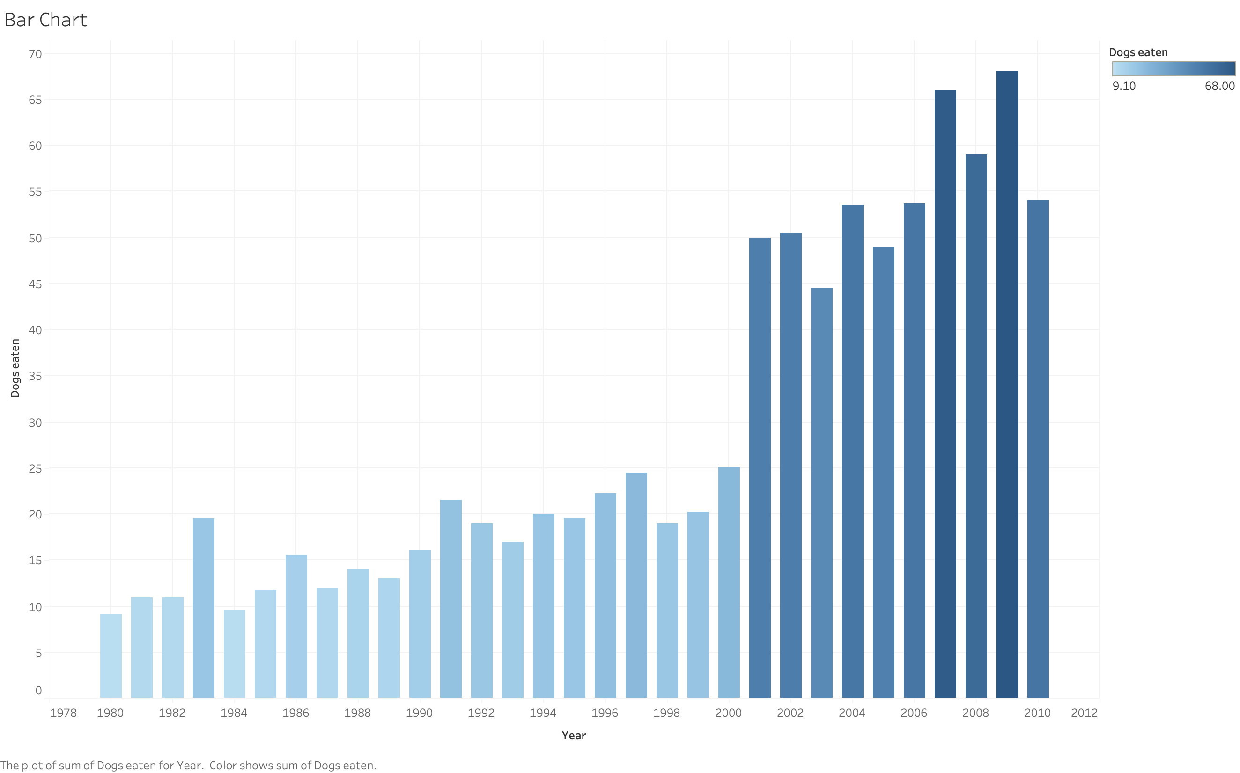
Bar Chart in Tableau

Slide 3
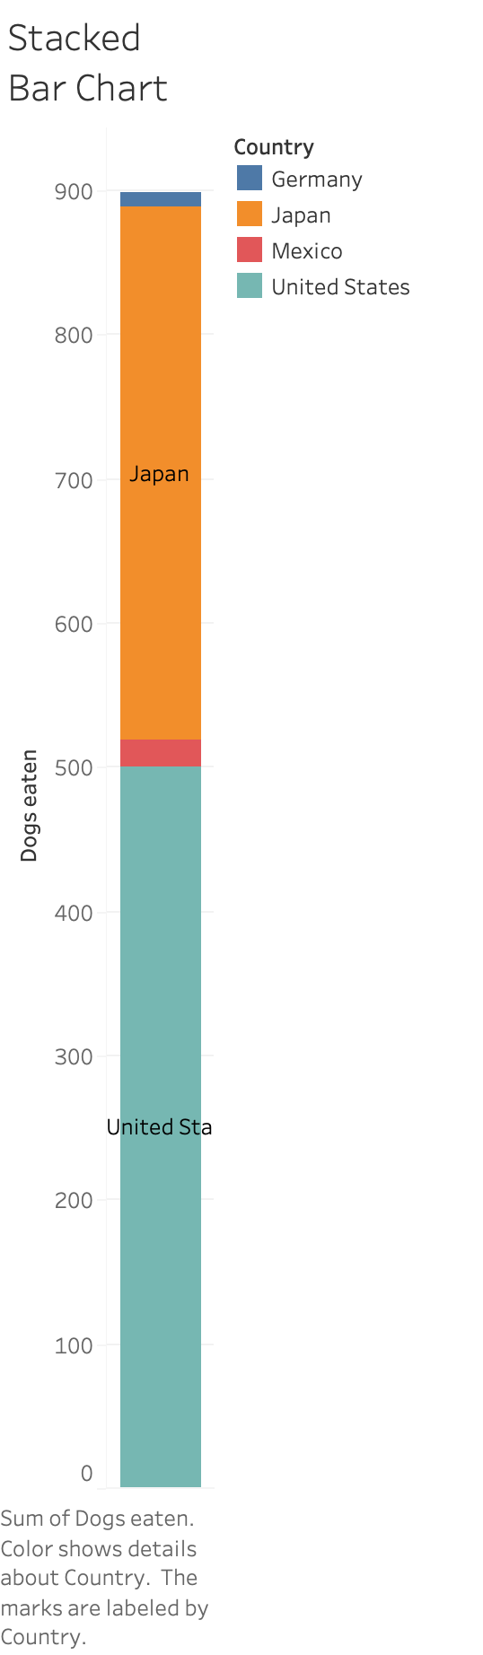
Stacked Bar Chart in Tableau

Slide 4
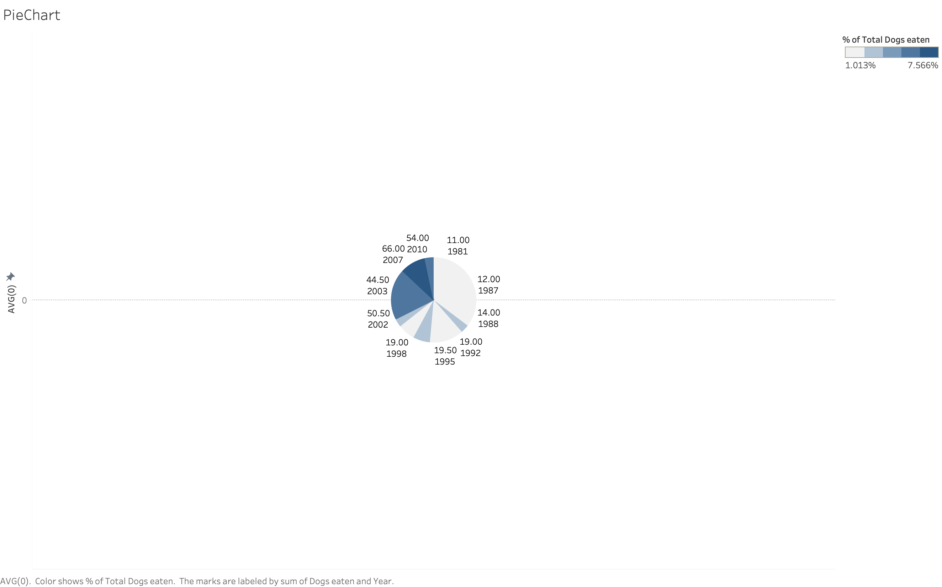
Pie Chart in Tableau

Slide 5
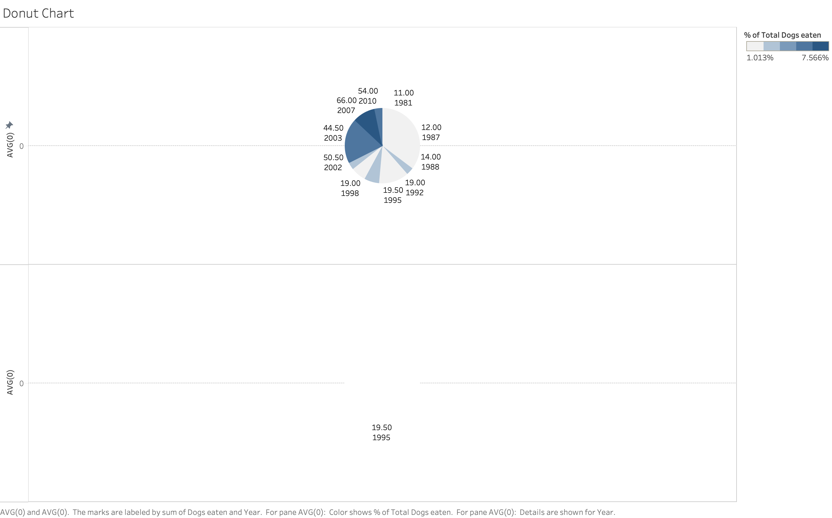
Donut Chart in Tableau

Slide 6
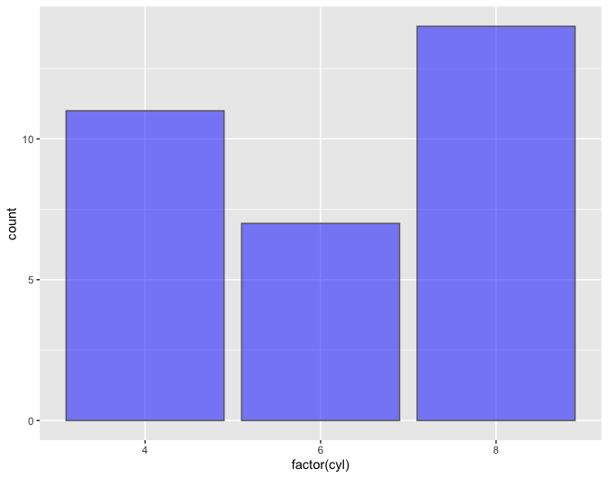
Bar Plot in R
> library(gridExtra)
> p1 <- ggplot(mtcars, aes(x = cyl)) +
+ geom_bar() +
+ ggtitle("Fig. A: x-axis as a continuous variable")
> p2 <- ggplot(mtcars, aes(x = factor(cyl))) +
+ geom_bar() +
+ ggtitle("Fig B: x-axis as a categorical (factor) variable")
> grid.arrange(p1, p2, ncol = 2)
> cyl_mpg <- mtcars %>%
+ group_by(cyl) %>%
+ summarise(avg_mpg = mean(mpg, na.rm = TRUE))
> ggplot(cyl_mpg, aes(x = factor(cyl), y = avg_mpg)) +
+ geom_bar(stat = "identity")
> ggplot(mtcars, aes(x = factor(cyl))) +
+ geom_bar(fill = "blue", color = "grey40", alpha = .5)

Slide 7
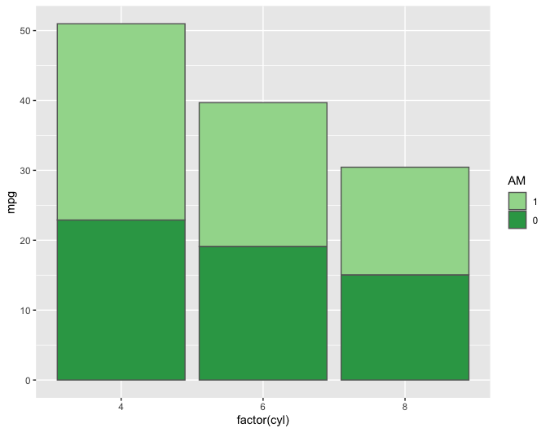
Stacked Bar in R
p1 <- ggplot(avg_mpg, aes(factor(cyl), mpg, fill = factor(am))) +
+ geom_bar(stat = "identity") +
+ guides(fill = guide_legend(reverse = TRUE)) +
+ labs(fill = "am")

Slide 8
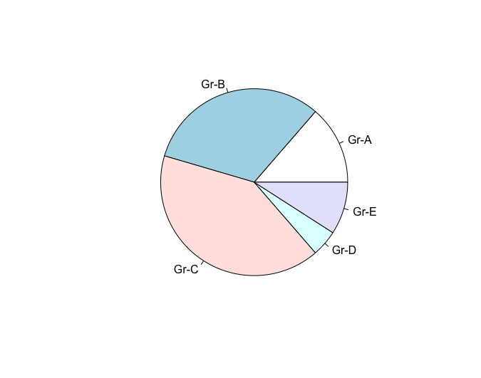
Pie Chart in R
# Create Data
> Prop <- c(3,7,9,1,2)
> # Create pie
> pie(Prop)
> pie(Prop , labels = c("Gr-A","Gr-B","Gr-C","Gr-D","Gr-E"))
# Create pie
> pie(Prop)
> pie(Prop , labels = c("Gr-A","Gr-B","Gr-C","Gr-D","Gr-E"))

Slide 9
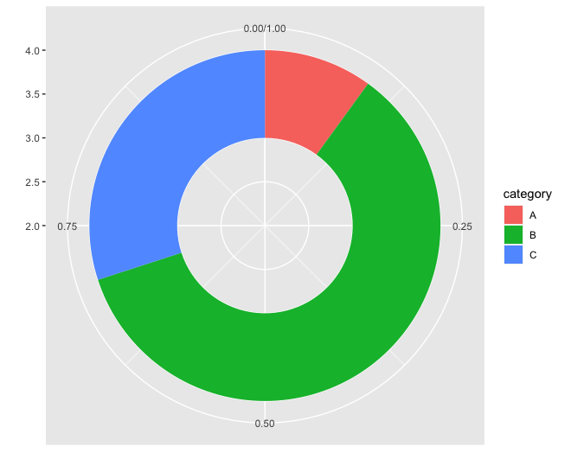
Donut Chart in R
> data <- data.frame(
+ category=c("A", "B", "C"),
+ count=c(10, 60, 30)
+ )
> data$fraction = data$count / sum(data$count)
> data$ymax = cumsum(data$fraction)
> data$ymin = c(0, head(data$ymax, n=-1))
> ggplot(data, aes(ymax=ymax, ymin=ymin, xmax=4, xmin=3, fill=category)) +
+ geom_rect() +
+ coord_polar(theta="y") +
+ xlim(c(2, 4))

Slide 10
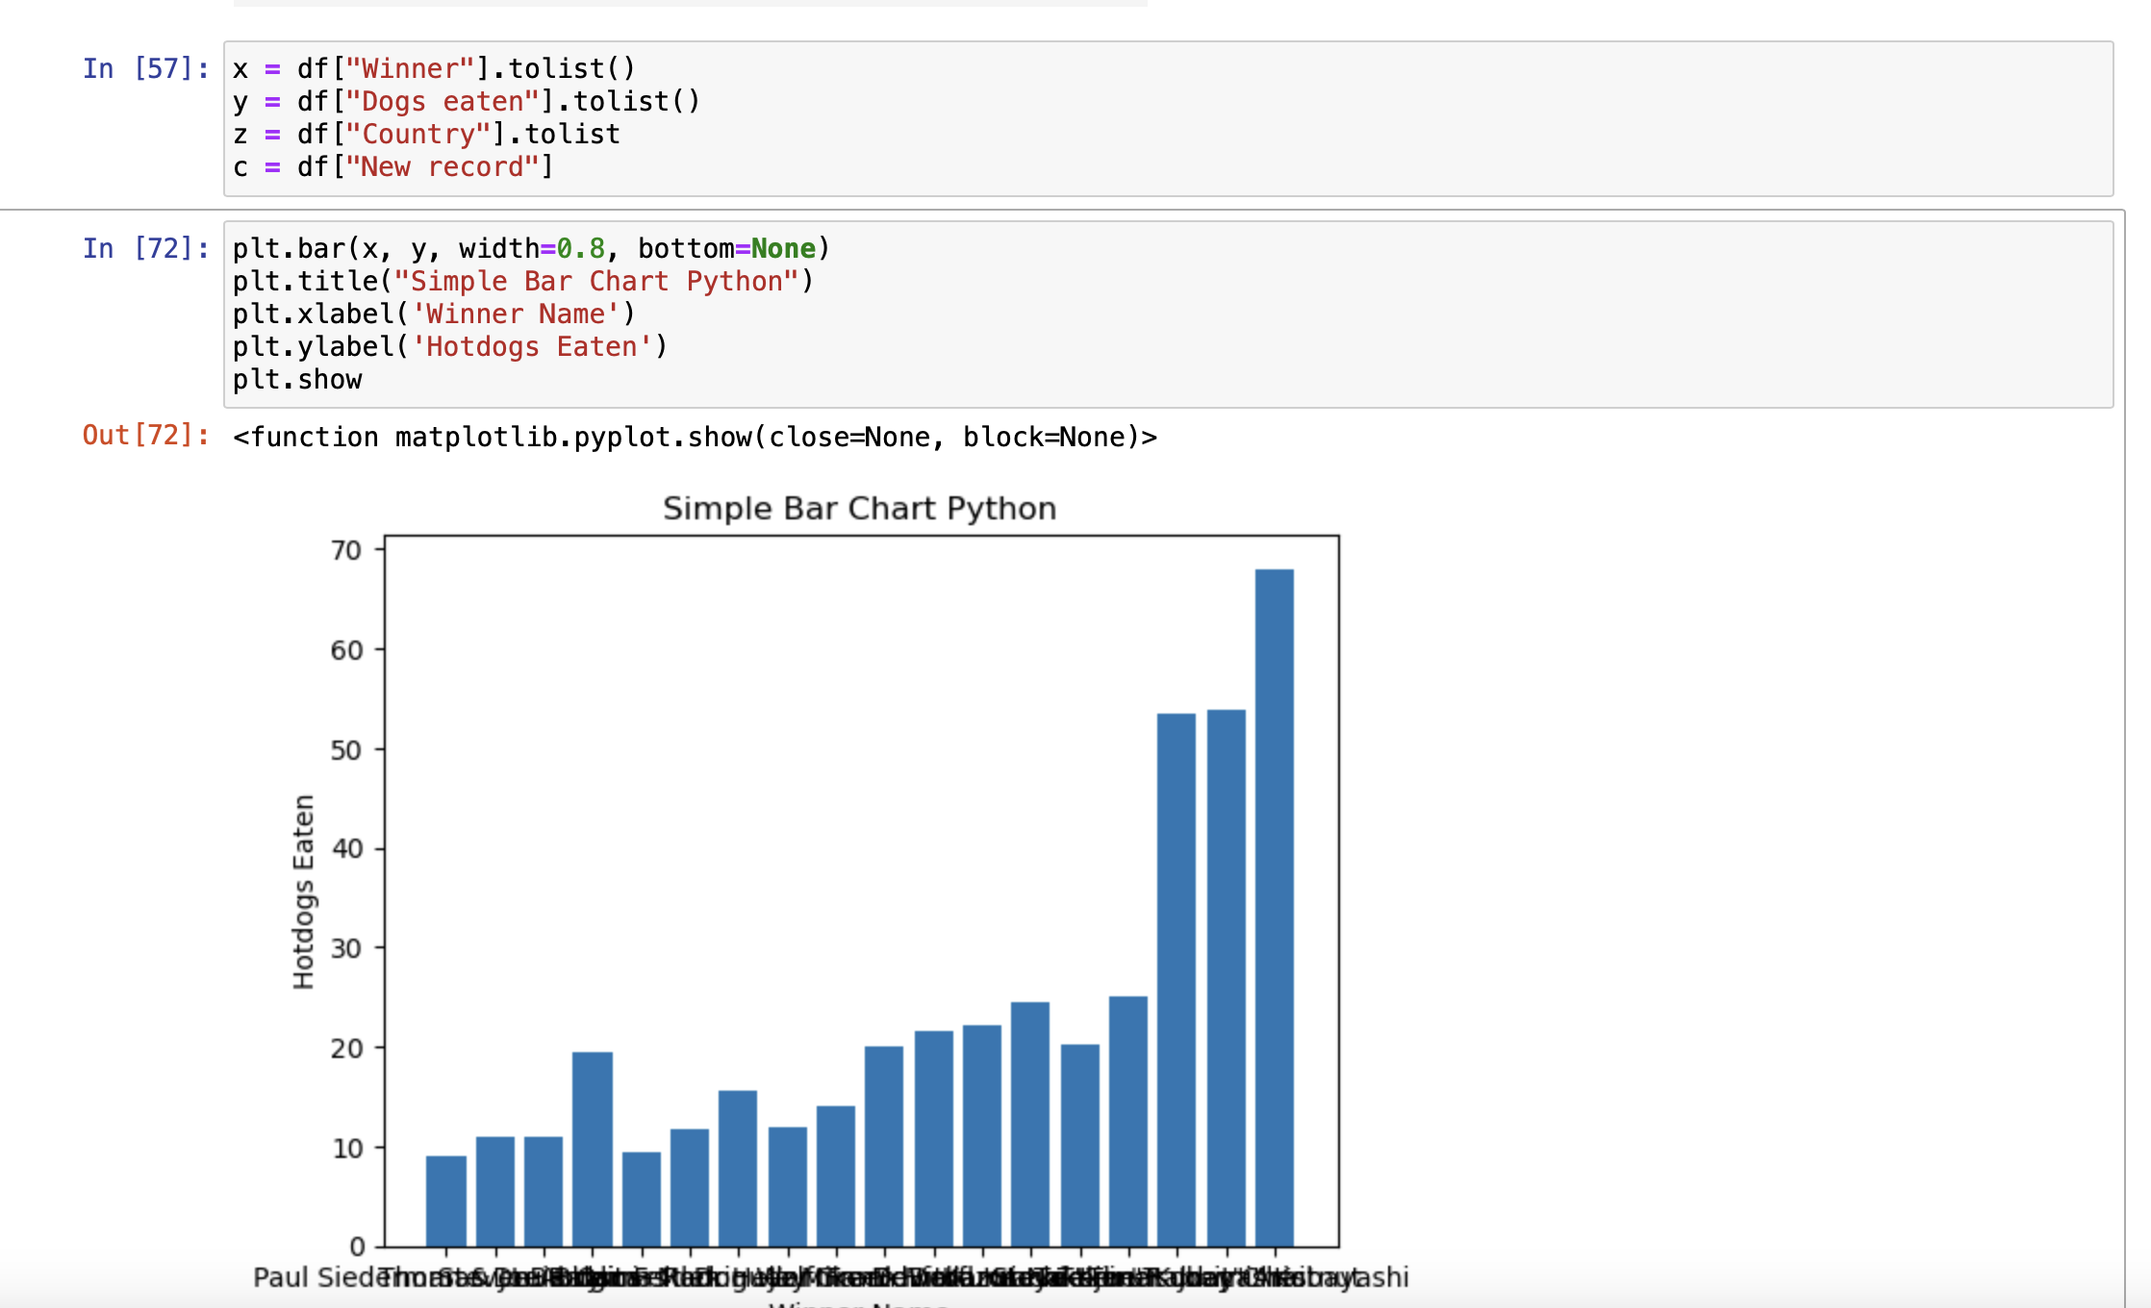
Simple Bar Chart in Python

Slide 11
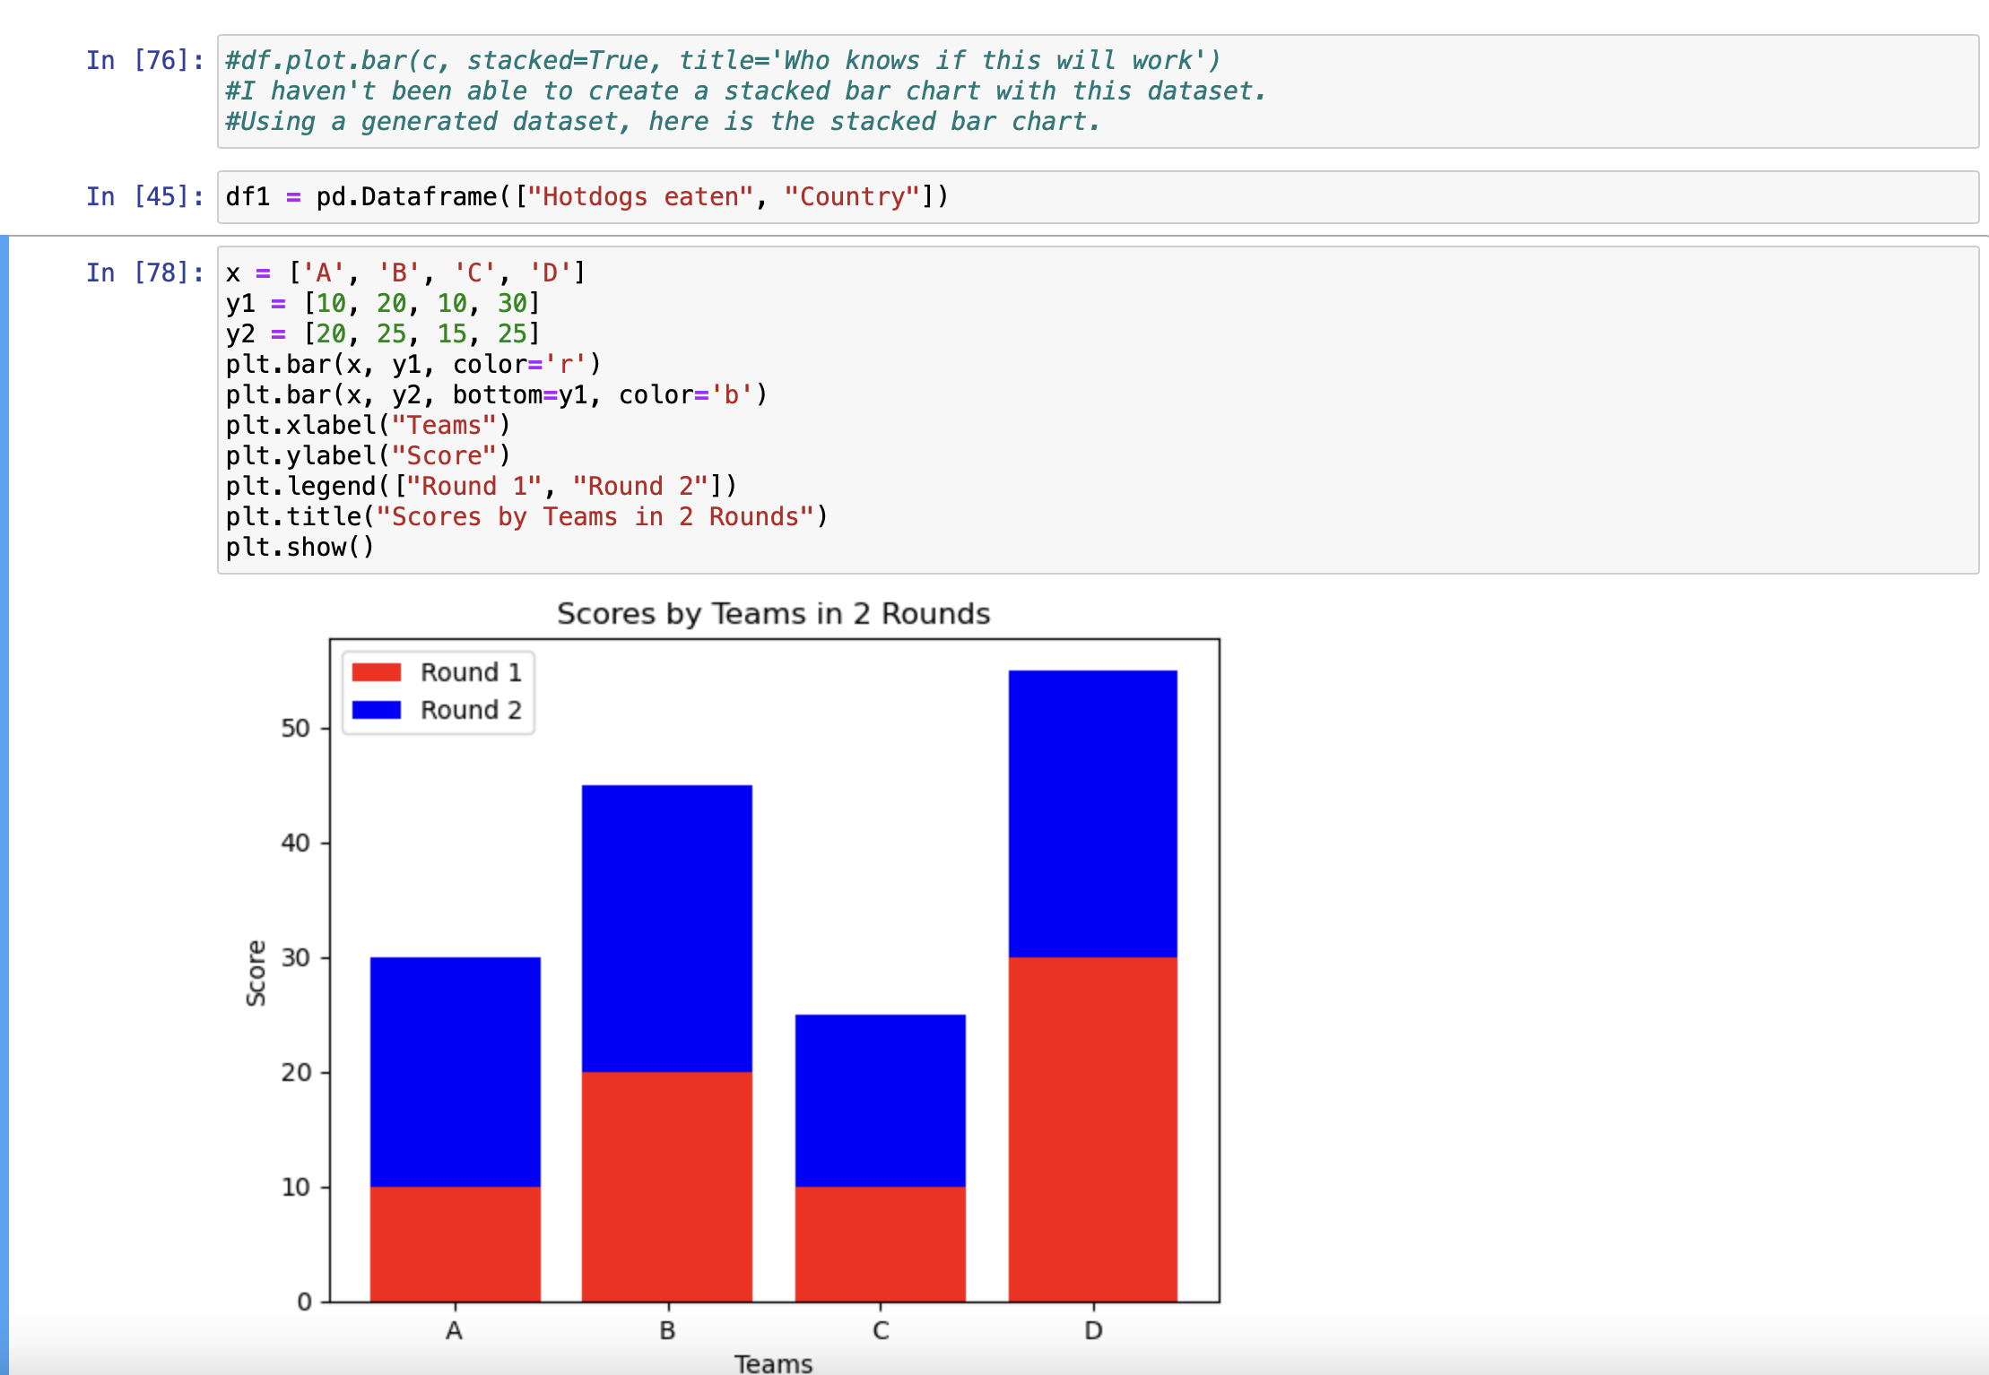
Stacked Bar in Python

Slide 12
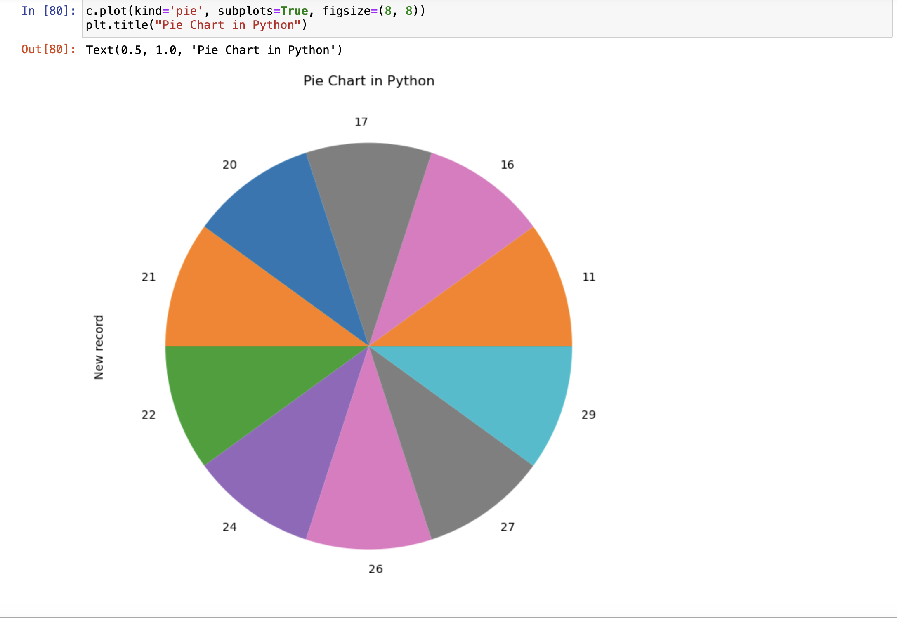
Pie Chart in Python

Slide 13
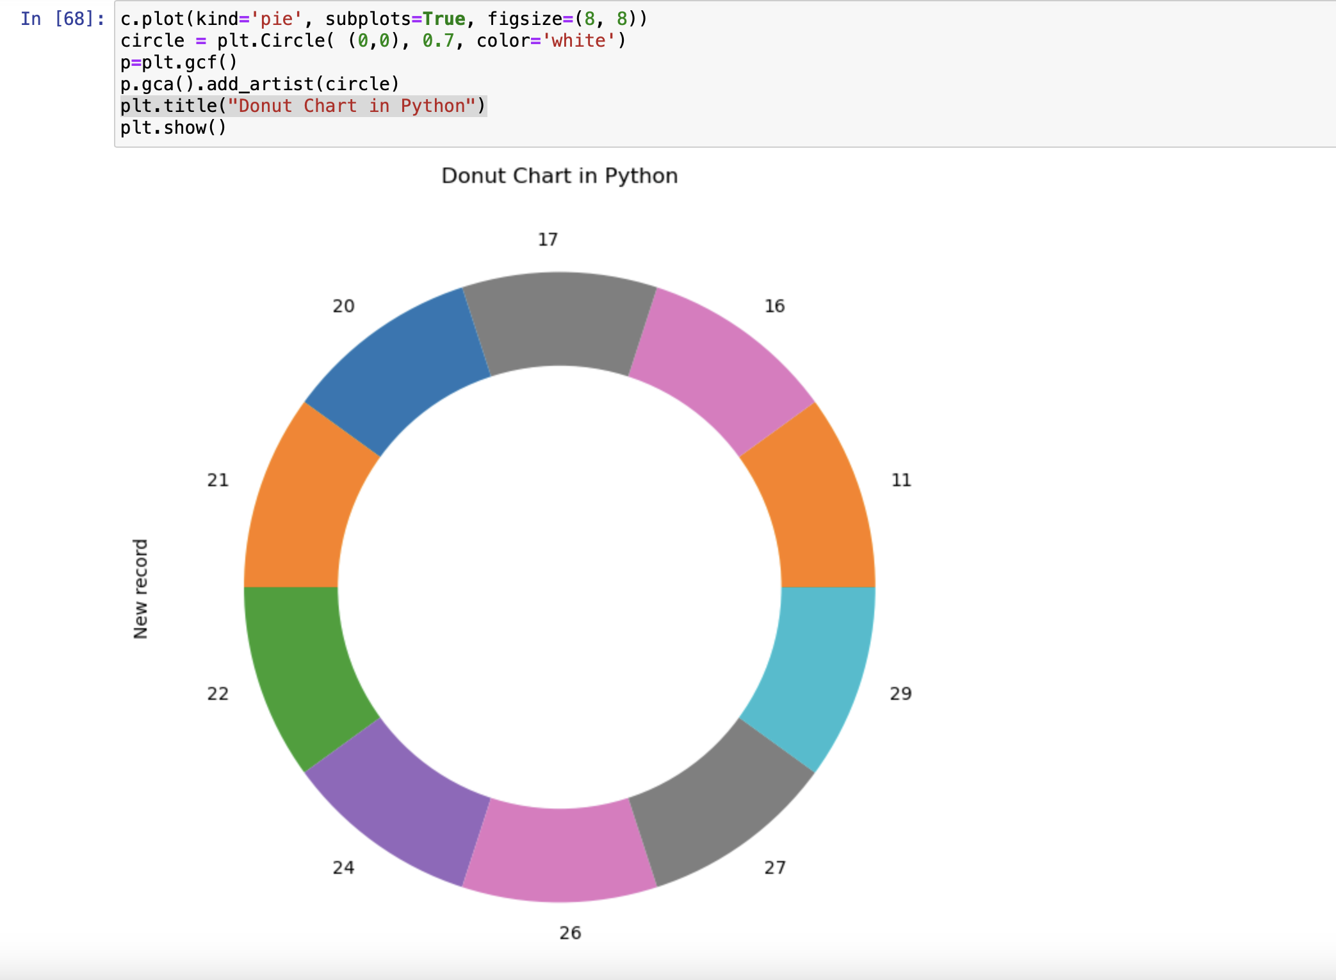
Donut Chart in Python

