Slide 1
Week 11&12
Professor Catherine Williams
Data Presentation and Visualization
Cindy Brinkmeyer

Slide 2
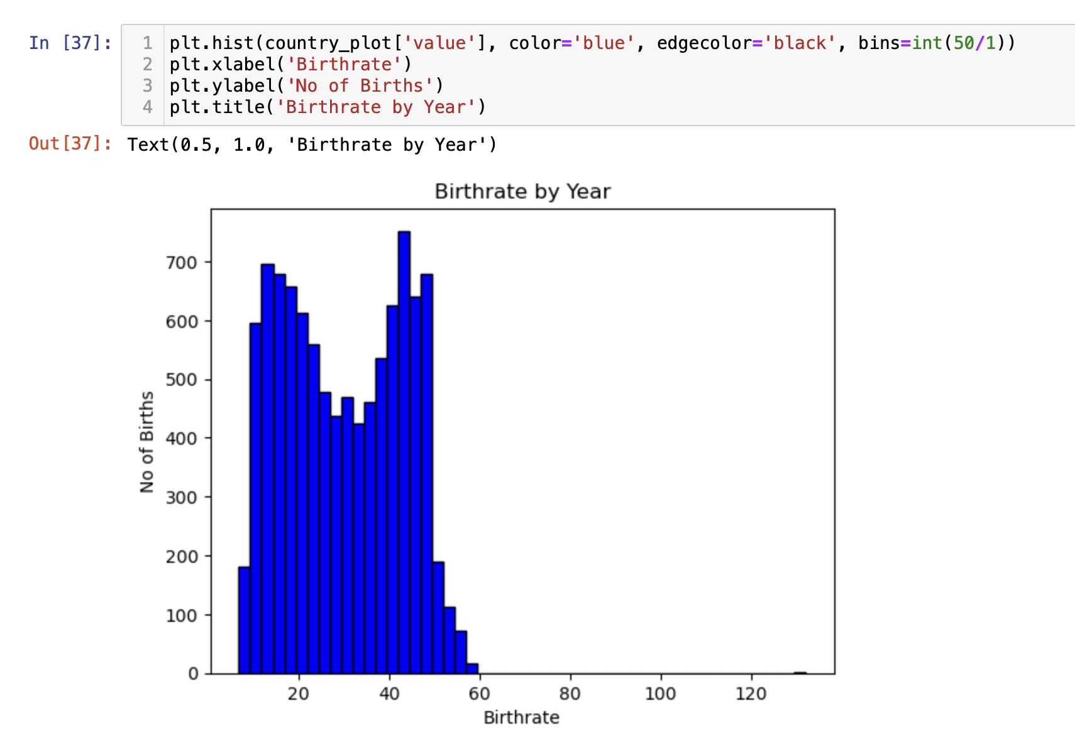
Histogram in Python
Notes:
https://www.askpython.com/python/examples/heatmaps-in-python

Slide 3
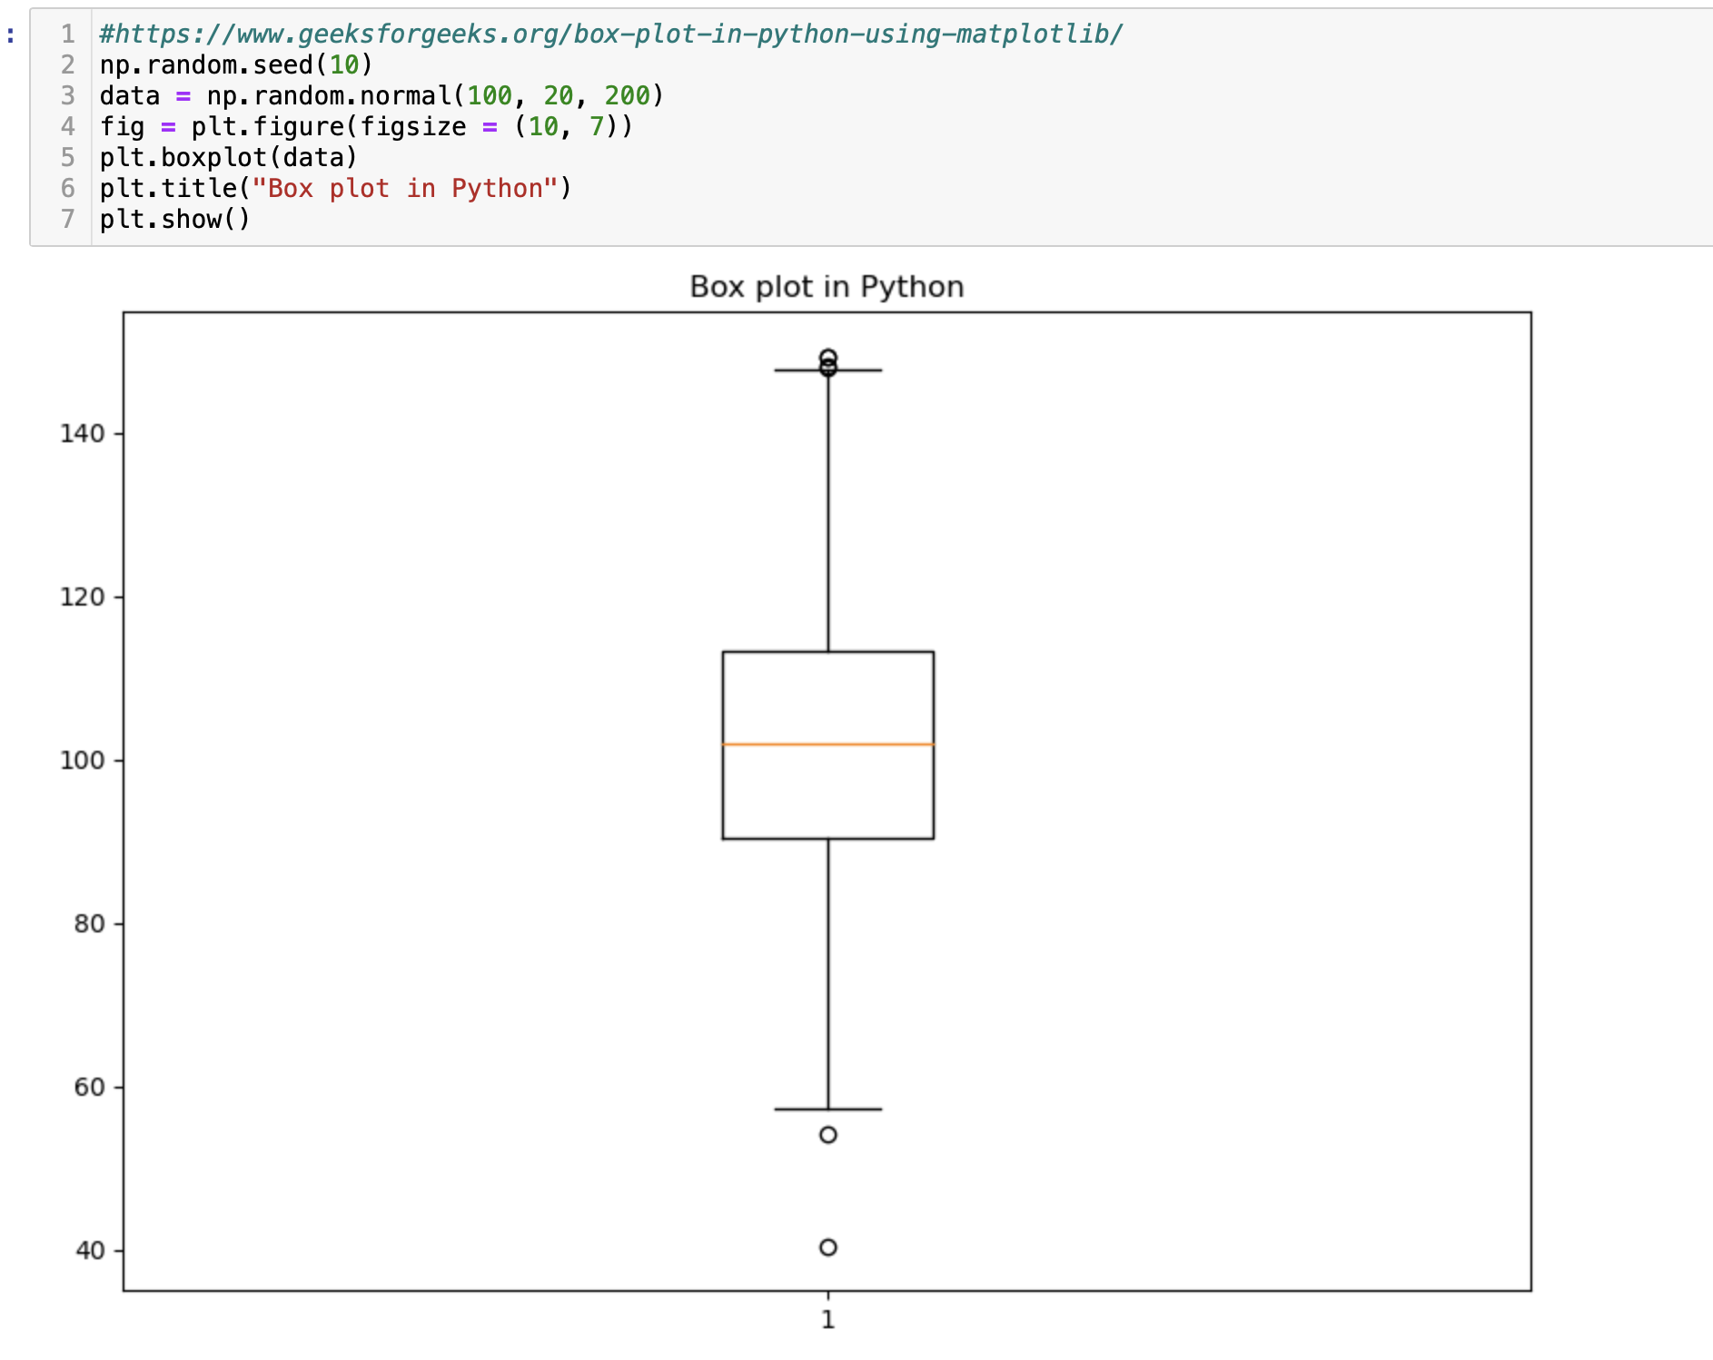
Box Chart in Python
Notes:
https://www.askpython.com/python/examples/heatmaps-in-python

Slide 4
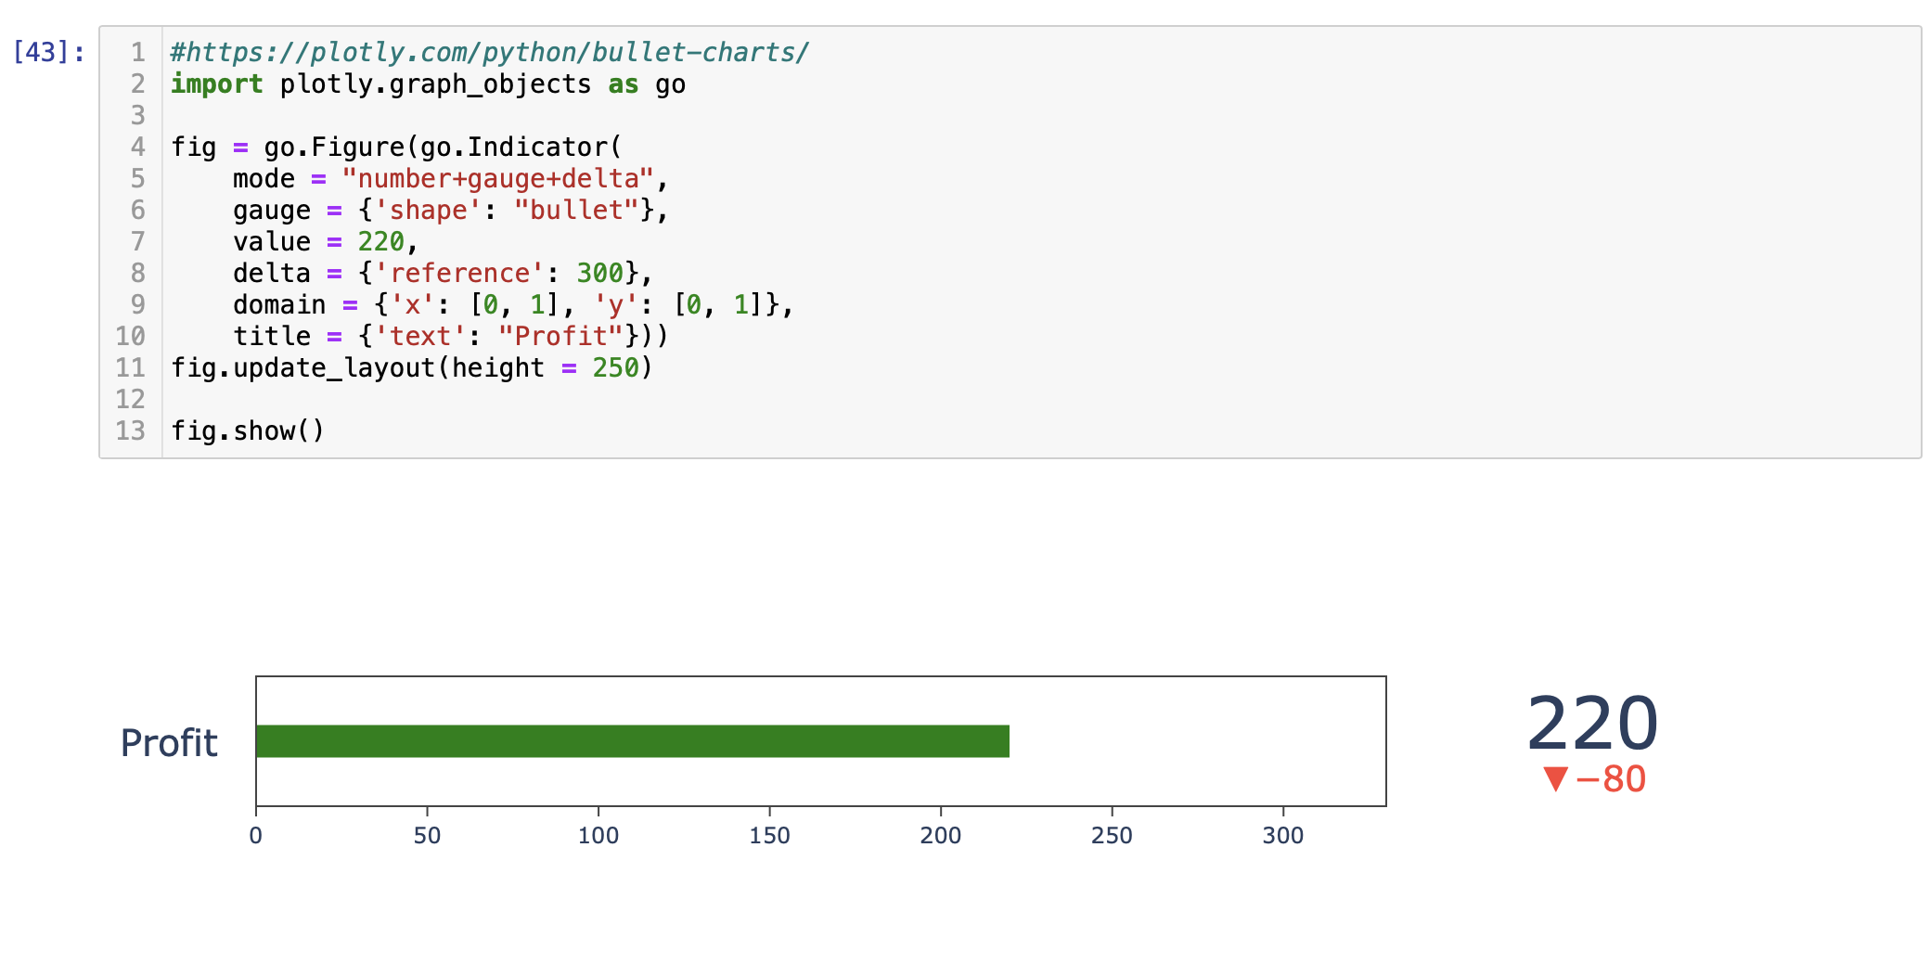
Bullet Chart in Python
Notes:
https://www.geeksforgeeks.org/contour-plot-using-matplotlib-python/

Slide 5
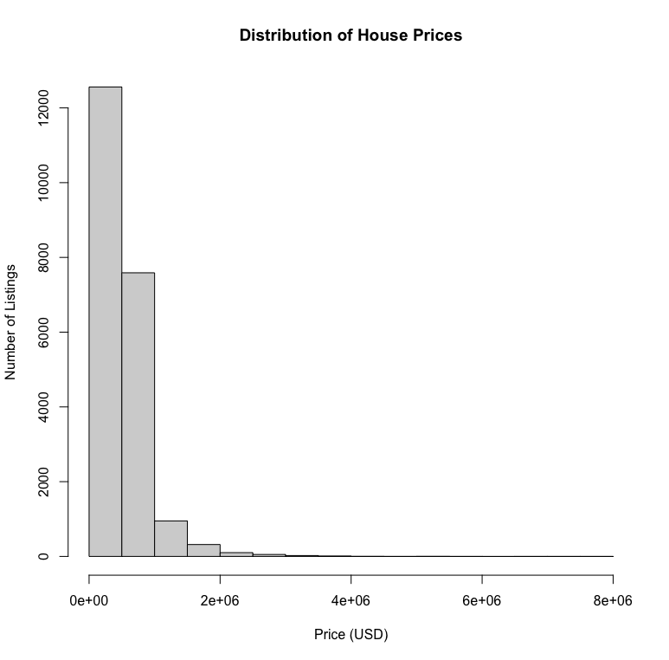
Histogram in R
Notes:
https://www.datacamp.com/tutorial/make-histogram-basic-r

Slide 6
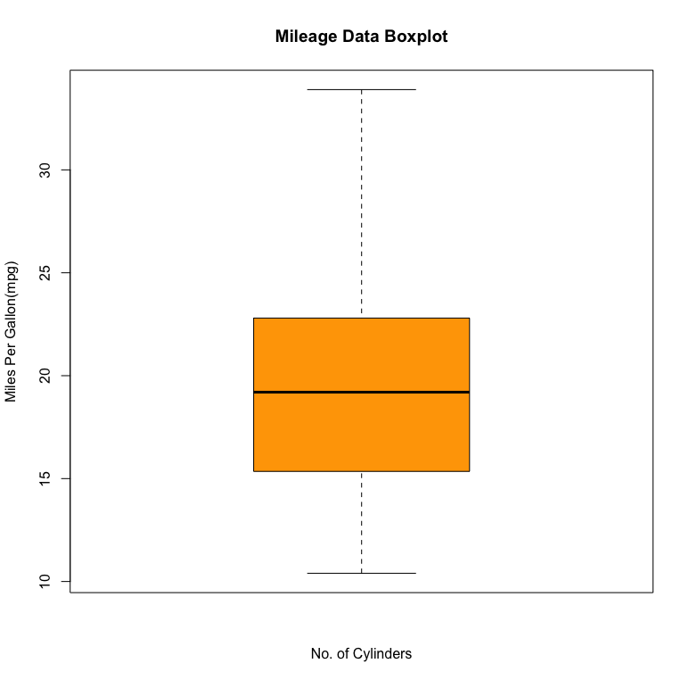
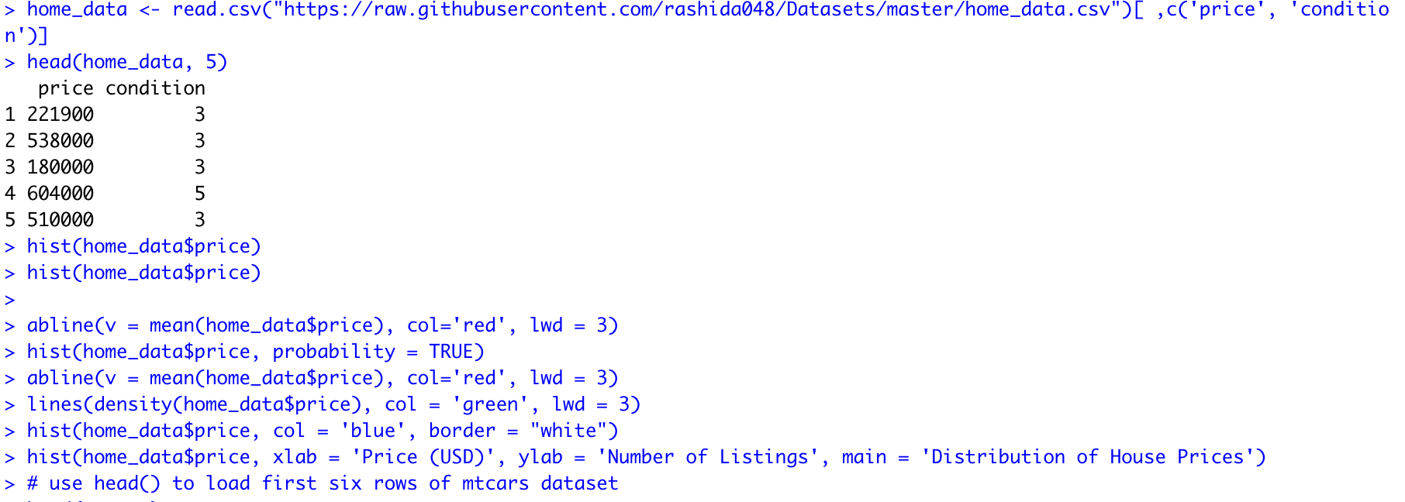
Box Plot in R
Notes:
https://www.programiz.com/r/boxplot

Slide 7
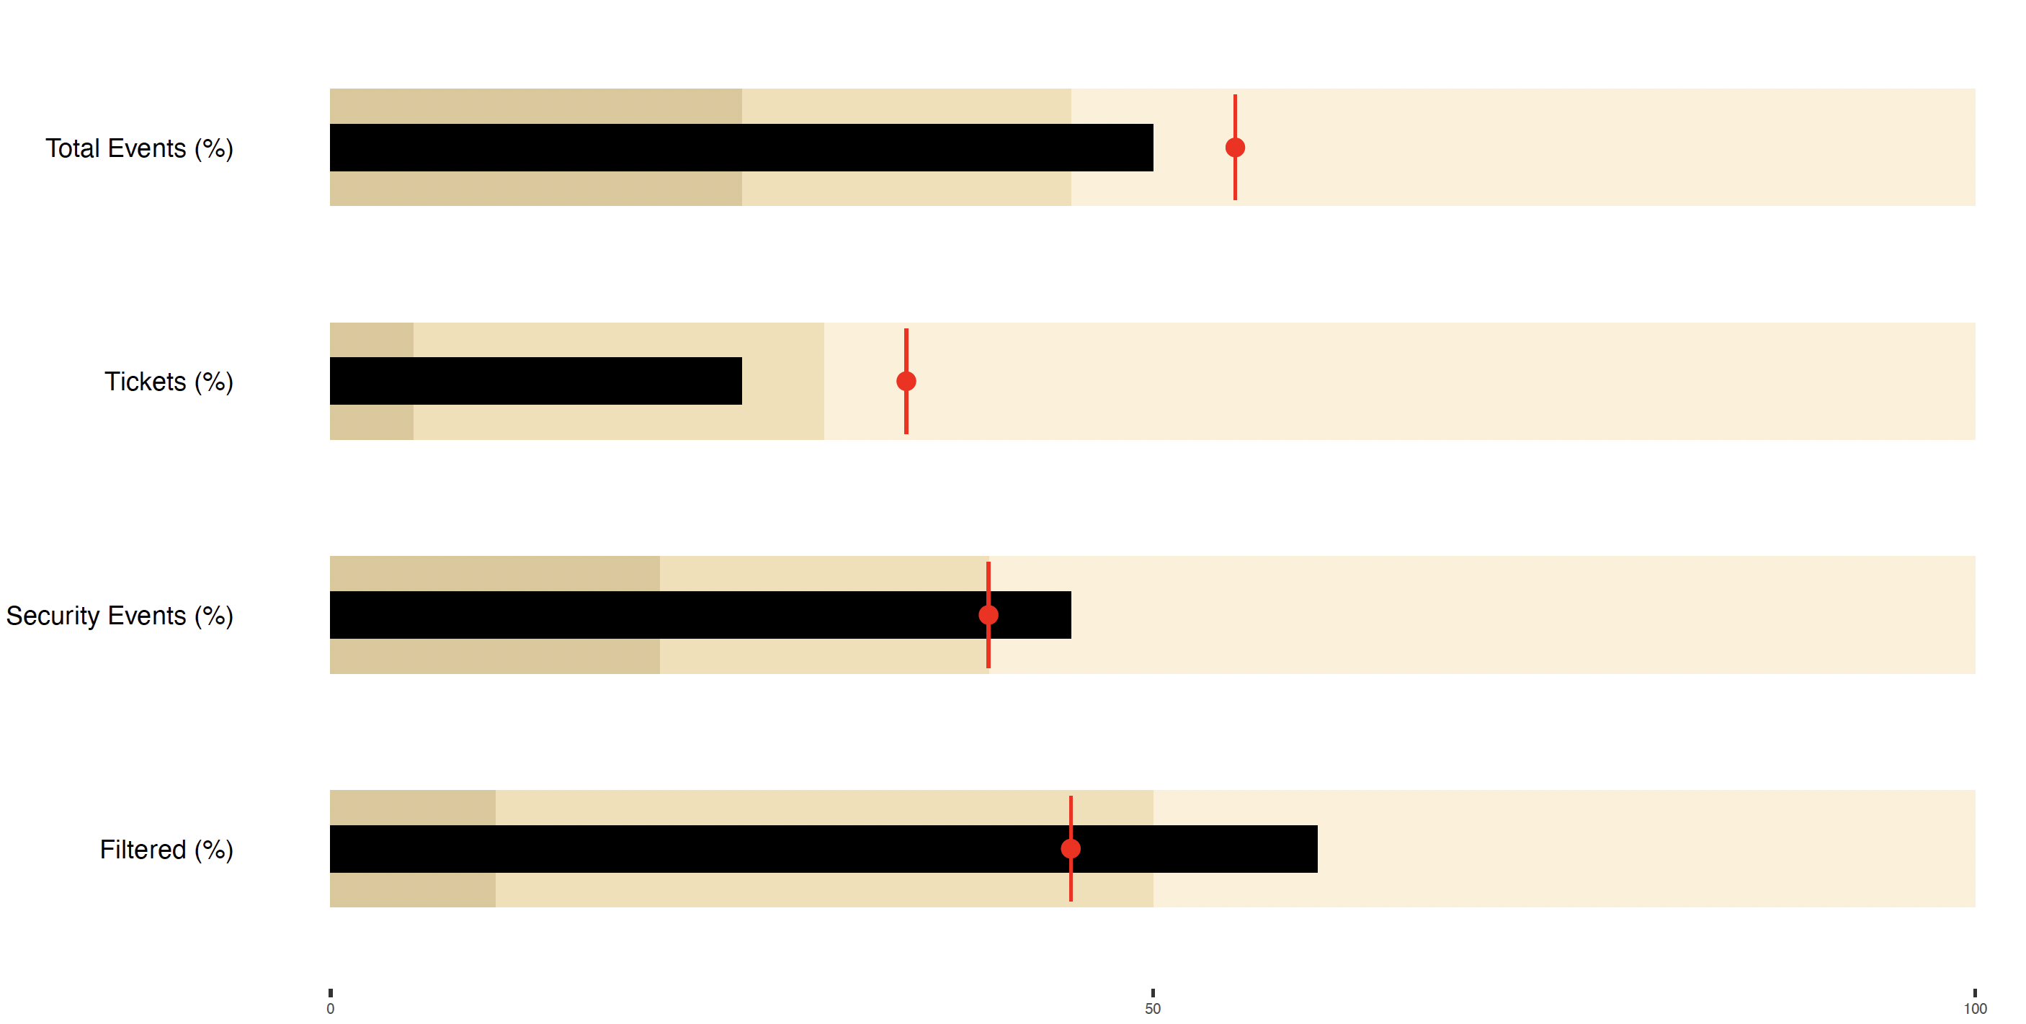
Bullet Chart in R
Notes:
https://github.com/hrbrmstr/Rbulletgraph/blob/master/bulletgraph.R

Slide 8
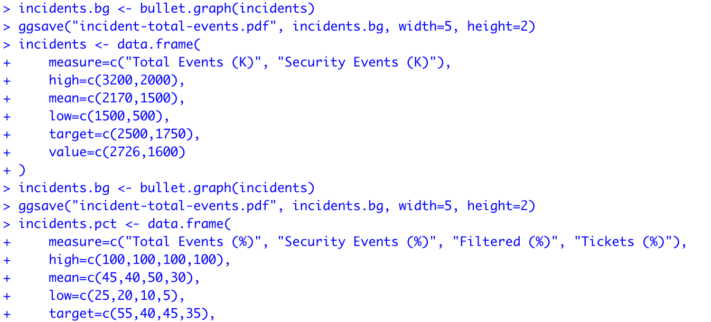
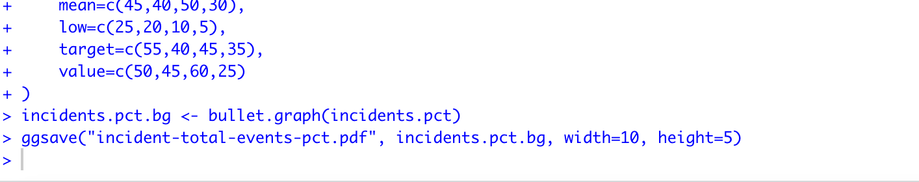

Slide 9
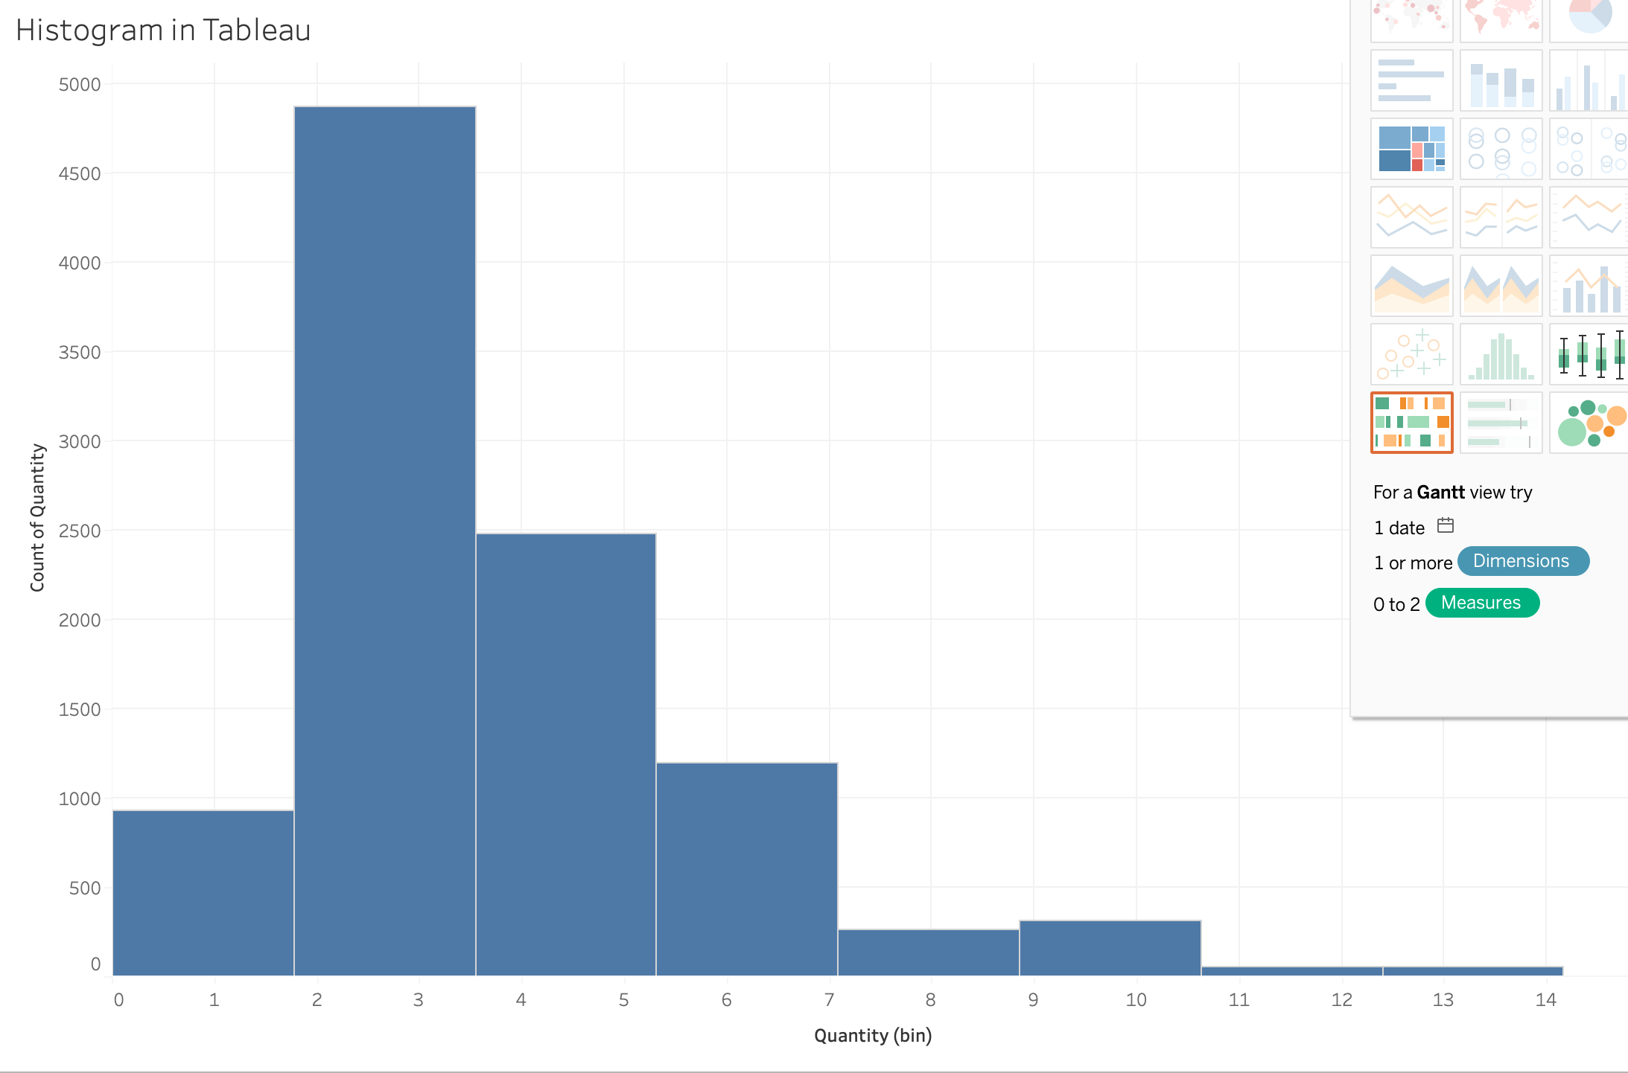
Histogram in Tableau
Notes:
https://help.tableau.com/current/pro/desktop/en-us/buildexamples_histogram.htm

Slide 10
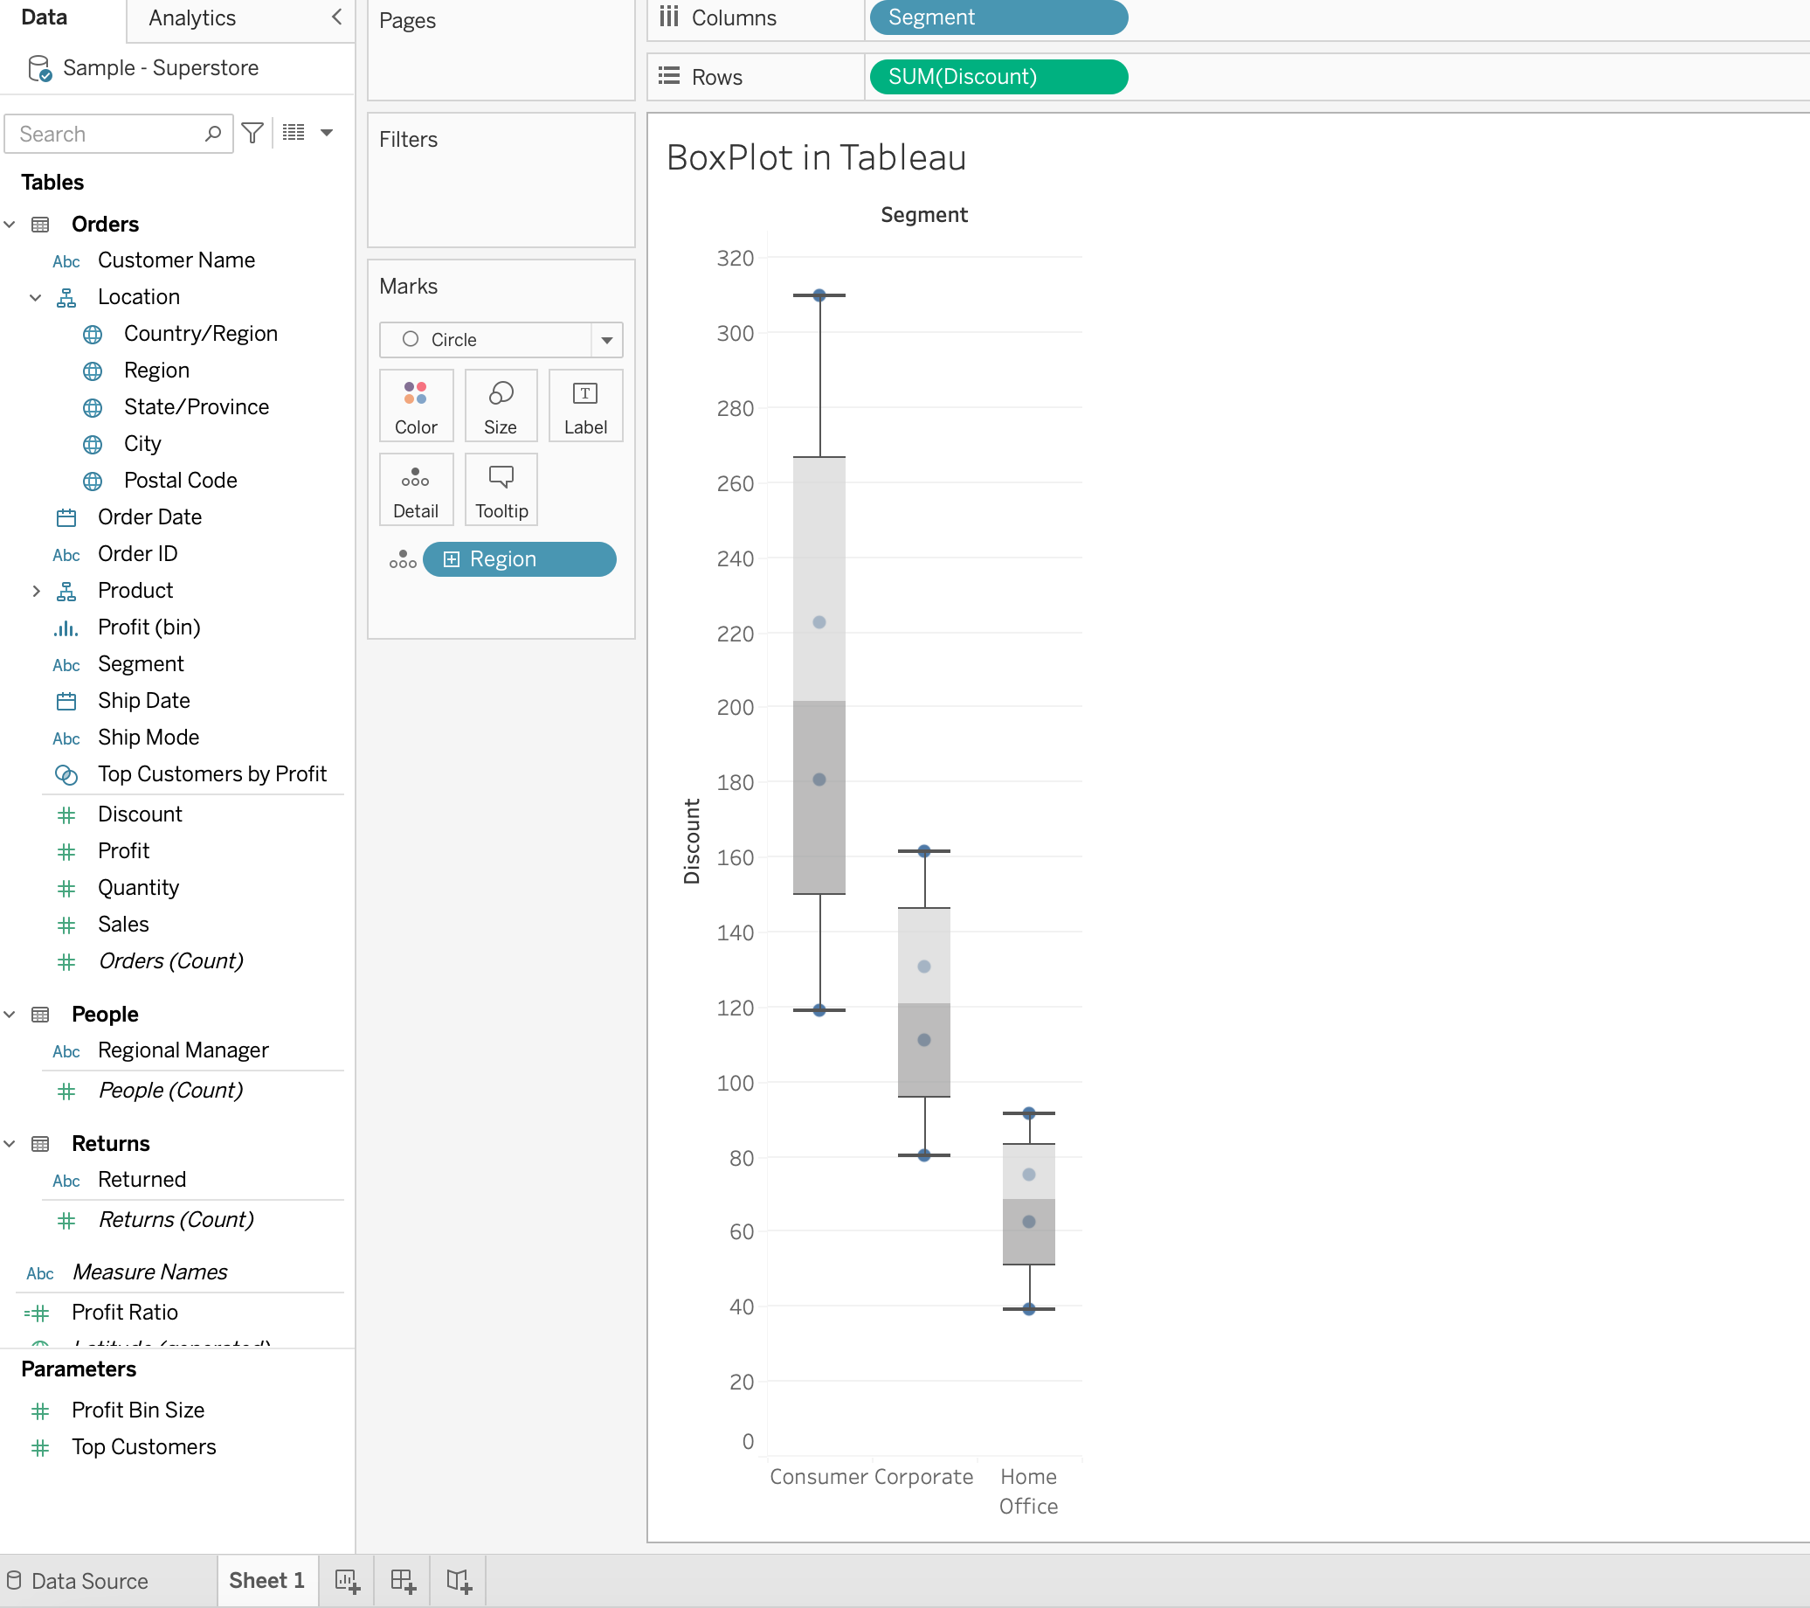
Box Chart in Tableau
Notes:
https://help.tableau.com/current/pro/desktop/en-us/buildexamples_boxplot.htm

Slide 11
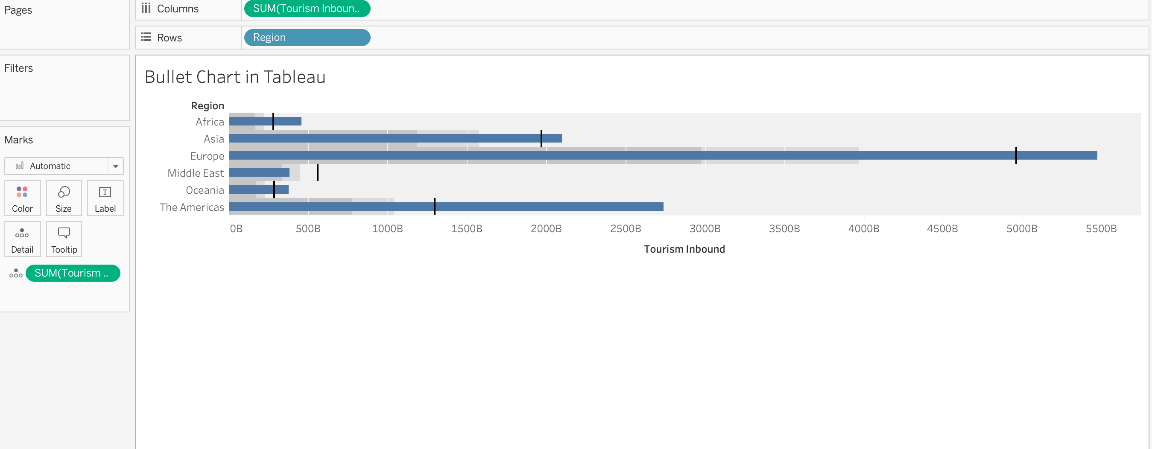
Bullet Chart in Tableau
Notes:
https://www.tutorialspoint.com/tableau/tableau_bullet_graph.htm

