Slide 1
Week 9&10
Professor Catherine Williams
Data Presentation and Visualization
Cindy Brinkmeyer

Slide 2
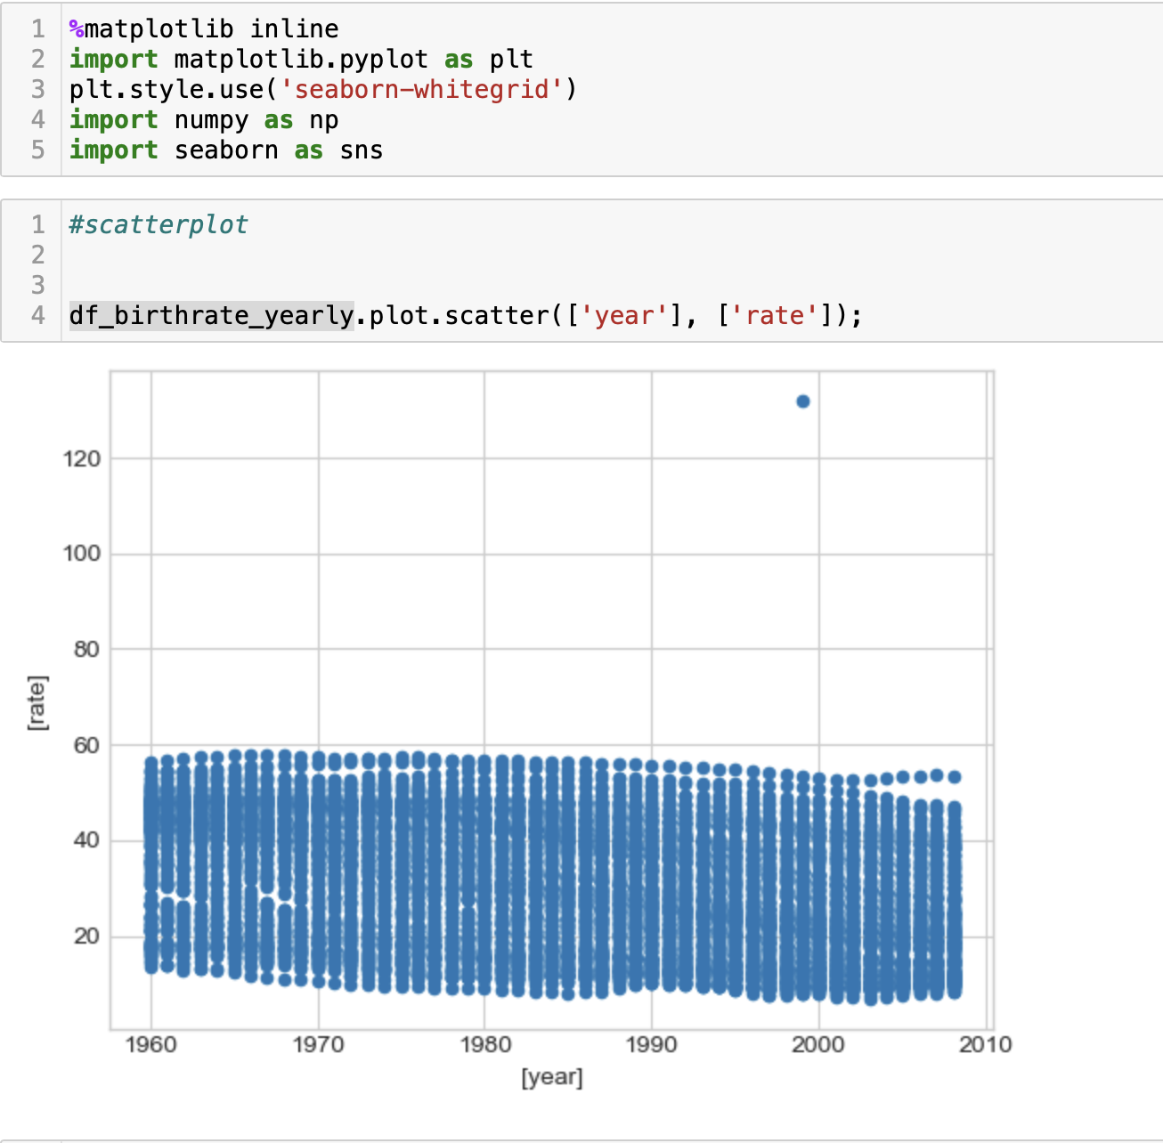
Heat Map in Python

Slide 3
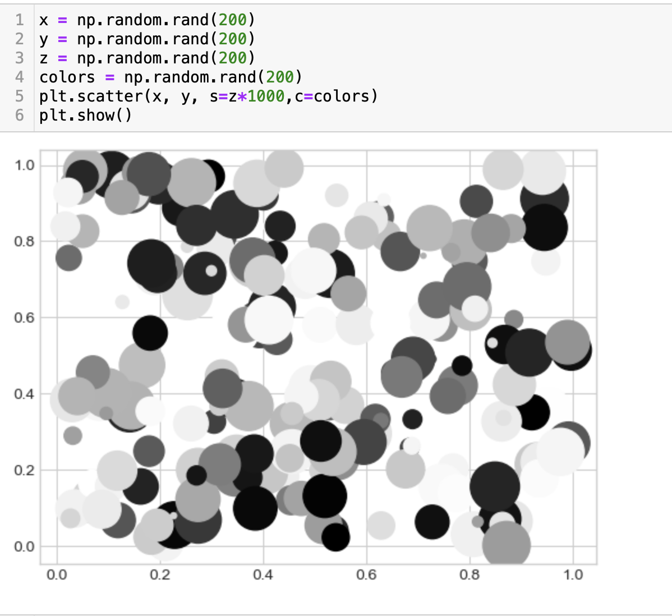
Spatial Chart in Python
Notes:
Reference internet python displays

Slide 4
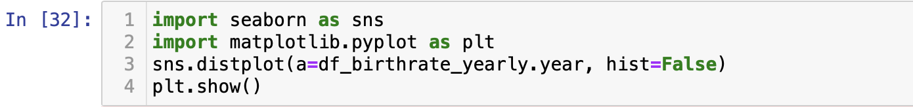
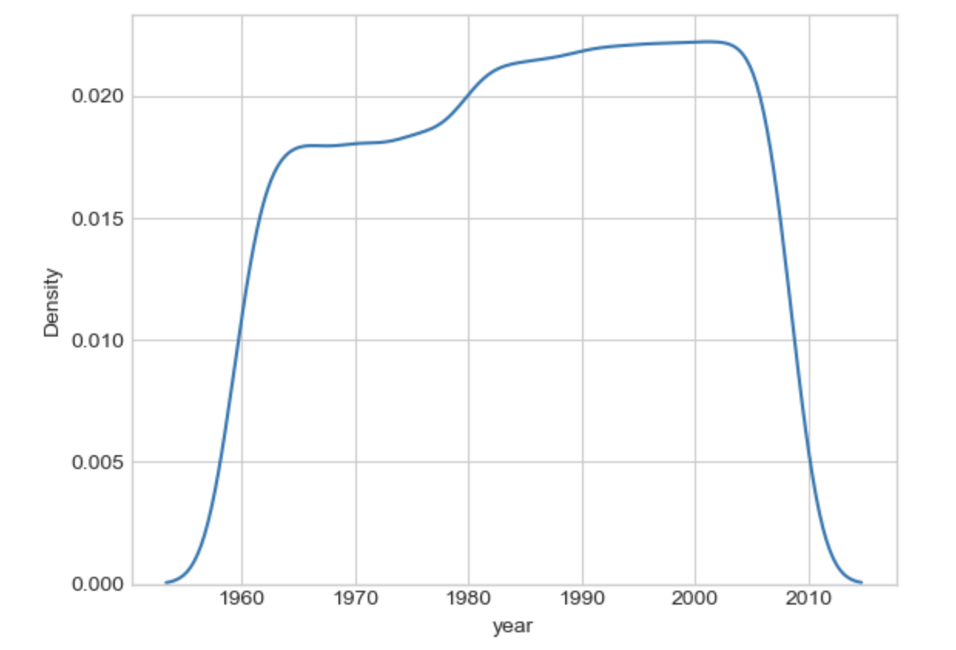
Contour Chart in Python

Slide 5
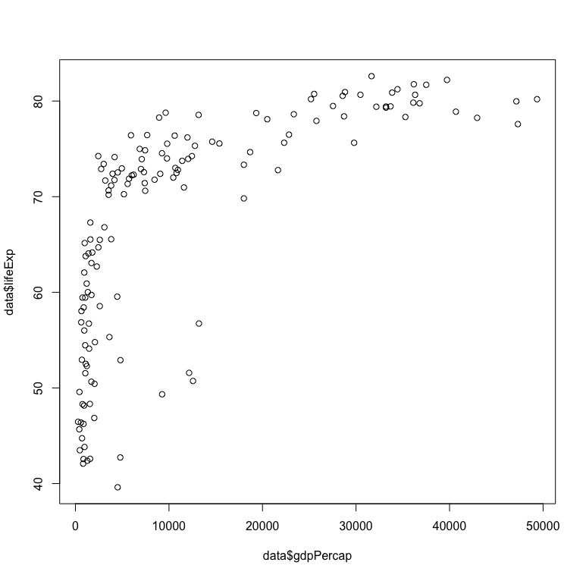
Heat Map in R
Notes:
https://r-graph-gallery.com/13-scatter-plot.html
https://r-graph-gallery.com/320-the-basis-of-bubble-plot.html

Slide 6
Spatial Chart in R

Slide 7
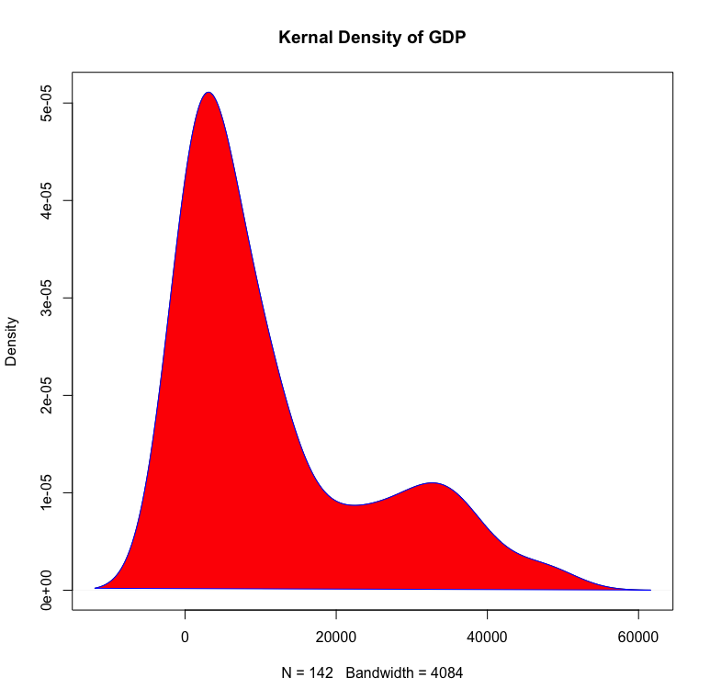
Contour Chart in R

Slide 8
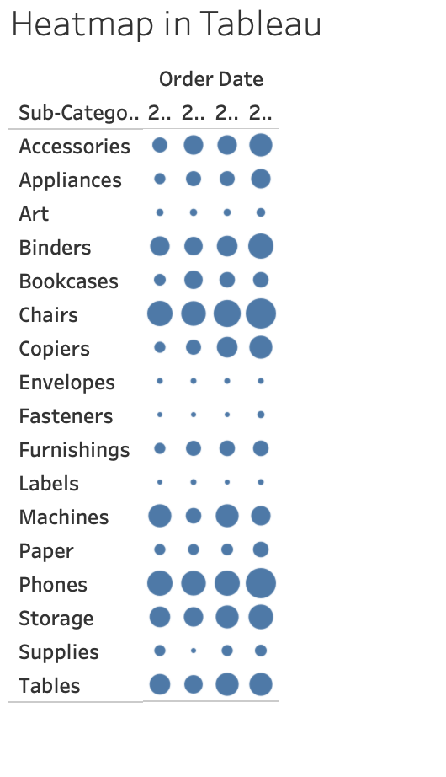
Heat Map in Tableau

Slide 9
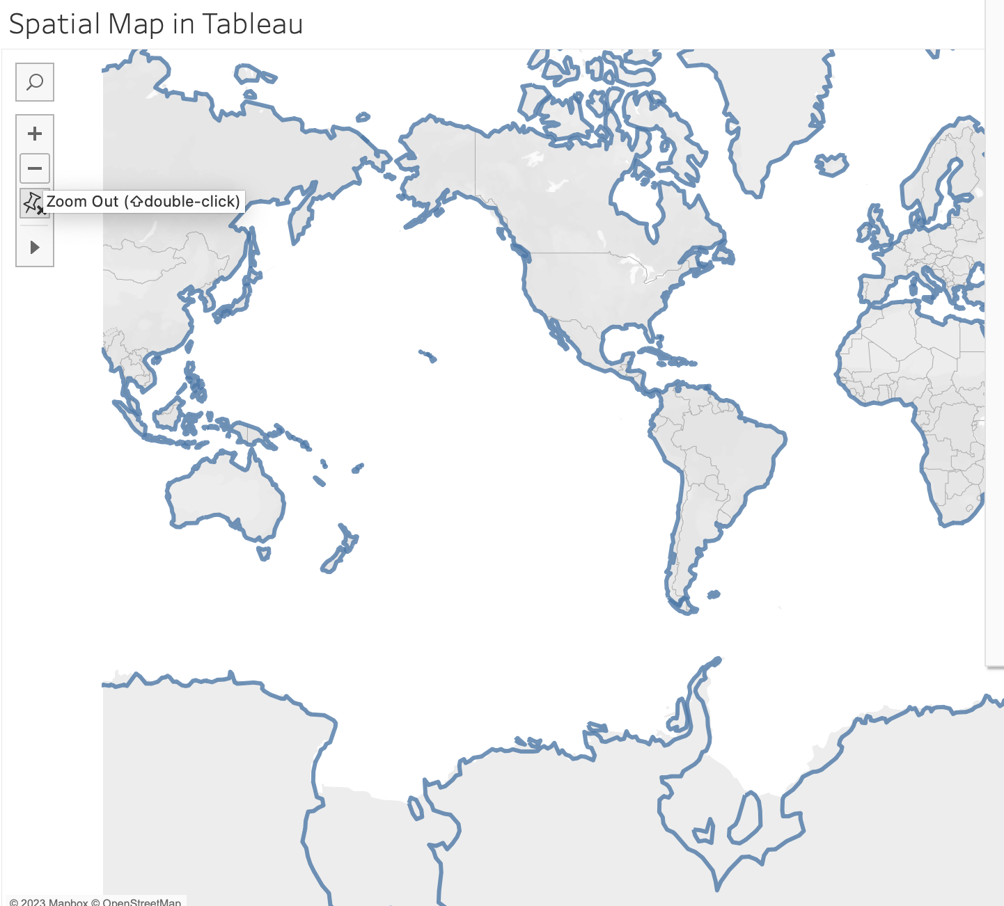
Spatial Chart in Tableau

Slide 10
Contour Chart in Tableau
Notes:
https://help.tableau.com/current/pro/desktop/en-us/buildexamples_density.htm

