Slide 1
ACS 2006-2010

Slide 2
Had to exclude census tracts missing information on at least 1 variable
N = 1456
Includes all 18 variables
Probit transformations undefined for 0 or 1→ shifted them slightly
For income, I divided the value by maximum
Methods
Hierarchical clustering
Agglomerative or bottom up
Multivariate Gaussian Mixture model where I transformed the proportions to z-scores

Slide 3
Hierarchical clustering
Goal: census tracts within a cluster are similar (e.g., census tracts with similar neighborhood composition)
Used the package Nbclust and function hclust()
Euclidean distance as measure of dissimilarity
Method = ward.D2 → minimizes the total within cluster variance
Index: method to decide the number of clusters– I used all the options in the package, at the end it provides a “majority rule” best number of clusters
In another paper looking at individual level SDoH they looked at the friedman index, which decides the number of clusters based on the maximum difference between hierarchy levels. paper 2024

Slide 4
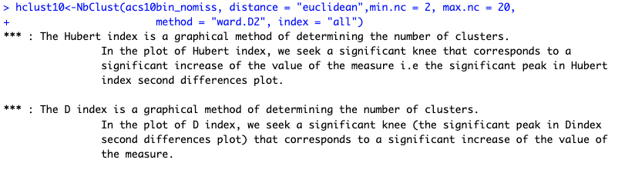
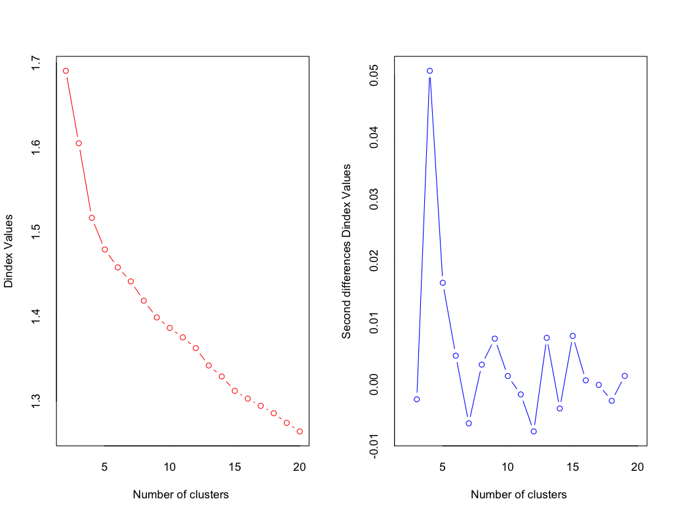
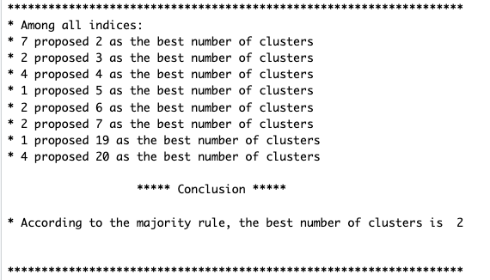
Notes:
Some warnings tho interpret with caution-
The error you're encountering with the NbClust package in R, which mentions "NaNs produced" in the context of log(det(P)/det(W)), typically arises from numerical issues related to the computation of the determinant of a matrix (or matrices). This can happen due to several reasons:
Singular Matrix: If either P (between-groups dispersion matrix) or W (within-group dispersion matrix) is singular (i.e., not invertible), their determinant will be zero. The logarithm of zero is undefined, leading to NaNs.
Very Small or Large Determinants: If the determinants of P and W are extremely small or large, numerical precision issues might occur, leading to NaNs.
Collinear or Perfectly Separated Data: High collinearity among variables or perfectly separated clusters can lead to a degenerate within-cluster covariance matrix (W), making it singular.

Slide 5
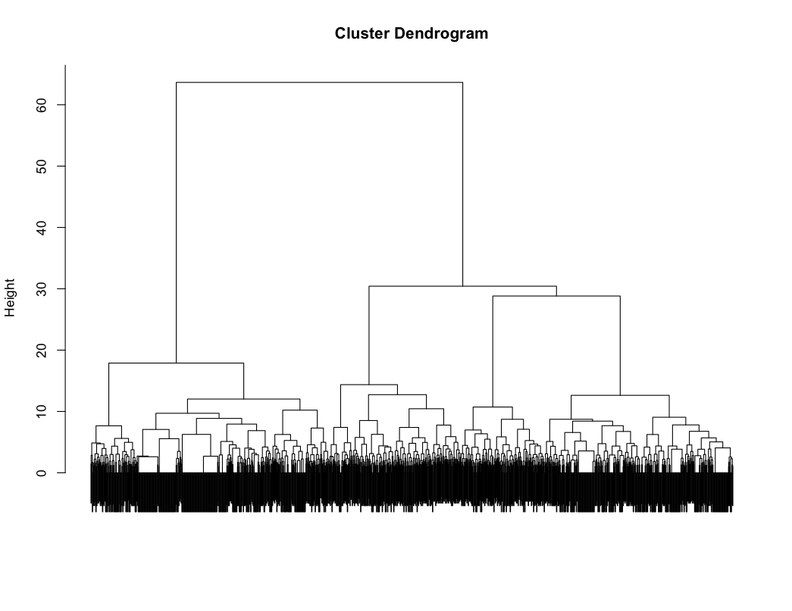
OtherFigs examples

Slide 6
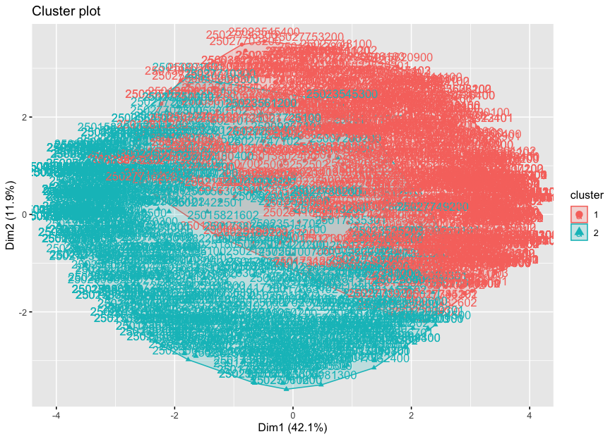
Cutting tree at 2 clusters– not the best visual…
Notes:
In a dendrogram, we can see the hierarchy of clusters, but we have not grouped data into different clusters yet. However, we can determine how many clusters are within the dendrogram and cut the dendrogram at a certain tree height to separate the data into different groups.

Slide 7
GMM
Multiple R packages
Mclust: EM algorithm (do not need to pre-specify K-
Initialization of EM is performed using the partitions obtained from agglomerative hierarchical clustering. The optimal model is then selected according to BIC.
https://mclust-org.github.io/book/
Mixtools
Flexmix

Slide 8
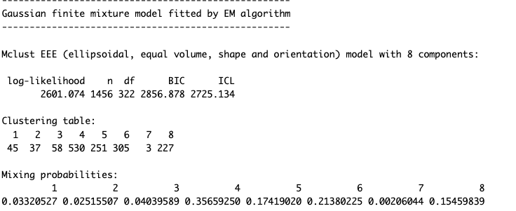
Mclust
Mixtools:
- 2 components

Slide 9
ACS 2011-2015

Slide 10
Had to exclude census tracts missing information on at least 1 variable
N = 1454
Includes all 18 variables
Probit transformations undefined for 0 or 1→ shifted them slightly
For income, I divided the value by maximum
Methods
Hierarchical clustering
Agglomerative or bottom up
Multivariate Gaussian Mixture model where I transformed the proportions to z-scores

Slide 11
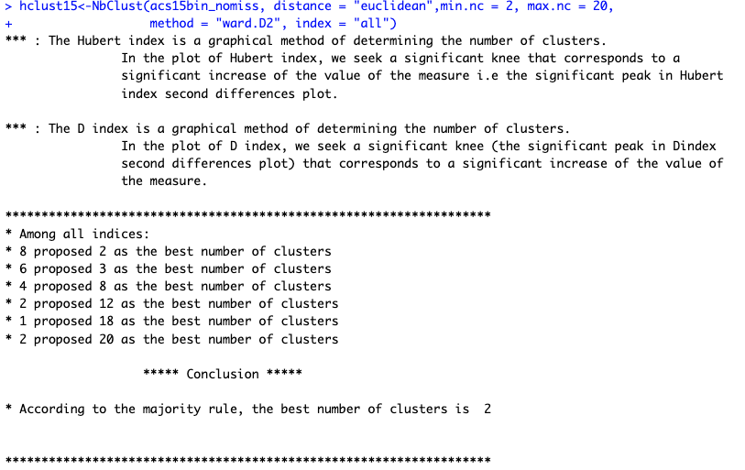
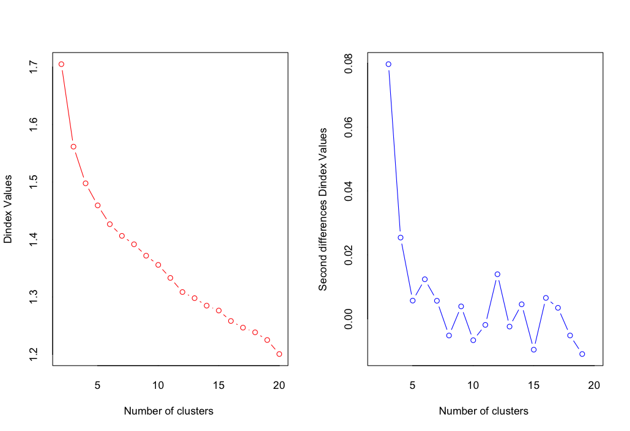

Slide 12
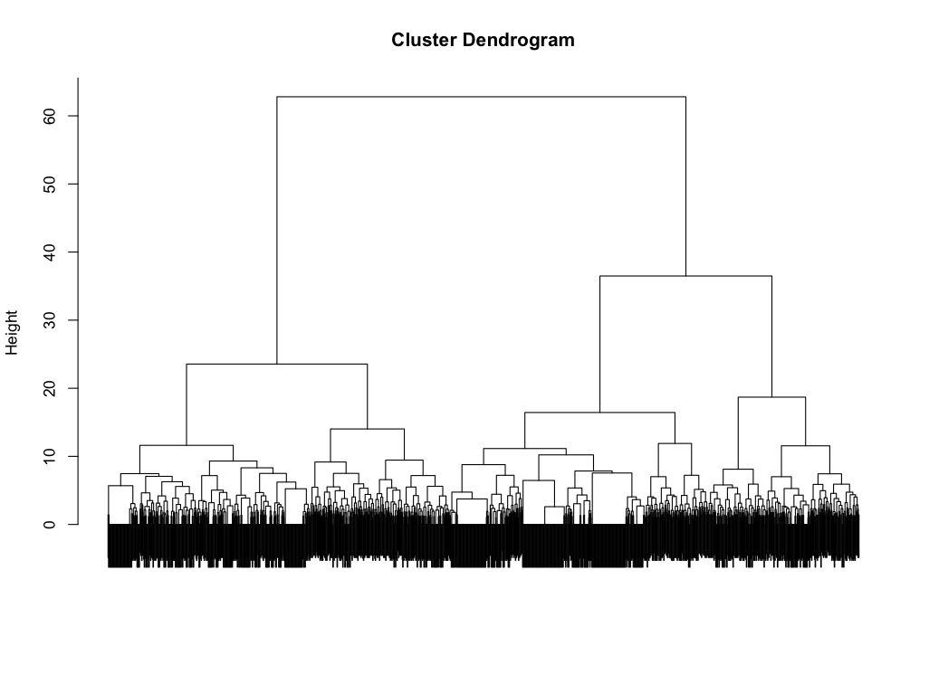

Slide 13
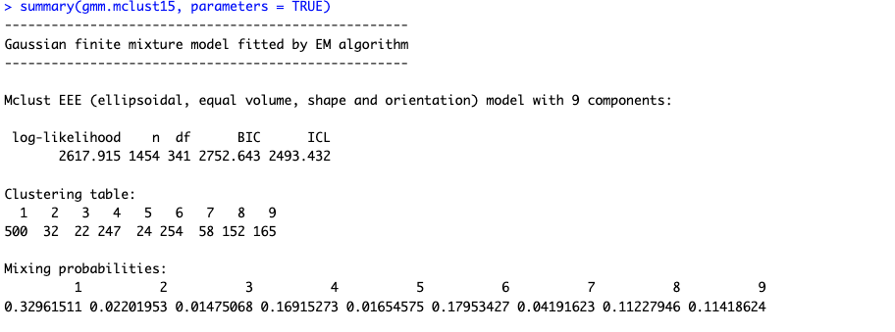

Slide 14
ACS 2015-2019

Slide 15

I wasn’t able to get results using this package for this, the next slide shows the results from using hclust()

Slide 16
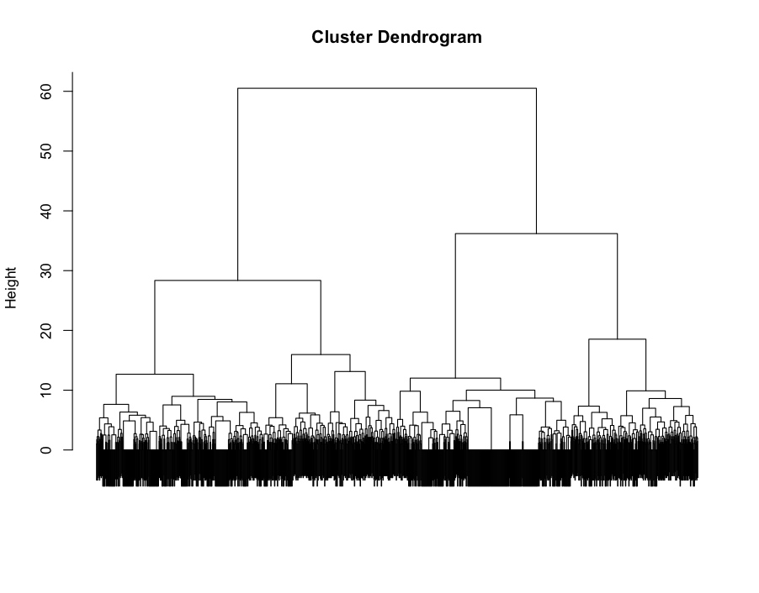

Slide 17
