Slide 1
Renter-occupied housing
Owner-occupied housing
Two people per room
Lack of complete plumbing
Female household
No vehicle in household
Patient Census tract
(MDPH)
ACS Census tract level data for MA
Proportion of less than high school education
Year of diagnosis
Proportion of high school degree or higher
Proportion of Bachelor's or higher
Food stamp/SNAP benefits
Median income
Proportion below poverty level
Proportion of unemployed/unemployment rate
White Collar Occupation

Slide 2
Stage 1A
Grade 1 & 2
surgery +/- vaginal brachytherapy if lymphovascular space invasion (LVSI) and/or age 60+
Grade 3
Stage 1B
Grade 1 & 2
Grade 3
Stage 2 (all grades)
Stages 3 and 4
surgery + chemo +/- EBRT and/or vaginal brachytherapy
surgery + EBRT and/or vaginal brachytherapy +/- chemo
surgery + vaginal brachytherapy or EBRT (consider observation if no other adverse risk factors)
surgery + vaginal brachytherapy or EBRT +/- chemo
surgery +/- vaginal brachytherapy or External beam radiation therapy (EBRT) (consider observation if no myoinvasion)

Slide 3
All women identified by the Massachusetts Department of Public Health with a uterine cancer diagnosis between 2006 and 2017 (n = 14,857)
Excluded
Duplicated IDs (n=52); same patient ID for different cancers
Unknown Census tract information (n=1)
Not endometroid ICD-O3 morphology codes (n=3514)
Stage in situ, regional direct & lymph or NOS/unknown (n=603)
Grade differentiation unknown (n=1366)
Final study population of adult women diagnosed with endometrial cancer (n=9318)

Slide 4
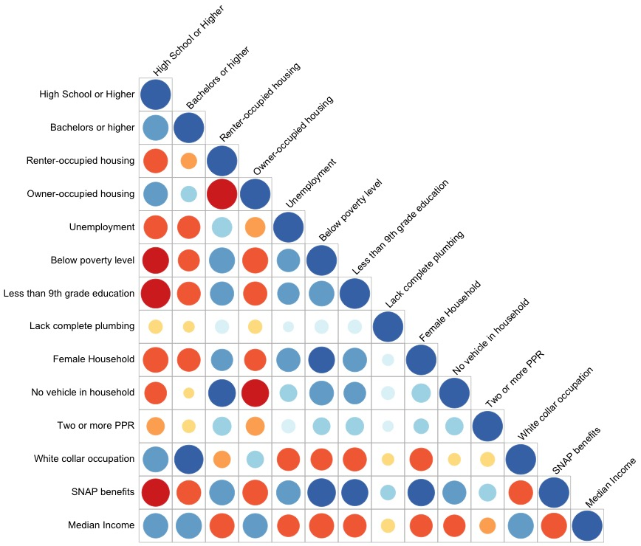
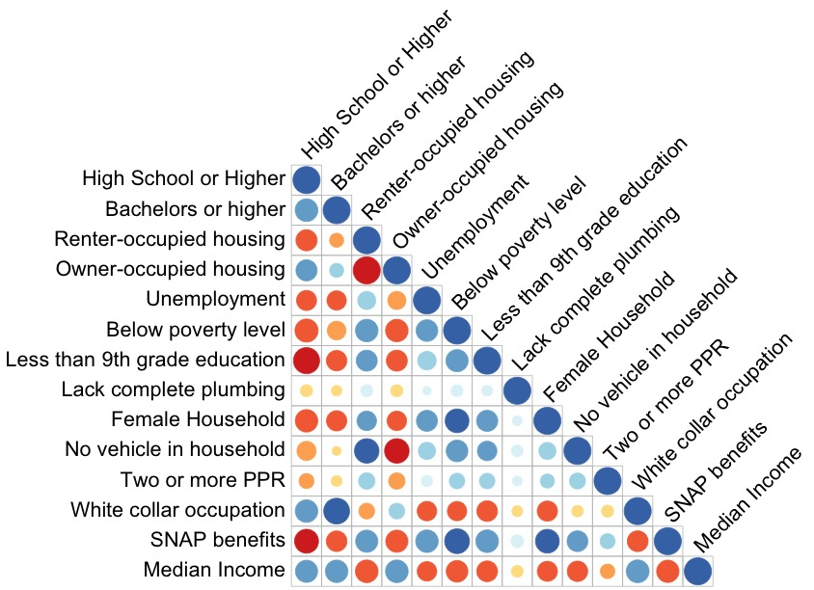
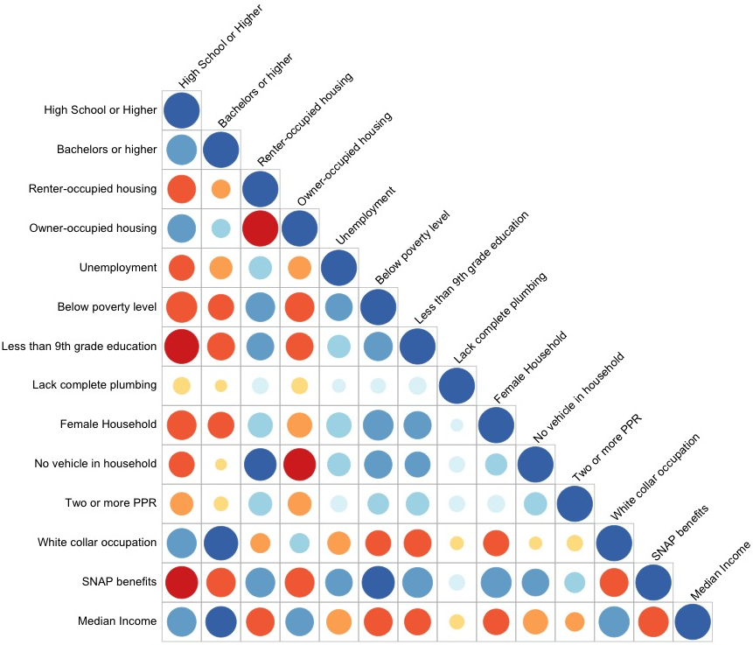
(b) ACS 2011-2015
(a) ACS 2006-2010
(c) ACS 2015-2019

Slide 5
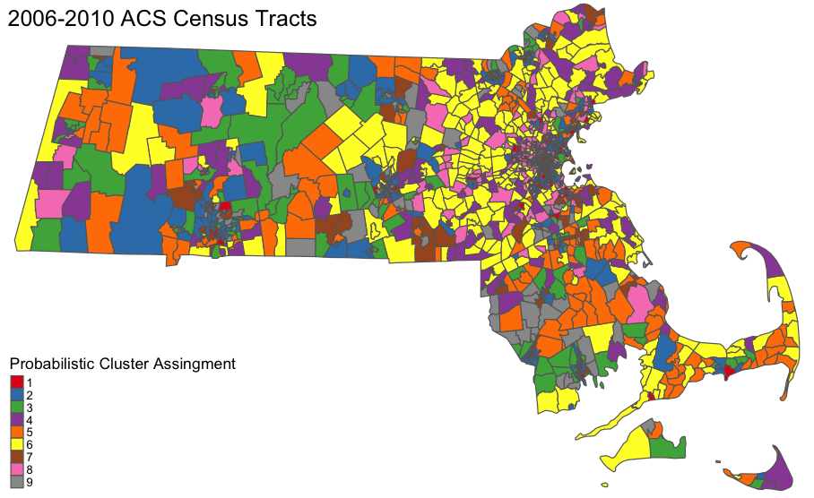

Slide 6
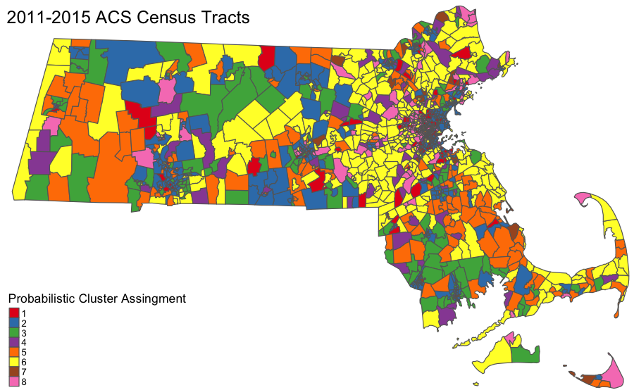

Slide 7
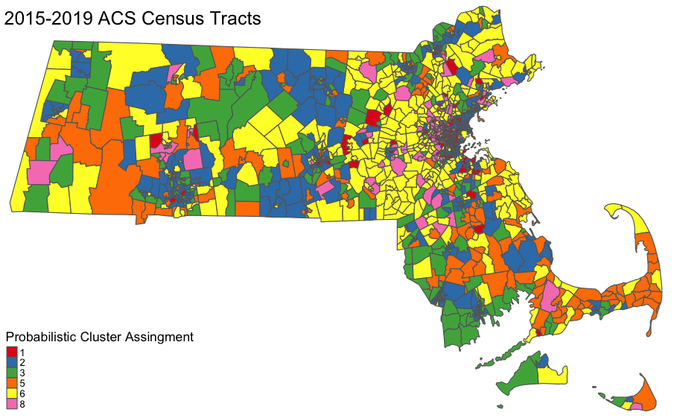

Slide 8
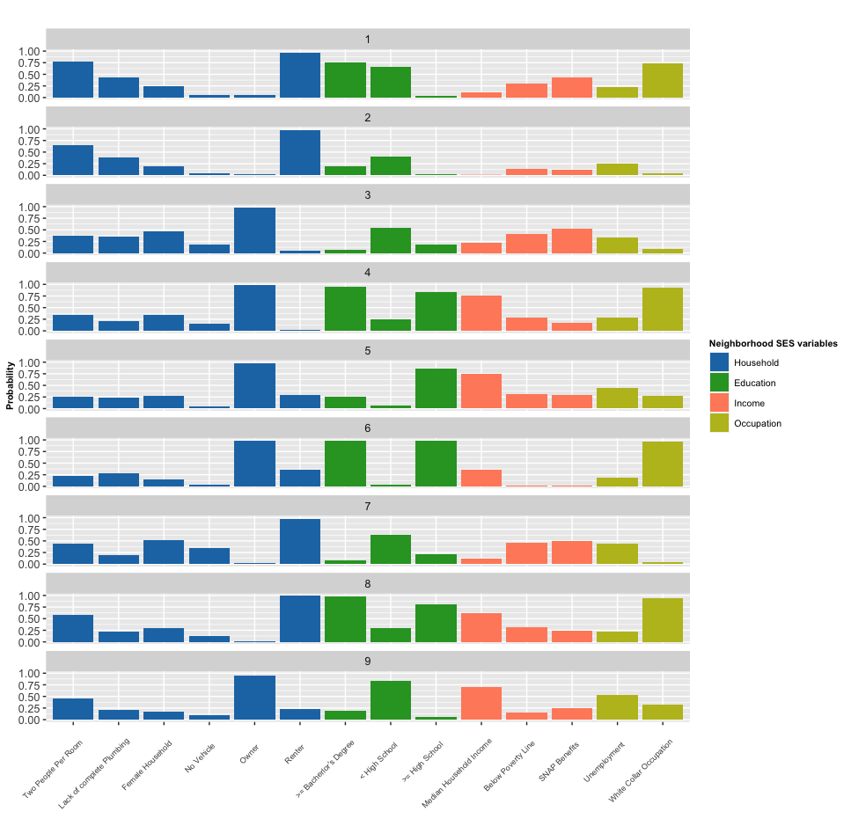

Slide 9
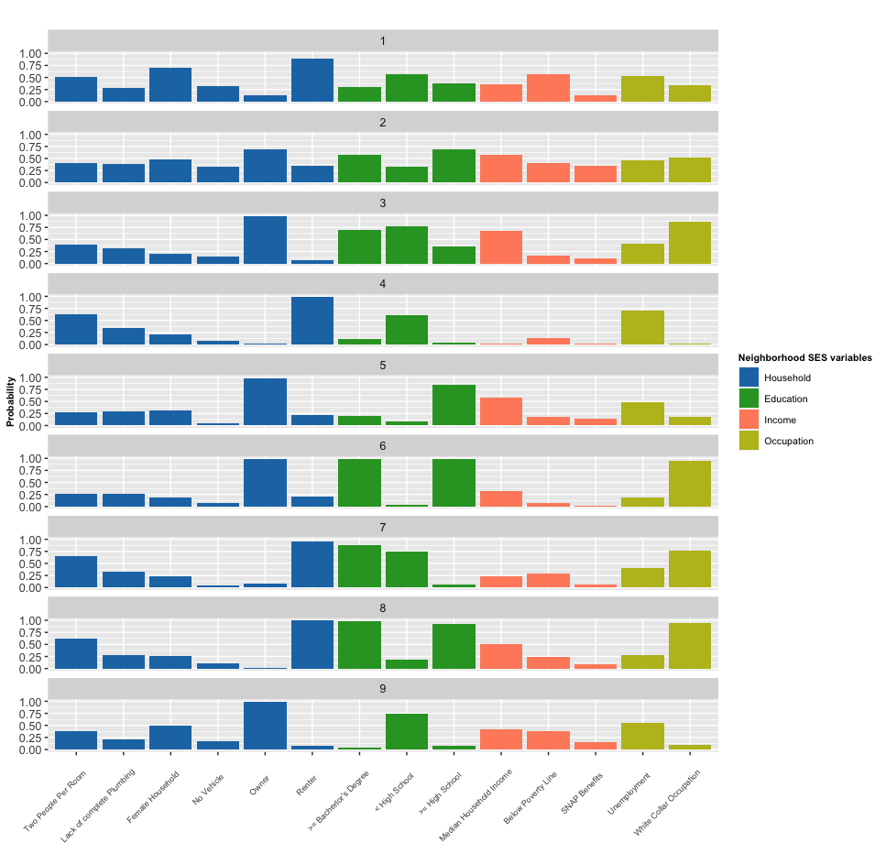

Slide 10
