Slide 1
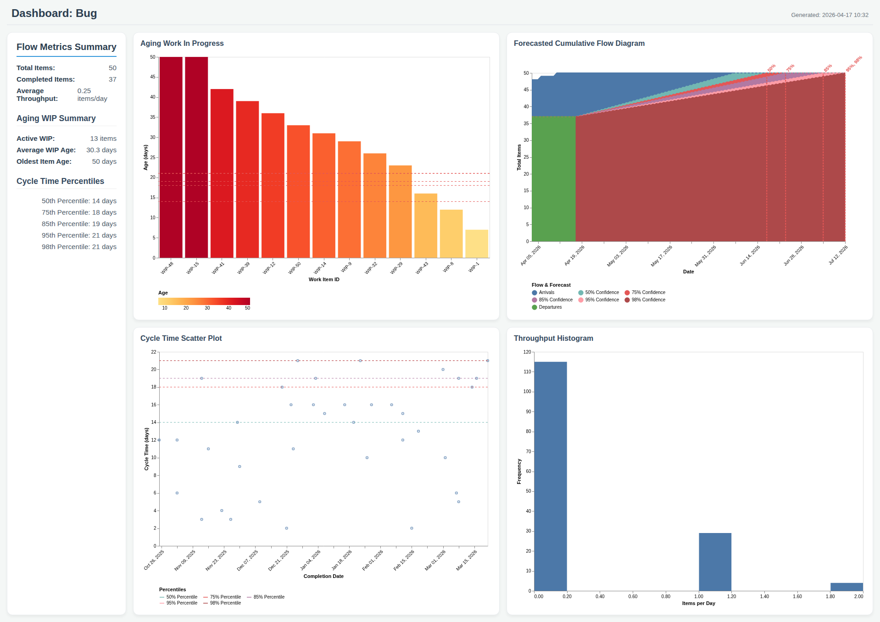
Dashboard: Bug

