Slide 1
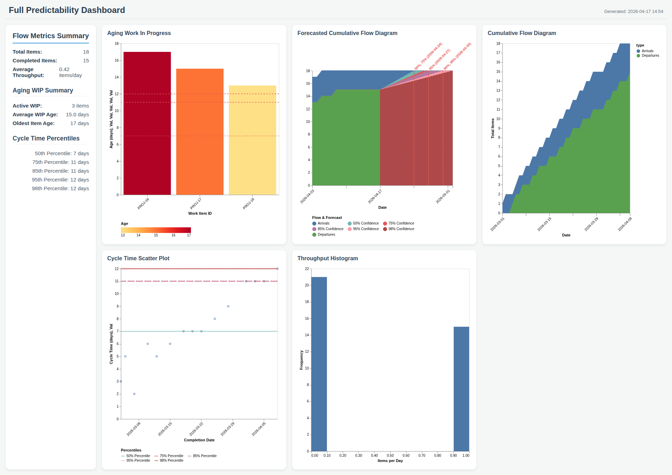
Full Predictability Dashboard

