Slide 1
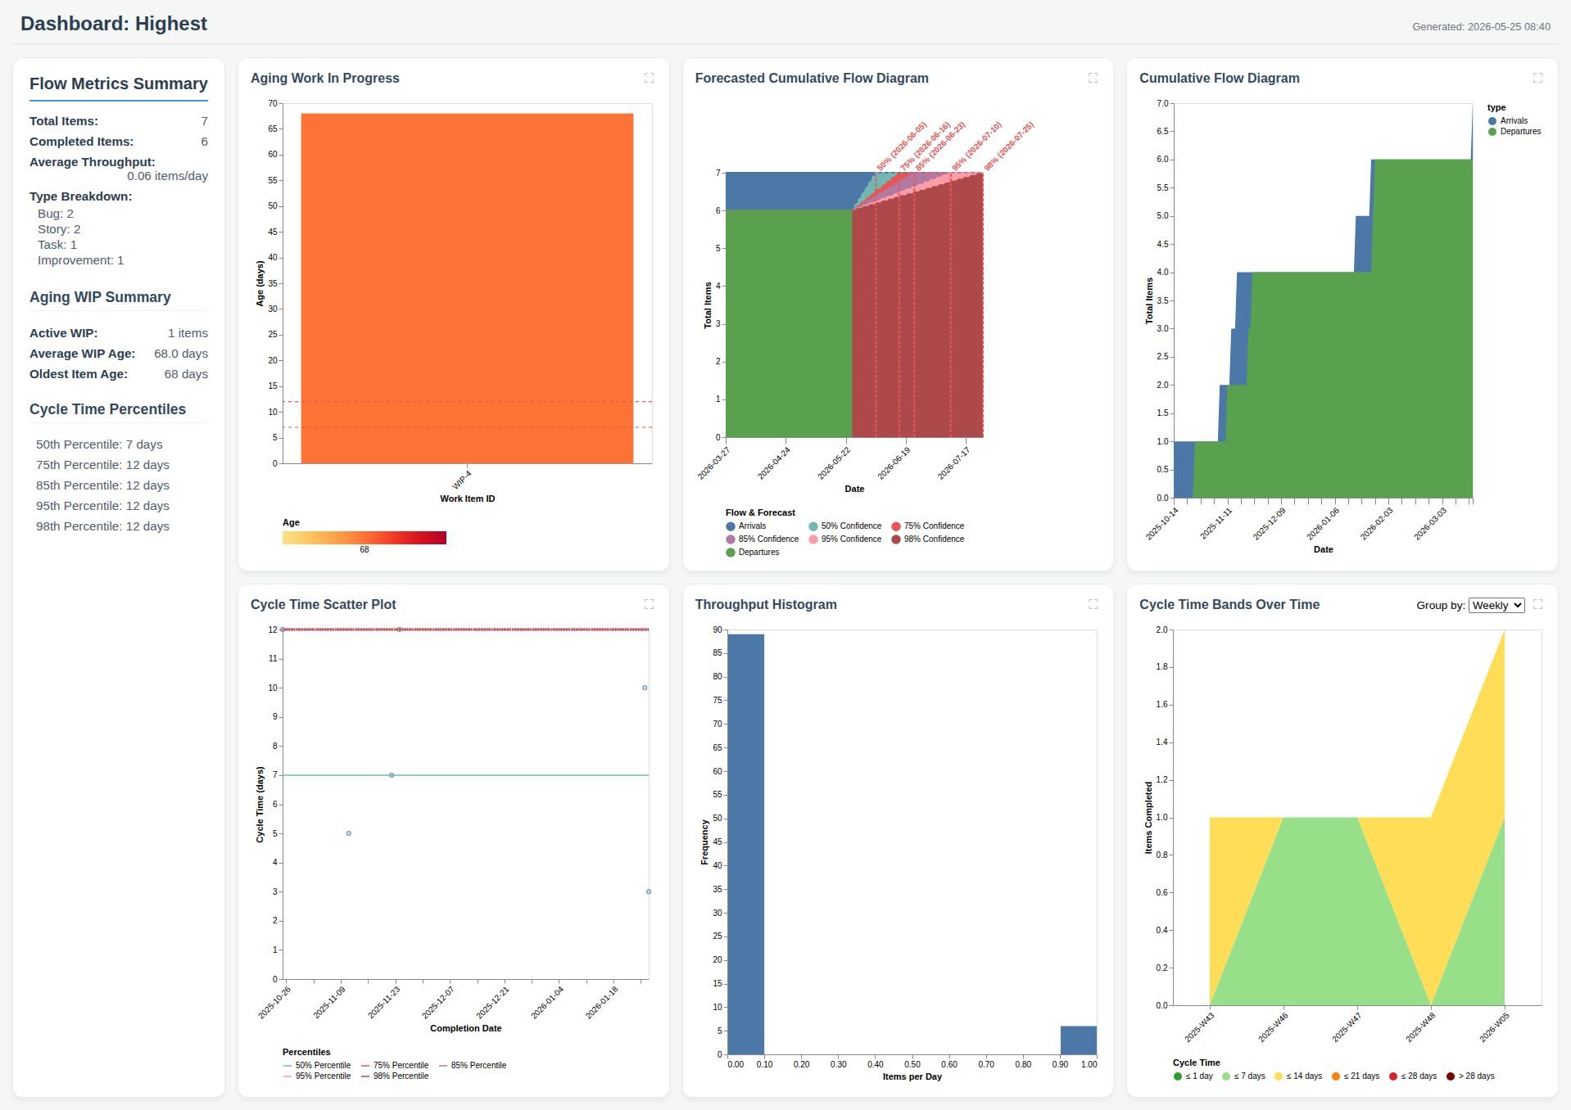
Dashboard: Highest

