Slide 1
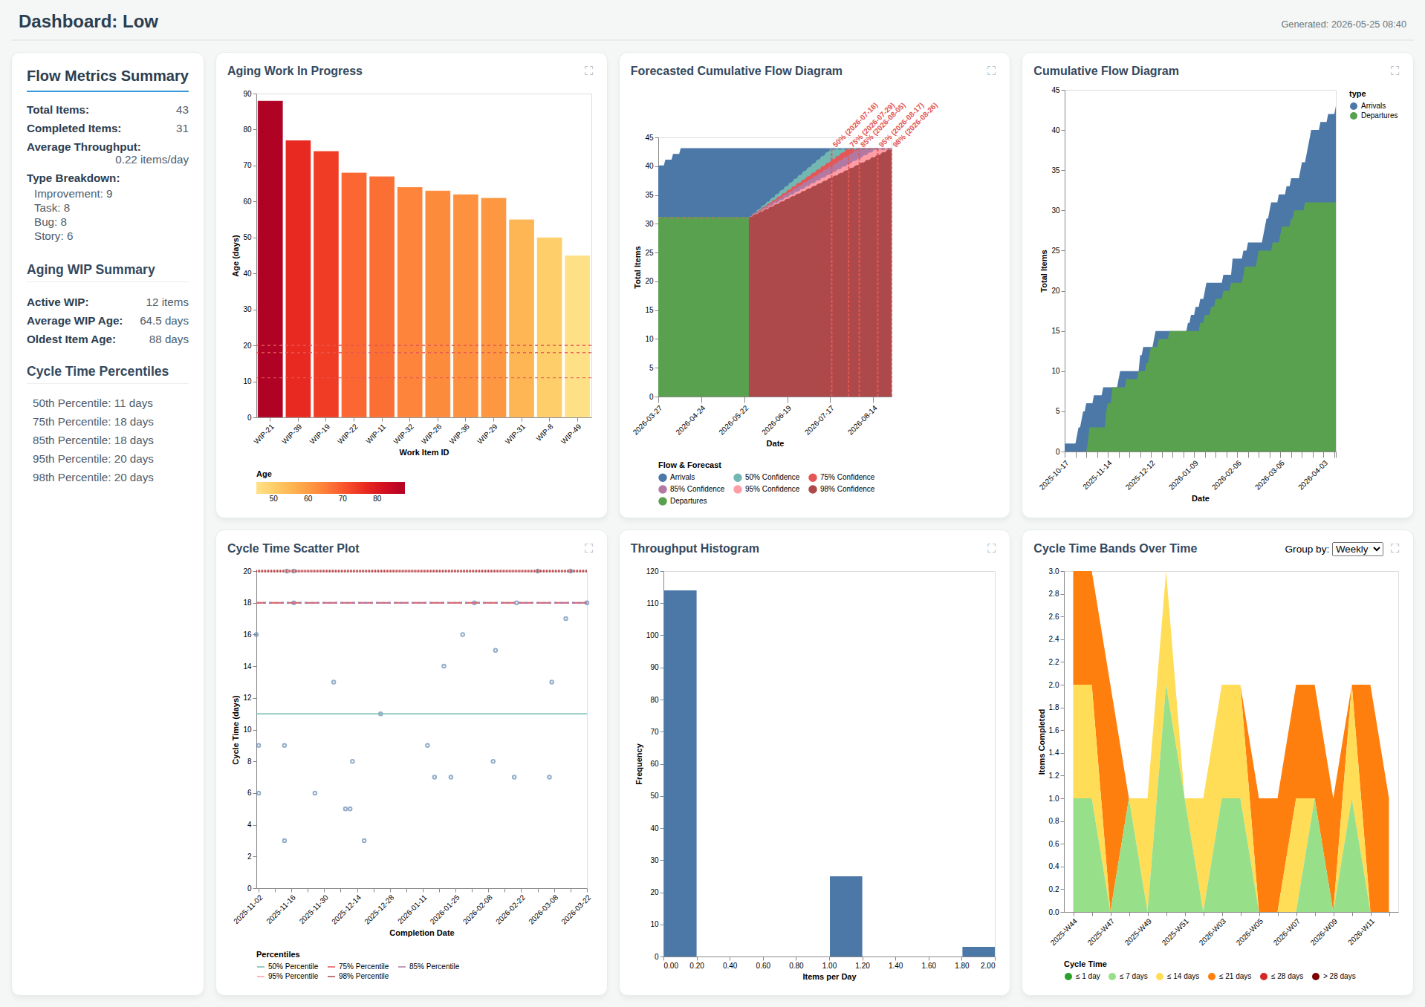
Dashboard: Low

