Slide 1
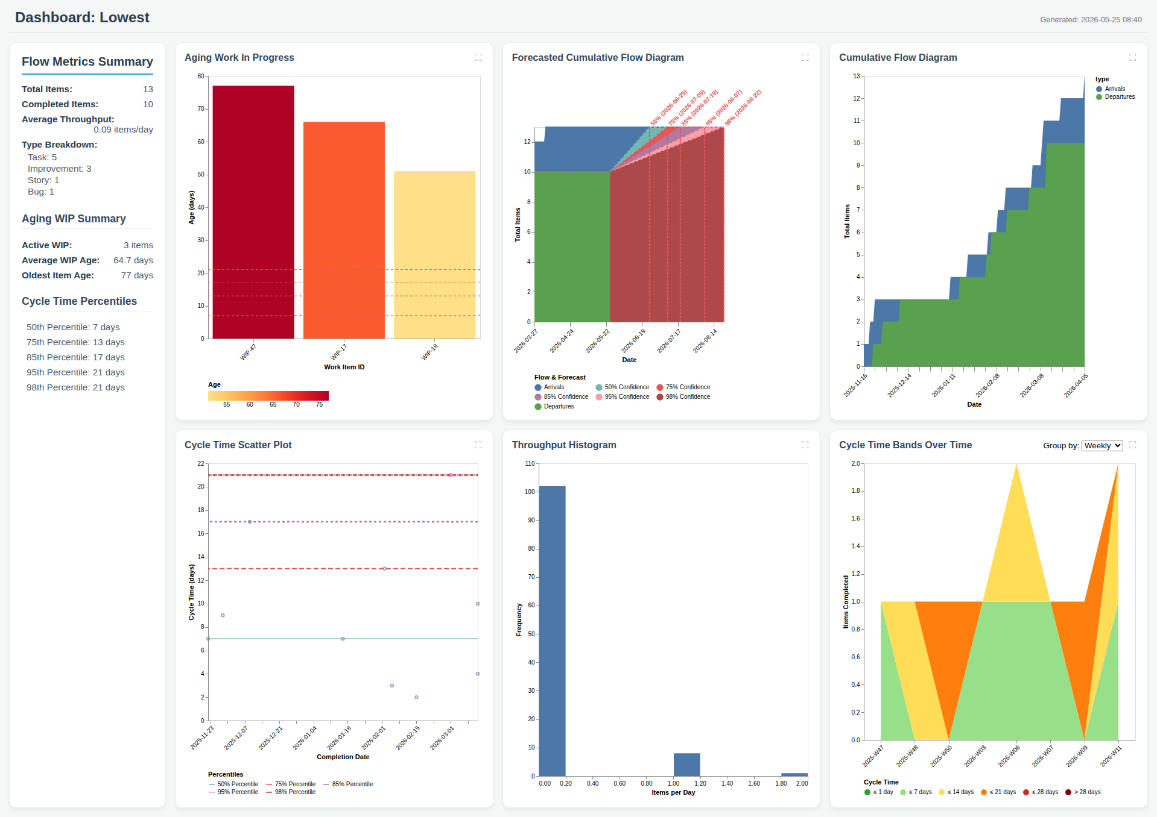
Dashboard: Lowest

