Slide 1
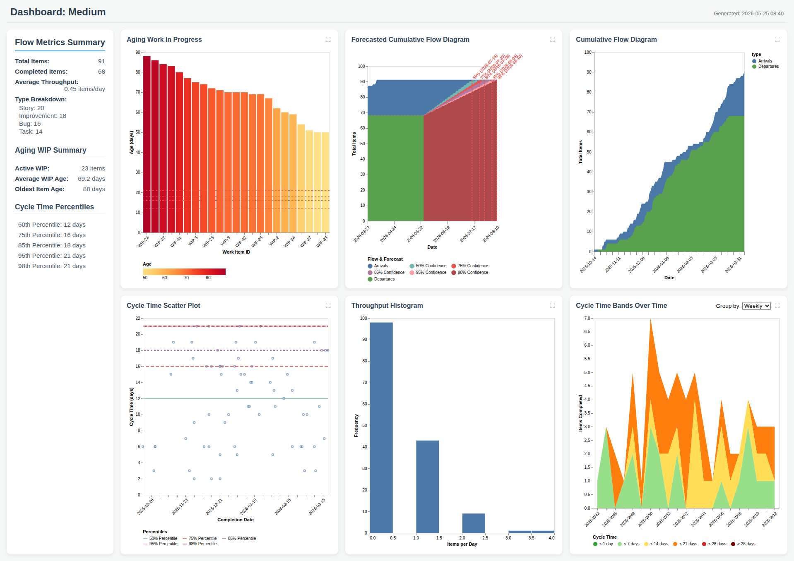
Dashboard: Medium

