Slide 1
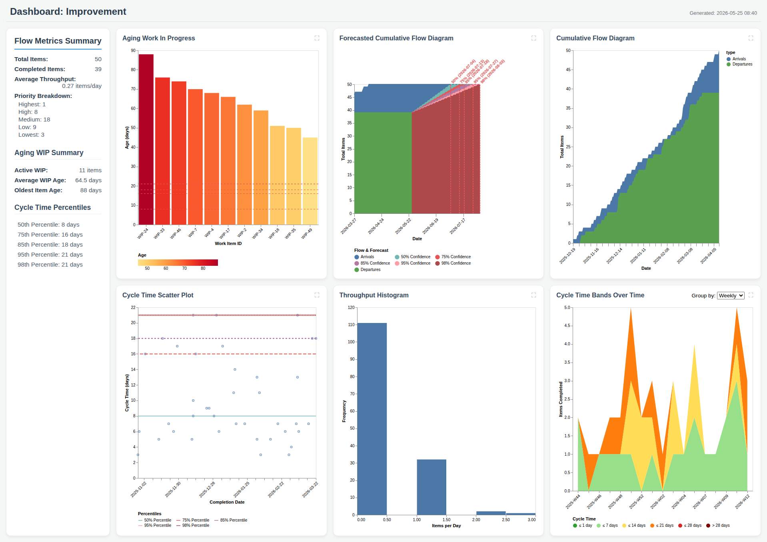
Dashboard: Improvement

