Slide 1
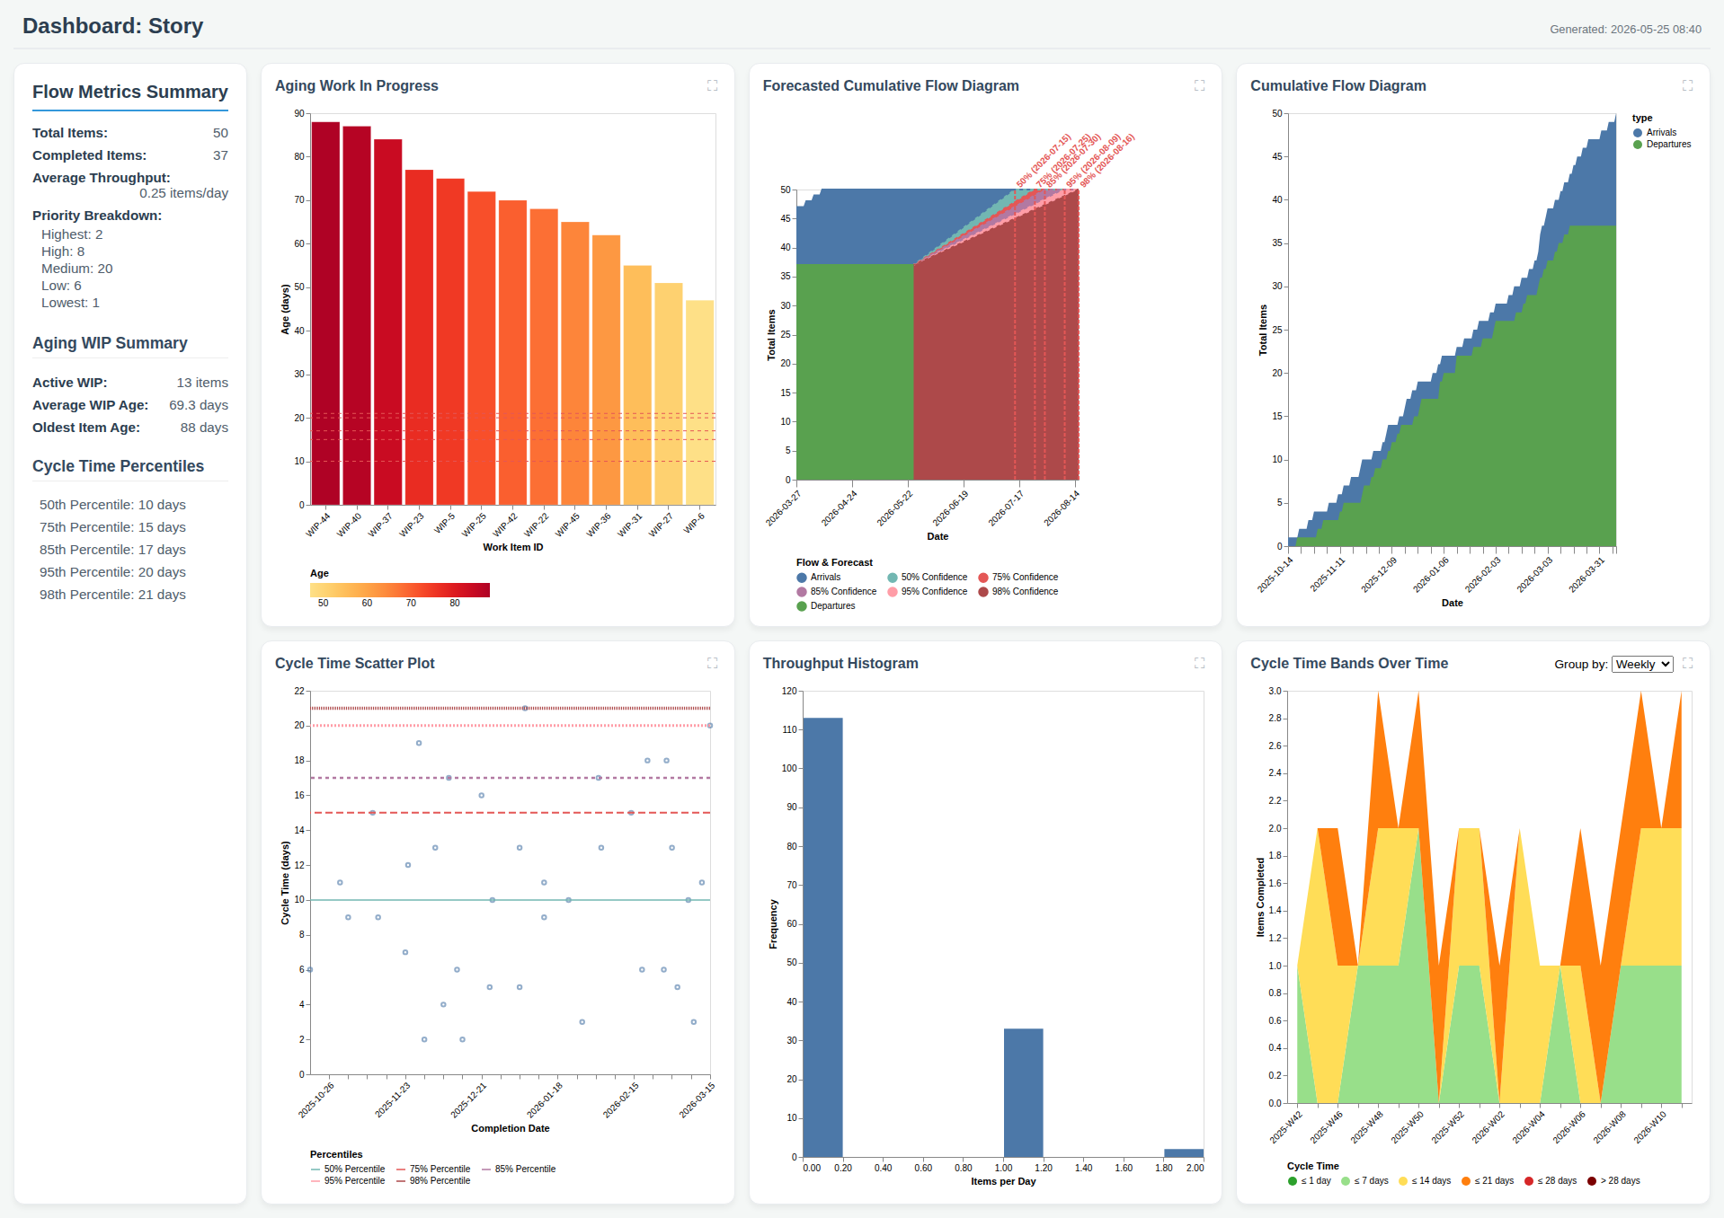
Dashboard: Story

