Slide 1
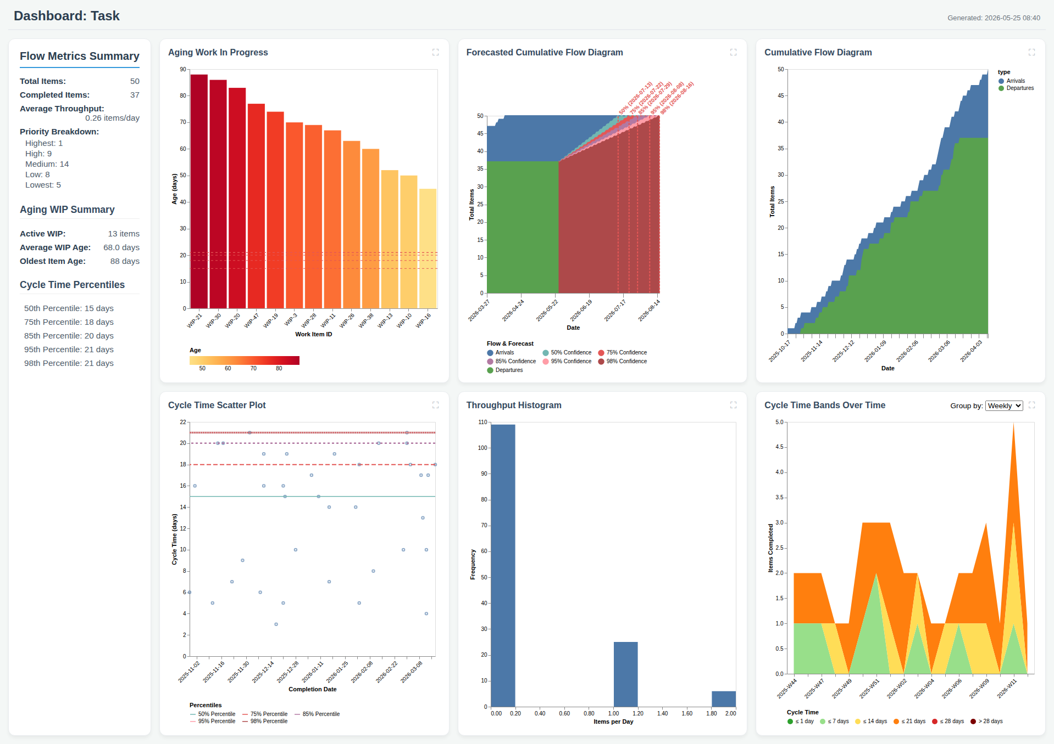
Dashboard: Task

