Slide 2
Simulated fishery
1 years of fishing for 50 vessels
Sets -> Trips -> Vessels
Trips per vessel per year and sets per trip varied
Catch on a set varied by:
  Vessels
  Trips
  Sets
5 types of catch event
Repeated 1000 times to capture variability

Slide 3
3 ways to allocate monitoring coverage
By sets, at random (20%/100%)
By vessels, either at random or biased to low catch vessels (20%/20%)
By trips, either at random or biased to low catch trips (20%/75%)
20% review was always at random
Notes:
Three ways to allocate monitoring (review and

Slide 4
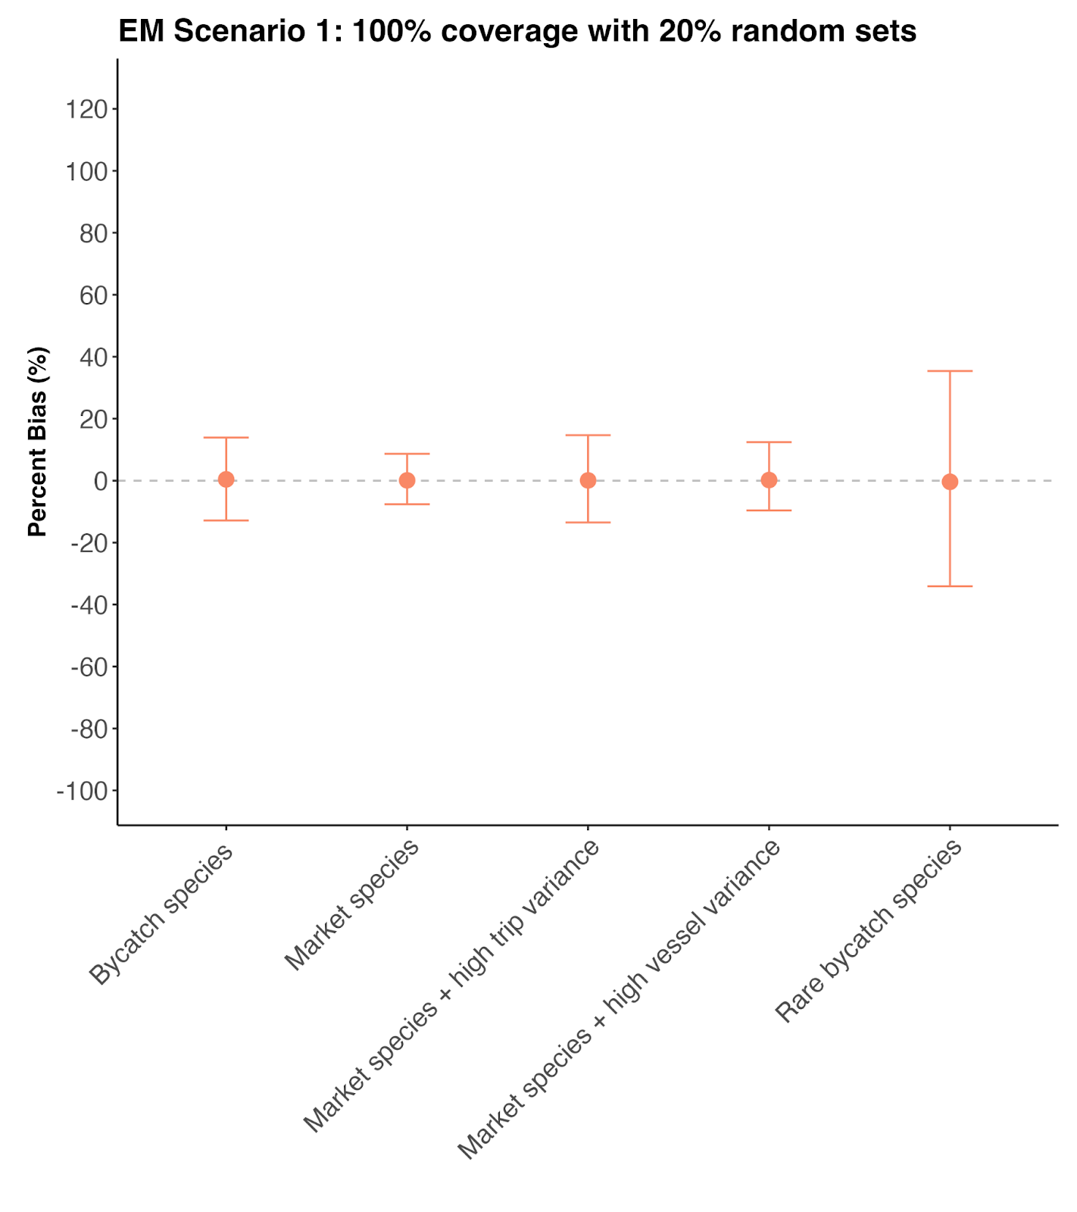

Slide 5
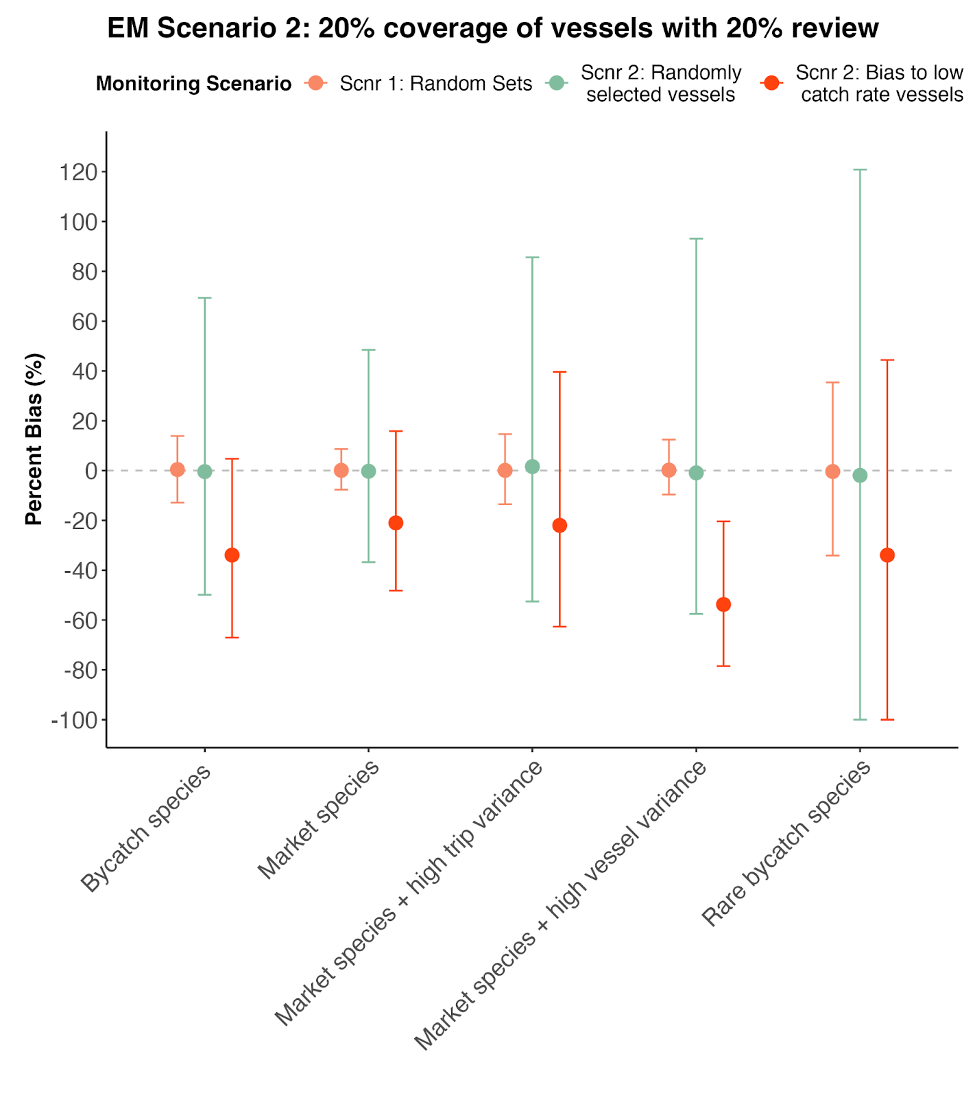

Slide 6
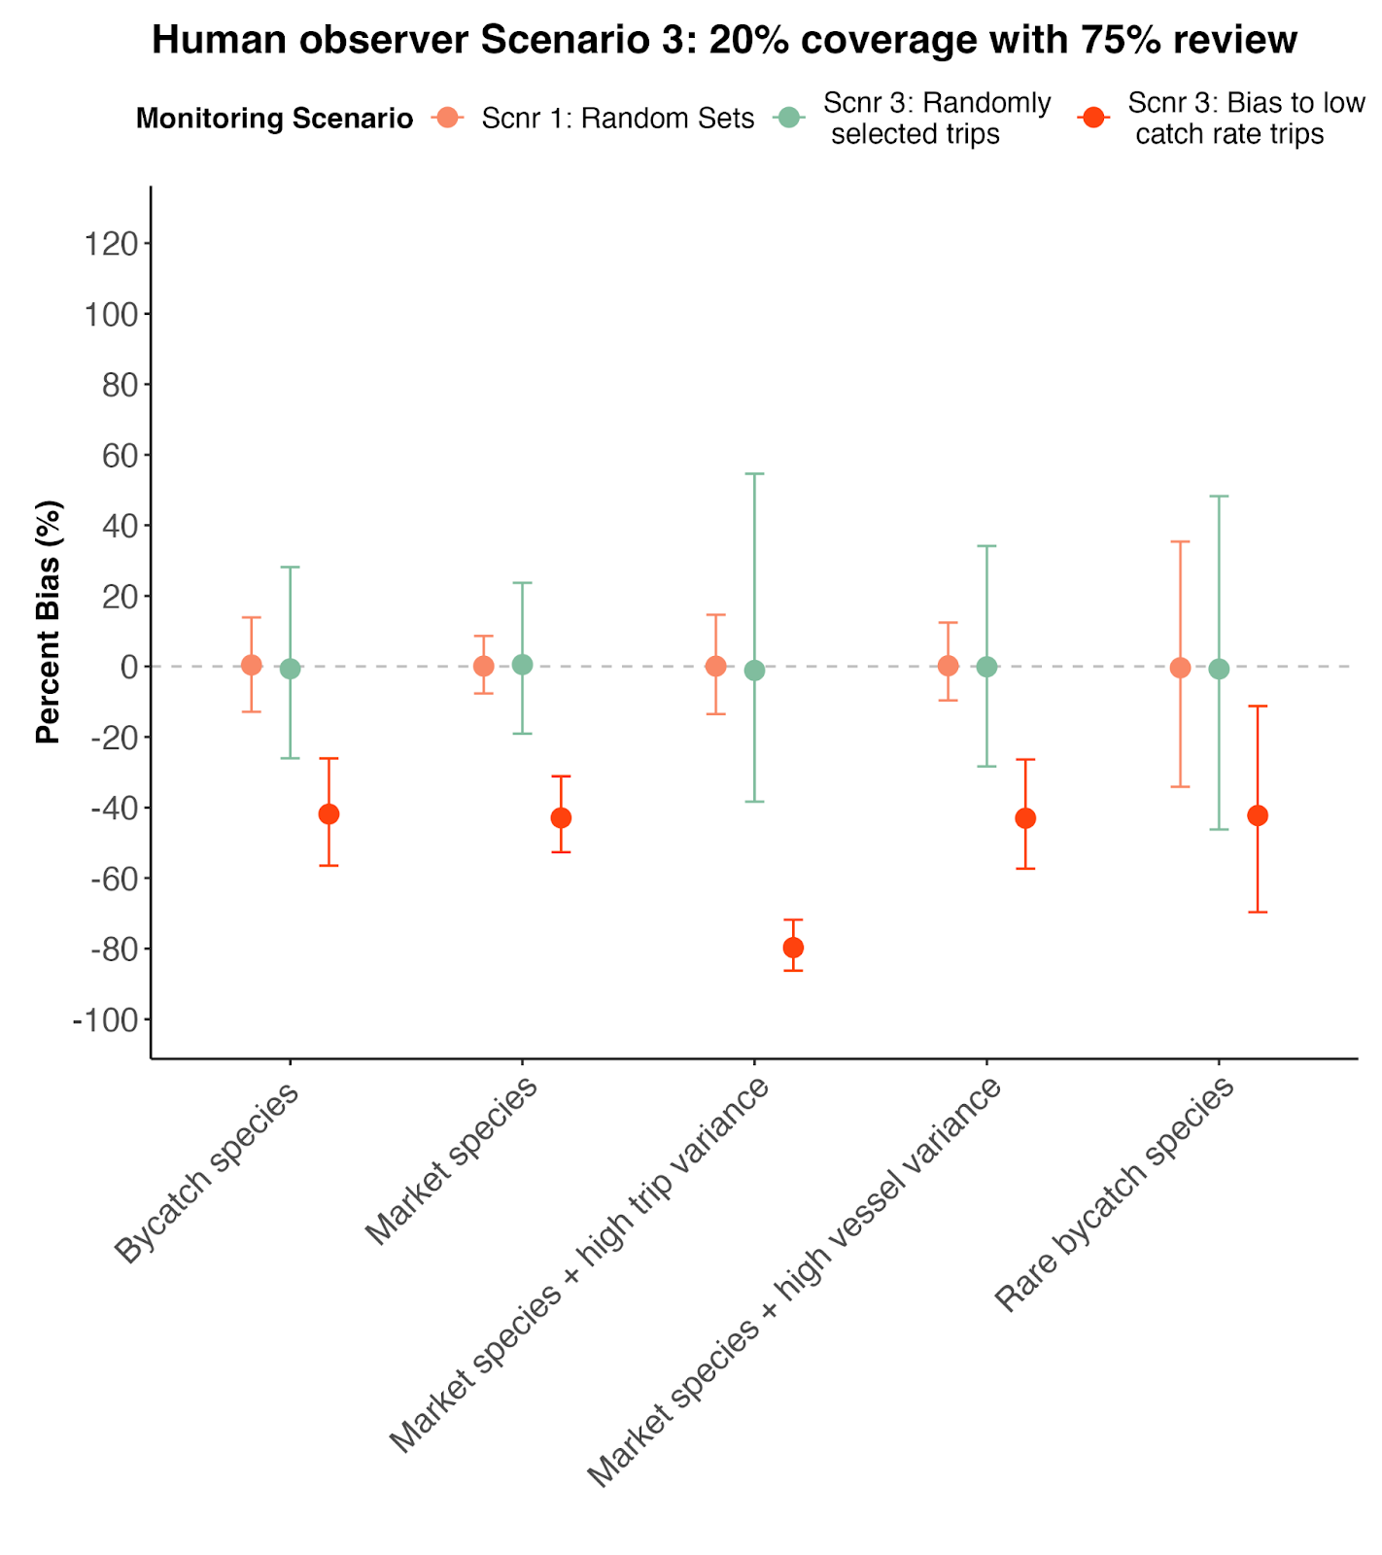

Slide 7
