Slide 1
AIR RIFLE SAFETY & RANGE PROCEDURES
JROTC Marksmanship Training, Section V
Notes:
JROTC Marksmanship Instructor Training Course
Section V: Air Rifle Safety and Range Procedures
This Section provides a detailed examination of all aspects of air rifle safety that JROTC cadets must learn prior to participation in JROTC air rifle marksmanship activities.
Resources:
A Junior Shooter’s Guide to Air Rifle Safety
Cadet Safety Exam
Cadet Safety Pledge
Session V, Revised 21Aug10, CMP

Slide 2
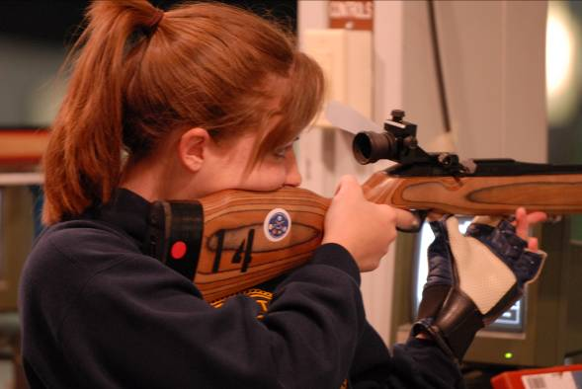
Air Rifle Safety & Range Procedures
Section Objective:
To learn about gun and range safety and the actions JROTC cadets must perform to safely participate in air rifle marksmanship
Notes:
5.1 Teaching Air Rifle Safety:
Section Objective: The objective of this Section is to teach the principles of gun safety and range procedures so that JROTC cadets who receive this training will achieve the safety performance outcomes that are required for marksmanship participation.

Slide 3
Air Rifle Safety Training
Safe Gun Handling Rules
Shooting Range Basics
Range Commands
Protecting Your Health
Everyone is a Safety Officer
Range Firing Procedures
Self-Discipline & Focus
Becoming “Marksmanship Qualified”
Notes:
5.2 Mastering Air Rifle Safety:
Topics covered in this session include:
Safe Gun Handling Rules. What are the basic rules of safe gun handling that everyone who handles air rifles or guns of any type must know and follow?
Shooting Range Basics. What must cadets know about air rifle range layouts and features?
Range Commands. What range commands must cadets know, understand and obey?
Range Firing Procedures. What are the range firing procedures that will govern the conduct of range firing activities?
Personal and Health Requirements. What health and safety precautions must cadets take during air rifle activities?
Everyone is a Safety Officer. When are cadets with safety training also responsible for acting to correct the unsafe gun handling actions of others?
Self-Discipline and Focus. What must cadets do to make sure every experience they have with rifle marksmanship is a safe experience?
Becoming Marksmanship Qualified. What steps must cadets take to become qualified to participate in JROTC air rifle marksmanship?

Slide 4
Safety Performance Objectives
Properly Trained Cadets Will:
Be aware of the gun muzzle and maintain proper muzzle control at all times
Check for and maintain an open action, with CBI properly inserted, on every gun they handle
Keep fingers off of the trigger at all times until actually aiming at a target
Respond properly to range commands and special range situations
Be aware of the gun handling of those around them to assist others in following safe gun handling rules
Notes:
5.3 Safety Performance Objectives:
When JROTC cadets are properly trained in air rifle safety and range procedures they will demonstrate a series of “performance objectives”:
Muzzle Control. Whenever they handle guns of any type, they will be constantly aware of where the gun muzzle is and maintain consistent control over the direction it is pointing.
Open Actions. Whenever they handle guns of any type, they will first control the gun muzzle and then visually check the gun’s action to be sure it is open; if it is not open, they will take action to open it.
Fingers Off Triggers. Whenever they handle guns of any type, they will always keep their fingers outside of the trigger guard except when they are actually shooting that gun.
Range Command Responses. They will recognize all regular range commands and know how to respond to them.
Gun Handling Actions of Others. They will also be aware of how other persons in their presence handle guns and be willing to take the responsibility to step in and correct an unsafe gun handling action.

Slide 5
Learning To Handle Guns Safely
The goal—eliminate all gun accidents!
Know primary gun parts that affect safety: M-A-T
Apply M-A-T performance standards
Practice handling air rifles--safety comes from practice, not knowledge
Safe gun handling rules apply to all guns and firearms
Notes:
5.4 Learning to Handle Guns Safely:
These are steps to be followed in developing the commitment, knowledge and skills to handle guns safely.
Goal. The goal of JROTC gun safety training is not just to reduce gun-related accidents, it is to eliminate them altogether. This goal is established with the conviction that it is possible to have a perfect safety record in shooting sports activities.
M-A-T. The primary gun parts, the muzzle (M), action (A) and trigger (T), are the keys to leaning the rules for safe gun handling. Everyone must know these gun parts, whether they ever do any target shooting or not.
M-A-T Performance Standards. The basic rules for safe gun handling that must be mastered focus on the muzzle, action and trigger.
Practice Safety. To be able to handle guns safely, a JROTC cadet must not only learn the rules and procedures for safe gun handling, but they must master those rules and procedures by actually handling air rifles during range firing activities. Safety is not mastered unless it is actually practiced.
Safe Gun Handling Rules are Universal. The rules JROTC cadets will learn about safe gun handling can be applied to other guns or firearms that cadets may encounter in their homes or in other situations.

Slide 6
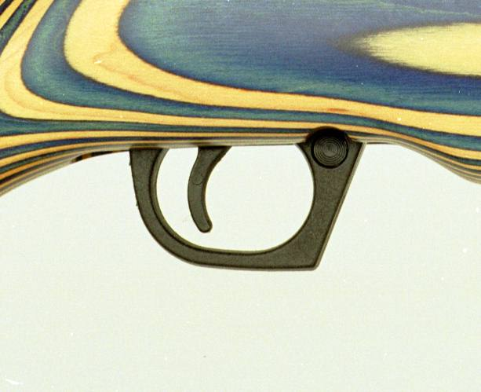
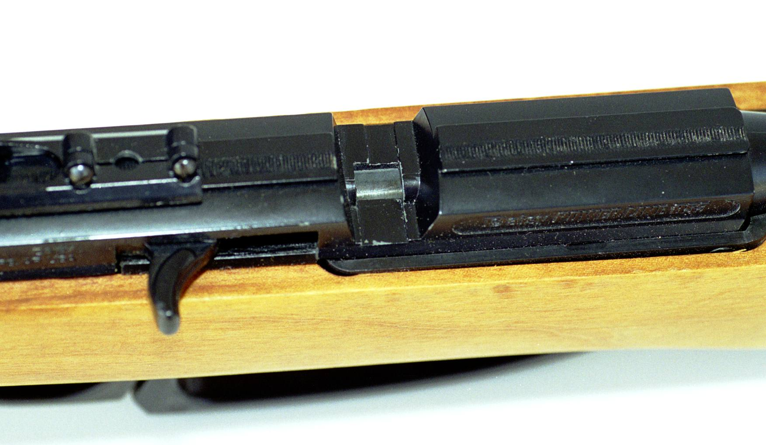
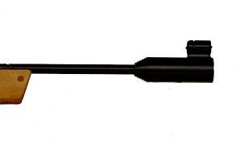
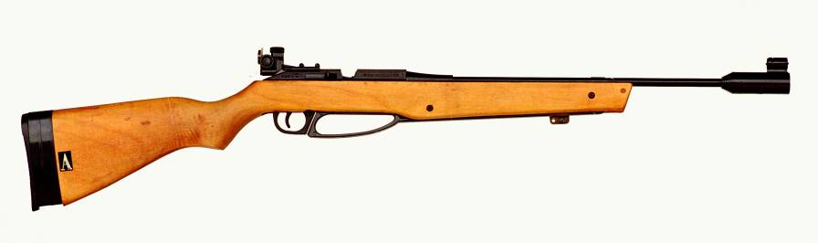
Primary Gun Parts that Affect Safety
3. Trigger
2. Action
1. Muzzle
Notes:
5.5 Primary Gun Parts and Their Functions:
The first step in being safe with air rifles or any other guns is to learn the three primary parts of the gun and their functions. These key gun parts are the basis for the Safe Gun Handling Rules that everyone who handles, fires or is in an area where guns are handled must know.
MUZZLE. The forward end of the barrel. This is the point where the pellet or projectile leaves the barrel when the gun is fired. A gun is aimed by pointing its muzzle at the target. When a projectile is fired it will strike exactly where the muzzle is pointed.
ACTION. The working mechanism of the gun. Gun actions typically have a bolt or cocking lever that is used to open and close the action so that the gun can be loaded and unloaded. Fundamentally, a gun cannot be fired unless its action is closed and locked.
TRIGGER. The trigger is part of the action or working mechanism of the gun. The trigger is a lever that projects out of the bottom of the action. A trigger guard protects the trigger. After a gun is loaded and the action is closed, the gun is fired by pulling or applying pressure to the trigger.

Slide 7
How Air Rifle Actions Function
Air rifle actions have a bolt or action that can be opened or closed. Opening the action exposes the breech (rear) end of the barrel for loading. Opening and closing the bolt/action cocks the firing mechanism to prepare the rifle for firing.
Daisy M853-bolt in open position, pulled to rear
Close bolt by pushing forward
Pressing the trigger to the rear releases the mechanism to fire the loaded rifle
Notes:
5.6 Know How Rifle Actions Function:
It is vitally important that anyone who shoots or handles an air rifle or any gun know at least the basics of how that gun functions.
On the Daisy M853 and other air rifles used in JROTC marksmanship, there is a bolt that can be opened to cock the firing mechanism and closed to prepare the mechanism for firing. Learn to operate this bolt.
Except for muzzle-loading firearms, all other guns also have an action or firing mechanism that can be opened or closed. For example, the smallbore rifles that are used in many junior rifle clubs have a bolt that can be opened to make the rifle safe and closed to prepare it for firing.
One of the most important features of all gun actions is that they are essentially unable to fire a shot as long as the bolt or action is open. In target shooting, the open action becomes the primary safety that is used to ensure that a rifle cannot be unintentionally fired.

Slide 8
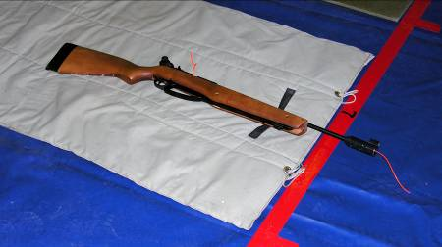
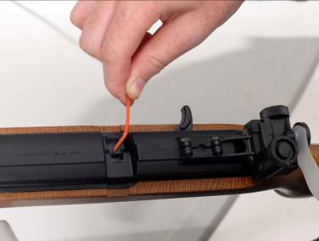
CBI—Clear Barrel Indicator
CBI (Clear Barrel Indicator) confirms that rifle is unloaded
CBI must be in rifle at all times except during preparation and firing
CBI removed on firing line when preparation for firing begins
When firing is complete, ground rifle, insert CBI
Keep CBIs clean and off the floor
Inserting CBI
Notes:
5.7 CBI—Clear Barrel Indicator:
The CBI is the basic means of assuring and demonstrating that air rifles are in an unloaded condition. An inserted CBI clearly and visibly demonstrates that the rifle action is open and there is no pellet in the barrel.
CBIs are made from orange or other bright-colored weed eater or heavy monofilament cord. They are cut long enough so that when inserted in an air rifle barrel, the cord projects out of both the breech and muzzle ends of the barrel.
CBIs must be inserted in air rifle barrels whenever they are taken from gun storage and to the range.
CBIs remain in air rifles until a firing exercise begins and the Range Officer gives instructions to begin preparing for firing. When preparation for firing begins, CBIs can be removed.
After you complete a firing exercise, immediately open the air rifle action, place the rifle on the ground, bench or mat and insert the CBI. You may also insert a CBI before grounding the rifle.
Take care to keep CBIs clean and off of the floor. Use a soft cloth to wipe off the CBI before inserting it in the air rifle. This will prevent the CBI from picking up grit and getting it in the barrel.

Slide 9
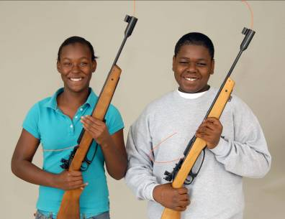
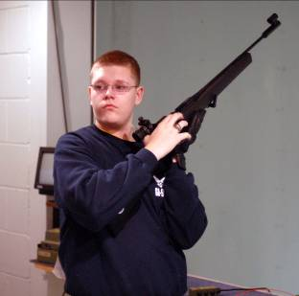
Rule 1--Muzzle Control
1st gun handling rule: control the direction the muzzle points
Point the gun in a safe direction—usually upward or downrange towards the targets
Never point a gun at another person
Carry guns with the muzzle above head level
Notes:
5.8 Safety Rule 1—Muzzle Control:
The first thing that anyone who handles a gun must do whenever they pick up or receive a gun is to control the direction the muzzle is pointing.
Gun muzzles must always be pointed in a safe direction. That means never pointing the gun at another person.
In most cases, pointing a gun in a safe direction means pointing the gun muzzle upward.
On a firing range, gun muzzles should be pointed upward or downrange towards the targets.
When carrying a gun, the safest way to carry the gun is to point the muzzle upward with the muzzle held above head level.

Slide 10
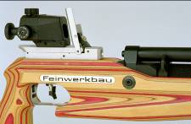
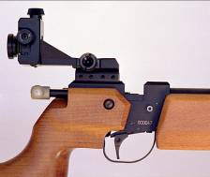
Rule 2—Action Open
2nd gun handling rule--keep gun action open, except when firing
Visually check the action to verify that it is open
Keep a CBI inserted to confirm that the action is open
A gun with an open action cannot be fired unintentionally
On target ranges, actions must remain open at all times, with CBIs inserted, except when the rifle is on the firing line and dry or live firing is authorized
OPEN AIR RIFLE ACTIONS
Notes:
5.9 Safety Rule 2—Actions Open:
The second thing everyone who handles a gun must do immediately after they get the muzzle pointed in a safe direction is to visually check the gun’s action and be sure it is open.
The safety standard is that gun actions must always be kept open except when the gun is on the firing line and dry firing or live firing has been authorized or when guns are in safe storage.
A CBI (Clear Barrel Indicator) is a brightly colored monofilament cord that is inserted in air rifle barrels to demonstrate that the action is open and there is no pellet in the barrel.
A gun with an open action cannot be fired. This means that keeping gun actions open whenever they are on a range or other location is a primary means of assuring that they cannot be unintentionally fired.

Slide 11
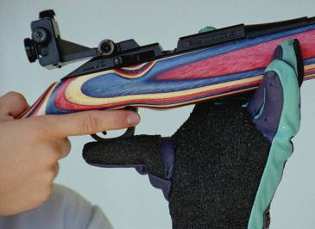
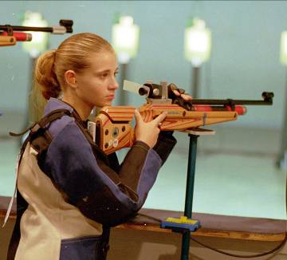
Rule 3—Finger Off Trigger
3rd gun handling rule--keep fingers outside of trigger guard except when aiming
The trigger guard protects the trigger from being unintentionally pulled
Place the index finger on the trigger only after starting to aim at the target
Notes:
5.10 Safety Rule 3—Finger Off Trigger:
One of the best means of preventing the unintentional firing of shots is to keep the index finger off of the trigger until the gun is actually being aimed at the target.
Whenever handling or carrying a gun of any type, it is important to keep all fingers outside of the trigger guard.
The trigger guard on air rifles and other guns protects the trigger from being accidentally released,
After an air rifle is loaded on the firing line, the index finger should be held outside of the trigger guard while the rifle is lifted and placed into the firing position. Only after beginning to look through the sights and aim should the finger be moved into the trigger guard to contact the trigger.

Slide 12
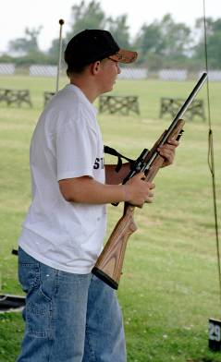
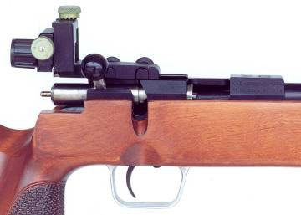
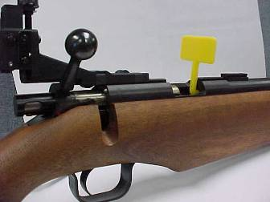
Safety Rules Apply to All Guns
Safe Gun Handling Rules Apply to all guns in all circumstances
Open Action
Muzzle Control
Open Action with Safety Flag
Notes:
5.11 Safety Rules Apply to All Guns:
JROTC cadets who learn the safe gun handling rules in this session should know that these rules can be applied to any other types of guns that they or other persons might handle.

Slide 13
Air Rifle Range Layout
Firing Line
Range Officer Area
Range Officer Station
Firing Distance = 10 meters
Firing Points
Ready Line
Targets & Backstops
Ready Area
Safety Barrier
Notes:
5.12 Air Rifle Range Layout:
To be safe on a range, JROTC cadets need to understand how the range is laid out and what the functions of the different parts of the range are:
Target Backstops. Target backstops or target holders corresponding to each firing point are placed at the front of the range. They hold the targets for firing and capture the fired pellets.
Firing Line. The firing line is a line that designates the forward limit of where shooters or firers can stand while shooting.
Firing Distance. The distance from the target backstops to the firing line must be 10 meters or 33 feet.
Firing Points. Sections of the firing line are designated for each shooter or firer to occupy while firing. The target backstops and firing points are numbered.
Safety Barrier. Ranges must have a safety barrier on the two side walls and front (behind the target backstops) of the range. The safety barrier must be capable of keeping someone from entering the range from the outside during firing.
Range Officer Station. The Range Officer works in the area immediately behind the firing points.
Ready Line. On some ranges Ready Line is established to limit the forward movement of persons waiting to fire or of spectators and visitors. The area behind the firing line is designated as the Ready Area.

Slide 14
Range Rules
Range Officer: In charge of range, RO must be an adult, adult RO must be present
Firing Point: One for each shooter
Target Holder/Backstop: One for each firing point
Firing Line: No part of the body may touch the firing line or the floor ahead of line
Ready Line: Persons waiting to fire & spectators must remain behind line
Notes:
5.13 Range Rules:
There are a few rules that govern the operation of a range.
Range Officer. Whenever range firing takes place, an adult Range Officer must be on the range and is in charge of the activity. The Range Officer controls the activity by giving commands and instructions.
Firing Point. Areas on the firing line are designated as firing points. One firing point is designated for each person who is firing.
Target Holder/Backstop. There are target holders and backstops that correspond to each firing point. The shooter’s targets are hung on the target holder.
Firing Line. During firing, no one can go forward of the firing line that is at the front of the firing points. When a shooter is in a firing position, no part of the shooter’s body that touches the floor may be ahead of the rear edge of the firing line.
Ready Line. If there is a ready line on a range, it is located behind the firing points and Range Officer station. The area behind the ready line is called the ready area. Persons who are not firing or assisting shooters on the line must remain behind the ready line in the ready area. Anyone who is watching the firing activities as a spectator must also remain behind the ready line while firing is taking place.

Slide 15
Range Safety Conditions
Line is “Hot”:
  No one is forward of firing line
  Line is ready for firing
Call to Firing Line:
  OK to move rifle and equipment to firing line
  Handling rifles may be permitted, CBIs remain in
Preparation Period:
  OK to remove CBIs, close bolts and dry-fire or do aiming exercises
  Charging gas or loading is not authorized
Unloaded Rifle:
  Action open
  No pellet in barrel
  CBI inserted
Grounded Rifle:
  On floor or bench
  Unloaded w/CBI inserted
Line is Clear:
  Rifles are unloaded, grounded and checked
  No one handles rifles
Notes:
5.14 Safety Conditions:
Here are some terms that shooters will hear as part of the instructions they receive on the firing line. Shooters need to know and understand these terms.
Line is Hot. When the Range Officer is ready to start a firing exercise and he determines that everyone on the range is in a safe and proper location, he will declare, “the line is hot.” No one can go or be forward of the firing line when the line is hot.
Preparation Period. After the Range Officer declares that the line is hot and informs shooters that they can handle their rifles, he will instruct them that they can begin their “preparation” or “preparation period” for the firing exercise that follows. When the Range Officer starts “preparation” this means that shooters can remove the CBIs from their rifles, get into their shooting positions, close their air rifle actions and dry fire if the air rifles may be dry-fired (Daisy M887 or M888 air rifles may not be dry fired. Shooters may do aiming or holding exercises with rifles that cannot be dry fired. No one may charge the rifle with gas or load a pellet in it during a preparation period.
Unloaded Rifle. When a firing activity is completed or when the command STOP is given, the rifle must be unloaded. For an air rifle, “unloaded” means that the action is open, there is no pellet in the barrel and the CBI is inserted. The CBI, of course, is proof that there is no pellet in the barrel.
Grounded Rifle. Rifles must normally be “grounded” when they are brought to the firing line and they must be grounded again after a firing exercise is completed. To ground a rifle, the action must be opened, it must be placed on the floor or shooting mat and a CBI must be inserted. Once a rifle is grounded, a shooter must request permission from the Range Officer before it can again be handled for any purpose.
Firing Line is Clear. When all rifles are grounded on the firing line before or after firing, the Range Officer must check them to be sure they are unloaded with CBIs inserted. The Range Officer can then declare that the “line is clear.” This means all rifles are grounded and no one is permitted to handle the rifles. The line must be clear before anyone can be instructed to go forward and hang, change or retrieve targets.

Slide 16
Basic Range Commands
LOAD
  OK to charge gas mechanism
  OK to insert pellet
  OK to close action
  Not OK to shoot
START
  OK to begin firing
  OK to continue firing
  When last shot is fired—open action, insert CBI, ground rifle
STOP
  Immediately stop attempting to fire shot (finger off trigger!)
  Firing no longer authorized
UNLOAD
  Open action and ground rifle
  Notify RO if rifle remains loaded
  RO must confirm unloaded condition--RO assistance is required to unload loaded rifles
Notes:
5.15 Basic Range Commands:
There are four basic range commands that are used by the Range Officer to start and stop all live firing activities. Cadets must know exactly what these commands mean and be prepared to respond instantly to them.
LOAD. After the Range Officer has given the shooters on the firing line an opportunity to prepare for firing, he will give the command LOAD. This means that it is now OK to charge the air rifle with gas, OK to insert a pellet in the breech and OK to close the rifle action.
START. Soon after the command LOAD is given, the command START is given. This command means that it is now OK to begin firing. It also means that it is OK to continue firing additional shots until the firing exercise is completed. It is not necessary to have a new command to LOAD and START for each shot. As soon as any firer completes firing all shots in a firing exercise, they must open the rifle action, insert a CBI and ground the rifle.
STOP. This command means that firing is no longer authorized. The command STOP is given when firing is completed or is no longer authorized. Sometimes it must be given in an emergency. Whenever the command STOP is given and you are still attempting to fire a shot, you must immediately stop trying to fire the shot by taking your finger off of the trigger. Then open the rifle action and follow additional instructions that the Range Officer may give.
UNLOAD. The command STOP is normally followed by the command UNLOAD. When all firers have finished, STOP-UNLOAD means that firing is finished and the Range Officer is going to check for all rifles to be grounded with CBIs inserted. If a shooter still has a loaded rifle when a STOP command is given, he/she must immediately raise their hand and tell the Range Officer they have a “loaded rifle.” The Range Officer will then instruct them as to how the rifle should be unloaded.

Slide 17
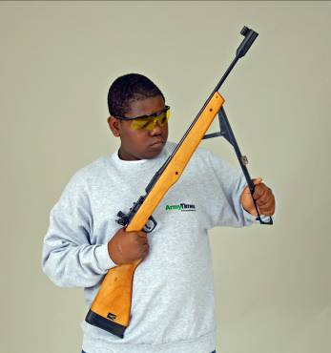
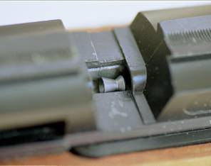
Safe Loading Procedure
Open Action
Charge Air
Insert Pellet (skirt to rear!)
Close Action
Place rifle in position and fire shot
Open action--repeat
Open action, charge air lever, then insert pellet
Insert pellet here, then close bolt
Notes:
5.16 Safe Loading Procedure:
The safe loading procedure described here is designed to assure the highest level of safety throughout the process of charging the air rifle’s gas system and loading a pellet in preparation for firing.
While loading the air rifle consider these things:
Always be aware of where the muzzle is pointing during the entire loading process. Be sure to keep it pointed downrange.
Always start with an open action and an unloaded air rifle. Never load a pellet first and then charge the rifle with air.
Even if the air rifle being used has a safety, the safety should not be used during the loading process. On a target range, the safety is the open bolt. As long as the bolt is open during the loading process, the rifle cannot be unintentionally fired.
Facilitate the loading process by placing the pellet container in a convenient location so that during loading it is not necessary to reach a long distance to pick up another pellet.
When loading the Daisy M853 or other Daisy air rifles, be sure to place the pellet in the loading port (shown in illustration) and not in the bolt slot (this will cause the rifle to malfunction).

Slide 18
Dry Firing
Dry Firing: Cocking and releasing trigger mechanism, without charging gas system, to simulate firing
Will not damage air rifles
Some air rifles cannot be dry fired (Daisy M887/888); aiming exercises can be done in lieu of dry firing
An especially effective way to practice
Where: Only on designated firing point
When: When authorized by RO (e.g. practice or preparation periods)
Do not charge air during dry firing--just open and close action to cock trigger mechanism
Notes:
5.17 Dry Firing:
Dry firing is an important part of the firer’s preparation and practice because it permits the shooter to rehearse the shot before actual shots are fired. Not all air rifles are capable of being dry fired, however. If an air rifle cannot be dry fired, it is still possible to rehearse shots by aiming while holding it in position and pressing the trigger to the rear to simulate firing (aiming or holding exercises).
Note especially that dry firing is not permitted anywhere on a range except when rifles are on the firing line and the Range Officer authorizes or instructs shooters to handle their rifles and begin preparation for firing. To dry fire air rifles follow these instructions:
Daisy M853/M753: Open the bolt and then close it WITHOUT loading a pellet or charging the cocking lever (pumping) the rifle. The trigger is now cocked and can be dry fired.
Daisy XS40 Valiant: Raise the bolt handle and pull it all the way to the rear until it clicks. WITHOUT loading a pellet or pushing the bolt forward, the trigger may now be manipulated without discharging air. The bolt will move forward when the trigger is released.
Daisy M888/Daisy M887: These rifles cannot be dry fired as they will discharge CO2 gas whenever the trigger is released.
All Other Air Rifles: Specific instructions for dry firing of precision air rifles are given in the owner manuals.
Competition Rules do not permit the discharge of air or CO2 gas during preparation periods or record firing in competitions.

Slide 19
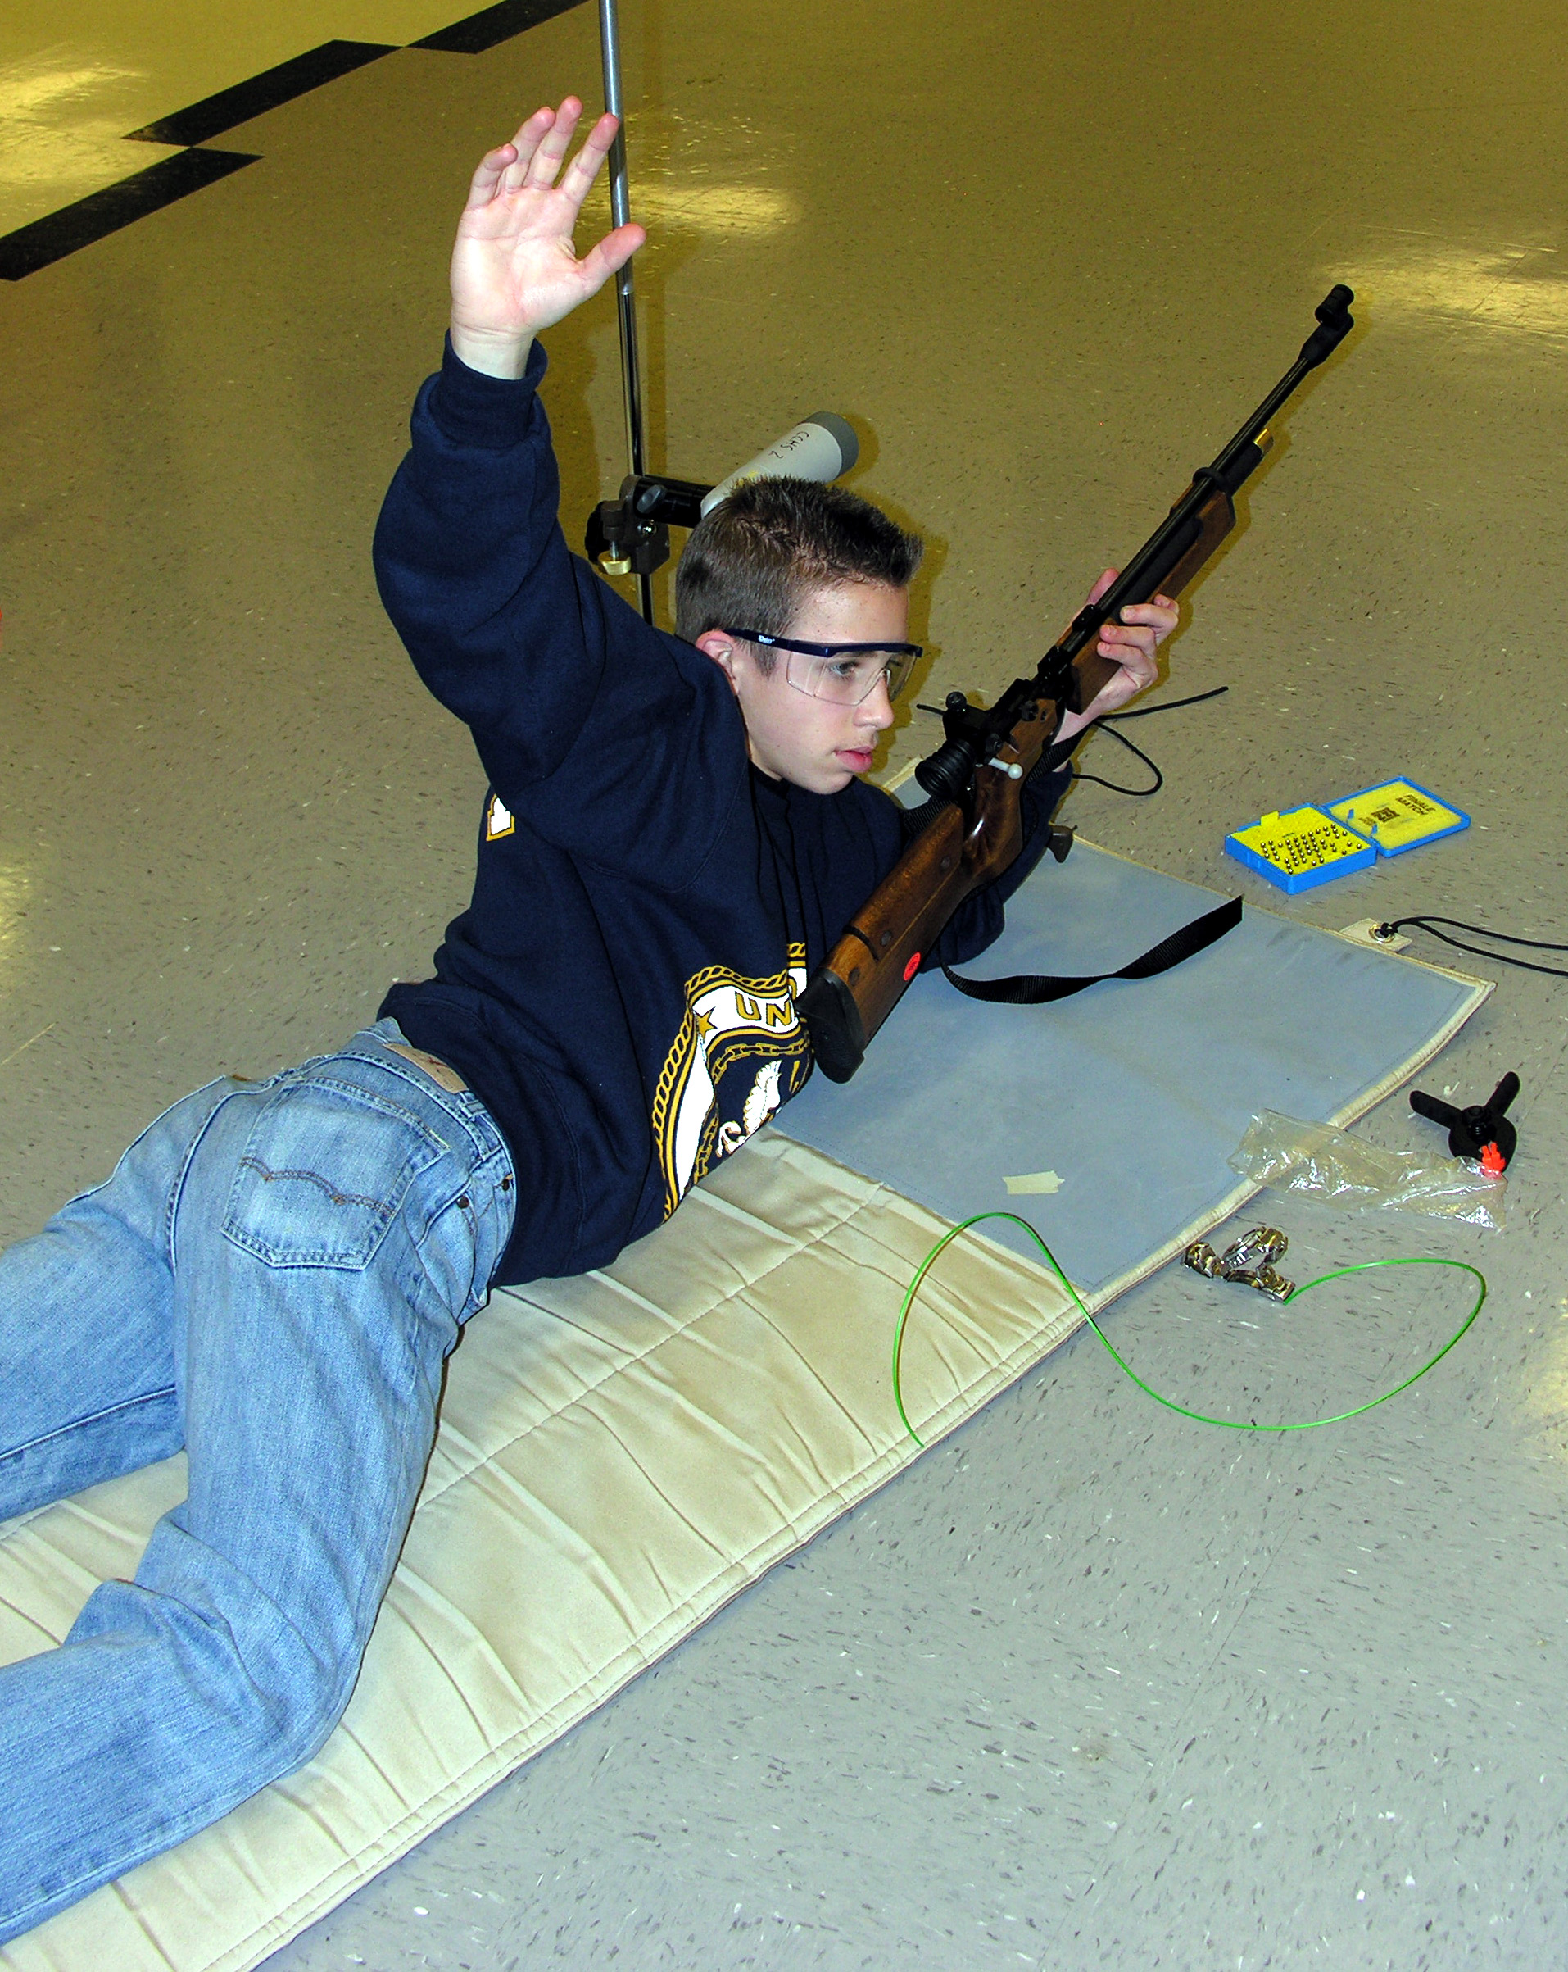
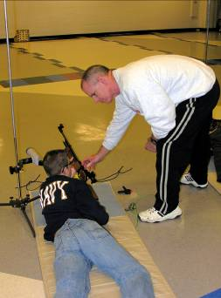
Range Safety Procedures
Malfunctions
  Stay in position
  Keep rifle pointed downrange
  Raise Hand
  Wait for RO to inspect rifle and give instructions
Notes:
5.18 Range Safety Procedures—Malfunctions:
A malfunction occurs when a gun fails to fire. If you are in a firing exercise and the air rifle you are using malfunctions, follow the steps described here.
Keep your rifle muzzle pointed downrange. Remain in position with the muzzle pointed downrange and do not attempt to come off the firing line with your rifle.
Raise your hand so the Range Officer can see it.
Wait for the Range Office to come to you. He/she will inspect the rifle and may ask questions about what happened. The Range Officer will give you instructions to try to fire the shot again or may take the rifle from you to clear it so it can be removed from the firing line.
Range procedures require that whenever a rifle malfunctions, it must be unloaded, that is, the pellet must be removed from the barrel, before the rifle can be taken from the line. The Range Officer may use a cleaning rod or dowel rod to remove the pellet from a malfunctioning rifle.

Slide 20
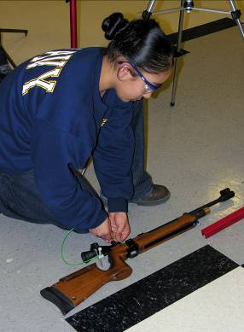
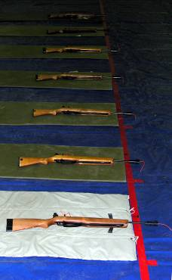
Range Safety Procedures
Firing Completed
  Immediately open action
  Get out of firing position
  Ground rifle
  Insert CBI
  Wait for instructions
Notes:
5.19 Range Safety Procedures—Firing Completed:
Normally the Range Officer will instruct you regarding how many shots you are to fire in a range activity. When you finish firing the prescribed number of shots, follow these procedures to make your rifle safe and show the Range Officer that you are finished.
Immediately open your air rifle action after you fire your last shot.
Then place your rifle down on the floor, shooting mat or bench.
After the rifle is placed down, insert the CBI in it. Use a cloth or rag to wipe off the CBI before placing it in the barrel. This will assure that no dirt or grit gets into the barrel from the CBI.
Follow instructions. The Range Officer will tell you whether you should step back from your firing point or remain on the firing point by your grounded rifle.
When all firers are finished and have grounded their rifles, the firing line should look something like the photo on the right where rifles are lying on the mat, with CBIs inserted and with muzzles lying ahead of the firing line.

Slide 21
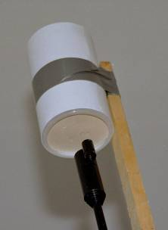
Range Safety Procedures
Loaded Rifle after STOP-UNLOAD
  Remain in position
  Keep rifle pointed downrange
  Raise Hand
  Wait for RO to give instructions to fire rifle in PDC (Pellet Discharge Container) or backstop
Discharging loaded rifle into PDC
Notes:
5.20 Range Safety Procedures—Loaded Rifle After STOP-UNLOAD:
Occasionally a situation will arise where a firer still has a loaded rifle after the command STOP-UNLOAD has been given. If this happens to you, follow these procedures.
Never attempt to fire a shot after the STOP command is given.
Remain in position and keep your muzzle pointed downrange.
Raise your hand so the Range Officer can see it. Announce “Loaded Rifle” so that the Range Officer can hear you.
Wait for the Range Officer to come to you. The Range Officer will give you instructions for firing the rifle to unload it. Normally, he/she will either tell you to fire the rifle into an open area in the backstop or instruct you to fire the rifle into a PDC (Pellet Discharge Container).
After you discharge the rifle, open the action, place the rifle on the floor, mat or bench and insert a CBI.

Slide 22
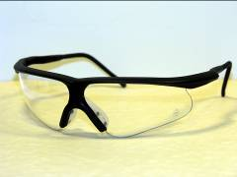
Personal Safety & Hygiene
Safety Glasses
  Wearing safety or eyeglasses during air rifle firing is recommended (required in NJROTC)
Personal Clothing
  Sweatshirt or work shirt
  Glove (for hand that holds or supports rifle)
Note: Hearing protection is not required for air rifle
Pellet Handling Hygiene
  Lead is toxic
  No food on range
  No open beverage containers
  WASH HANDS AFTER HANDLING PELLETS
Notes:
5.21 Personal Safety and Hygiene:
Pellet Handling. Lead is a toxic substance that must be handled with care, but so far no one has been able to make air rifle pellets from a non-lead substance that have sufficient accuracy for precision target shooting. Fortunately, several medical tests on air rifle shooters have proven that when shooters take the necessary precautions while firing air rifles, they do not face any health risks from this limited exposure to lead. These precautions include eating no food on the range, not having open beverage containers on the range and washing your hands immediately after every range activity. Hands should preferably be washed in cold water.
Safety Glasses. NJROTC cadets are required to wear safety glasses while firing air rifles. Some ranges also require this. The National Three-Position Air Rifle Council, AJROTC and MCJROTC make wearing safety glasses optional. The risk is extremely minimal, but since there is a remote possibility of having a pellet fragment bounce back, consideration should be given to using eye protection. If safety glasses are used, be sure to select quality glasses that do not distort the sight picture and target while aiming. Prescription glasses are adequate as eye protection; anyone who wears eyeglasses for distant vision should wear them while shooting.
Hearing Protection. Air rifles do not generate sufficient sound to cause hearing loss and using hearing protection is optional.
Personal Clothing. Cadets should have a tight-fitting sweatshirt or long-sleeved work shirt to wear while firing. A glove for the hand that supports the rifle should be used if the unit does not have regular shooting gloves.

Slide 23
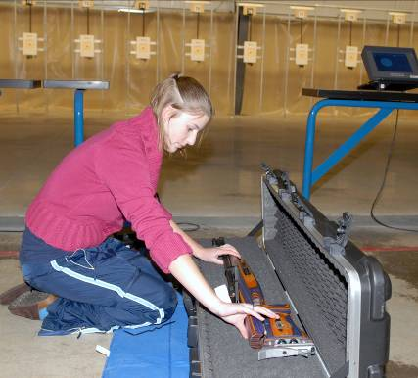
Gun Cases
Gun Cases:
Used to store and transport air rifles
Behind firing line—keep rifles in closed cases
Bring closed case to firing line with muzzle oriented downrange
After opening case—open action and insert CBI
Remove rifle from case, ground rifle, remove case from firing line
After firing—replace rifle in case on firing line—CBI may be removed, action closed and trigger released before closing case
Notes:
5.22 Gun Cases:
Gun cases are often used to store and transport air rifles to and from the range. If you use a gun case to bring your air rifle to the range follow these procedures.
Behind the Firing Line. When air rifles are brought to the range in cases, cases should remain closed when they are behind the firing line.
Bringing Cases to the Firing Line. When the Range Officer gives instructions to bring rifles and equipment to the firing line, bring the rifle to the line with the case closed. Place the case on the line with the muzzle pointed downrange.
Opening Gun Cases. When the gun case is opened to remove the rifle, immediately open the action and insert a CBI in it. You can then remove the rifle from the case and ground it on the firing point. The gun case should then be reclosed and removed from the firing point. If a gun case has two air rifles in it that are pointed in opposite directions, remove one rifle with the muzzle pointed downrange, then close and turn the case to remove the other air rifle.
After Firing. When firing is completed and the Range Officer gives instructions to remove rifles from the firing line, bring the case back to the line and replace the air rifle in it. At this point, it is OK to remove the CBI, close the action and release the trigger so that the hammer spring will not remain under tension while the air rifle is stored. Close the case and remove it from the firing line.

Slide 24
Special Conditions
Safeties
  Mechanical devices to facilitate carrying loaded guns
  On target ranges, the safety is the open action and CBI
  Most target air rifles do not have mechanical safeties
  The use of the mechanical safety is not required in air rifle target shooting
Safe Air Rifles for Target Ranges
  Use only 4.5mm/.177 cal. air rifles
  Use only air rifles with pellet velocities of 600 fps or less
Taking a Break
  Never lay a loaded rifle down
  Rifle must be cleared with a CBI inserted before laying it down
Some ranges may have special safety rules—they must be followed too
Notes:
5.23 Special Conditions:
JROTC cadets need to know about a few other situations that may impact on safety.
Safeties. Some air rifles have safeties, but many air rifles designed especially for target rifle shooting do not have safeties. A safety is a mechanical device that is expressly designed for carrying a gun in a loaded condition. There is not need to carry a loaded air rifle anywhere on a target range. On target ranges, the open bolt is the required safety and there is no need and some additional danger from attempting to use a mechanical safety during air rifle range firing.
Other Range Commands. Some Range Officers may still use the traditional range commands that include “commence firing” and “cease firing.” If you hear these commands, just remember that commence firing means START and cease firing means STOP.
Safe Air Rifles. Air rifle target ranges are not designed for high velocity air rifles and their use could be dangerous because of the possibility that a backstop or barrier wall could be penetrated. Only air rifles firing 4.5mm pellets at velocities of 600 fps or less may be used on air rifle ranges.
Targets. There is a designated target holder for each firing point. Shooters must fire only on the targets placed on the target holder for their designated firing point.

Slide 25
Achieving a Perfect Safety Record
Safety requires self-discipline and focus--you are the most important component of safety
Everyone is a Safety Officer
  Never tolerate unsafe gun handling by others
  Act immediately to correct unsafe situations
  Anyone can call STOP in a safety emergency
Remember the Goal—Eliminate All Gun Accidents!
Notes:
5.24 Achieving a Perfect Safety Record:
With a goal of achieving a perfect safety record of no gun-related accidents, there are a few additional considerations that must be kept in mind by instructors and cadets.
Self-Discipline and Focus. Achieving a perfect safety record is not possible unless everyone, Range Officers and shooters, continue to focus their attention on safe gun handling. It takes strong personal discipline to do this, but with discipline and focus, the safety of all shooting sports participants can be assured.
Everyone is a Safety Officer. This is an important concept for everyone who handles guns. It means that whenever you are present when someone else is doing something unsafe, you have a responsibility to act. If you see someone pointing a gun at another person or handling a gun with a closed action, you should step in to make that person aware of the unsafe act and how to correct it. In addition, when you are on a range and you see a safety emergency such as some one walking into the downrange area of a range, you can and must command STOP. Don’t wait for the Range Officer to see it or for someone else to command STOP.
The Goal—No Gun Accidents!

Slide 26
Becoming Marksmanship Qualified
Cadets must attend safety training class
Cadets must pass a standard safety exam
  Exam based on safety training class and Cadets Guide to Air Rifle Safety
Cadets must sign Cadet Safety Pledge
Enjoy your rifle marksmanship experience!
Notes:
5.25 Becoming Marksmanship Qualified:
This slide summarizes what JROTC cadets must do to complete the safety requirements that will make them “marksmanship qualified.”
Safety Training Class. Cadets must receive a safety training class from their JROTC instructor that uses this Session IV presentation or that is based on the Cadets Guide to Air Rifle Safety and the Army JROTC Unit 7 Curriculum, Lesson 2.
Safety Exam. Cadets must complete and achieve a grade of 100% on a standardized safety exam.
Cadets Safety Pledge. Cadets must review and sign the Cadets Safety Pledge.

