Slide 1
QoRNet: Timing Prediction for VLSI Circuits
Cory Brynds, DeAndre Hendrix, Youssef Samwel, and Pablo Rodriguez
Electrical and Computer Engineering Department
Track II, Sub-Track I

Slide 2
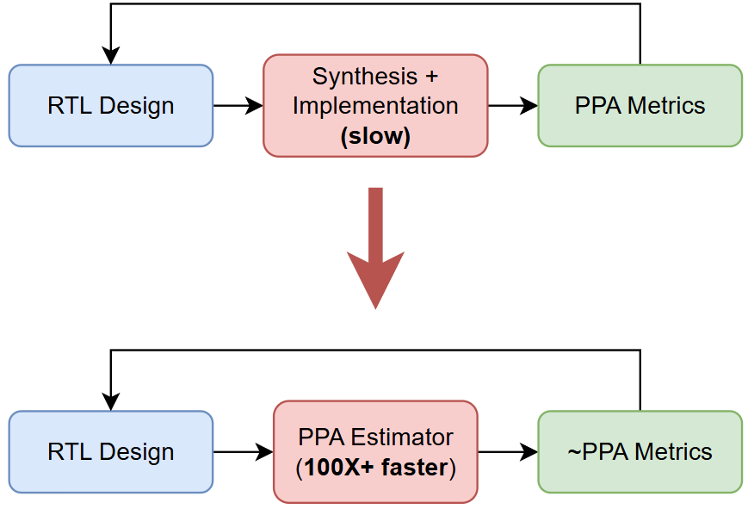
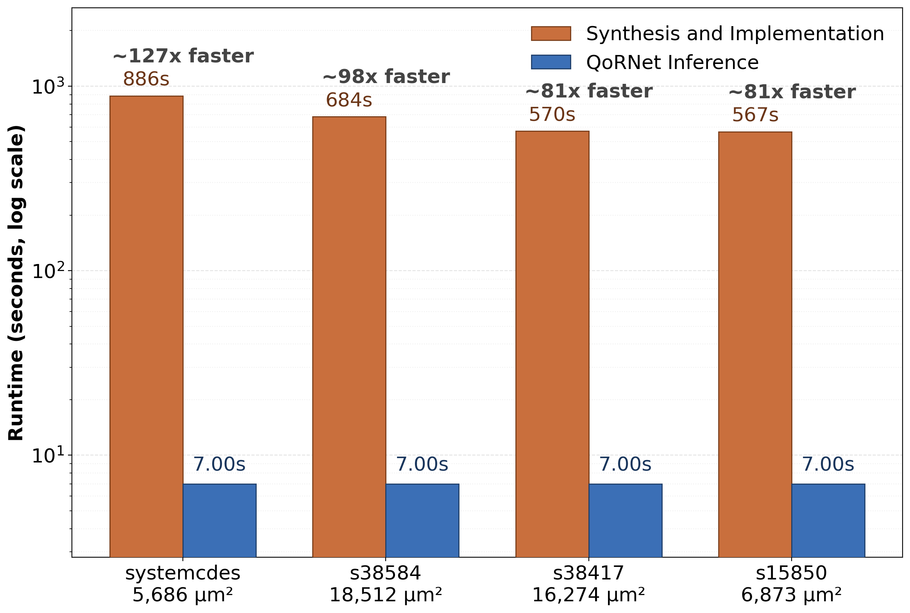
Motivation
Runtime comparison of fast synthesis + implementation flow and deep learning-based QoR prediction.
Context
RTL designers must balance a complex tradeoff between power, performance, and area when designing hardware
Time-consuming synthesis + placement-and-routing iterations needed for exact QoR (slow development iterations)
Problem: Can we utilize deep learning to optimize the RTL design iteration flow by quickly and accurately predicting post-synthesis timing metrics (WNS and TNS) from pre-synthesis RTL?
Worst Negative Slack (WNS) – timing violation of longest path through design
Total Negative Slack (TNS) – total sum of all paths with negative slack
Notes:
Cory
Presented by Deandre
1 slide (2 points)
❑ Problem Motivation:
❑ What is the problem?
❑ Why does it matter?
❑ Where is its applications and implications?
❑ Guidelines:
❑ Explain in simple language avoiding too many jargons
❑ Must use one motivating figure that is most representative of the problem motivation

Slide 3
Related Work
Chowdhury, Tan, Karri, and Garg, “OpenABC-D: A Large-Scale Dataset For Machine Learning Guided Integrated Circuit Synthesis”, arXiv, 2021.
Dataset/benchmark for ML-guided logic synthesis with 870,000 AIGs from 1,500 synthesis runs
Basic GNN model for post-synthesis QoR prediction (# of levels of logic, node count)
Synthetically generate data from a smaller set of designs using different synthesis recipes
C. Xu, C. Kjellqvist, L. Wills, “SNS's not a synthesizer: a deep-learning-based synthesis predictor,” ISCA, 2022.
RTL-level synthesis predictor for predicting area, power, and timing from RTL-derived path samples
Targets post-synthesis QoR prediction as a fast method of design space exploration
Samples complete paths and synthetically generates data using a SeqGAN
Notes:
Pablo
1-2 slides, (4 points)
❑ Related work overview:
❑ At least 3 related works
❑ A short description of what each method does that conveys the key idea of
the work
❑ Guidelines:
❑ Focus on the key details: it could be an equation or a representative figure along with brief textual detail
❑ Cite each work in the following format
❑ Authors, ``tiltle of the paper”, Journal/Conference name, Year
❑ Must present one comparison table with suggested columns:
❑ Paper/Method
❑ Main Idea
❑ Strength
❑ Limitation

Slide 4
Related Work
P. Sengupta, A. Tyagi, Y. Chen and J. Hu, "How Good Is Your Verilog RTL Code? A Quick Answer from Machine Learning," ICCAD, 2022.
Survey of different deep-learning methods for post-implementation timing (TNS and WNS) and power estimation from RTL code
Synthetic data creation using synthesis and implementation recipes
Paper | Input | Prediction | Synthetic Data | Strength | Limitation
OpenABC-D | And-Inverter Graph (AIG) | Levels of logic, number of AIG nodes | Via sweeping synthesis recipes | Large amount of training data, open-source dataset | Synthesis-centric, not usable by an RTL designer
SNS | RTL Code | Post-synthesis timing, power, area | Via SeqGAN model | Fast QoR estimation for DSE, path-based method scalable to larger designs | No post-implementation prediction, path-based model can miss global structure
“How Good…” | RTL Code | Post-implementation timing, power | Via sweeping synthesis + implementation recipes | Physical-aware, compares different methods | Dataset diversity (~50 unique designs), vague implementation details
Notes:
Pablo
1-2 slides, (4 points)
❑ Related work overview:
❑ At least 3 related works
❑ A short description of what each method does that conveys the key idea of
the work
❑ Guidelines:
❑ Focus on the key details: it could be an equation or a representative figure along with brief textual detail
❑ Cite each work in the following format
❑ Authors, ``tiltle of the paper”, Journal/Conference name, Year
❑ Must present one comparison table with suggested columns:
❑ Paper/Method
❑ Main Idea
❑ Strength
❑ Limitation

Slide 5
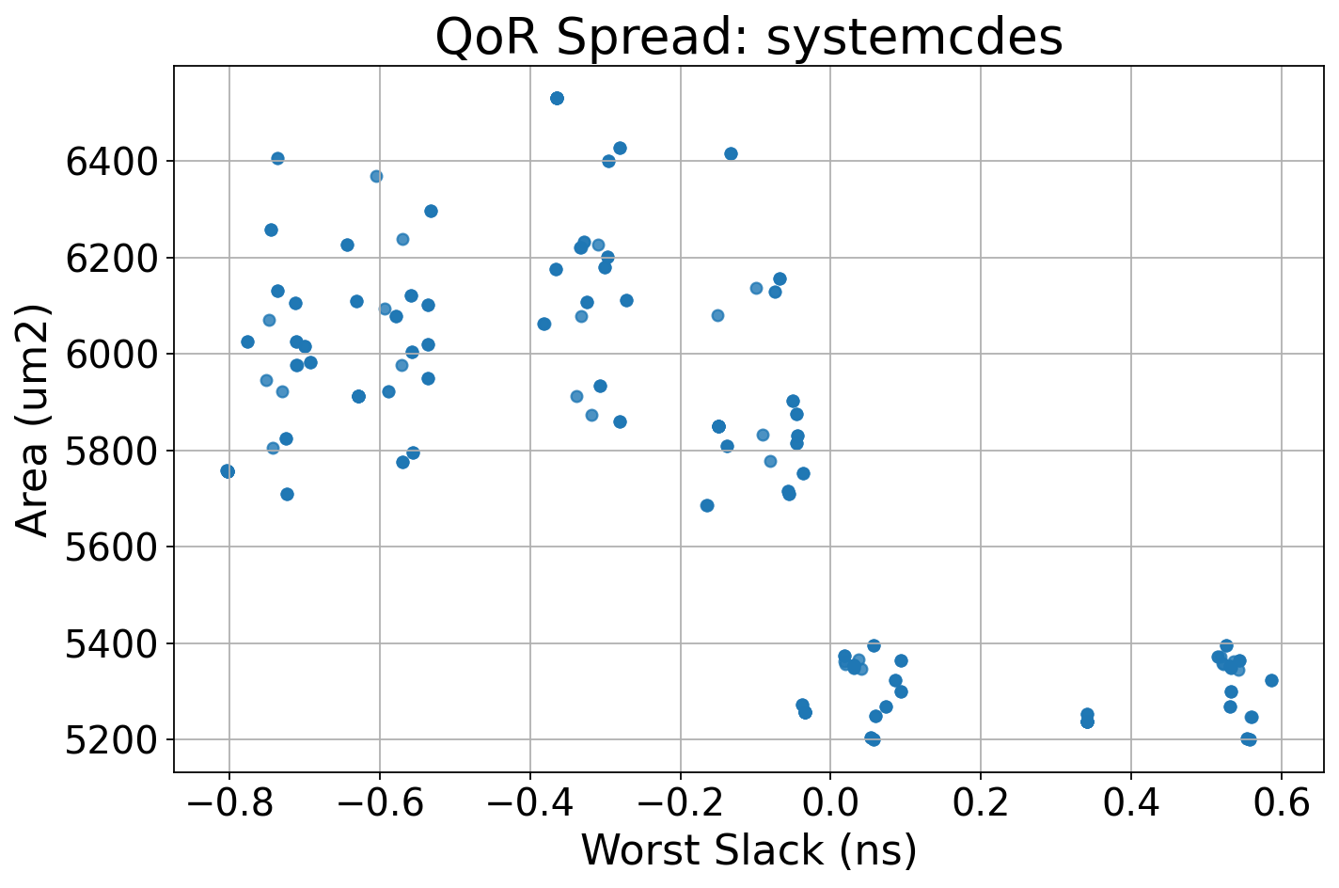
Technical Gap in Prior Work
Early Prediction
Problem: Early-stage predictions (OpenABC-D, SNS) are inaccurate to physical timing effects
Structural Compression
Problem: Path-based models (SNS) can capture local timing paths but miss global node interactions
Small, Generic Datasets
Problem: All papers rely on methods of synthetically generating training data (EDA recipes, GANs) due to limited availability
Solution: In addition to recipes (“How Good…”), use component generators to produce many unique RTL designs
Leads to under-modeling of WNS/TNS paths
Solution: train on post-placement-and-routing timing information
Solution: attention-based full-graph regression
No cell placement or routing information, ±60% accuracy [8]
Figure: Post-implementation area-delay spread of the same post-synthesis design under different post-synthesis recipes
Notes:
Cory and DeAndre
1 slide, 2 points
❑ What is the technical gap you found out based on the limitations of the existing method?
❑ What motivates your idea?
❑ This slide should make the need of your project/proposed work more obvious, clearly convincing you are not trying something ``random”
❑ Guidelines:
❑ When you state the technical gap, it should not be merely based on statements like “poor performance for classification”
❑ Show table/figure/illustration, anything that provides concrete proof
❑ Must use at least one figure that is most representative of the technical gap/your method’s motivation in this figure
Predicting QoR for the same design across different synthesis recipes

Slide 6
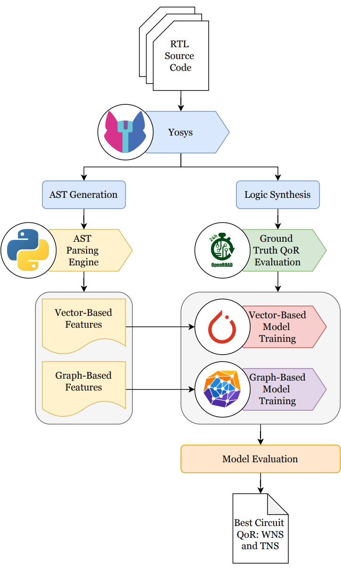
QoRNet Overview
RTL Feature Extraction
Yosys generates an Abstract Syntax Tree (AST)
Data Generation
Yosys for logic synthesis
Model Training
Vector-based models: linear regression and MLP
Custom parsing engine produces vector and graph-based features
OpenROAD for physical synthesis
Graph-based model: graph attention network (GAT)
Notes:
Everyone
1 slide, 3 points
❑ Overview diagram of your proposed method’s pipeline
❑ Input -> Model components -> Output
❑ Highlight main components and add one or two lines to describe them
❑ Guidelines:
❑ Must use the block diagram figure that captures the overall pipeline of your deep learning architecture
❑ Focus on the main idea of the proposed solution, not every implementation detail here
❑ This should answer what your approach is and what is innovative about it.

Slide 7
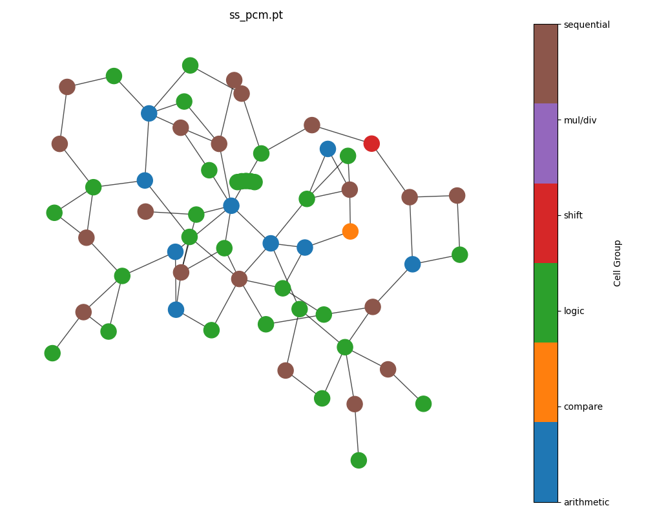
Abstract Syntax Tree Parsing
Two types of feature extraction methods given an AST:
Vector-based: global statistics (e.g., total I/O bits, logic, registers); simple but loses structure
Graph-based: nodes = cells with attributes (e.g. type, input/output bit widths, neighbor count); edges = signal connections capturing data/control flow and cell dependencies
Property | Value
total_input_bits | 70
total_adder_sub_bits | 435
total_logic_operator_bits | 2615
total_multiplexer_bits | 2220
total_multiplication_bits | 24
avg_wire_width | 6.0
avg_tree_depth | 4.45
Notes:
Youssef

Slide 8
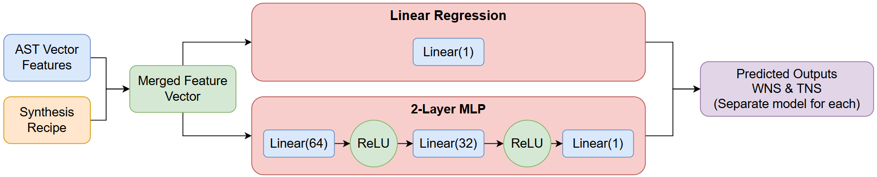

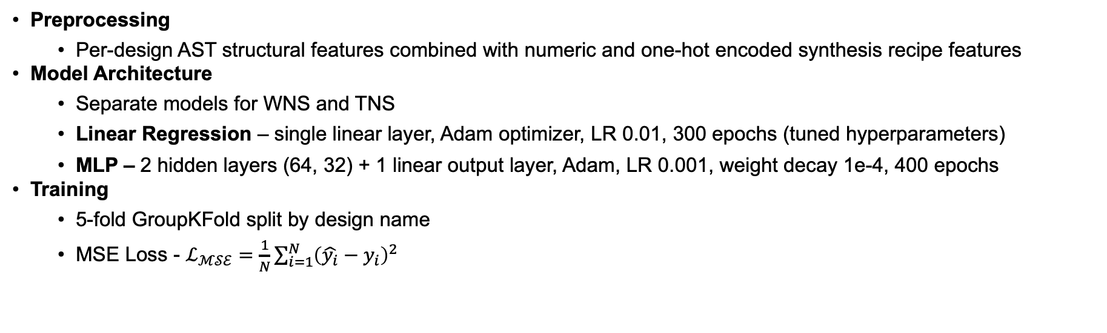
Baseline Models: Linear Regression & 2-Layer MLP
$$\hat{y}=Wx+b$$
$$\hat{y}=W_{3}\text{ReLU}\left(W_{2}\text{ReLU}\left(W_{1}x+b_{1}\right)+b_{2}\right)+b_{3})$$
Preprocessing
Per-design AST structural features combined with numeric and one-hot encoded synthesis recipe features
Model Architecture
Separate models for WNS and TNS
Linear Regression – single linear layer, Adam optimizer, LR 0.01, 300 epochs (tuned hyperparameters)
MLP – 2 hidden layers (64, 32) + 1 linear output layer, Adam, LR 0.001, weight decay 1e-4, 400 epochs
Training
5-fold GroupKFold split by design name
MSE Loss - $ℒ_{ℳ𝒮ℰ}=\frac{1}{N}\sum_{i=1}^{N}{{\left(\hat{y_{i}}−y_{i}\right)}^{2}}$
Notes:
DeAndre
1 slide, 3 points
I added 1 slide for AST parsing, 1 slide for linear models, and 1 slide for GNN model (we are allowed 2-3 extra slides)
❑ More technical details about the proposed approach
❑ How did you train your model
❑ Write explicitly the training loss optimization equation here
❑ Clearly introduce relevant mathematical notations, define them and use them correctly
❑ Convey why your method is different or innovative compared to the existing works you studied in slides 2-3
❑ Guidelines:
❑ Training approach must be made explicitly clear with the training loss optimization problem
❑ This should clearly show and highlight you are not just re-running an existing paper/just simply changing some hyperparameters in the architecture (e.g., using 3 layers instead 2 layers etc)

Slide 9
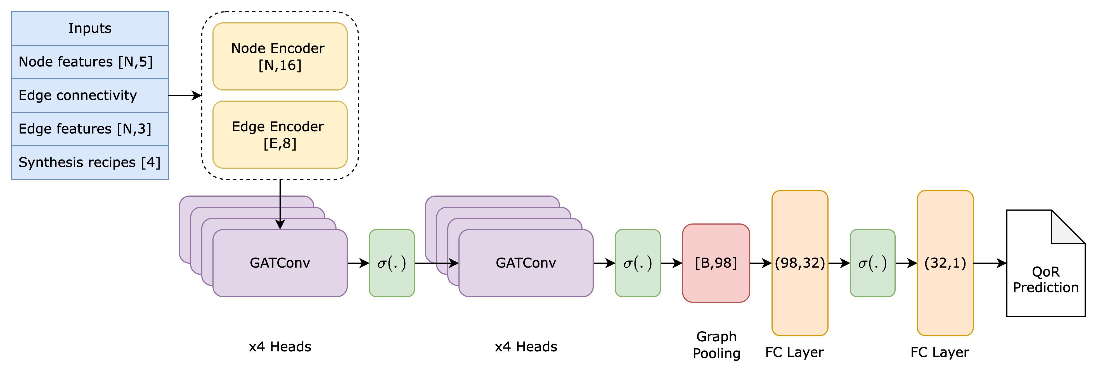
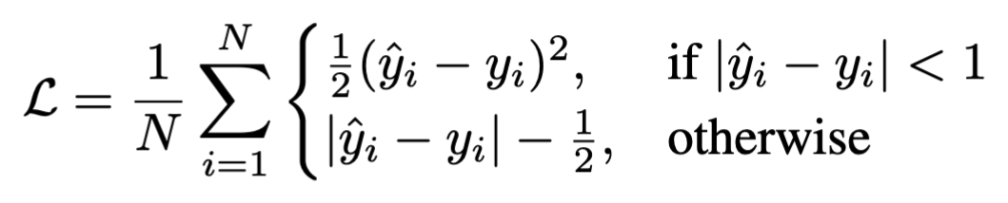
Graph Prediction Model
Parameter | Value
Batch size | 32
Epochs | 200 (early stopping)
Learning Rate | 1e-4
Activation | ReLU
Dropout | 0.1
Loss Function | SmoothL1Loss
QoRNet’s GNN model is based on the Graph Attention Network (GAT) from [4]
Message passing network that adds attention weights between a node and its neighbors
GAT is configured to perform graph-level regression
A pooling layer aggregates the embeddings of each node into one global embedding
Two FC layers use the global embedding to predict the regression target (WNS/TNS)
Notes:
Cory
Presented by Cory
1 slide, 3 points
I added 1 slide for AST parsing, 1 slide for linear models, and 1 slide for GNN model (we are allowed 2-3 extra slides)
❑ More technical details about the proposed approach
❑ How did you train your model
❑ Write explicitly the training loss optimization equation here
❑ Clearly introduce relevant mathematical notations, define them and use them correctly
❑ Convey why your method is different or innovative compared to the existing works you studied in slides 2-3
❑ Guidelines:
❑ Training approach must be made explicitly clear with the training loss optimization problem
❑ This should clearly show and highlight you are not just re-running an existing paper/just simply changing some hyperparameters in the architecture (e.g., using 3 layers instead 2 layers etc)
Model ablation studies: switching from MSEloss to SmoothL1Loss improved prediction accuracy by 4x (less sensititve toou
Each node has 3 numeric features and 2 categorical features,
Categorical features are converted to an embedding vector (learned dense representation of each category), and then the synthesis recipe is broadcast to each node
Dropout used between GAT layers to reduce overfitting, which was observed to be common during training without
Combination of mean pooling and max pooling is used at the GAT output – capture the typical node behavior and the dominant node feature

Slide 10
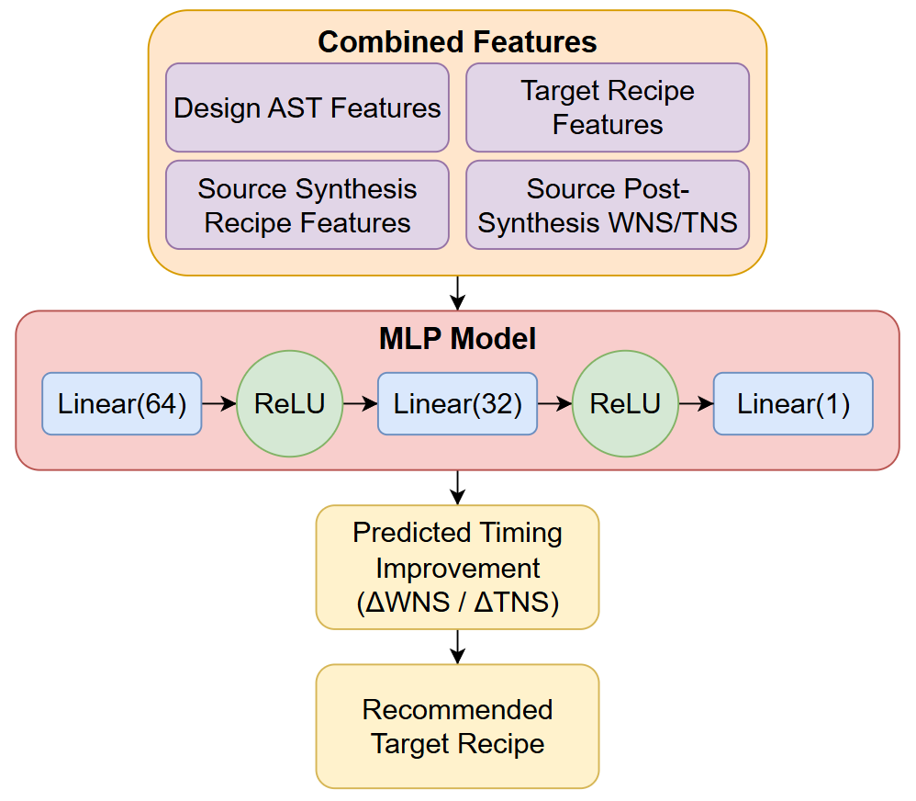
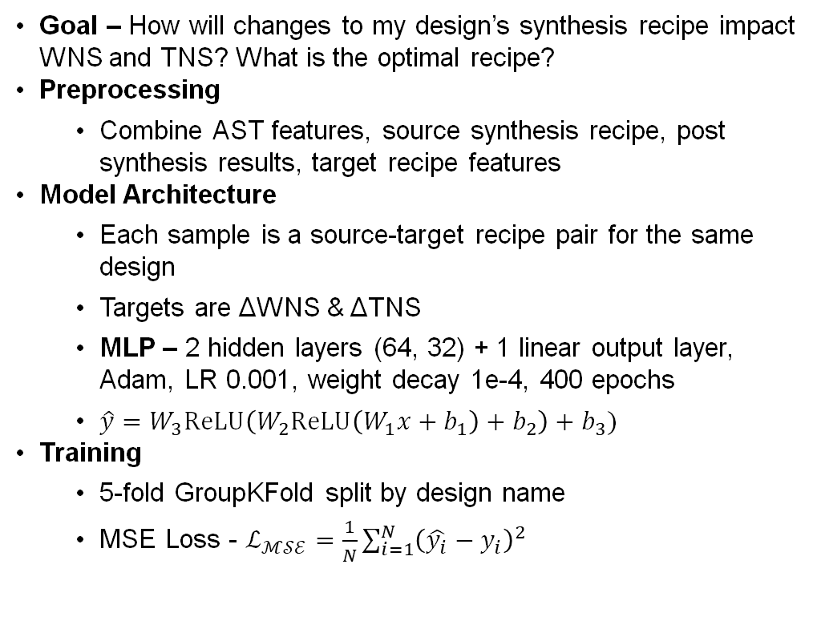
Recipe Improvement Ranker: Recommending Better OpenROAD Recipes
Goal – How will changes to my design’s synthesis recipe impact WNS and TNS? What is the optimal recipe?
Preprocessing
Combine AST features, source synthesis recipe, post synthesis results, target recipe features
Model Architecture
Each sample is a source-target recipe pair for the same design
Targets are ΔWNS & ΔTNS
MLP – 2 hidden layers (64, 32) + 1 linear output layer, Adam, LR 0.001, weight decay 1e-4, 400 epochs
$\hat{y}=W_{3}\text{ReLU}\left(W_{2}\text{ReLU}\left(W_{1}x+b_{1}\right)+b_{2}\right)+b_{3})$
Training
5-fold GroupKFold split by design name
MSE Loss - $ℒ_{ℳ𝒮ℰ}=\frac{1}{N}\sum_{i=1}^{N}{{\left(\hat{y_{i}}−y_{i}\right)}^{2}}$
Notes:
DeAndre
1 slide, 3 points
I added 1 slide for AST parsing, 1 slide for linear models, and 1 slide for GNN model (we are allowed 2-3 extra slides)
❑ More technical details about the proposed approach
❑ How did you train your model
❑ Write explicitly the training loss optimization equation here
❑ Clearly introduce relevant mathematical notations, define them and use them correctly
❑ Convey why your method is different or innovative compared to the existing works you studied in slides 2-3
❑ Guidelines:
❑ Training approach must be made explicitly clear with the training loss optimization problem
❑ This should clearly show and highlight you are not just re-running an existing paper/just simply changing some hyperparameters in the architecture (e.g., using 3 layers instead 2 layers etc)

Slide 11
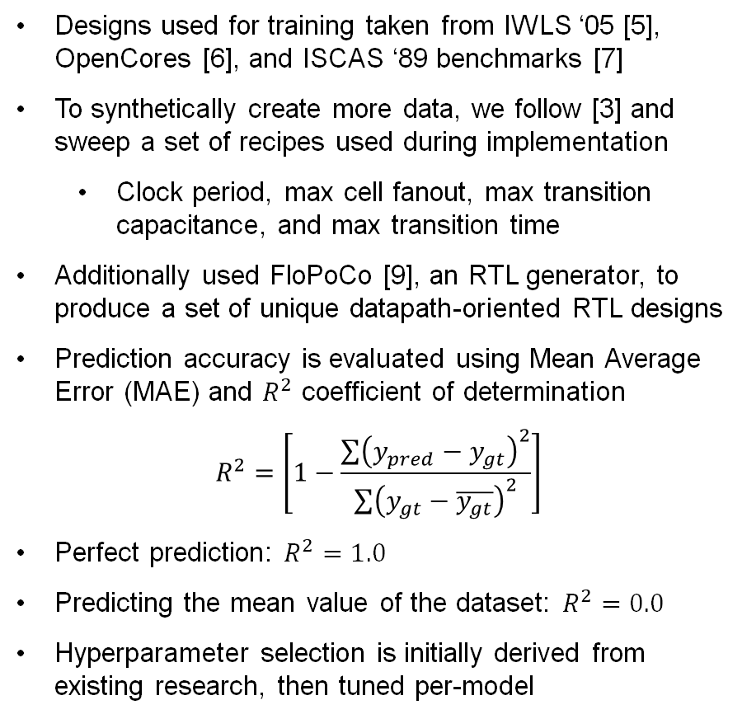
Experimental Setup
Designs used for training taken from IWLS ‘05 [5], OpenCores [6], and ISCAS ‘89 benchmarks [7]
To synthetically create more data, we follow [3] and sweep a set of recipes used during implementation
Clock period, max cell fanout, max transition capacitance, and max transition time
Additionally used FloPoCo [9], an RTL generator, to produce a set of unique datapath-oriented RTL designs
Prediction accuracy is evaluated using Mean Average Error (MAE) and $R^{2}$ coefficient of determination
$$R^{2}=\left[1−\frac{\sum{{\left(y_{pred}−y_{gt}\right)}^{2}}}{\sum{{\left(y_{gt}−\overline{y_{gt}}\right)}^{2}}}\right]$$
Perfect prediction: $R^{2}=1.0$
Predicting the mean value of the dataset: $R^{2}=0.0$
Hyperparameter selection is initially derived from existing research, then tuned per-model
Dataset Summary | Circuit Benchmarks | FloPoCo
Total # of Designs | 35 | 500
Recipes per design | 280 | 1
Training/test split (80%) | 28 / 7 | 400 / 100
Average # of nodes | 3060 | 1650
Average # of edges | 4336 | 4486
Configuration | Dataset Generation | GNN Training | Linear Regression Training | MLP Training
Workload Type | CPU-Based | GPU-Based | GPU-Based | GPU-Based
Hardware | Intel Xeon (Stokes) | T4 GPU (Colab) | T100 GPU (Colab) | T100 GPU (Colab)
Runtime | ~24hr (final dataset) | ~30min | ~10min | ~20min
Notes:
Presented by Cory
1 slide, 2 points
❑ Experimental Setup
❑ Clearly state dataset (cite the source)
❑ Train/test split or evaluation protocol
❑ Baselines used for experimental study
❑ Metrics used for evaluation (AUROC, Acc, F1, mAP etc)
❑ Hardware used (GPU version/CPU etc)
❑ Any preprocessing used
❑ How did you choose hyperparameters
❑ Guidelines:
❑ Convey these using well-structured tables or concise bullet points
Added benefit of synth recipes: GNN learns the impact of physical optimization on timing paths

Slide 12
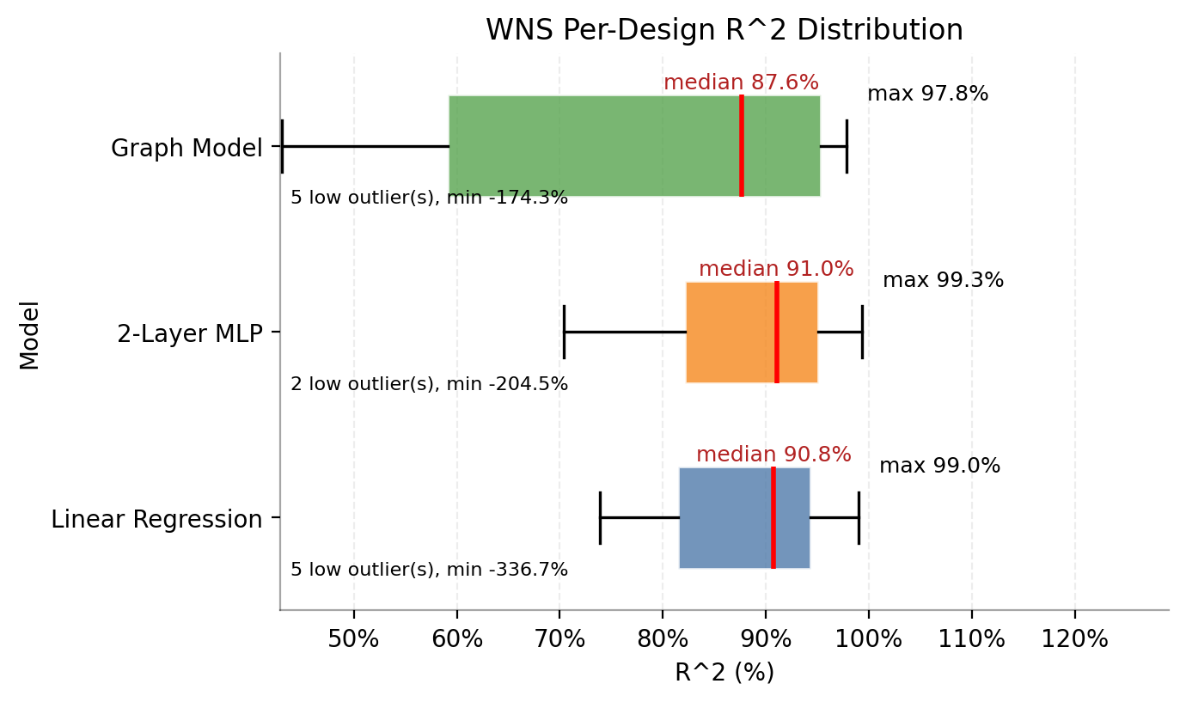
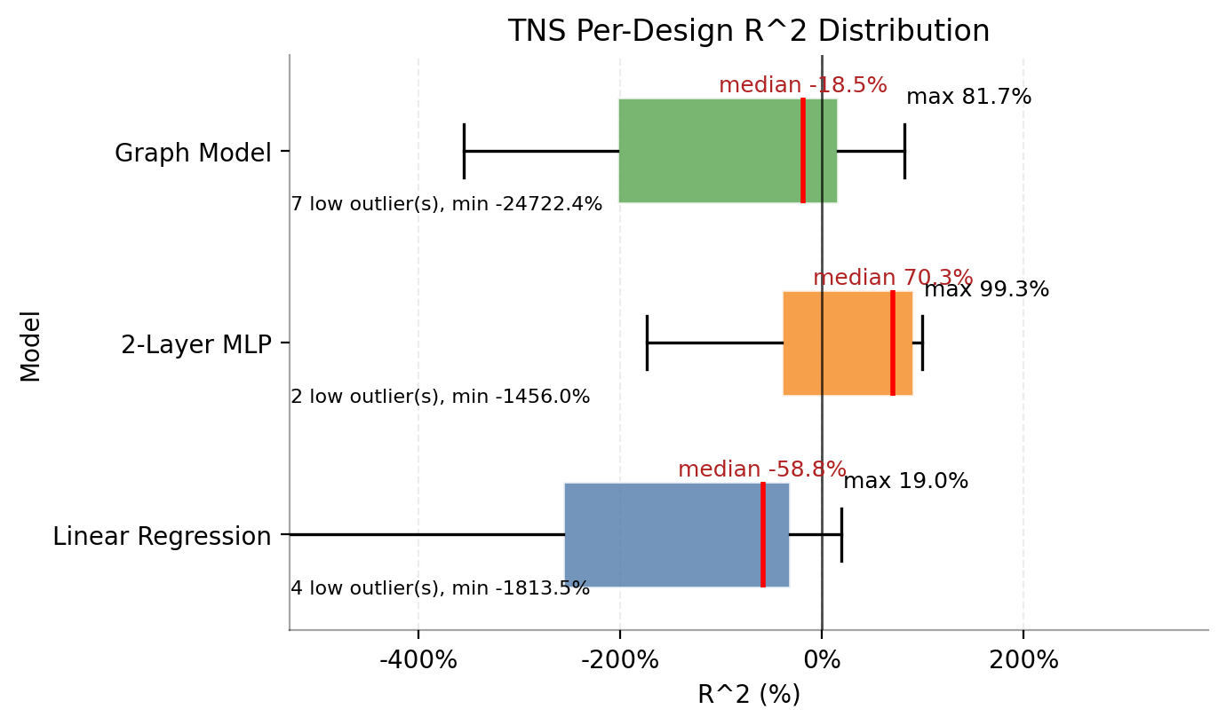
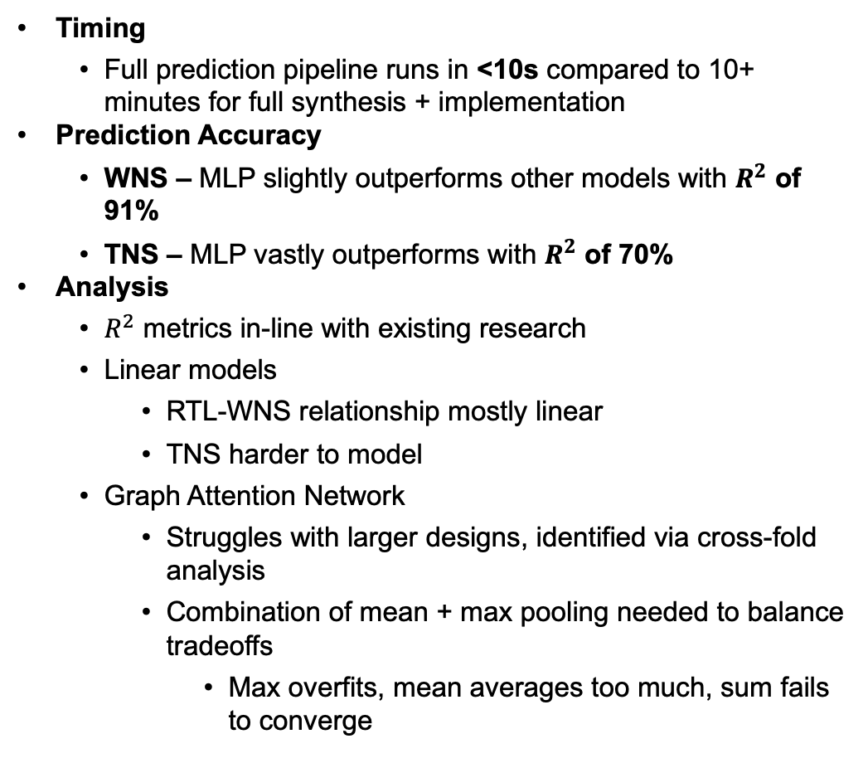
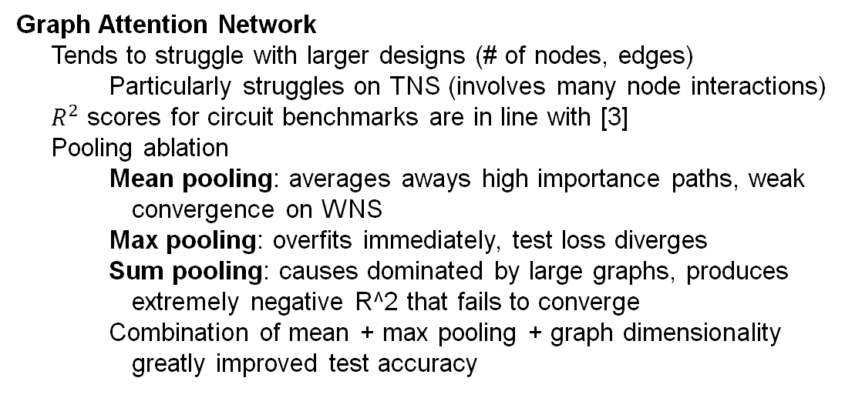
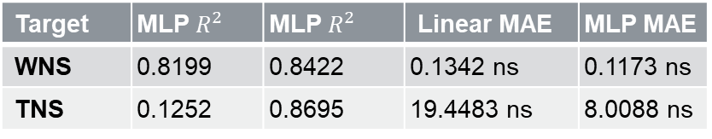
Results
Timing
Full prediction pipeline runs in <10s compared to 10+ minutes for full synthesis + implementation
Prediction Accuracy
WNS – MLP slightly outperforms other models with $R^{2}$ of 91%
TNS – MLP vastly outperforms with $R^{2}$ of 70%
Analysis
$R^{2}$ metrics in-line with existing research
Linear models
RTL-WNS relationship mostly linear
TNS harder to model
Graph Attention Network
Struggles with larger designs, identified via cross-fold analysis
Combination of mean + max pooling needed to balance tradeoffs
Max overfits, mean averages too much, sum fails to converge
Graph Attention Network
Tends to struggle with larger designs (# of nodes, edges)
Particularly struggles on TNS (involves many node interactions)
$R^{2}$ scores for circuit benchmarks are in line with [3]
Pooling ablation
Mean pooling: averages aways high importance paths, weak convergence on WNS
Max pooling: overfits immediately, test loss diverges
Sum pooling: causes dominated by large graphs, produces extremely negative R^2 that fails to converge
Combination of mean + max pooling + graph dimensionality greatly improved test accuracy
Target | MLP $R^{2}$ | MLP $R^{2}$ | Linear MAE | MLP MAE
WNS | 0.8199 | 0.8422 | 0.1342 ns | 0.1173 ns
TNS | 0.1252 | 0.8695 | 19.4483 ns | 8.0088 ns
Notes:
Cory, Pablo, and DeAndre
(Presented by Dre)
1 slide, 4 points
1 plot: comparison of different networks
1 plot: impact of different hyperparameters
❑ Results
❑ 1-2 quantitative result table/plot
❑ Comparison with baseline
❑ 1-2 sentences explaining the key takeaway
❑ Guidelines:
❑ Highlight the important numbers/metric from your approach
❑ Do not overcrowd the slide with so many results
❑ Show one or two strong result, not ten weak ones
❑ If the results are still incomplete, show
❑ Preliminary results
❑ Ablation in progress
❑ Failure cases (showing you know/have clearly identified the issue)
Graph Attention Network
Tends to struggle with larger designs (# of nodes, edges)
Particularly struggles on TNS (involves many node interactions)
$R^{2}$ scores for circuit benchmarks are in line with [3]
Pooling ablation
Mean pooling: averages aways high importance paths, weak convergence on WNS
Max pooling: overfits immediately, test loss diverges
Sum pooling: causes dominated by large graphs, produces extremely negative R^2 that fails to converge
Combination of mean + max pooling + graph dimensionality greatly improved test accuracy

Slide 13
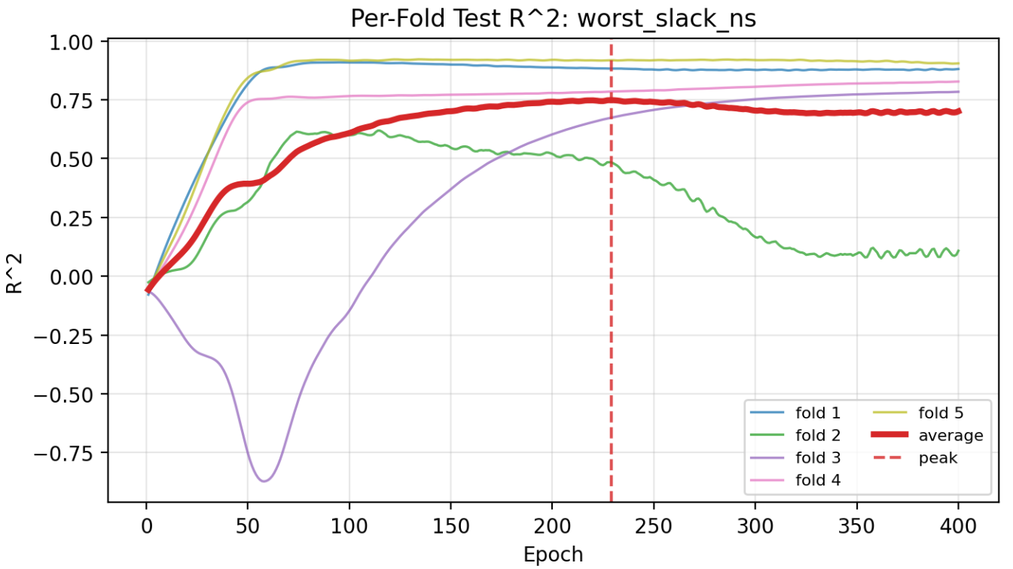
Challenges and Path Forward
Challenges
Lack of and difficulty obtaining data
Extracting complex RTL features
Notes:
Cory, Pablo, and DeAndre
1 slide, 4 points
1 plot: comparison of different networks
1 plot: impact of different hyperparameters
1 table: speedup over full synthesis flow
❑ Results
❑ 1-2 quantitative result table/plot
❑ Comparison with baseline
❑ 1-2 sentences explaining the key takeaway
❑ Guidelines:
❑ Highlight the important numbers/metric from your approach
❑ Do not overcrowd the slide with so many results
❑ Show one or two strong result, not ten weak ones
❑ If the results are still incomplete, show
❑ Preliminary results
❑ Ablation in progress
❑ Failure cases (showing you know/have clearly identified the issue)

Slide 14
Conclusion
Pending Experiments
Further ablation studies with number of GAT layers/attention heads and tuning vector model hyperparameters
Limitations
Restricted to timing prediction, no area or power regression
Future Work
Gather a larger spread of data with more nonzero TNS values
Limited dataset diversity – most benchmarks are communication interfaces and toy sequential circuits
Ground truth generated from open-source tool – less accurate than industrial tools
Increase number of synthesis recipe knobs – could incorporate more physical constraints
Specialize QoRNet to timing/area prediction for datapath circuits
Explore additional intermediate graph representations of circuits
Manage the difference in dimensionality between graph inputs
Notes:
Everyone
Presented by Cory
1 slide, 2 points
❑ Any challenges remaining
❑ List of pending experiments
❑ What are the limitations of your proposed approach?
❑ What is your future idea if you get more time to address this limitation
❑ Guidelines:
❑ Make it a thoughtful slide showing clear plan of finalizing the project as well
as clear understanding of limitations/methods of further improvement

Slide 15
Demo
HuggingFace Link
Notes:
Everyone
Demo, 3 points
❑ Option 1: Use Googlecolab/Newton
❑ Introduce what you are going to demonstrate
❑ 2-3 Examples. It may be one of these
❑ Image input and predicted output
❑ Generated sample (if using generative models)
❑ Domain adaptation result
❑ Anomaly detection result (showing the model detects anomaly and non-anomaly)
❑ Any other visualization that shows the models predicts qualitatively
❑ You can be more creative showing the baseline model fails whereas your approach wins
❑ Guidelines:
❑ Use only 2-3 minutes for demo
❑ Do not plan for lengthy training during the class. Keep the trained model ready for the demo
❑ Have all files (input image, input document etc), colab notebooks, and checkpoints open and ready before class
❑ Show input, the model inference running (some print messages), output/result
❑ You can keep backup (pre-recorded) video of this demo, if there is any technical challenges
❑ Option 2 (with Bonus points 3): Gradio on Hugging Face Spaces
❑ You can use the following resources to learn how to show the demo in an
interactive UI
https://huggingface.co/spaces
https://www.marqo.ai/blog/how-to-create-a-hugging-face-space

Slide 16
References
Chowdhury, Tan, Karri, and Garg, “OpenABC-D: A Large-Scale Dataset For Machine Learning Guided Integrated Circuit Synthesis”, arXiv, 2021.
C. Xu, C. Kjellqvist, L. Wills, “SNS's not a synthesizer: a deep-learning-based synthesis predictor,” ISCA, 2022.
P. Sengupta, A. Tyagi, Y. Chen and J. Hu, "How Good Is Your Verilog RTL Code? A Quick Answer from Machine Learning," 2022 IEEE/ACM International Conference On Computer Aided Design (ICCAD), San Diego, CA, USA, 2022, pp. 1-9.
Brody, S., Alon, U., and Yahav, E. How attentive are graph attention networks?, 2022. URL https://arxiv.org/abs/2105.14491.
Albrecht, C. Iwls 2005 benchmarks. In International Workshop for Logic Synthesis (IWLS). IEEE, 2005.
Opencores. URL https://opencores.com/.
S. Kajihara, K. Kinoshita, I. Pomeranz and S. M. Reddy, "Combinationally irredundant ISCAS-89 benchmark circuits," 1996 IEEE International Symposium on Circuits and Systems (ISCAS), Atlanta, GA, USA, 1996, pp. 632-634 vol.4, doi: 10.1109/ISCAS.1996.542103.
Sanjay Gandham, Joe Walston, Sourav Samanta, Lingxiang Yin, Hao Zheng, Mingjie Lin, and Stelios Diamantidis. 2025. CircuitSeer: RTL Post-PnR Delay Prediction via Coupling Functional and Structural Representation. In Proceedings of the 43rd IEEE/ACM International Conference on Computer-Aided Design (ICCAD '24). Association for Computing Machinery, New York, NY, USA, Article 67, 1–9. https://doi.org/10.1145/3676536.3676668
Florent de Dinechin and Bogdan Pasca. Designing custom arithmetic data paths with FloPoCo. IEEE Design & Test of Computers, 28(4):18--27, July 2011.

Slide 17
Thanks for Listening!
Notes:
Other comments
❑ It is ok to have 2-3 extra slides if the details spill over in some sections
❑ But try to make it concise so that the presentation will be covered in 12 minutes
❑ Team members may decide among themselves how to divide the presentation slides. Each team member is expected to present part of the presentation
❑ Evaluation will be based on both the content of each slide (as given in the guidelines) and the clarity and effectiveness of the presentation.

