Slide 1
Distributed Systems Design COMP 6231
Naming: Chapter 5 Part 2
Lecture 6
Essam Mansour

Slide 2
Today…
Last Session:
Naming- Part I
Today’s Session:
Naming- Part II

Slide 3
Classes of Naming
Flat naming
Structured naming
Attribute-based naming

Slide 4
Classes of Naming
Flat naming
Structured naming
Attribute-based naming

Slide 5
Structured Naming
Structured names are composed of simple human-readable names
Names are arranged in a specific structure
Examples:
File-systems utilize structured names to identify files
/home/userid/work/dist-systems/naming.txt
Websites can be accessed through structured names
www.concordia.ca

Slide 6
Name Spaces
Structured names are organized into name spaces
A name space is a directed graph consisting of:
Leaf nodes
Each leaf node represents an entity
A leaf node generally stores the address of an entity (e.g., in DNS), or the state of (or the path to) an entity (e.g., in file systems)
Directory nodes
Directory node refers to other leaf or directory nodes
Each outgoing edge is represented by (edge label, node identifier)
Each node can store any type of data
I.e., State and/or address (e.g., to a different machine) and/or path

Slide 7

Name Spaces: An Example
Looking up for the entity with name “/home/steen/mbox”
Data stored in n1
n0
keys
n2: “elke”
n3: “max”
n4: “steen”
home
n1
n5
“/keys”
steen
elke
max
n2
n3
n4
Leaf node
twmrc
mbox
Directory node

Slide 8
Name Resolution
The process of looking up a name is called name resolution
Closure mechanism:
Name resolution cannot be accomplished without an initial directory node
The closure mechanism selects the implicit context from which to start name resolution
Examples:
www.concordia.ca: start at the DNS Server
/home/steen/mbox: start at the root of the file-system

Slide 9
Name Linking
The name space can be effectively used to link two different entities
Two types of links can exist between the nodes:
Hard Links
Symbolic Links

Slide 10
1. Hard Links
There is a directed link from the hard link to the actual node
Name resolution:
Similar to the general name resolution
Constraint:
There should be no cycles in the graph
“/home/steen/keys” is a hard link to “/keys”
n0
home
keys
n1
n5
“/keys”
elke
steen
max
keys
n2
n3
n4
twmrc
mbox
Notes:
$ ls -id .
1069765 ./
$ mkdir tmp ; cd tmp
$ ls -id ..
1069765 ../
The –id option to ls makes it give the inode number of the file/dir. On Unix filesystems .. is a real directory entry; it is a hard link pointing back to the previous directory. To this end, hard links are the tendons that tie the filesystem's directories together.

Slide 11
2. Symbolic Links
Symbolic link stores the name of the original node as data
Name resolution for a symbolic link SL
First resolve SL’s name
Read the content of SL
Name resolution continues with content of SL
Constraint:
No cyclic references should be present
“/home/steen/keys” is a symbolic link to “/keys”
n0
home
keys
n1
n5
“/keys”
elke
steen
max
n2
n3
n4
keys
twmrc
mbox
n6
Data stored in n6
“/keys”

Slide 12
Mounting of Name Spaces
Two or more name spaces can be merged transparently by a technique known as mounting
With mounting, a directory node in one name space will store the identifier of the directory node of another name space
Network File System (NFS) is an example where different name spaces are mounted
NFS enables transparent access to remote files

Slide 13
Mounting of Name Spaces
Issue
Name resolution can also be used to merge different name spaces in a transparent way through mounting: associating a node identifier of another name space with a node in a current name space.
Terminology
Foreign name space: the name space that needs to be accessed
Mount point: the node in the current name space containing the node identifier of the foreign name space
Mounting point: the node in the foreign name space where to continue name resolution
Mounting across a network
The name of an access protocol.
2 The name of the server.
3 The name of the mounting point in the foreign name space.
Notes:
- In practice, the focus is on masking crash and omission failures
Add a slide prior to this slide with an animated example to make your point clear.

Slide 14
Example of Mounting Name Spaces in NFS
Machine A
Machine B
Name Server for
foreign name space
Name Space 1
Name Space 2
remote
home
vu
steen
“nfs://flits.cs.vu.nl/home/steen”
mbox
OS
OS
Name resolution for “/remote/vu/home/steen/mbox” in a distributed file system

Slide 15
Distributed Name Spaces
In large-scale distributed systems, it is essential to distribute name spaces over multiple name servers
Distribute the nodes of the naming graph
Distribute the name space management
Distribute the name resolution mechanisms

Slide 16
Layers in Distributed Name Spaces
Distributed name spaces can be divided into three layers
Global
Layer
Consists of high-level directory nodes
Directory nodes are jointly managed by different administrations
Administrat-ional Layer
Contains mid-level directory nodes
Directory nodes grouped together in such a way that each group is managed by an administration
Managerial Layer
Contains low-level directory nodes within a single administration
The main issue is to efficiently map directory nodes to local name servers

Slide 17
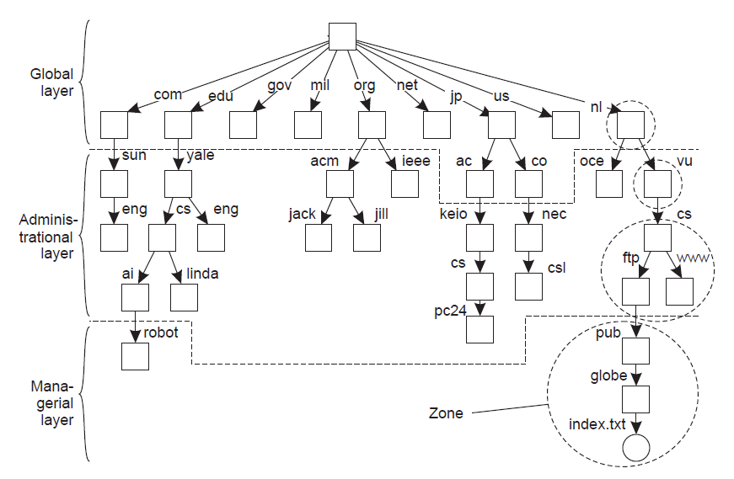
Distributed Name Spaces – An Example
Notes:
A DNS zone is any distinct, contiguous portion of the domain name space in the Domain Name System (DNS) for which administrative responsibility has been delegated to a single manager

Slide 18
Comparison of Name Servers at Different Layers
 | Global | Administrational | Managerial
Geographical scale of the network
Total number of nodes
Number of replicas
Update propagation
Is client side caching applied?
Responsiveness to lookups
Worldwide
Organization
Department
Few
Many
Vast numbers
Many
None or few
None
Lazy
Immediate
Immediate
Yes
Yes
Sometimes
Seconds
Milliseconds
Immediate

Slide 19
Distributed Name Resolution
Distributed name resolution is responsible for mapping names to addresses in a system where:
Name servers are distributed among participating nodes
Each name server has a local name resolver
We will study two distributed name resolution algorithms:
Iterative Name Resolution
Recursive Name Resolution

Slide 20
1. Iterative Name Resolution
Client hands over the complete name to root name server
Root name server resolves the name as far as it can, and returns the result to the client
The root name server returns the address of the next-level name server (say, NLNS) if address is not completely resolved
Client passes the unresolved part of the name to the NLNS
NLNS resolves the name as far as it can, and returns the result to the client (and probably its next-level name server)
The process continues untill the full name is resolved

Slide 21
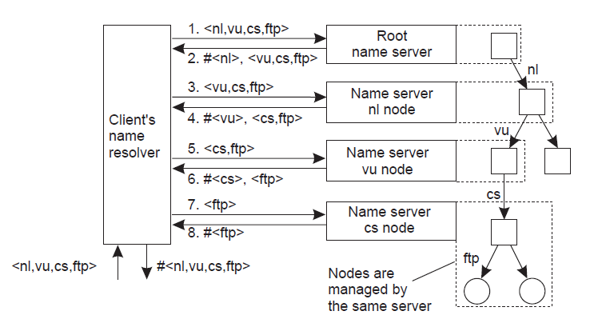
1. Iterative Name Resolution – An Example
<a,b,c> = structured name in a sequence
#<a> = address of node with name “a”
Resolving the name “ftp.cs.vu.nl”

Slide 22
2. Recursive Name Resolution
Approach:
Client provides the name to the root name server
The root name server passes the result to the next name server it finds
The process continues till the name is fully resolved
Drawback:
Large overhead at name servers (especially, at the high-level name servers)

Slide 23
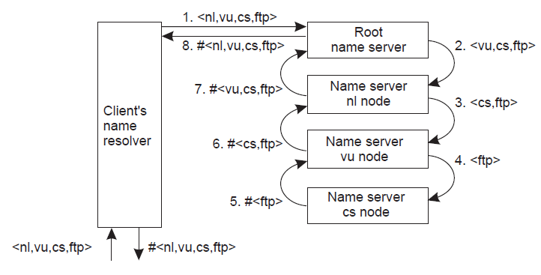
2. Recursive Name Resolution – An Example
<a,b,c> = structured name in a sequence
#<a> = address of node with name “a”
Resolving the name “ftp.cs.vu.nl”

Slide 24
Scalability issues
Size scalability
We need to ensure that servers can handle a large number of requests per time unit ⇒ high-level servers are in big trouble.
Solution
Assume (at least at global and administrational level) that content of nodes hardly ever changes. We can then apply extensive replication by mapping nodes to multiple servers, and start name resolution at the nearest server.
Observation
An important attribute of many nodes is the address where the represented entity can be contacted. Replicating nodes makes large-scale traditional name servers unsuitable for locating mobile entities.
Notes:
- In practice, the focus is on masking crash and omission failures
Add a slide prior to this slide with an animated example to make your point clear.

Slide 25
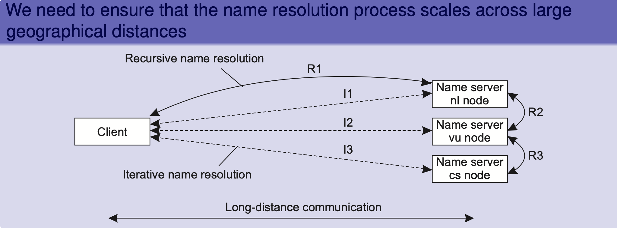
Scalability issues
Problem
We need to ensure that servers can handle a large number of requests per time unit ⇒ high-level servers are in big trouble.
Notes:
- In practice, the focus is on masking crash and omission failures
Add a slide prior to this slide with an animated example to make your point clear.

Slide 26
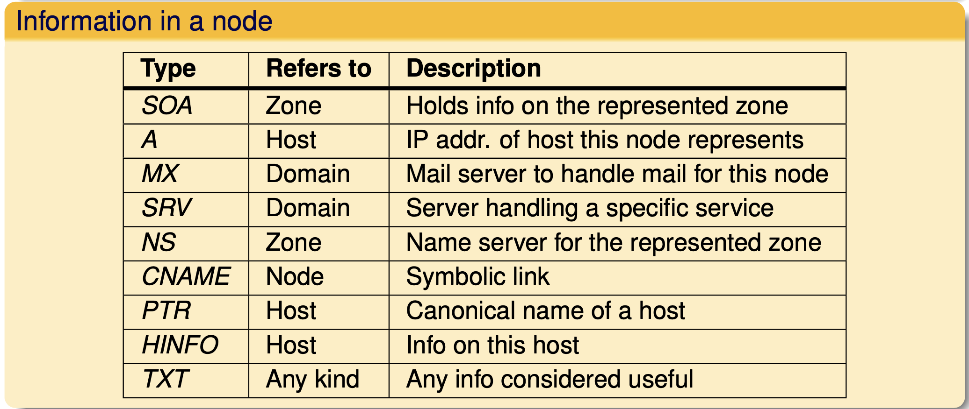
Domain Name System (DNS)
Essence
Hierarchically organized name space with each node having exactly one incoming edge ⇒ edge label = node label.
domain: a subtree
domain name: a path name to a domain’s root node.
Notes:
- In practice, the focus is on masking crash and omission failures
Add a slide prior to this slide with an animated example to make your point clear.

Slide 27
Classes of Naming
Flat naming
Structured naming
Attribute-based naming

Slide 28
Attribute-based Naming
In many cases, it is much more convenient to name, and look up entities by means of their attributes
Similar to traditional directory services (e.g., yellow pages)
However, the lookup operations can be extremely expensive
They require to match requested attribute values, against actual attribute values, which might require inspecting all entities
Solution: Implement basic directory service as a database, and combine it with traditional structured naming system
We will study Light-weight Directory Access Protocol (LDAP); an example system that uses attribute-based naming

Slide 29
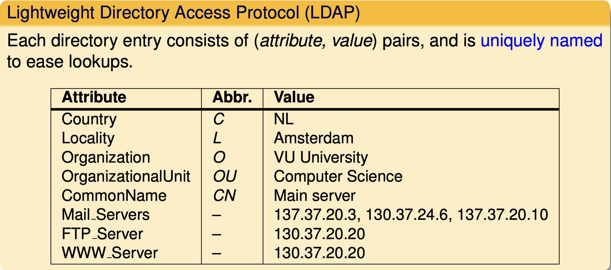
Implementing directory services
Solution for scalable searching
Implement basic directory service as database, and combine with traditional structured naming system.
Notes:
- In practice, the focus is on masking crash and omission failures
Add a slide prior to this slide with an animated example to make your point clear.

Slide 30
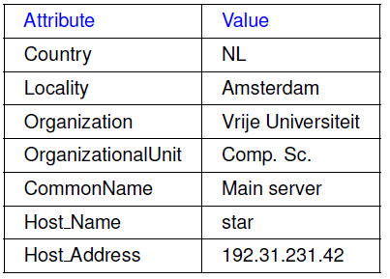
Light-weight Directory Access Protocol (LDAP)
LDAP directory service consists of a number of records called “directory entries”
Each record is made of (attribute, value) pairs
LDAP standard specifies five attributes for each record
Directory Information Base (DIB) is a collection of all directory entries
Each record in a DIB is unique
Each record is represented by a distinguished name
E.g., /C=NL/O=Vrije Universiteit/OU=Comp. Sc.

Slide 31
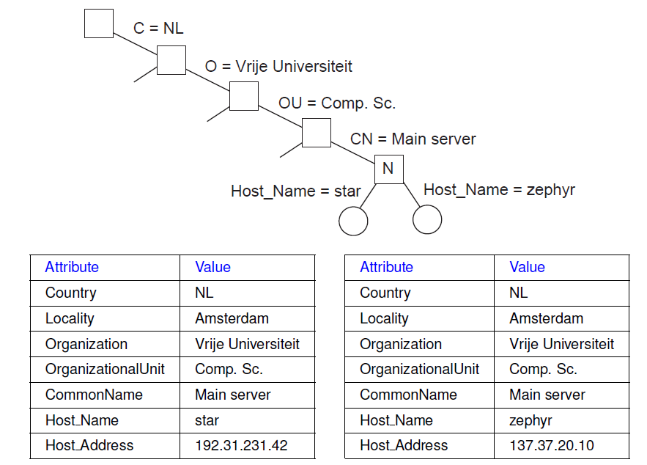
Directory Information Tree in LDAP
All the records in the DIB can be organized into a hierarchical tree called Directory Information Tree (DIT)
LDAP provides advanced search mechanisms based on attributes by traversing the DIT
Example syntax for searching all Main_Servers in Vrije Universiteit:
search("&(C = NL) (O = Vrije Universiteit) (OU = *) (CN = Main server)")

Slide 32
Drawbacks of distributed index
Quite a few
A query involving k attributes requires contacting k servers
Imagine looking up “lastName = Smith ∧ firstName = Pheriby ”: the client may need to process many files as there are so many people named “Smith.”
No (easy) support for range queries, such as “price = [1000 − 2500].”

Slide 33
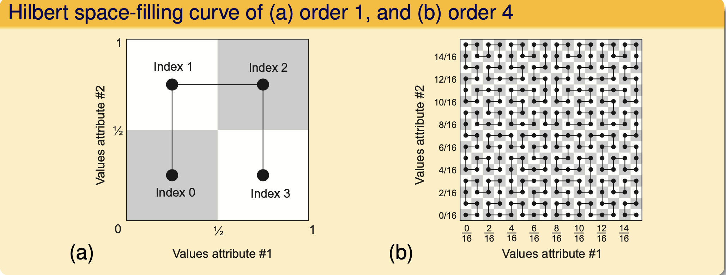
Alternative: map all attributes to 1 dimension and then index
Space-filling curves: principle
Map the N-dimensional space covered by the N attributes {a1,...,aN} into a single dimension
Hashing values in order to distribute the 1-dimensional space among index servers.

Slide 34
Summary
Naming and name resolutions enable accessing entities in a distributed system
Three types of naming:
Flat Naming
Broadcasting, forward pointers, home-based approaches, Distributed Hash Tables (DHTs)
Structured Naming
Organizes names into Name Spaces
Distributed Name Spaces
Attribute-based Naming
Entities are looked up using their attributes

Slide 35
Next Class
Concurrency and Synchronization
Explain the need for synchronization
Analyze how computers synchronize their clocks and concurrent accesses to resources
Clock Synchronization Algorithms
Mutual Exclusion Algorithms

