Slide 1


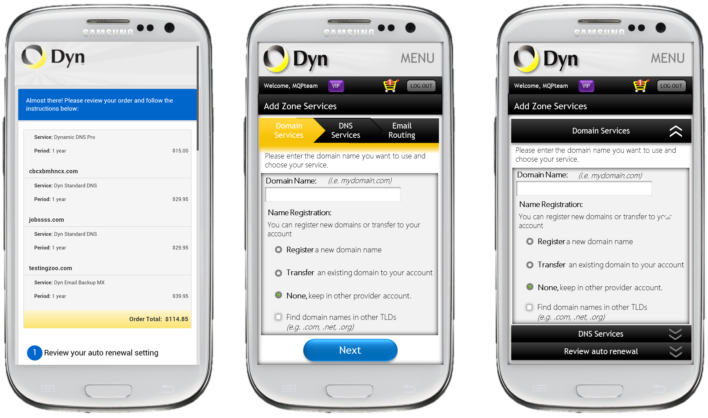
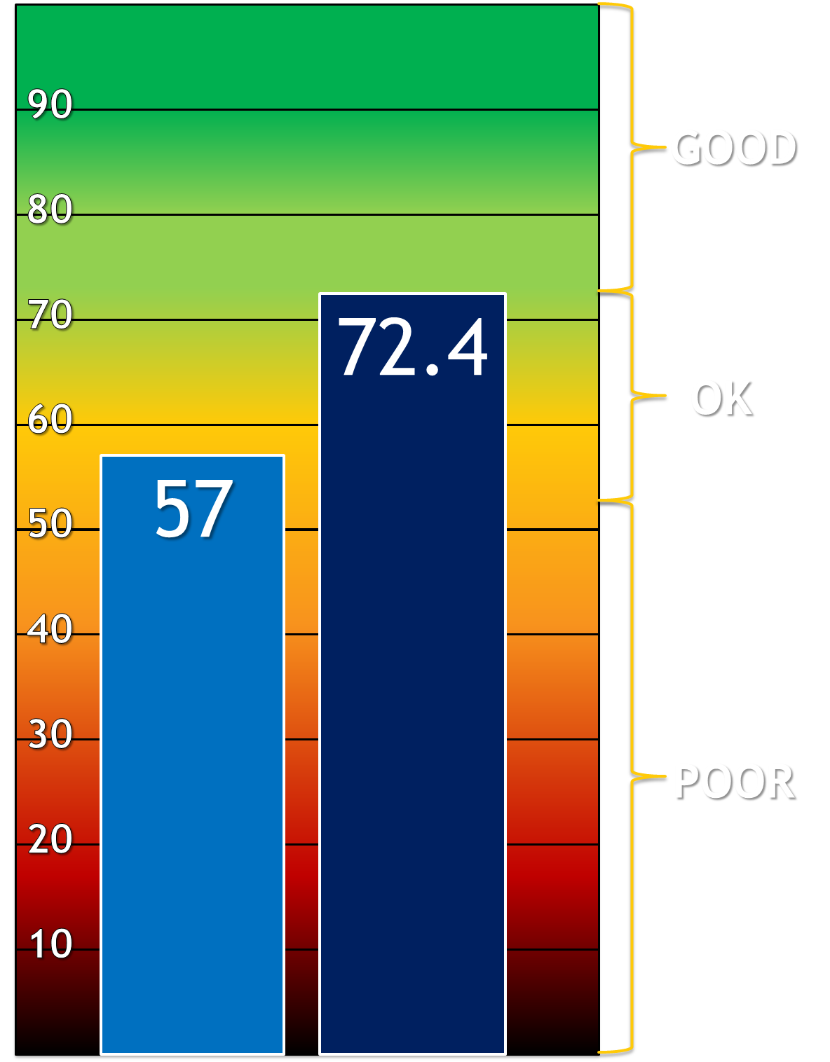
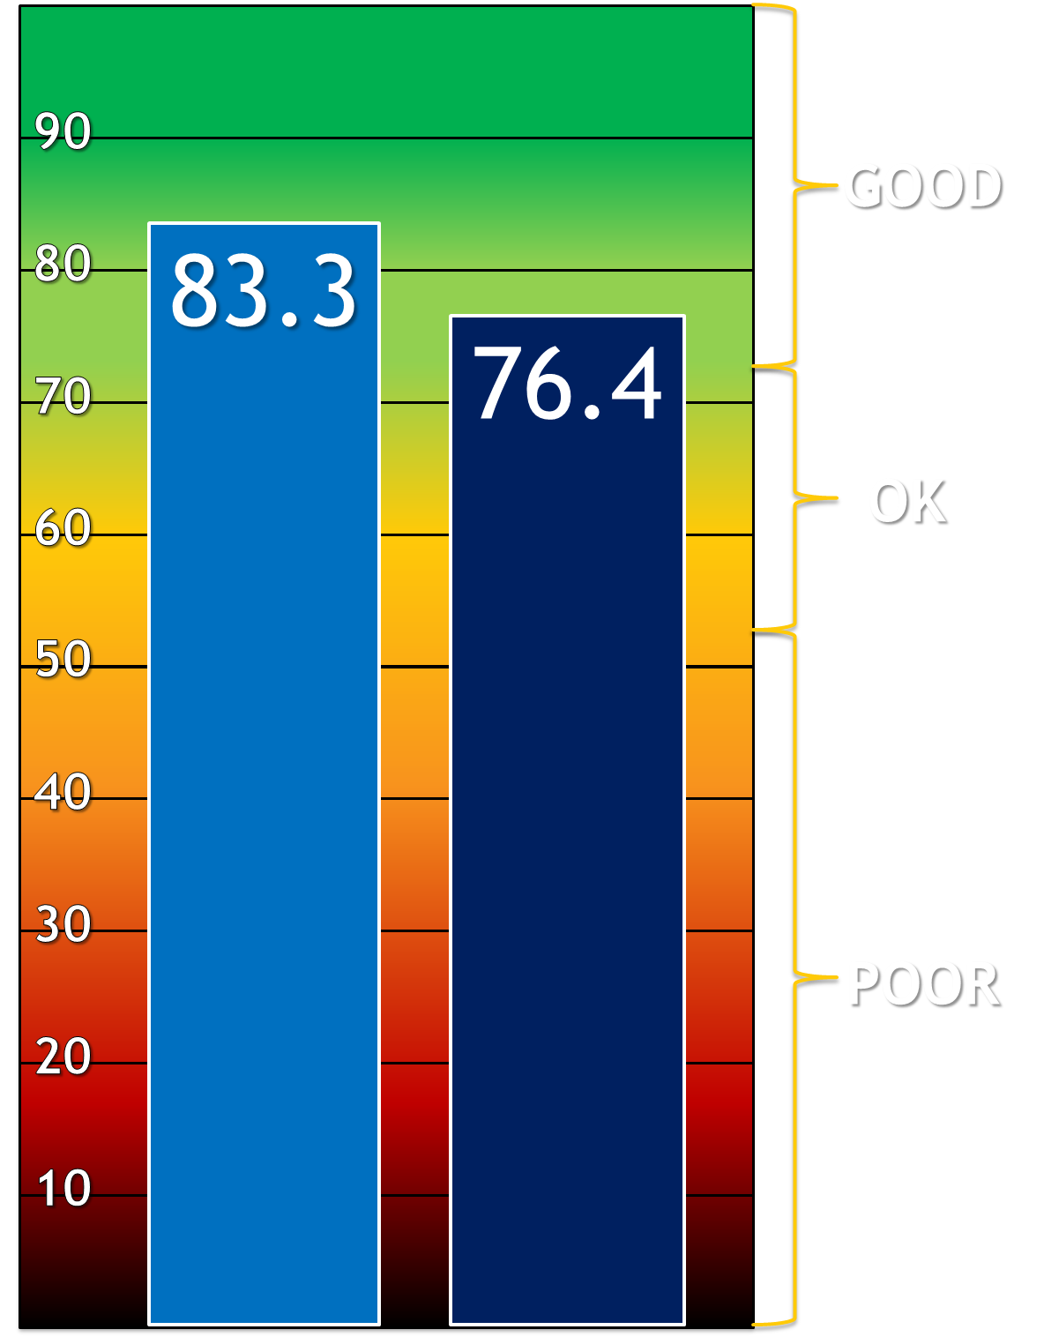
Improving Mobile Web Experience at Dyn
Sponsored by:
Wilmann Gómez, Georgi Kardzhaliyski, Wan (Tammy) Liu and Frank Oglesby
Advisor: Dr. Soussan Djamasbi (Associate Professor of IT, Director of UXDM Research Lab - School of Business, WPI)
Opportunity
Improving User Experience (UX) for Dyn’s Mobile E-commerce Web Design and Workflow
Globally, mobile web traffic has tripled yearly since 2010.
Cutting edge mobile UX is an emerging business need.
Methodology
Business Value
User Study I:
Current State
UX Literature
Adaptive web design theory was coupled with observed user behavior and feedback to outline detailed layout and content changes.
“This [MQP] team has been able to help us test subjective opinion against the reality of cold hard facts. Their ability to test their hunches and recommendations in a scientific setting using the UXDM Lab has provided us with an extremely unique opportunity and advantage, helping us stay on the cutting edge of UX technology.”
-Dan McAuliffe, User Experience Manager, Dyn Inc.
Results & Analysis I
Best Practices
Recommendations to Dyn
One of the major improvements was to eliminate the need for horizontal scrolling.
Dyn observed a 10.4% increase in number of mobile transactions, with a 32% increase in the average value of these transactions.
MQP Deliverables
Dyn Implementation:
November 2012
Dyn’s mobile unique traffic visits observed an increase of 27%.
Early focus on UX projects provides significant competitive advantages (Fieldman, 2012)
UX projects have been shown to provide as high as 83% ROI. Have great impact on bottom line (Nielsen, 2008).
For the specific workflow addressed in this MQP, Dyn observed a 25.3% increase in units sold.
(Dyn.com, Google Analytics, Nov ‘12 – Mar. ’13)
User Study II:
Testing Implementation including eye-tracking
MQP Deliverables
Additional Work Delivered
Results & Analysis II
Provided a set of actionable opportunities to improve usability of mobile web design and workflows.
User testing of alternative layouts designed to reduce vertical scrolling required.
Recommendations For Future Work
Developed two potential alternative designs for fully optimized mobile UX.
Significant improvements observed in Dyn’s mobile usability (27% increase in UX score).
Usability for both layouts scored above industry average.
Objectives
Identify UX improvement opportunities for Dyn’s mobile e-commerce site.
Provide recommendations to Dyn’s UX development team.
Measure usability improvements.
Provide Dyn foundations that can drive future improvements in mobile UX.
Additional Work Delivered
Layout Logic and Content Changes
Mobile Optimized Interface
Dyn UX Score Improvement
Alternative Design UX Scores
User Study III:
Testing Mock-up Alternatives
Statistically significant improvement (p =0.03; 97% confidence)
Collapsible (CM)
Breadcrumb (BC)
Selected References
Sauro, J. (2011, 02 02). Measuring Usability With The System Usability Scale (SUS). Retrieved 09 27, 2012, from Measuring Usability: http://www.measuringusability.com/sus.php
Post-MQP Work by Dyn
Dyn Implementation:
April 2013
Dyn Implementation: (forthcoming)
Before
After
CM
BC

