Slide 1
Southwestern Tires
ByDesign Inc.
Georgi Kardzhaliyski, Muyeedul Hoque,
Caroline Mallory, Bing (Lily) Yang
4/19/2013

Slide 2
Case Overview
Inventory management problems
Partly paper-based system
Incorrect order placement
System architecture design
Use scenario influence

Slide 3
Use Scenarios
Use Scenario: Not Time-Sensitive Tire Purchase
Customer has tire type carried by SWT. Has time to wait for tires to be delivered and installed.
Customer gives tire information to salesman (1.1).
Salesman looks up availability of tires and discovers they are not in the store’s warehouse, but are in the company’s (1.1).
Asks customer about waiting availability- can either wait for delivery or can pick new type of tire (1.1).
Customer chooses first type of tire, can wait for them to be delivered and installed (1.1).
Tires are installed; need for further repair noted (1.1).
Customer alerted to repairs needed, cost of parts and repairs and offered choice to fix.
Customer chooses to have repairs completed, waits for further notification.
Customer pays (1.1).

Slide 4
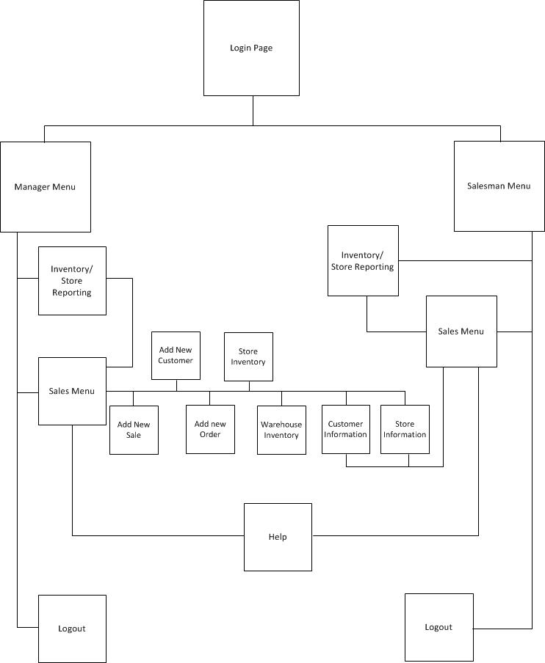
Interface Structure Design

Slide 5
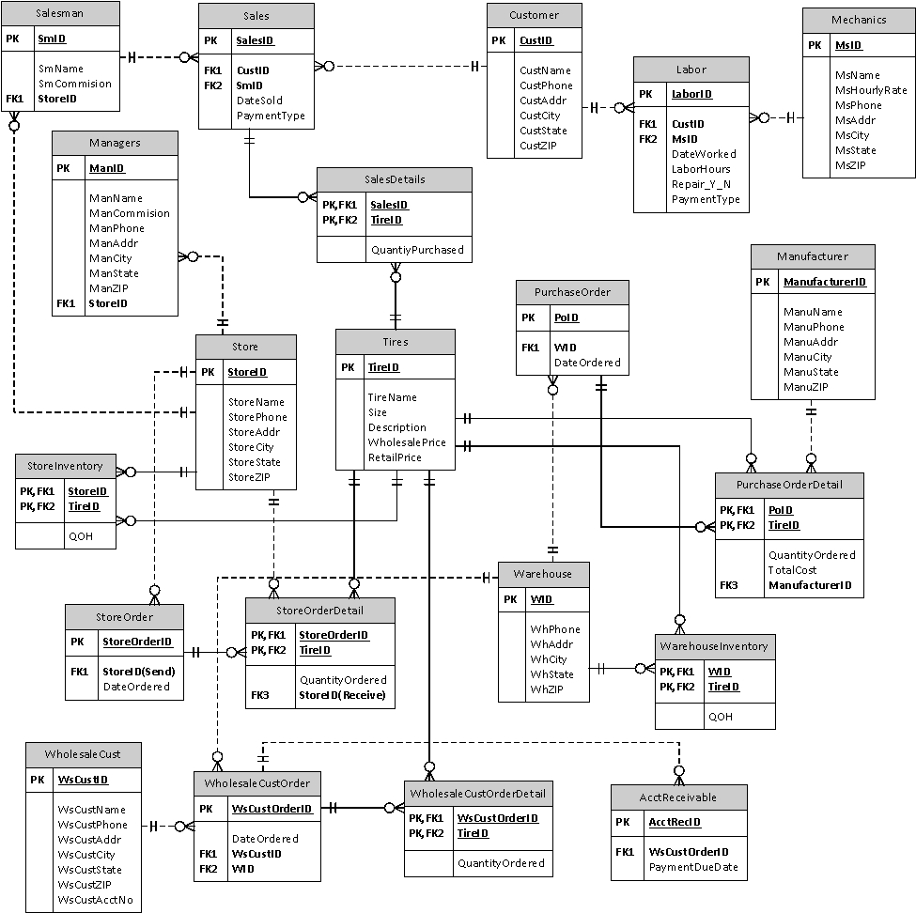
Revised ERD

Slide 6
Demo

Slide 7
Questions?

Slide 8
Thank you!

