Slide 1
Decomposing executive function deficits in psychiatric risk models:
A computational perspective
CAITLIN BROWN, PHOEBE COHEN, NATHAN FOX, & DEVIN MICHAELS
CSC 550 FINAL PROJECT
Notes:
Phoebe

Slide 2


Set shifting
Ability to adapt to a dynamic, changing environment
Important for goal pursuit and self-regulation
KNOWN:
Is this a consequence of depression/anxiety, or a potential early risk marker?
UNKNOWN:
Depression and anxiety: set shifting impairments
Austin et al., 2001
Notes:
Phoebe
Type of Cognitive Flexibility task
Also Known As Task Switching
Different from Cognitive Shifting - (moving only your attention from one thing to anohter)

Slide 3
Aim #1
Link set shifting to repetitive negative thinking, a known early risk factor for depression and anxiety disorders.
Set shifting
Repetitive Negative Thinking (RNT)
Post-event processing
Rumination
Depression
Social Anxiety
Worry
Generalized Anxiety
Ehring & Watkins, 2008
Notes:
Phoebe + Caitlin
RNT = commonly associated with psychopathological disorders
Associated with cognitive inflexibility
Present in many mood and anxiety disorders
Addressing the unknown from previous slide, which has been a significant limitation of previous lit

Slide 4
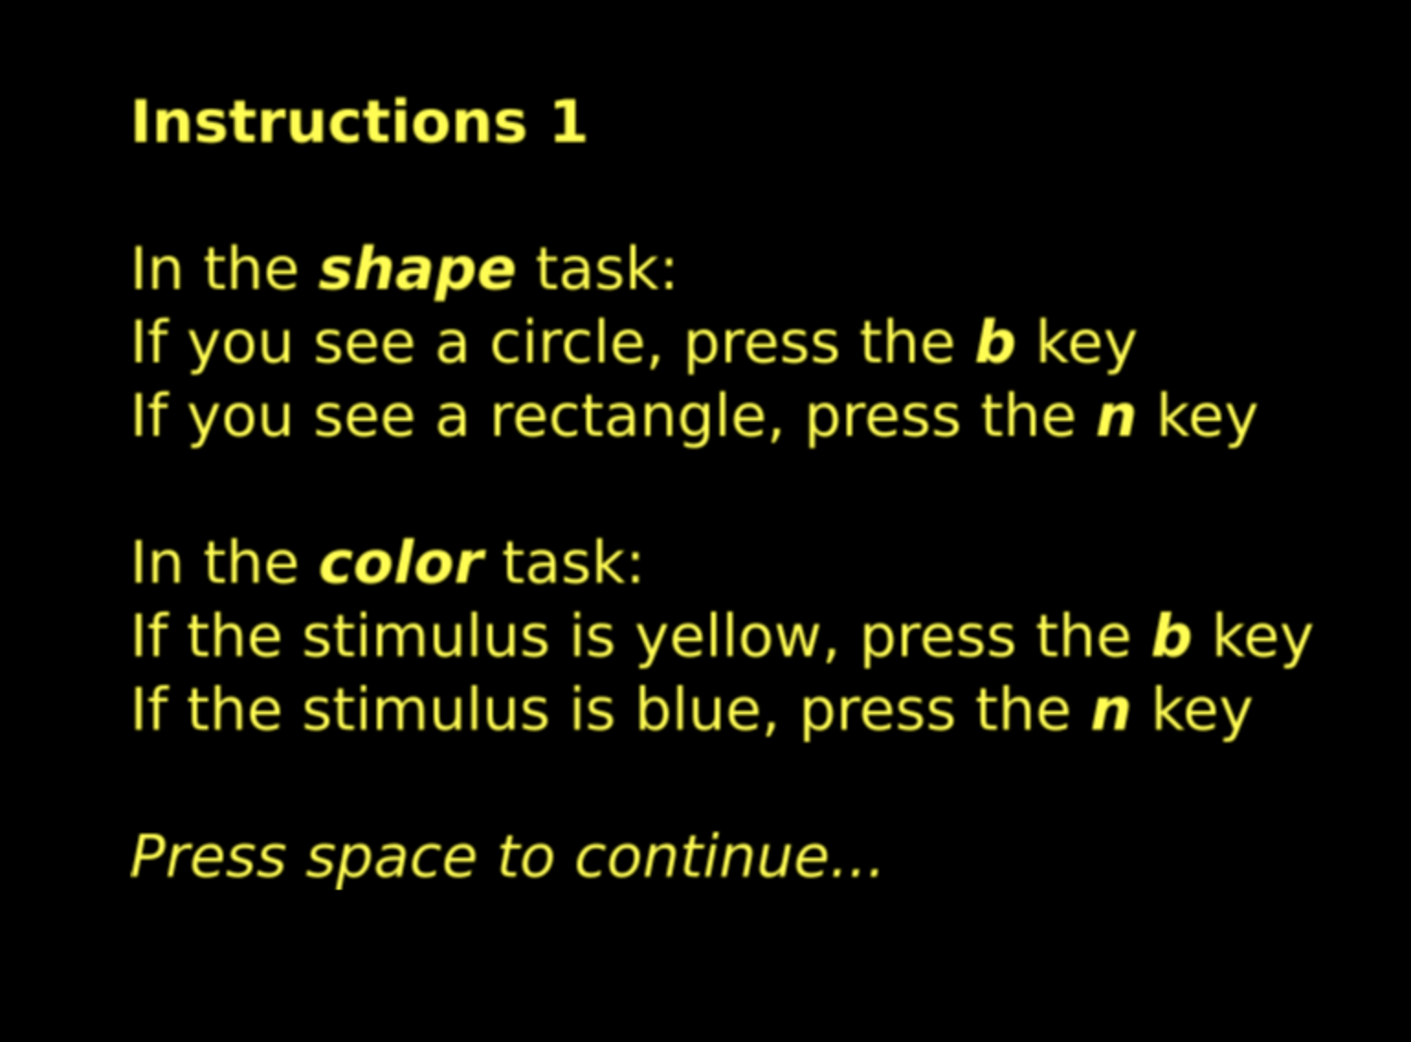
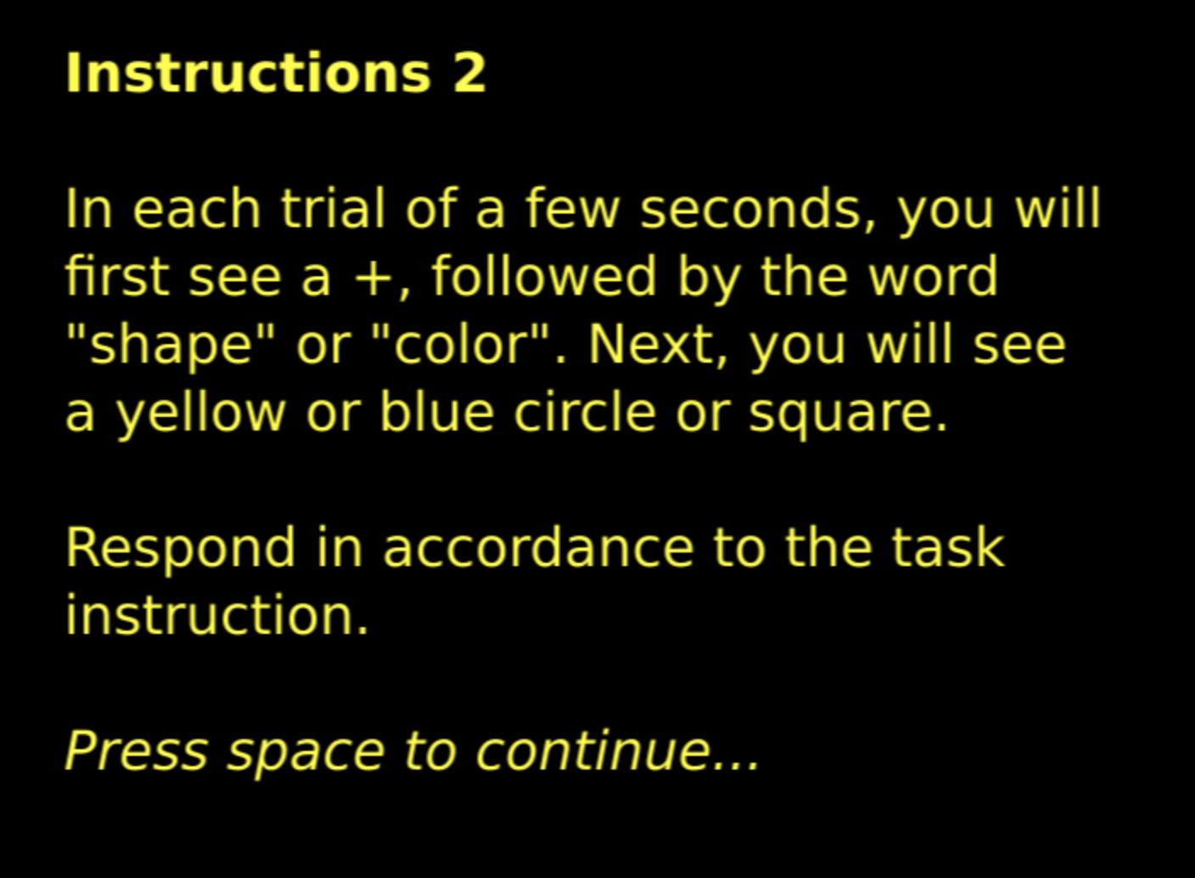
Set shifting: measurement
Notes:
Phoebe

Slide 5
Set shifting: measurement
Color
Notes:
Phoebe

Slide 6
Set shifting: measurement
Color
Notes:
Phoebe

Slide 7
Set shifting: measurement
Shape
Notes:
Phoebe

Slide 8
Set shifting: measurement
Shape
Notes:
Phoebe

Slide 9
Set shifting: measurement
Color
Notes:
Phoebe

Slide 10
Set shifting: measurement
Standard behavioral analysis:
4 trial types: congruent/incongruent by stay/switch
Focus on average reaction time and accuracy
“Switch cost” = RT for switch trials (harder) – RT for stay trials (easier)
Accuracy across all trials
Accuracy across switch trials
PROBLEMS:
Doesn’t use all available data to estimate parameters
Doesn’t account for speed-accuracy tradeoffs
Doesn’t capture nuances of decisional processes
Assumes 1-to-1 mapping of brain-behavior (invalid)
Notes:
Nathan

Slide 11
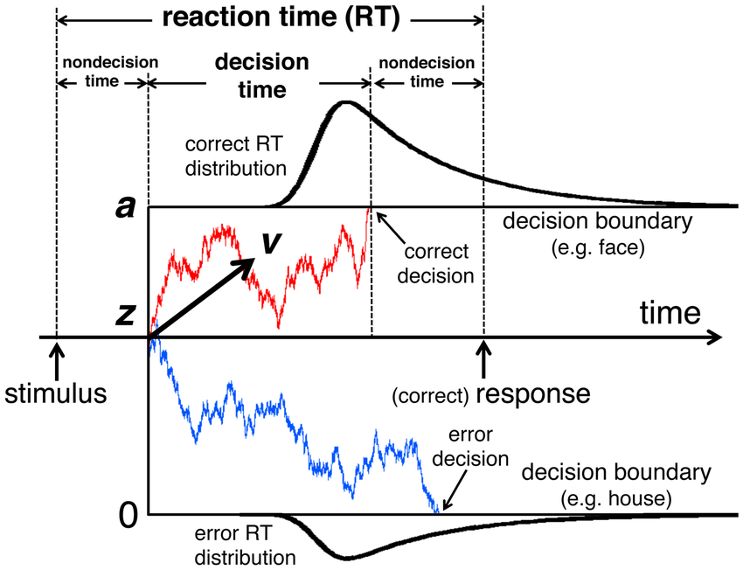
Aim #2
To take a computational approach to estimate set shifting abilities using hierarchical drift diffusion modeling.
Advantages
Integrates accuracy and reaction time into same model
Uses information from both correct and incorrect trials
Permits nuanced separation of different components of switch cost (e.g., preparation time vs. inertia)
Parameters
v = drift rate
t = non-decision parameter
a = decision boundary/threshold
Notes:
Devin + Caitlin
Theory
Model for how humans make binary decisions
Top line is one decision, bottom line is the opposite of that decision. In the milliseconds between being shown the shape and my decision to press the button, I’m accumulating evidence that the shape is a triangle at some rate. Once I have enough evidence that it’s a triangle I decide it is a triangle. So v is that rate I accumulate evidence, called the drift rate. a is the threshold of evidence to decide it’s a triangle. T is the non decision time, meaning once I’m shown the triangle, there are some milliseconds where my eyes are sending signals and the visual cortex is processing it until I’m conscious of it. Then the evidence accumulation begins.
Advantages:
point 1: the a and the 0 are the opposite decisions so I know if I got it right or wrong, and t and v allow me to see reaction time. Important to include both because there is a tradeoff between the two. Essentially, if you can have unlimited reaction time you can pretty much get everything right. So we are interested in getting it right as fast as possible.
Applying the model:
This model takes as inputs a 0 or 1 per trial indicating whether the subject answered the task correctly, as well as the response time for that trial.
And it can return these parameters.

Slide 12
Methods

Slide 13
Participants and measures
N = 90 young adults (73.33% female; 16.67% Hispanic/Latino)
Mean age of 18.7 years (SD = 1.39 years)
Repetitive negative thinking (known risk factor)
Perseverative Thinking Questionnaire (PTQ)
Set shifting (putative risk factor)
Color shape set shifting task (E-Prime)
Ehring et al., 2011
Notes:
Caitlin
Measures ability to flexibly switch between tasks or mental sets: i.e. evaluate either the the shape or color of an object, based on a cue.
RNT measured dimensionally

Slide 14
Data cleaning & analytic plan
Estimate cognitive task parameters using HDDM
Data cleaning (basic EDA, flip errors for incorrect trials, etc.)
Run unconstrained model (estimates a single drift rate across all trial types)
Run constrained model (estimates separate drift rates for the 4 trial types)
Link cognitive task data to psychiatric risk factors
Regression models comparing predictive power of computational vs. behavioral indices in explaining RNT
Clustering analyses on cognitive task data
https://github.com/nathancfox/comp-neuro-project/blob/master/CompNeuro.ipynb
Notes:
Devin
So we are running the HDDM to produce these parameters. THEN we are comparing the predictive power of these parameters compared to behavioral measures for predicting risk factors. So we ran several regression analyses
All 3 types

Slide 15
Results

Slide 16
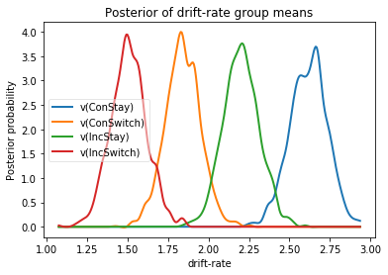
HDDM model: unconstrained vs. constrained model
Compared model fit to data using DIC (deviance information criteria):
Unconstrained DIC = 19705.49
Constrained DIC = 19016.49
Lower DIC supports differences in drift rate (v) according to trial type
Notes:
Devin
So we could run the model constrained or unconstrained. Basically unconstrained is returning one drift rate per subject, so the average rate at which they make decisions in the task. Constrained will break this down by trial type - for example, we expect a lower drift rate for Incongruent Switch than the other trial types, because this decision is a set shift and therefore harder, so the decision will take longer.
Deviance information criteria describes teh amount of error that the model has in trying to explain things. Lower DIC is better. The absolute values of these number mean nothing concrete it’s just used to compare models. The constrained model has less error in describing the data.
We also see from this graph here that the distributions of drift rates for subjects are separable by trial type. If the drift rate did not depend on trial type at all they’d probably overlap each other. Visible separability is a good sign decision time is impacted by trial type.

Slide 17
Individual difference regression models
Behavioral parameters (accuracy and reaction time)
RNT was not significantly linked with any of the relevant task parameters.
Computational parameters (a, t, and v’s)
RNT was linked with lower drift rates (v) on congruent switch trials (β = -.64; p = .004), such that people with higher RNT exhibited slower accrual of evidence needed for a decision when changing rule sets.
http://rpubs.com/caitlinbrow/csc550
Notes:
Caitlin
This model explained 13 percent of the variance in RNT. In other words, high risk people are worse at integrating info when there is a shift.

Slide 18
Support Vector Regression: Adjusted R²
Behavioral Analysis to RNT :
-0.094430
Constrained HDDM to RNT :
0.006331
Constrained HDDM Means to RNT :
0.071180
Constrained HDDM Std Devs to RNT :
-0.083911
Notes:
Nathan

Slide 19
Can clustering techniques applied to the cognitive task data provide additional information about risk profiles?
Notes:
Caitlin
Neither linked with RNT in regression models

Slide 20
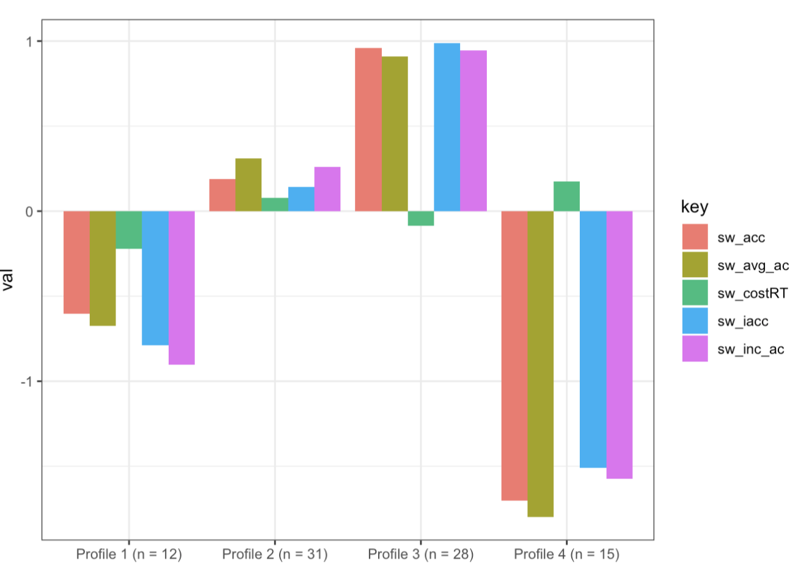
Latent profile analysis: Behavioral data
No significant differences in RNT between the 4 clusters
http://rpubs.com/caitlinbrow/csc550
Notes:
Caitlin
Neither linked with RNT in regression models

Slide 21

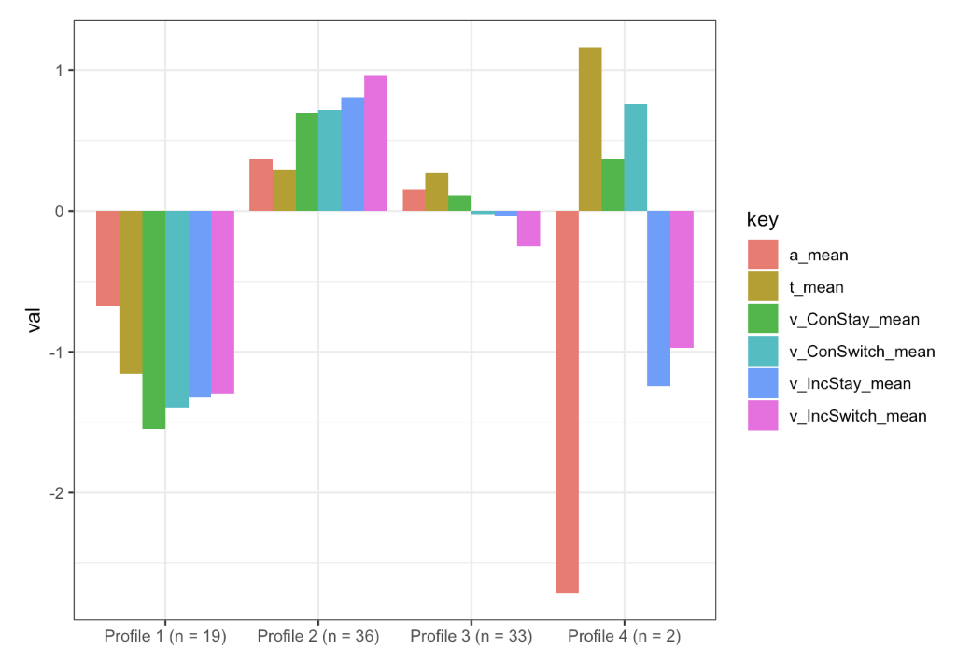
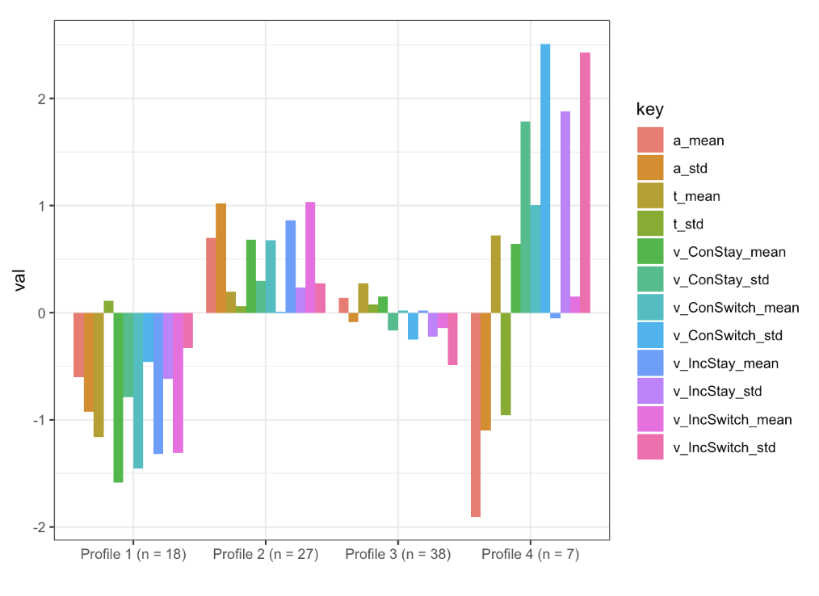
Can clustering techniques applied to the cognitive task data provide additional information about risk profiles?
Latent profile analysis: Computational data
Significantly lower RNT
http://rpubs.com/caitlinbrow/csc550
Notes:
Caitlin
Basically shows that really average people are low in RNT, but doesn’t tell us who is high….

Slide 22
Discussion
Compared to canonical Behavioral Analysis parameters, Hierarchical Drift Diffusion Modeling interprets Set Shifting data in a way that explains more variance in Repetitive Negative Thinking
Neither model explains a significant amount of variance.
It may be HDDM represents a way to explain another small part of the hopeful link between Executive Function and Depression, but impossible to say from this small analysis.
Notes:
Nathan + Caitlin

Slide 23
Limitations & Future Directions
Non-clinical, convenience sample
Replicate these findings in larger, representative groups
Many other potential ways (i.e., beyond drift diffusion) to model set shifting processes
Notes:
Nathan

Slide 24
Conclusions
Tentative evidence for set shifting impairments as an early risk factor
Highlights the importance of:
Considering developmental trajectories in psychiatric research
Capitalizing on interdisciplinary paradigms
Notes:
Caitlin

Slide 25





Thank you!
Notes:
Yay!

Slide 26
Source Code
Github Repo: https://github.com/nathancfox/comp-neuro-project
Jupyter Notebooks (finicky to run correctly, exported static HTML documents are in the folder “Exported_Notebooks”)
CompNeuro includes Model generation, parameter generation, and data cleaning/export
Regression Analysis includes the Support Vector Regression analyses
Powerpoint presentation hard copy
R Notebook: http://rpubs.com/caitlinbrow/csc550
Contains rest of the regression analyses and the clustering analysis

