Slide 1
CAPSTONE PROJECT – WEEK4 PART2 – THE BATTLE OF NEIGHBORHOOD
FIND A SUITABLE LOCATION TO START A NEW INDIAN CUISINE IN NEWYORK MANHATTAN NEIGHBORHOOD

Slide 2
INTRODUCTION TO BUSINESS PROBLEM
My brother and family wants to start a business which his wife can run.
Their interest and skills are in cooking industry which they want to use in the business.
They want to open an Indian restaurant in New York.
Factors to consider include busy crowded place, easy for commute, near grocery shop, near recreational place which can support a business like this to thrive.

Slide 3
DATA COLLECTION
NewYork Neighborhood data set can be obtained using below.
https://cf-courses-data.s3.us.cloud-object-storage.appdomain.cloud/IBMDeveloperSkillsNetwork -DS0701EN-SkillsNetwork/labs/newyork_data.json
Further this data set can be pruned to focus in Manhattan area. We have five borough’s filtered from the main data set.
manhattan_data = neighborhoods[neighborhoods['Borough'] == 'Manhattan'].reset_index(drop=True)
manhattan_data.shape
(40,4)
Get the Indian Cuisince data set for this Manhattan area from FourSquare using user client ID and Secret key
newyork_Indian_cuisine.shape
(1084, 7)

Slide 4
METHODOLOGY
Collect the Manhattan neighborhood data set
Collect the Indian Cuisine data set in the Mahattan neighborhood and merge both in terms of latitude and longitude
Filter any data that has NaN – (Data Wrangling) – by dropping them from the data set
Merge both the data sets to form a single container
Consider not just Indian Cuisince but also Himalayan Cuisine as most of the North East Indian food is heavily influenced by this food
Map all the Indian & Himalayan Cuisines in the NewYork Manhattan neighborhood like below.

Slide 5
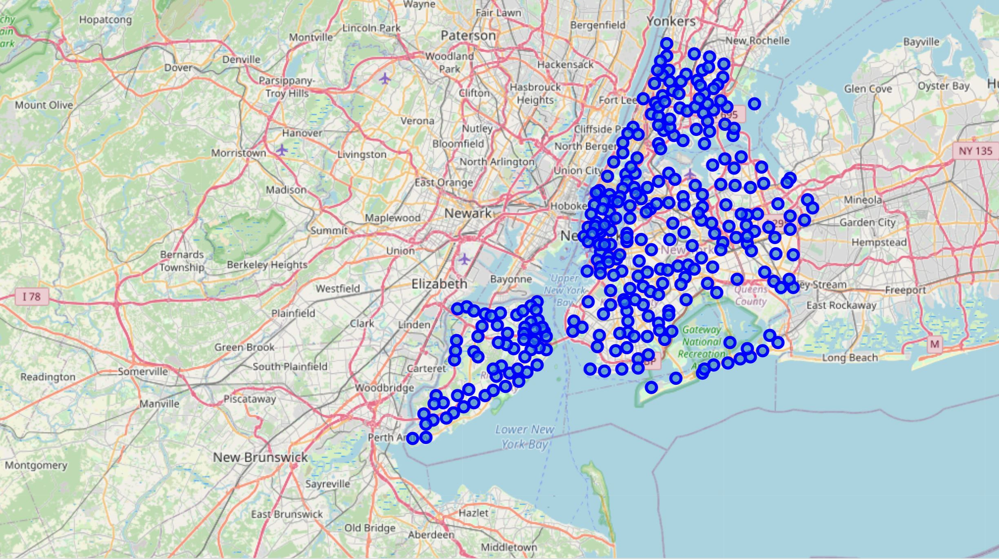
METHODOLOGY (ALL INDIAN CUISINES IN MANHATTAN AREA)

Slide 6
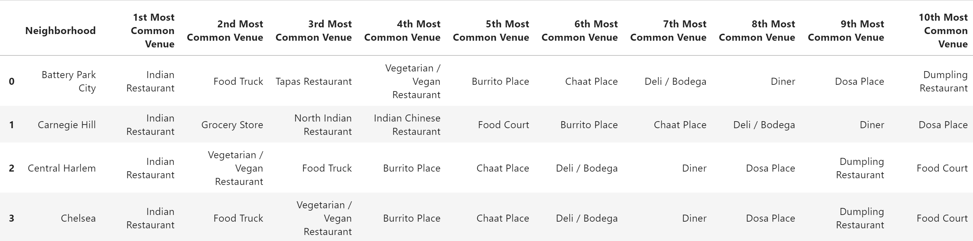
METHODOLOGY MERGED DATA SET SHOWING INDIAN CUISINES IN DIFFERENT MANHATTAN NEIGHBORHOOD

Slide 7
RESULTS BASED ON K-MEANS CLUSTERING TECHNIQUE
- Based on the grouping, four clusters were formed.
Cluster 1 has 13, Cluster has 16, Cluster 3 has 7 and Cluster 4 has 3
Indian Cuisines.
Clearly Cluster 1 and Cluster 2 are NOT suitable for starting a new Indian Cuisine as it is highly already crowded. Cluster 3 and 4 has good options.
CLUSTER 3 ANALYSIS: Very interesting data. This cluster is flooded by Vegetarian restaurant, fast food place like food truck, burrito place, chaat place, deli, diner, dosa place, a Himalayan cuisine and then food court. So this place clearly lacks few things like an authentic IndoChinese Cuisine, an Indian Pizza place, a grocery store to quickly supply materials for cuisine to run efficiently, authentic multi Indian dish serving cuisine where both vegetarian and non vegetarian food can be made available. We have 7 places covered in this cluster and pretty much all of them follow the same pattern of Indian cuisines due to close neighborhood boundary may be.
CLUSTER 4 ANALYSIS: This cluster covers little away from the other
crowded Manhattan place. Gramercy, Carnegie Hill and Stuyvesant Town
are the only places in this cluster where we find some Indian cuisine.

Slide 8

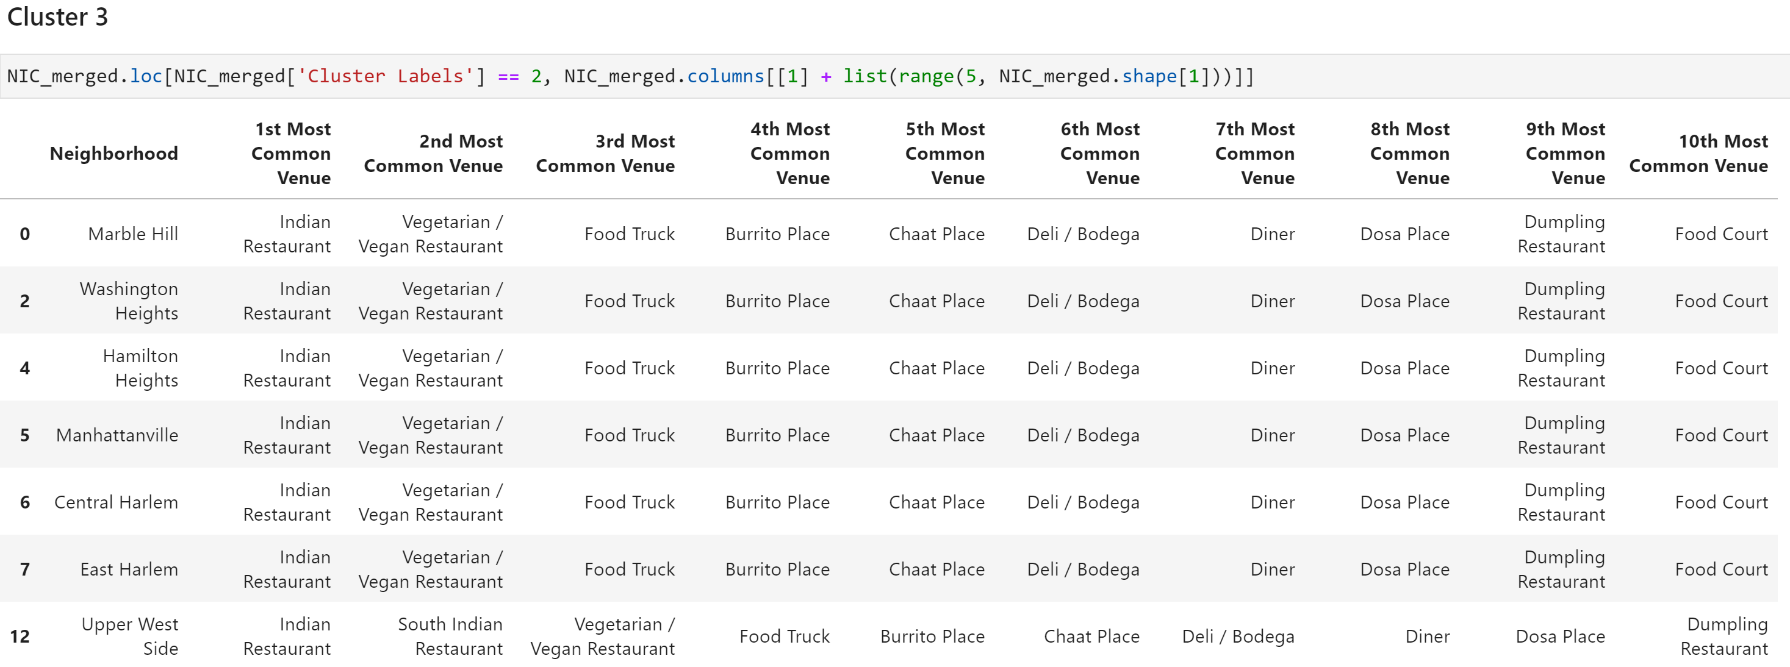
RESULTS BASED ON K-MEANS CLUSTERING TECHNIQUE

Slide 9
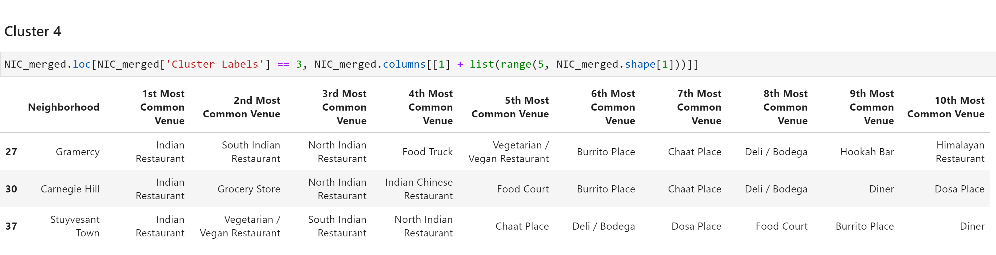
RESULTS BASED ON K-MEANS CLUSTERING TECHNIQUE

Slide 10
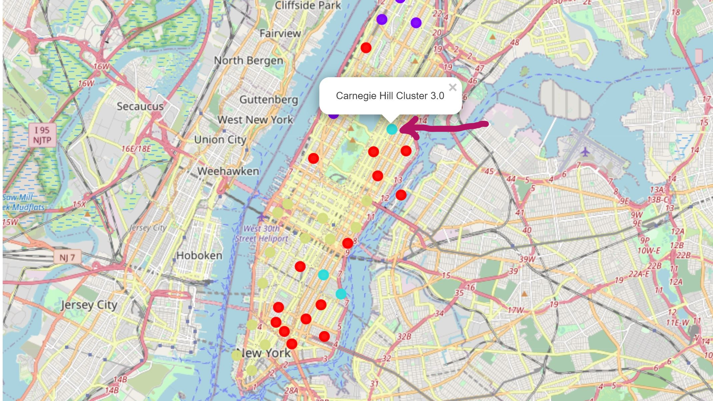
RESULTS BASED ON K-MEANS CLUSTERING TECHNIQUE

Slide 11
DISCUSSION
With more than 1500+ restaurants already in Manhattan area, starting another Indian cuisine in Cluster 1 and Cluster 2 would be challenging for doing god business
In addition both Cluster 1 and Cluster 2 are highly crowded place where commute is a concern. Only public transportation needs to be used to avoid traffic jam. People will avoid during peek hours to visit a restaurant due to fear of lack of parking and lack of service.
This analysis can be more pruned by including nearby schools, parks, any business centers, train stations etc.
Cluster 3 is also a good candidate for opening a new Indian cuisine provided it caters non-vegetarian food. The 1st common busy place is actually a vegetarian or vegan restaurant in almost 6 out of 7 locations. Almost all the locations have fast food and burrito shops. Also lack of grocery shop poses a problem in getting raw materials for cooking quickly if needed.

Slide 12
DISCUSSION
Cluster 4 compliments are drawbacks of cluster 1, 2, and 3.
This cluster covers little away from the other crowded Manhattan place. Gramercy, Carnegie Hill and Stuyvesant Town are the only places in this cluster where we find some Indian cuisine.
Overall given the data analysis performed with the available data set, Carnegie Hill location seems best suitable to start a multi Indian cuisine which can also cater to fine dining experience, fast food corner, chaat corner, sweet sales both in the dinning place and also catering to the nearby grocery shop and delivery to most locations based on services like doordash.

Slide 13
CONCLUSION
Based on this project and data analysis, my brother's family can start an Indian cuisine which mainly focusses on catering fine dinning of authentic South/North Indian dishes, Steam cooked food (to cover any Himalayan origin food), fast food, sweet product catering both in the cuisine and to the near by Grocery shop for sale and drive through facility for quick food pickup. Having tie up with services like doordash would also benefit the business growth.

