Slide 1
Bilingual Language Processing
COGS 200
October 2, 2014

Slide 2
Announcements
Please note: we have changed the end-of-term poster session date from November 27 to November 25.
The review of the topic of Time will be on November 27.
IF YOU HAVE NOT FILLED IN THE BACKGROUND AND INTEREST ASSESSMENT, YOU MUST DO SO BEFORE SATURDAY.

Slide 3
Goals
How do a bilingual speaker’s two languages interact?
What does that tell us about language processing in bilinguals?
Relationship of bilingualism to other cognitive processes
(A bit about) teaching and learning a second language
(A bit about) the neural basis of bilingualism
Notes:
By the way, the first paragraph of this paper is a great model for the first paragraph of your final write-up

Slide 4
Corrections: Beware!
Polysemy (a little murky)
Sam threw the ball: ball [spherical object] and ball [fancy dancing party] are homonyms, homophones, and homographs, but not polysemes (because the meanings are not related)
Sue and Jill were reading the same book: I have no idea whether book is polysemous in this sentence or not.
Bonus! Capitonyms are words that are spelled the same but mean something different if they are capitalized: march and March.
Connotation
Chris tells me that, in Philosophy, this is not quite synonymous with “sense,” as I used it in my previous lecture; it carries the additional meaning of having to do with some emotional aspect of the word.

Slide 5

Translation
“Carry across,” presumably meaning
“A written or spoken rendering of the meaning of a word, speech, book or other text in another language.”
Notes:
Bob’s right—we never really defined it

Slide 6
Translation
Ikstuarpok (Inuit) “the frustration of waiting for someone to show up”
Fernweh (German) “feeling homesick for a place you have never been to”
“Carry across,” presumably meaning
“A written or spoken rendering of the meaning of a word, speech, book or other text in another language.”
Tingo (Pascuense) “to gradually steal all the possessions out of a neighbor’s house by borrowing and not returning”
Papakata (Cook Islands Maori) “having one leg shorter than the other”
Prozvonit (Czech) “to call a mobile phone only to have it ring once so that the other person will call you back and you don’t have to spend money on minutes”
Tsundoku (Japanese) “the act of leaving a book unread after buying it, typically piling it up together with other such unread books”
Notes:
Bob’s right—we never really defined it

Slide 7
Translation
Ikstuarpok (Inuit) “the frustration of waiting for someone to show up”
Fernweh (German) “feeling homesick for a place you have never been to”
“Carry across,” presumably meaning
“A written or spoken rendering of the meaning of a word, speech, book or other text in another language.”
Tingo (Pascuense) “to gradually steal all the possessions out of a neighbor’s house by borrowing and not returning”
Miss (English) “to feel sad when someone or something is not around”
Papakata (Cook Islands Maori) “having one leg shorter than the other”
Prozvonit (Czech) “to call a mobile phone only to have it ring once so that the other person will call you back and you don’t have to spend money on minutes”
Tsundoku (Japanese) “the act of leaving a book unread after buying it, typically piling it up together with other such unread books”
Notes:
Bob’s right—we are talking from an English-centric point of view
We will return to these issues. Today we are going to look at the person who does the translating—someone who has command of two languages, and examine what is going on in their mind as they navigate their world

Slide 8
How would you define a bilingual person?
Notes:
How many people think of themselves as bilingual?
How many know a second language? The same number? If not, why not?
How many people in the world are bilingual? How many bilinguals do you know?

Slide 9


Is this a language I know?
The train station is over there.
Jkwondmclshuspcjd !?
Which one?
Gd;o;skmnbhosba, !
Which language do I use to answer?
Bilingual
English or sklm, ?
Jkwondmclshuspcjd !?
Nope
Is this English?
Monolingual
Notes:
Bilinguals slower to name pictures and recognize non-words
Illustrates suppression of one language as well (will talk about later)
Most importantly—bilinguals don’t have two separate systems for their two languages, so what we know about monolinguals may not be right for bilinguals
What we know about monolinguals may not be right for monolinguals, in light of what investigating bilingual langage processing can tell us about language processing
Digression to address another assumption about language processing

Slide 10


Lessons from bilinguals: Label acquisition by infants
General purpose, innate constraints
New labels interpreted as applying to basic categories.
Dog, not Spot, spaniel or animal
New labels apply to whole object.
Entire dog; not leg, tail, brown-ness or spots
Contrast
If you are using more than one word for something (e.g., dog, spaniel, animal) then those meanings highlight some contrast.
Mutual exclusivity
Basic categories have just one name.
Notes:
Point and say doesn’t work: gavagai, abstract nouns, blind people, people don’t always do it, verbs in general don’t get labeled, flee and chase—same action
ILLUSTRATE ME WITH NONSENSE OBJECT WITH CLASS…segue to testing with babies

Slide 11
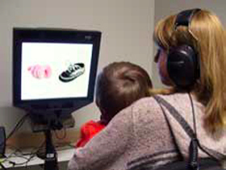
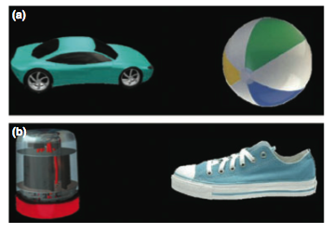
Lessons from bilinguals: Mutual exclusivity
Notes:
Test with class--TAKE A NONSENSE OBJECT

Slide 12
Lessons from bilinguals: Mutual exclusivity
Look at the car!
Notes:
Test with class--TAKE A NONSENSE OBJECT

Slide 13
Lessons from bilinguals: Mutual exclusivity
Look at the car!
Look at the blick!
Infants look at the weird red-and-grey object because they know what a “shoe” is, and you aren’t asking for the “shoe.”
Byers-Heinlein & Werker, 2009
Notes:
Test with class--TAKE A NONSENSE OBJECT

Slide 14
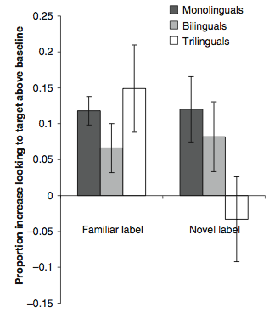
Mutual exclusivity is an innate constraint on learning words.
e.g., car
Byers-Heinlein & Werker, 2009

Slide 15
Mutual exclusivity is an innate constraint on learning words.
Novel label
e.g., car
e.g., blick
Byers-Heinlein & Werker, 2009

Slide 16
Mutual exclusivity is an innate constraint on learning words. Or is it??
Novel label
e.g., car
e.g., blick
Byers-Heinlein & Werker, 2009

Slide 17
Mutual exclusivity is a function of number of languages known.
e.g., car
e.g., blick
Byers-Heinlein & Werker, 2009
Notes:
So, studying bilingual language processing can tell us a lot about language processing in general: tolerant of more than one label, EVEN WHEN EXPERIMENT IS CONDUCTED IN JUST ONE LANGUAGE—will come back later
End of digression about language acquisition

Slide 18
Bilinguals and translation
Low proficiency L2 (second language) users “translate”
Proficient L2 users still move back and forth between languages
Do we want to call this “translating”?
How?

Slide 19
Bilinguals and translation
Low proficiency L2 (second language) users “translate”
Proficient L2 users still move back and forth between languages
How?
L1
L2

Slide 20
Bilinguals and translation
Low proficiency L2 (second language) users “translate”
Proficient L2 users still move back and forth between languages
How?
L1
L2
L1
L2

Slide 21
Bilinguals and translation
Low proficiency L2 (second language) users “translate”
Proficient L2 users still move back and forth between languages
How?
L1
L2
L1
L2
L1
L2

Slide 22
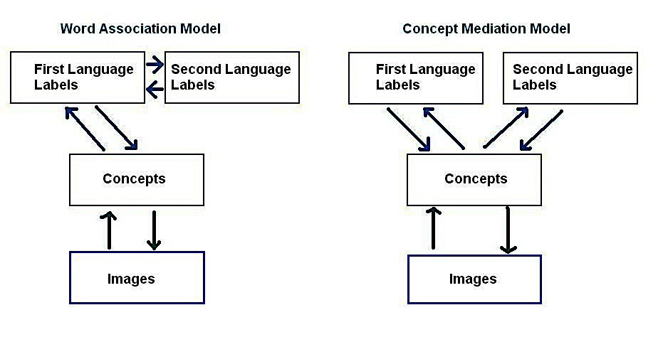
Two ways to think about the relationship between L1 and L2
A “translation” model
An “interlingua” model
Notes:
WAM: picture naming harder than translation; CM: both take the same time
Is there just one bank of concepts that the two language share??? Footnote 3 mentions some possible counter examples—you know of others

Slide 23
Two ways to think about the relationship between L1 and L2
= Interlingua
A “translation” model
An “interlingua” model
Notes:
WAM: picture naming harder than translation; CM: both take the same time
Is there just one bank of concepts that the two language share??? Footnote 3 mentions some possible counter examples—you know of others

Slide 24
Interlingua model for translation
Words in every language are linked to a conceptual description
Kill → Cause to become not alive
Component concepts: cause, become, not, alive
Language …
Language 4
Language 1
Interlingua
Language 3
Language 2

Slide 25
Interlingua model for translation
Kill → Cause to become not alive
Component concepts: cause, become, not, alive
Set of concepts matched to word/expression in the target language
Language …
Language 4
Language 1
Interlingua
Language 3
Language 2

Slide 26
Interlingua model for translation
miss X→ not happy in the case that X is not present
Concept components: not, happy (??), present (??)
One problem: what are the right basic concepts to include in the interlingua?
Language …
Language 4
Language 1
Interlingua
Language 3
Language 2

Slide 27
Interlingua model for translation
tingo → come to possess (??) objects where objects = sum of possessions (??) of person where person = someone occupying (??) domicile (??) near subject of tingo
Language …
Language 4
Language 1
Interlingua
Language 3
Language 2

Slide 28
Interlingua model for translation
tingo → come to possess (??) objects where objects = sum of possessions (??) of person where person = someone occupying (??) domicile (??) near subject of tingo
Another problem
Not that it is complicated
Not that a single word in the source language must be translated by an expression in the target language
But that, even when translated,
the target language
speaker may not have
the concept
Language …
Language 4
Language 1
Interlingua
Language 3
Language 2

Slide 29
“Impossible” translation
Stylistic reasons
Already discussed; a question of aesthetics…
Languages represent the world differently
So there can never be exact equivalence between languages
Possible solutions
Settle for functional, close-enough “equivalence”
hello = guten Tag = konnichiwa
tingo = moocher (?)
Accept the need for lengthy work-arounds
tingo = stealing all your stuff by borrowing it and never returning it
Stay tuned! We’ll come back to this when we read Whorf for our discussion of Time

Slide 30
Testing models of bilingual language processing
Predictions:
Word Association Model: Translation in either direction (L1 → L2 or L2 → L1) should be faster than picture-naming in L2
Concept Mediation Model: L1 → L2 translation should take the same amount of time as picture-naming in L2
Notes:
WAM: picture naming harder than translation; CM: both take the same time

Slide 31
Results:
✓
Translating from L1 to L2 takes the same amount of time as naming a picture in L2.
But actually…
Notes:
With both proficient and not proficient bilinguals

Slide 32
Revised concept mediation model
L2 → L1 translation is faster than L1 → L2 translation.
L2 → L1 lexical links are sufficient for translation.
L1 → L2 requires reference to concept level as well.
And, semantic interference is greater in L1 → L2 translation
Supports the notion that L1 → L2 translation requires reference to concept level, and that…
L2 → L1 uses lexical links.

Slide 33
Revised concept mediation model
Still haven’t quite addressed the question of how L1 and L2 are stored and activated.
L1
L2
L1
L2
L1
L2
33
Notes:
That evidence comes from studies pitting L1 against L2 and looking at competition

Slide 34

Competition
z
JkwonL2mclshuspcjd !!
Use your L1! Understand what you are hearing as your L1!
Cognate advantage:
words that sound alike
and mean the same thing are produced and comprehended faster than other words (milk and Milch).
In bilingual and monolingual modes
In stronger or weaker language
Interlingual homograph disadvantage:
Words from two languages that sound and look alike, but mean different things.
chef = “cook” (English) and “boss” (German)
Bilinguals respond more slowly to these words, when reading OR hearing.
Notes:
Cognate advantage tasks: picture naming and translation
Traxler differs in his definition of “cognate”—he says they mean the same thing, too—not necessarily
Interlingual homographs like ambiguous words for monolinguals

Slide 35

Hearing a word activates
BOTH L1 and L2
Pseudohomophone priming: roap (“rope”) primes touw (“rope”) in Dutch-English bilinguals.
Pseudo: “not real”; homo: “same”; phone: “sound”
In a picture-word interference experiment, for example, naming a picture of a mountain in English…
Phonological distractors speed naming: hearing Dutch mouw AND English mouth speed response of “mountain”
Semantic distractors slow naming: hearing Dutch dal (“valley”) AND English valley slow response of “mountain”
Supports the view that bilinguals’ two languages share long-term memory; are activated together.
Notes:
Just like with other forms of word processing, including reading, store semantics based on phonology
Mouw is sleeve in Dutch; dal is valley in Dutch—picture-word interference results same for either L1 or L2 distractors—show that languages affect one another
Last two pices of evidene show that naming and translation are, again, different

Slide 36


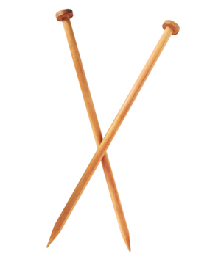


A closer look
Pick up the speaker.
Target
Within language competitor
Between language competitor
Distractor
Results
Russian/English bilinguals are distracted by BOTH competitors
E knitting needles
R spitsky
E speaker
R dinamik
E book
R kniga
E spear
R kop’ye

Slide 37
A closer look
Pick up the speaker.
Target
Within language competitor
Between language competitor
Distractor
Results
Russian/English bilinguals are distracted by BOTH competitors
E knitting needles
R spitsky
E speaker
R dinamik
E book
R kniga
E spear
R kop’ye

Slide 38
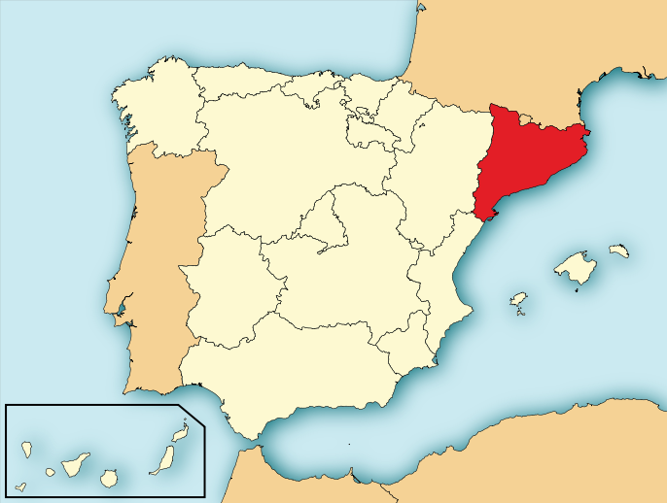
Possible exceptions to L1 and L2 simultaneous activation
Dominant language usually more activated
Interference minimized when speakers are highly and equally fluent; in two similar languages
Highly proficient Catalan-Spanish/Spanish-Catalan bilinguals
No interference in picture-
naming or translation
Symmetrical switch (L1 → L2
vs. L2 → L1) costs
Notes:
High proficiency allows controlling two langages without supressing one of them? But what about similarity of languages, etc.?

Slide 39
Shared syntactic structure
(1) The truck is chased by the taxi.
(2) El camión es perseguido por el taxi.
Shared syntax account: bilinguals re-use as much of the syntax of L1 as possible when using L2.
ONLY when patterns in L1 and L2 match
Syntactic priming effects are just as large between L1 and L2 as within the same language.
Persist across brief lag
Notes:
French-English bilingual children more likely to violate adj-n word order than either monolingual counterpart—competition between syntactic structures (adj-n vs. n-adj) of the two languages: contributes to language change?

Slide 40

“Shared” syntactic structure
Sign in a hotel in the Netherlands.
Have you the time?
Here is Hani.
Other examples?

Slide 41

Language control in bilinguals
Selective access: bilinguals can switch L1 and L2 on and off
Evidence against selective access: paradoxical switch costs.
Change from L2 → L1 is costlier than switch from L1 → L2, because…
L1 is likely dominant
Therefore, has to be suppressed harder
Therefore harder to switch into
(Note: SWITCHING between L1 and L2;
NOT translating)
Notes:
So, if there is all this competition, why don’t they make mistakes and mix language all the time?
Use color background and numbers (rather than words) to test
Switch costs are really more costly from weak to strong than from strong to weak
BIA+ (Bilingual interactive activation): based on TRACE (which we didn’t study)
High level control structure keeps track of which language is being spoken
Both can still be activated
Control structure aids in choice of word/structure

Slide 42
Bilingualism and executive control
Executive control: the set of skills that allows us to manage our thought processes and behavior effectively
Bilinguals have superior executive control
More practice
Bilinguals outperform monolinguals in tasks that require an individual to ignore task-irrelevant information
interference suppression
response inhibition
Notes:
Bilinguals practice executive control with every word

Slide 43
Bilingualism and executive control
Bilinguals do better than monolinguals on
ANT and Simon tasks
Better on congruent tasks
Much better on incongruent tasks
Press left button for green objects
Congruent
Incongruent
Congruent
Incongruent
Notes:
ANT = Attention Network Test

Slide 44
Goals
A bilingual speaker’s two languages compete
Language processing in bilinguals is a complex interplay of competition, access and suppression
Involving both phonology and semantics
Bilinguals may have superior executive control
Different methods for learning a second language are appropriate for different learners
We are just beginning to learn about the neural basis of bilingualism
And…?
44

Slide 45
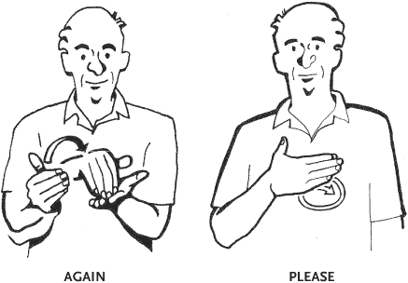
Are bilinguals just cognitively better?
No
Some phonological tasks are easier for bilinguals; some easier for monolinguals; some the same
Bimodal bilinguals resemble monolinguals on executive control tasks
Don’t have to suppress
sign while speaking English?

