Slide 1

RAT-STATS 2017 Development
April 20, 2017
Table of Contents
Prerequisites
Installing CMake
Installing QtSDK
QtSDK Configuration
Build Artifacts and Deployment

Slide 2
Prerequisites
Please download the tools below before continuing.
Tool | URL
CMake – This is the build system used by RAT-STATS 2017 | https://cmake.org/files/v3.8/cmake-3.8.0-win32-x86.zip
QtSDK – This is a C++ library for creating user interfaces. It also provides the QtCreator IDE that RAT-STATS 2017 uses for development. | http://download.qt.io/official_releases/qt/5.8/5.8.0/qt-opensource-windows-x86-mingw530-5.8.0.exe
SourceGen / ProjectGen – These tools are used for generating C++ skeleton source code and CMake projects. | These tools are located in the rstats_source/products/RAT-STATS/rstats_contrib/sgen and rstats_source/products/RAT-STATS/rstats_contrib/pgen folders You may also browse GitHub for future releases at: http://www.github.com/Cbtek/SourceGen and http://www.github.com/Cbtek/ProjectGen

Slide 3
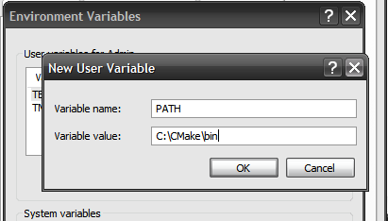
Installing CMake
Extract the CMake ZIP file to any path somewhere on your local machine. (e.g C:\CMake)
Add the URL to the “bin” folder located in the CMake installation to your PATH variable:

Slide 4
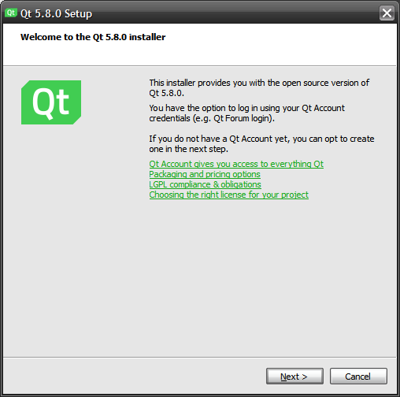
Installing QtSDK
Open the installer
Press “Next”

Slide 5
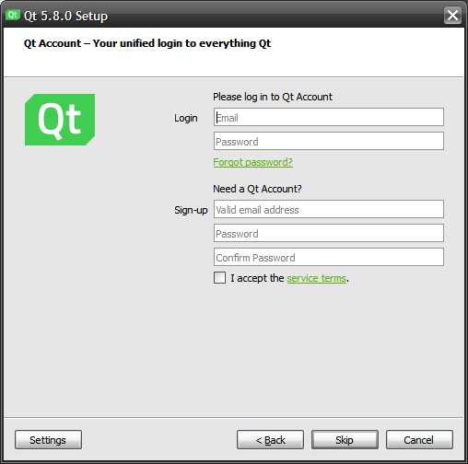
Installing QtSDK (cont.)
Click the “Skip” button
Press “Next”

Slide 6
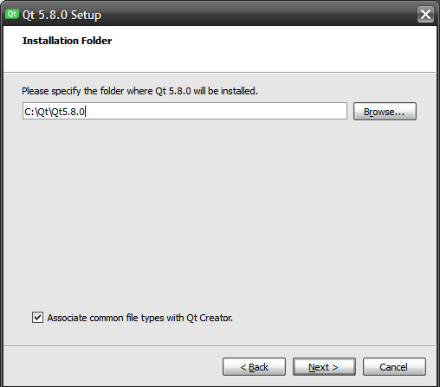
Installing QtSDK (cont.)
Set the path where you would like to install QtSDK.
Press “Next”

Slide 7
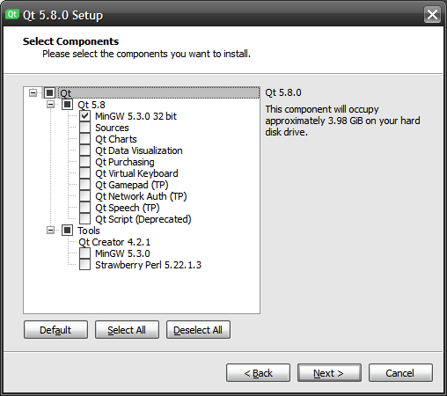
Installing QtSDK (cont.)
Expand the “Qt 5.8”
tree and un-check all the extra Qt components since they are not used by RAT-STATS 2017.
Press “Next”

Slide 8
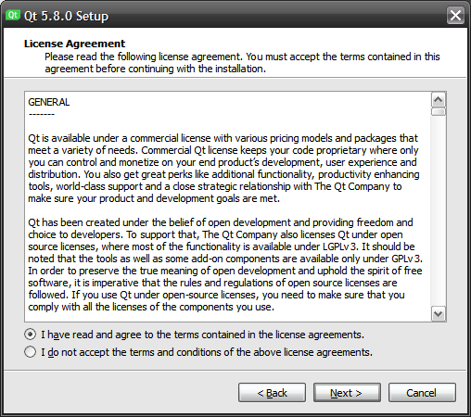
Installing QtSDK (cont.)
Click to accept the license
Press “Next”

Slide 9
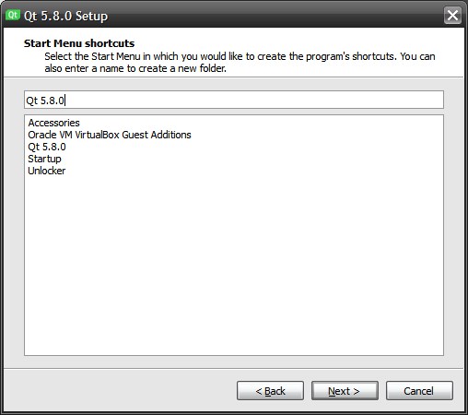
Installing QtSDK (cont.)
Select Start Menu shortcut name
Press “Next”

Slide 10
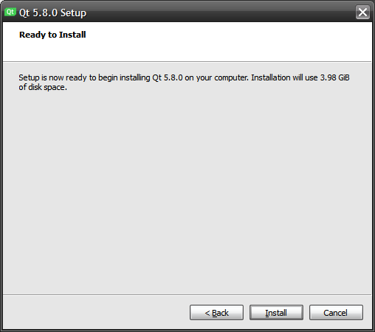
Installing QtSDK (cont.)
Click the “Install” button to begin continue
Installation should
take between 5 and 10 minutes
If you chose to install QtSDK to your user folder and don’t have admin privileges, you may be presented with dialog asking for admin credentials. You should also be able to continue the install by clicking the “Ignore” button.

Slide 11
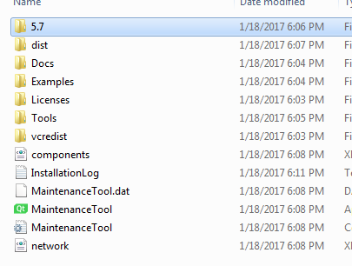
Configuring QtSDK
When installation completes locate your installation directory (See the image on right. Note you may have a “5.8” folder instead of “5.7”)
There are three paths that need to be added to the PATH environment variable (e.g):
(1) Path to QtSDK bin folder
  C:/Qt/QtSDK5.7.0/5.7/mingw_53_32/bin
(2) Path to MinGW bin folder
  C:/Qt/QtSDK5.7.0/tools/mingw_530_32/bin
(3) Path to QtCreator bin folder
  C:/Qt/QtSDK5.7.0/tools/QtCreator/bin
(4) Add your paths to PATH and (re)start QtCreator and any open command prompts.

Slide 12
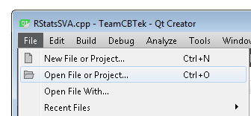
Configuring QtSDK (cont.)
Once QtCreator restarts select File→Open File or Project…

Slide 13
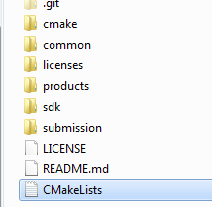
Configuring QtSDK (cont.)
Navigate to the “rstats_source” folder and select “CMakeLists.txt” or “CmakeLists”

Slide 14
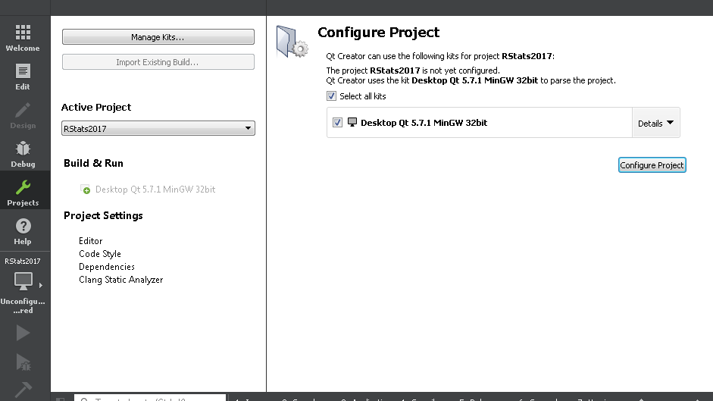
Configuring QtSDK (cont.)
Click the “Details” drop down on the far right:

Slide 15
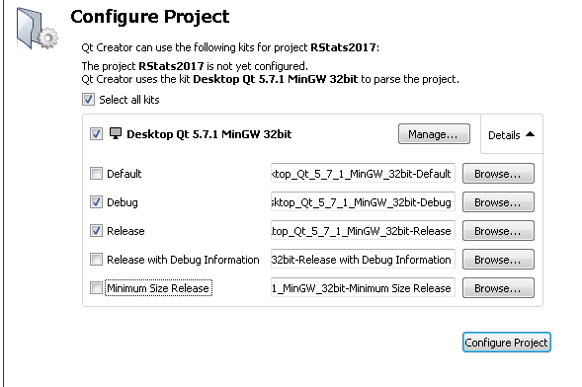
Configuring QtSDK (cont.)
Make sure you only select the “Debug” and “Release” configurations.
Click Configure Project to continue

Slide 16
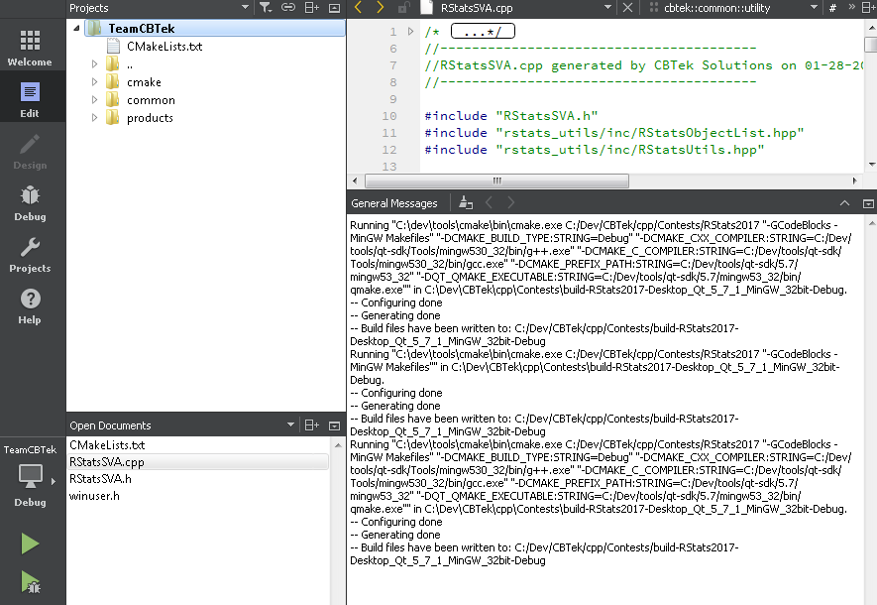
Configuring QtSDK (cont.)
If everything is setup correctly you should see a window similar to the one on the right.
You are now ready to build RAT-STATS 2017
Just press <CTRL+B> or click the “Play” icon in the bottom left.

Slide 17
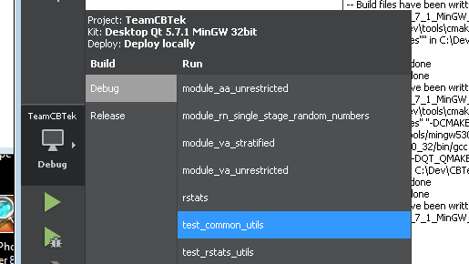
Configuring QtSDK (cont.)
Clicking the Computer Icon under “TeamCBTek” allows you to select a “debug” or “release” build as well as which module/executable you want to run:

Slide 18
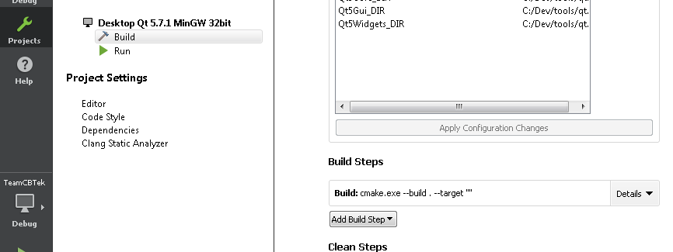
Configuring QtSDK (cont.)
Clicking the “Projects” icon on the far left, takes you to advanced configuration settings for the project. Note the “Build Steps” section on the right. Click the “Details” drop down:

Slide 19
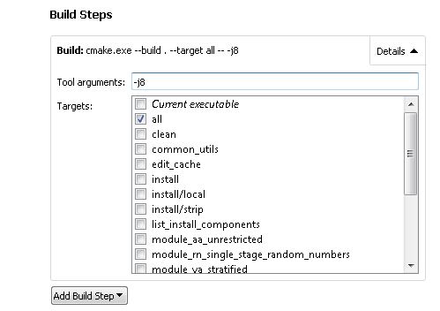
Configuring QtSDK (cont.)
The “Targets” list allows you to select an individual module / executable to build. I usually always just leave the “all” check box checked.
Also notice the “Tool Arguments” text box. yours will probably be empty initially The “-j8” tells the compiler to use 8 parallel cores to build the project. This results in a much faster build depending on how many cores your CPU has. I highly recommend using this if you can. Just set it to how ever many cores your machine has:

Slide 20
Configuring QtSDK (cont.)
Just continue playing around with QtCreator and set it up to your liking.
If you have any issues / problems / suggestions I can be reached via email at corey.berry@cbtek.net

Slide 21
Build artifacts and deployment
All builds are automatically copied to the “bin” folder at the same level as “rstats_source”. They are separated between “Debug” and “Release” builds.
The following files are required from the QtSDK in order to ship / deploy modules / executables with Qt forms:
(1) Qt5Widgets.dll
(2) Qt5Core.dll
(3) Qt5Gui.dll
(4) libgc_s_dw2-1.dll
(5) libstdc++-6.dll
(6) libwinpthread-1.dll
(7) platforms/qminimal.dll
(8) platforms/qoffscreen.dll
(9) platforms/qwindows.dll
This are all provided for you in the rstats_binary folder

