Slide 1

RAT-STATS 2017
Single Stage Random Numbers
Help Guide
April 20, 2017

Slide 2
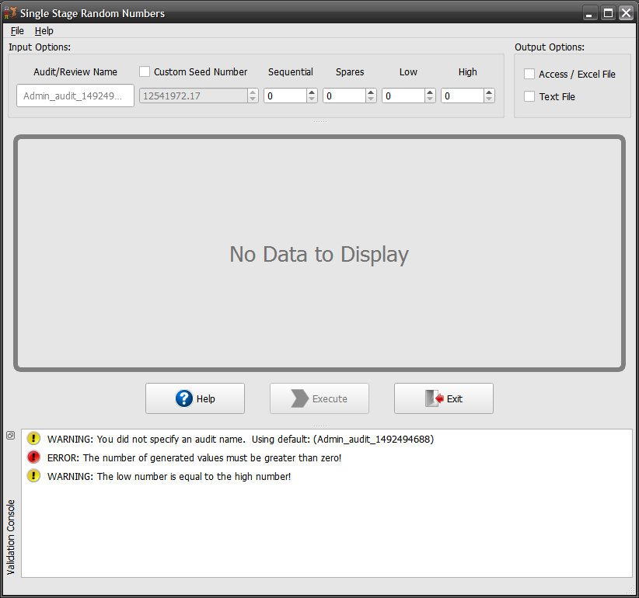
Single Stage Random Numbers
User Interface Overview
Enter the input / output options for needed for producing results.
Display is empty by default. This view changes when “Execute” is pressed.
Get quick access to Help (Alt+H) and Exit (Alt+Q) at any time.
The validation console is used to inform you of any issues that were detected before running the function.

Slide 3
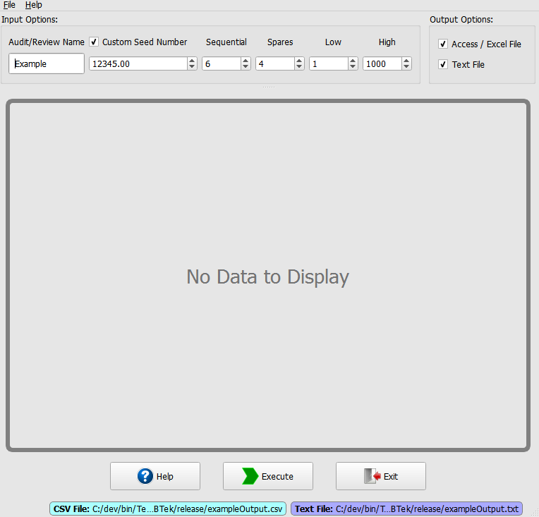
Fill out the input / output options. In this example I am using the input values from the example in the Companion Manual.
Notice that when you select an output option it is labeled at the bottom of the window.
When all the input options pass validation then the console is automatically disables itself.

Slide 4
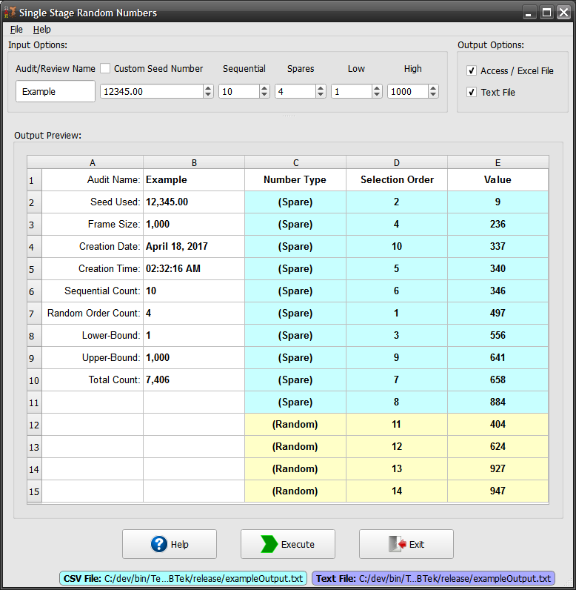
After the execute button is pressed, the function runs and generates the desired output.
Both color and text are used to differentiate between the spare/random types.

Slide 5
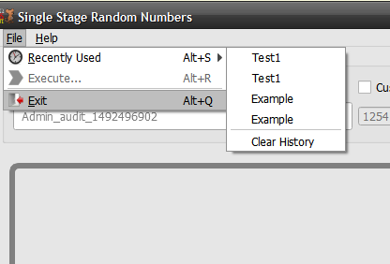
All RAT-STATS functions come with the ability to re-run the last 10 sessions. This is located under the file menu item named “Recently Used” or you can just press ALT+S to quickly see which sessions are available.

