Slide 1

RAT-STATS 2017
Unrestricted Attribute Appraisal
Help Guide
April 20, 2017

Slide 2
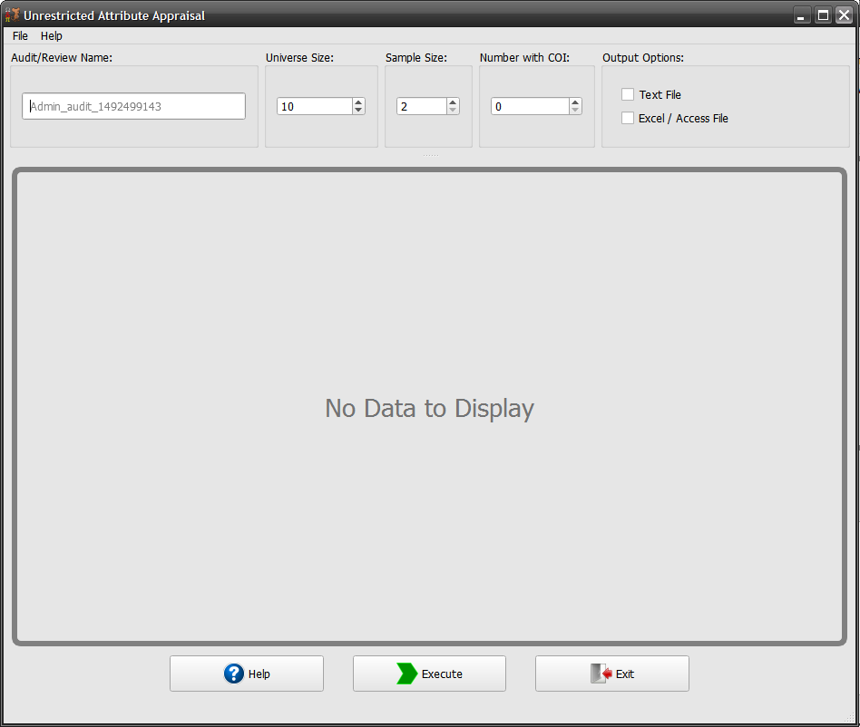
Unrestricted Attribute Appraisal
Help
Fill out the input options and select any desired output. (I am using the example from the Companion Manual for RAT-STATS 2010)
Notice that when you select an output option it is labeled at the bottom of the window.
When all the input options pass validation then the console is automatically disables itself.

Slide 3
Unrestricted Attribute Appraisal
Help (cont.)

