Slide 1

RAT-STATS 2017
Main Menu Users Guide
April 20, 2017

Slide 2
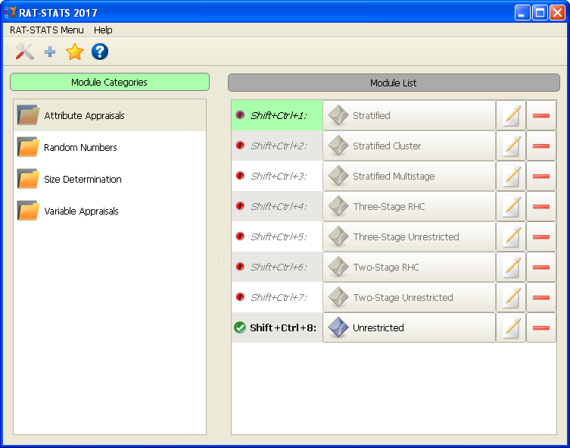
RAT-STATS 2017
The left most list shows the available module categories available. Each category contains one or more modules. You can use the arrow keys (UP/DOWN) to navigate this list.
You may use the arrow keys (LEFT/RIGHT) to switch between the left and right list.
The table on the right shows the available modules for a selected category. You may use the arrow keys (UP/DOWN) to navigate these items.
While highlighted you can press <ENTER> to execute a module, <F1> to edit a module’s properties or <DELETE> to remove the module from the category.

Slide 3
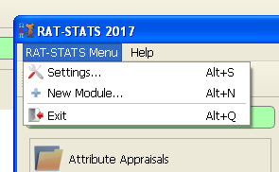
RAT-STATS 2017
The “RAT-STATS Menu” contains the following:

Slide 4
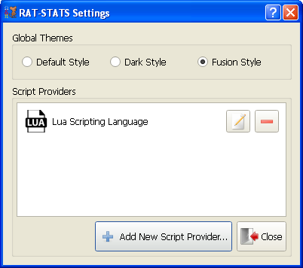
RAT-STATS 2017
Settings
1) Global Themes – This section allows you to change the “look and feel” of the RAT-STATS program.
2) Script Providers – This section allows you to add scripting engines to RAT-STATS for adding support for additional modules.

Slide 5
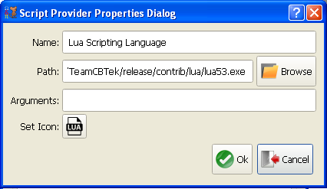
RAT-STATS 2017
Script Providers
Adding / Editing Script Providers gives you the ability to extend RAT-STATS with additional external modules. The example to the right uses the Lua scripting language which ships with RAT-STATS.

Slide 6
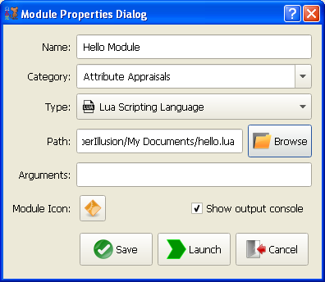
RAT-STATS 2017
Creating a new module
Click the “Add new Module” button or press Alt + N from the main menu.
The following dialog is used for creating / editing modules.
The name given to the module will be saved in the main menu.
You have the option to select an existing category or you can create a new one to add the module to.
The “Type:” field can be used to select a scripting provider for the module. If no scripting modules are available it defaults to using executables.
The Launch button is available for quickly testing the module configuration without saving it.

Slide 7
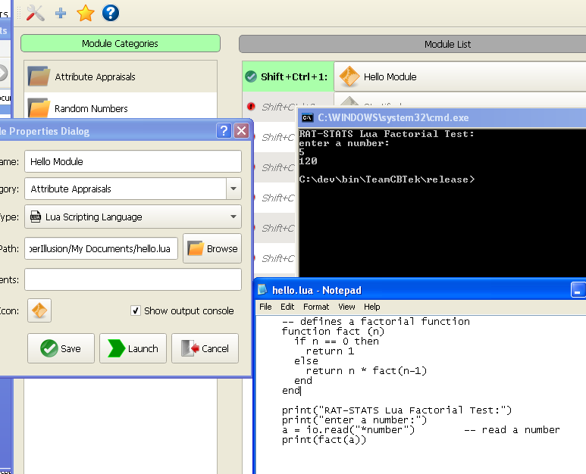
RAT-STATS 2017
Launching new module
The screen to the right shows the output of the “Hello Module”.
You will notice that the module launched a console to allow for entering input data.
This method of extending RAT-STATS is both powerful and easy to use.

Slide 8
Keyboard Shortcuts
Description | Shortcut
Add new module | Alt + N
Open settings dialog | Alt + S
Select list of module categories | Right Arrow Key / Left Arrow Key
Select list of modules | Left Arrow Key / Right Arrow Key
Navigating modules and categories | Up Arrow Key / Down Arrow Key
Edit selected module | F1
Delete selected module | Delete
Launch selected module | Enter
Launch any visible module | (See UI for assigned shortcut)
Quit | Alt + Q (Does not close any open modules)

