Slide 1

Example Comparison Guide Between
RAT-STATS 2017 and RAT-STATS 2010
April 20, 2017

Slide 2
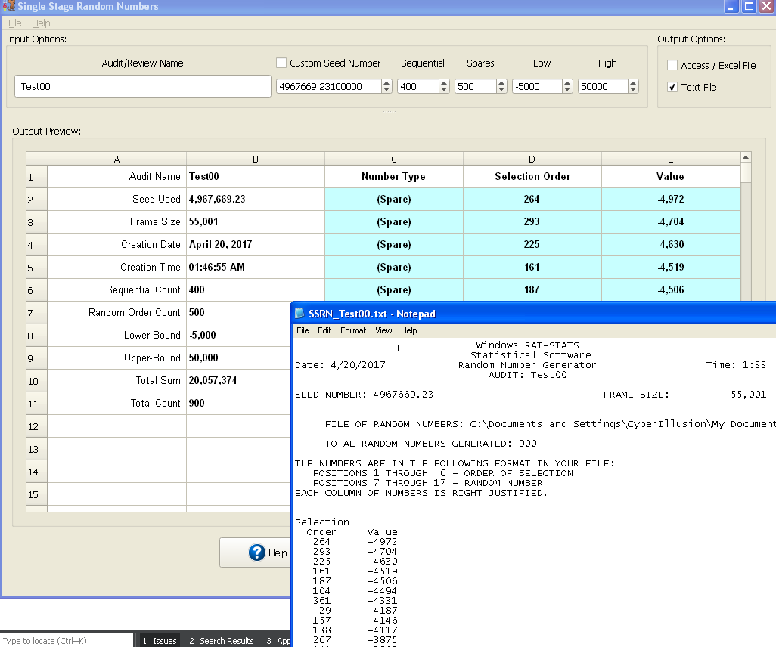
Single Stage Random Numbers
Example 1 (test00)

Slide 3
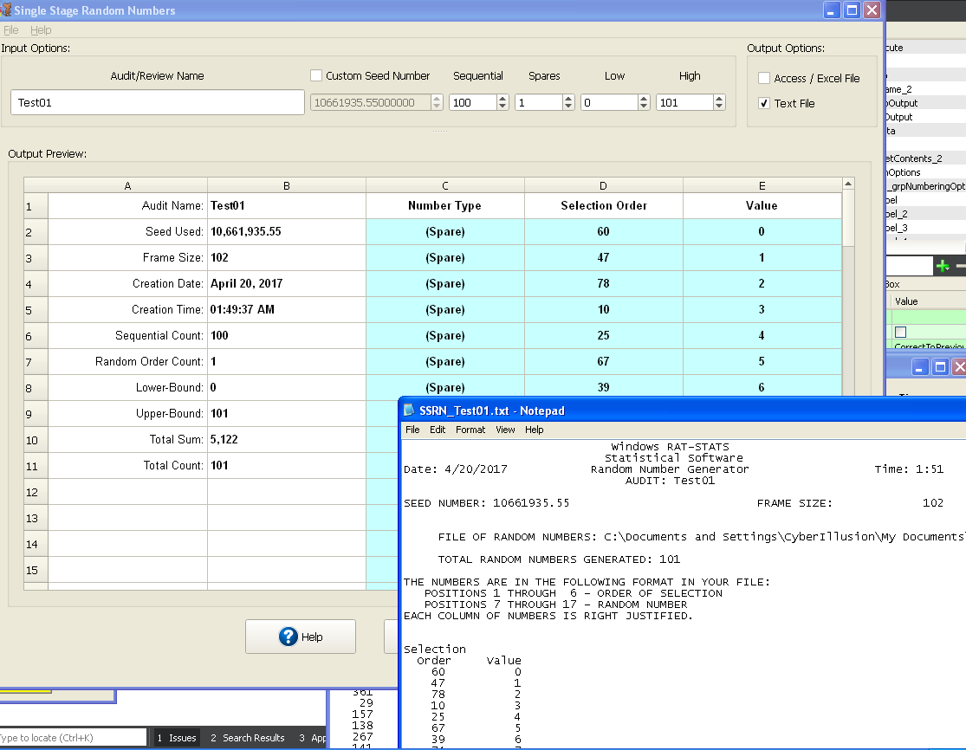
Single Stage Random Numbers
Example 2 (test01)

Slide 4
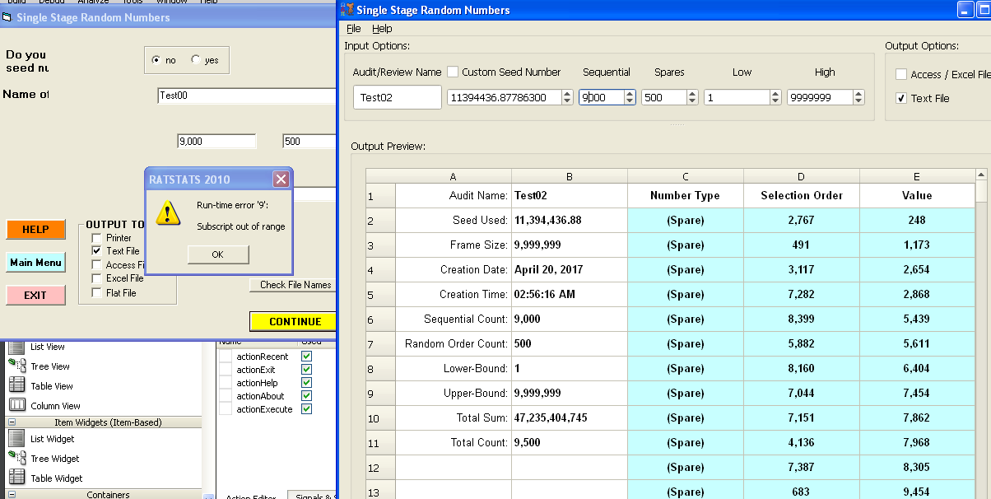
Single Stage Random Numbers
Example 3 (test02)
RAT-STATS 2010 appears to have crashed in this case. The User Guide says that the limit is 10,000 so I am unsure why/how the old version of RAT-STATS failed. The classic runtime error indicates that an array somewhere was being accessed out of bounds.

Slide 5
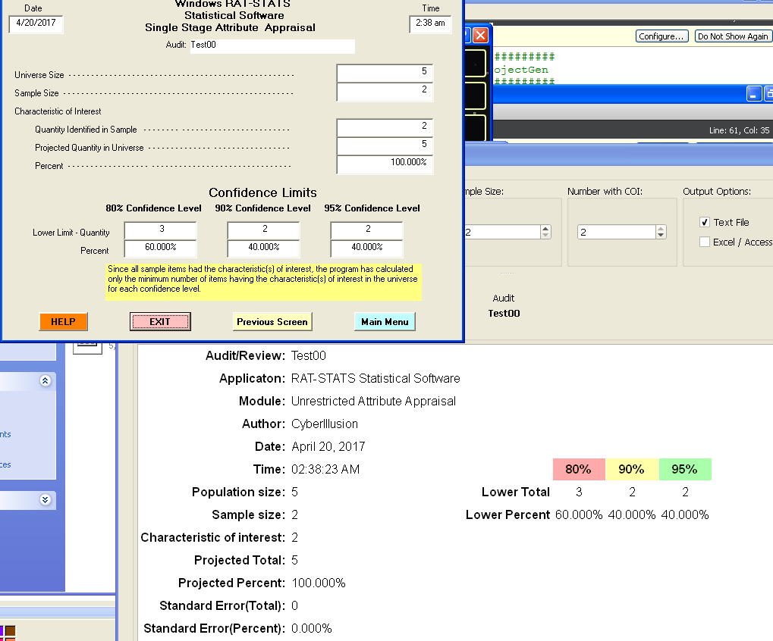
Unrestricted Attribute Appraisal
Example 1 (test00)

Slide 6
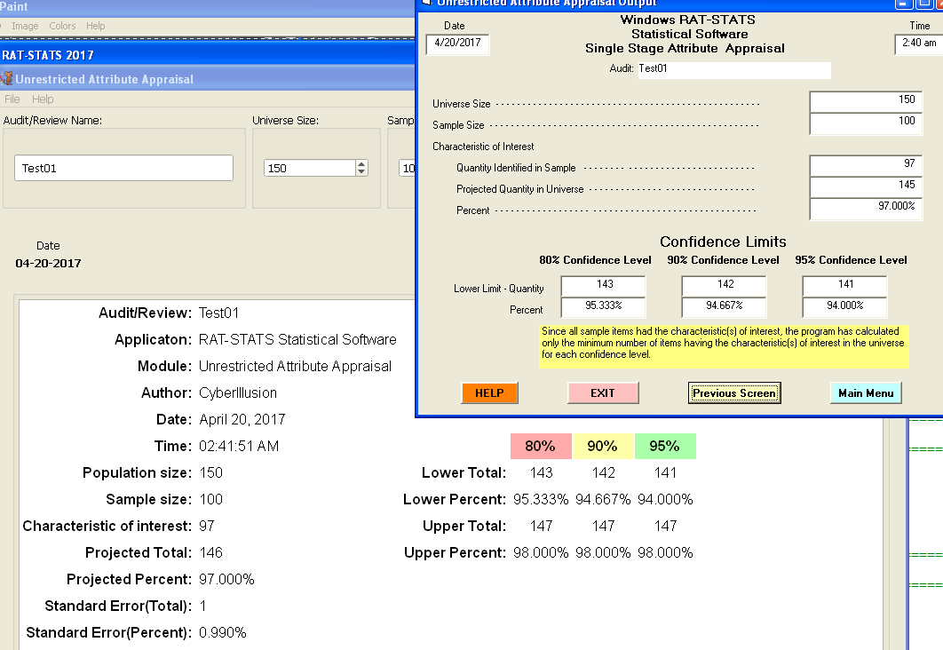
Unrestricted Attribute Appraisal
Example 2 (test01)

Slide 7
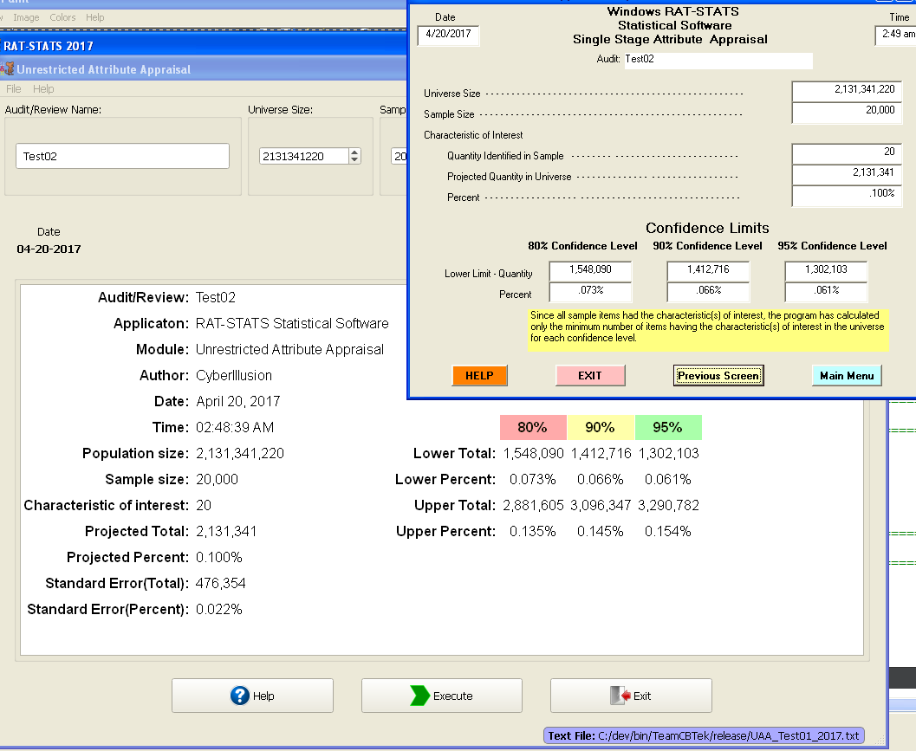
Unrestricted Attribute Appraisal
Example 3 (test02)

Slide 8
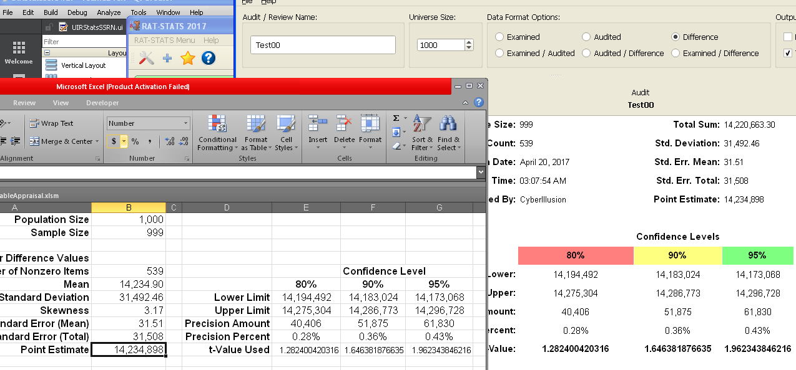
Unrestricted Variable Appraisal
Example 1 (test00)

Slide 9
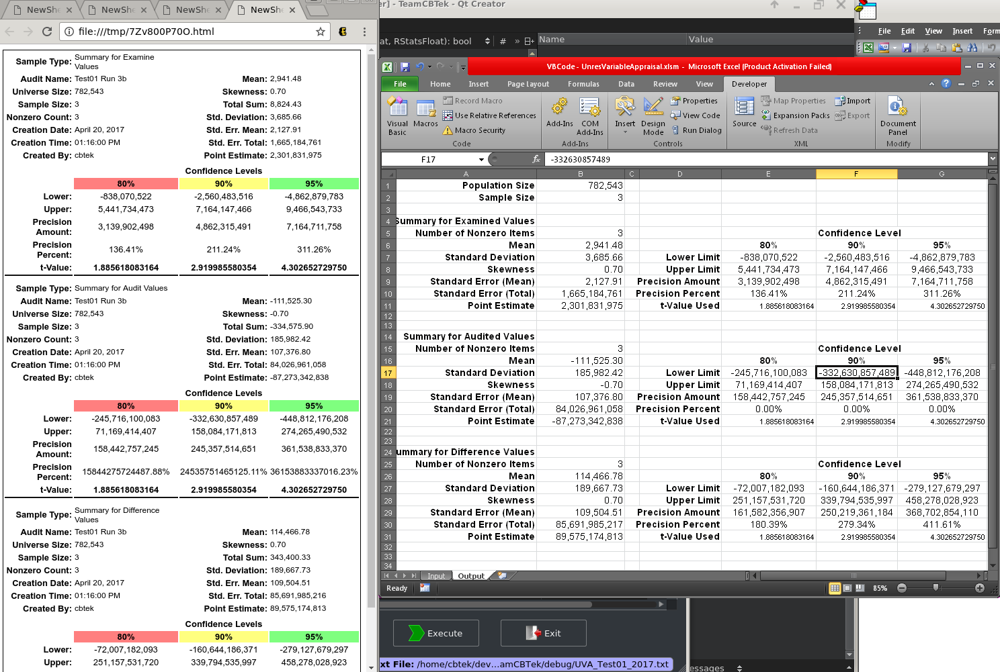
Unrestricted Variable Appraisal
Example 2 (test01)
This comparison utilized the “HTML” output option in RAT-STATS 2017 to better compare more amounts of data

Slide 10
Stratified Variable Appraisal
The SVA function would be better tested in person so it is not provided here.

