Slide 1

RAT-STATS 2017
Stratified Variable Appraisal
Help Guide
April 20, 2017

Slide 2
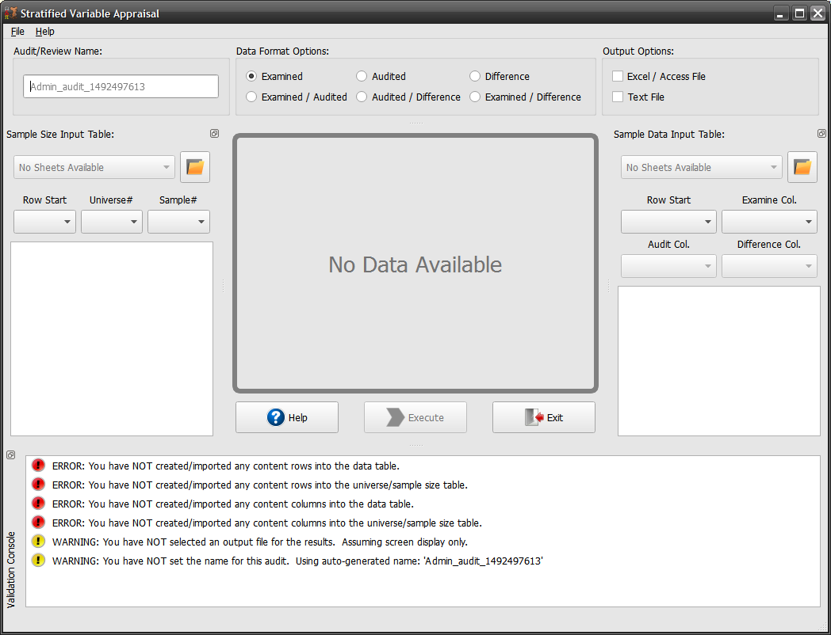
Stratified Variable Appraisal
Help
This dialog attempts to simplify the process of obtaining input data.
Clicking the folder icon under either the Sample Size Input Table or the Sample Data Input Table will allow you to choose between CSV, XLSX and DIF files to import.
The start columns and rows can be selected from simple drop down menus

Slide 3
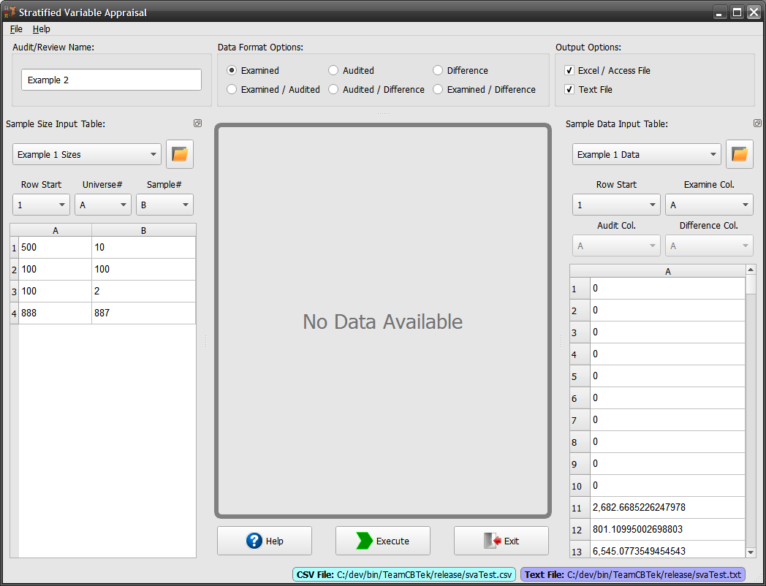
Stratified Variable Appraisal
Help (cont.)
In this example I am loading the example file provided for the competition. I am using the Example 1 data set.
Once the data is loaded for both the left and right tables, you can select the row / column offsets.
“Row Start” defines where the data row should start. This allows you to skip over column labels. The other fields allow you to select which column contains the desired data format.
Choose your data format and update the tables accordingly.

Slide 4
Stratified Variable Appraisal
Help (cont.)
Now that the correct columns and row offsets have been selected you can continue and press the “Execute” button.

Slide 5
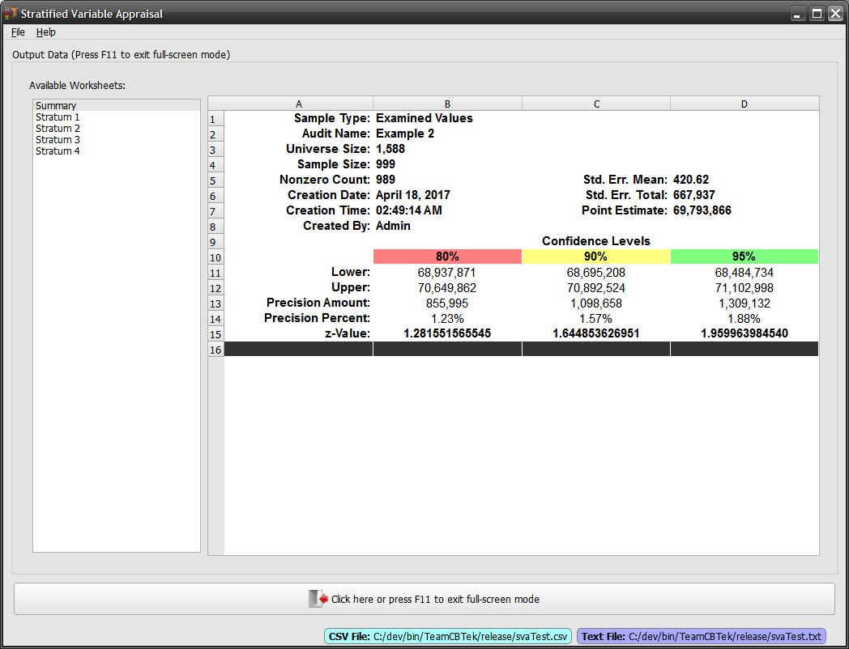
Stratified Variable Appraisal
Help (cont.)
After clicking the “Execute” button a full-screen output window will appear showing the results.

Slide 6

Stratified Variable Appraisal
Help (cont.)
Output results that contain multiple worksheets for output will be saved to individual CSV or text files.

