Slide 1
ECE 18-649
Final Project Report
December 5, 2012
Group # 17:
Jessica Tiu
Collin Buchan
Jesse Salazar
Rajeev Sharma
1
Group 17, Speaker: Jesse

Slide 2
Outline: Group 17
Project Statistics
Dispatcher
  Design Improvements
    Statecharts
    Transitions, Macros
  Testing Strategy
  Interactions with other modules
  Optimizations
Lessons Learned
Open Issues & Suggestions
2
Group 17, Speaker: Jessica

Slide 3
Project Statistics:
Date of Presentation | 10/31 | 12/05
# of sequence diagrams | 18 | 20 | ---
# of SD Arcs | 135 | 218 | ---
# of requirements | 46 | 55 | ---
# of statecharts | 7 | 7 | ---
# of SC States | 19 | 23 | ---
# of SC Arcs | 28 | 33 | ---
# of non-comment/blank LOC | 2063 | 3055 | ---
# of unit tests | 16 | 13 | ---
# of integration tests | 18 | 20 | ---
# of acceptance tests | 4 | 10 | ---
3
Group 17, Speaker: Rajeev

Slide 4
Project Statistics:
Date of Presentation | 10/31 | 12/05
# of unresolved defects | 0 | 0 | ---
# of issue log entries | 33 | 51 | ---
# of peer reviews | 74 | 102 | ---
# of defects found | 75 | 107 | ---
# of defects fixed | 75 | 107 | ---
# of other defects found | 33 | 51 | ---
# of other defects fixed | 33 | 51 | ---
# revision entries | 597 | 826
4
Group 17, Speaker: Rajeev

Slide 5
Dispatcher: Design Improvements
General Design: Sabbath -> Smart Dispatcher
Recycled the 'RESET' state
Added an 'IDLE' state
'COMPUTE' state actually computes a desired floor using available calls
Fast-speed added: Utilize commit-points
Calculate where the car can land based on speed/direction of the drive
Dispatcher design tradeoff:
Fewer states vs. fewer transitions - we opted for fewer states.
Group 17, Speaker: Rajeev
5

Slide 6
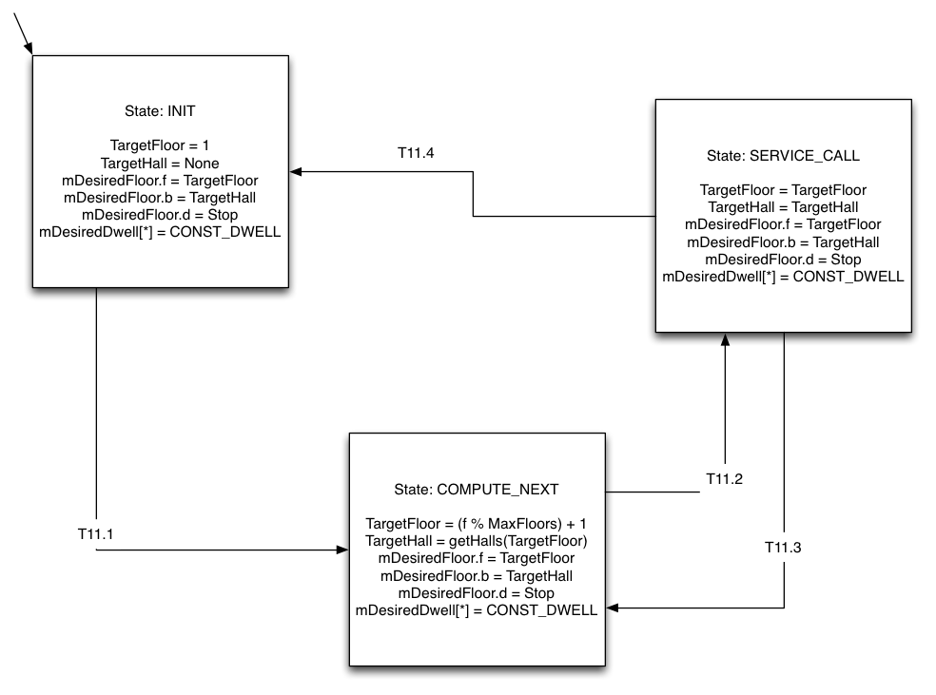
Dispatcher: Old Statechart
Group 17, Speaker: Rajeev
6

Slide 7
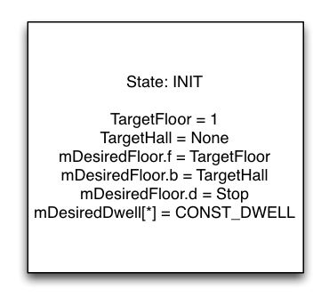
Dispatcher: Old States
1.) INIT
2.) SERVICE_CALL
3.) COMPUTE_NEXT
Group 17, Speaker: Rajeev
7

Slide 8
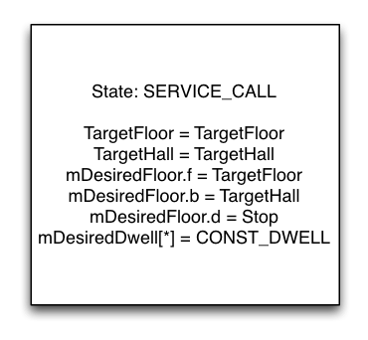
Dispatcher: Old States
1.) INIT
2.) SERVICE_CALL
3.) COMPUTE_NEXT
Group 17, Speaker: Rajeev
8

Slide 9
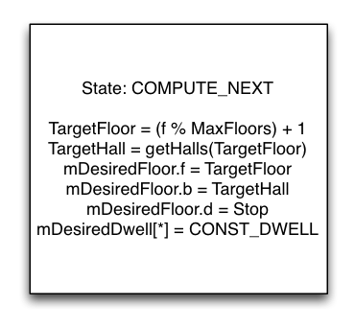
Dispatcher: Old States
1.) INIT
2.) SERVICE_CALL
3.) COMPUTE_NEXT
9
Group 17, Speaker: Rajeev

Slide 10
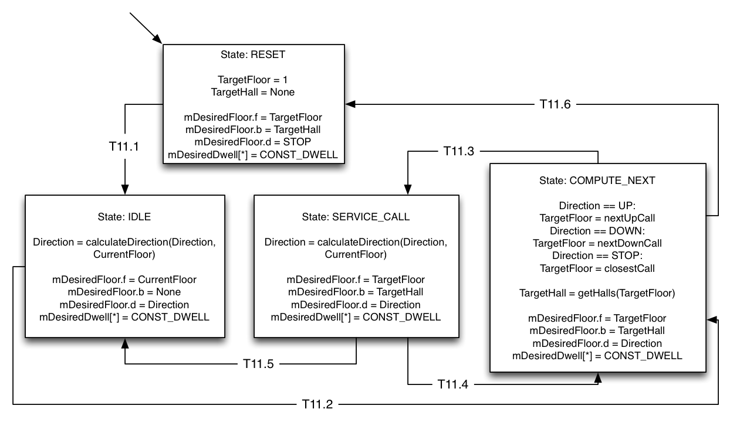
Dispatcher: New Statechart
10
Group 17, Speaker: Jessica

Slide 11
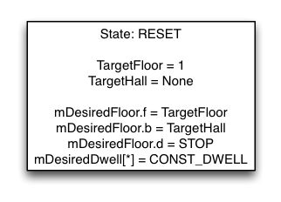
Dispatcher: New States
1.) RESET
2.) IDLE
3.) SERVICE_CALL
4.) COMPUTE_NEXT
11
Group 17, Speaker: Jessica

Slide 12
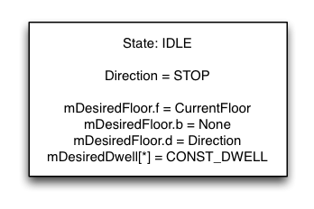
Dispatcher: New States
1.) RESET
2.) IDLE
3.) SERVICE_CALL
4.) COMPUTE_NEXT
12
Group 17, Speaker: Jessica

Slide 13
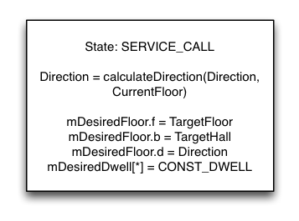
Dispatcher: New States
1.) RESET
2.) IDLE
3.) SERVICE_CALL
4.) COMPUTE_NEXT
13
Group 17, Speaker: Jessica

Slide 14
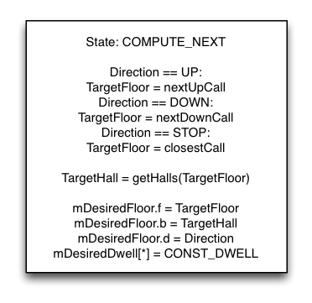
Dispatcher: New States
1.) RESET
2.) IDLE
3.) SERVICE_CALL
4.) COMPUTE_NEXT
14
Group 17, Speaker: Jessica

Slide 15
Statechart Transitions
Transition | Condition
T11.1 | CurrentFloor == 1 && all mDoorClosed[*,*] == True
T11.2 | any HallCall[f,b,d] == true || any CarCall[f,b] == true
T11.3 | CurrentFloor == TargetFloor
T11.4 | anyUpCall(CurrentFloor) || anyDownCall(CurrentFloor) && any mDoorClosed[b,r] == false
T11.5 | ~anyUpCall(CurrentFloor) && ~anyDownCall(CurrentFloor) && any mDoorClosed[b,r] == false
T11.6 | all mAtFloor[b,r] == false && any mDoorClosed[b,r] == false
15
Group 17, Speaker: Jessica

Slide 16
Macros
Macro | Value
CurrentFloor | value of f of whichever mAtFloor[f,b] true, if any. Set to None if all mAtFloor[f,b] false.
anyUpCall(CommitPoint) | (any mHallCall[f,b,UP] == true || any mCarCall[f,b] == true) where CommitPoint >= f
anyDownCall(CommitPoint) | (any mHallCall[f,b,DOWN] == true || any mCarCall[f,b] == true) where CommitPoint < f
nextUpCall(CommitPoint) | min(HallCall[f,b,UP], CarCall[f,b]) where f >= CommitPoint
nextDownCall(CommitPoint) | max(HallCall[f,b,DOWN], CarCall[f,b]) where f <= CommitPoint
closestCall | value of f of the nearest floor, arbitrarily biased towards UP in the event of a tie
getHalls(TargetFloor) | halls where calls exist on the given floor
16
Group 17, Speaker: Collin

Slide 17
Dispatcher: Testing Strategy
Unit Testing:
Importance: Low-Medium
Function: mostly tests the implementation of design
Note: our dispatcher has high coupling with DriveControl, so usefulness is limited
Integration Testing:
Importance: Medium-High
Function: tests interactions, correctness of design
Note: helps find obvious errors
Acceptance Testing:
Importance: Medium-High
Function: stress tested with script (# iterations)
Note: subtler errors found during acceptance testing
Group 17, Speaker: Jesse
17

Slide 18
Interactions with other modules:
Hall Lights, Car Lights, Lanterns:
CarLanternControl <-- mDesiredFloor <-- Dispatcher
HallButtonControl <-- mDesiredFloor <-- Dispatcher
CarButtonControl <-- mDesiredFloor <-- Dispatcher
Door Control:
DoorControl <-- mDesiredFloor <-- Dispatcher
DriveControl: Highly coupled with Dispatcher
Commit-point requires DriveSpeed and DesiredFloor to calculate
DriveControl --> mDriveSpeed --> Dispatcher
DriveControl <-- mDesiredFloor <-- Dispatcher
Both modules perform an independent commit point calculation.
18
Group 17, Speaker: Collin

Slide 19
Optimizations:
Elevator ignores calls when overweight
Reduce the number of door reversals
Reduce passenger delivery time
==> Increase passenger satisfaction
Service call for current floor first, even if call comes after those at other floors
Corner case: (scenario)
Reduce passenger delivery time
==> Increase passenger satisfaction
19
Group 17, Speaker: Collin

Slide 20
Lessons Learned:
Technical strategies:
  Automate parts of the process such as testing - this saves a lot of time!
    ..but be careful with automation!
Team strategies:
  Submission checklists
  Meetings in person
  Don't tell the team if you're the only one that realizes due date is later than normal
    ..sounds evil, but it's for their own good!
Group 17, Speaker: Jesse
20
Notes:
Concentrate on 2nd
half of course
Problems that you have already solved
How they came up
What did you do to solve them
Which strategies (team, technical, etc.)
have worked well, and which have not?
In retrospect, which aspects of testing,
peer reviews, other worked best?

Slide 21
Lessons Learned:
Runtime Monitoring: High-level requirements
Use SD high-level traceability comments in TOC [scen_sd.html] to find SD arcs corresponding to HL reqs.
Use sd_req_traceability.xls to find BR's corresponding to those arcs.
Use requirements-to-state-chart traceability tables [requirements2.html] to find SC transition logic corresponding to those BR's.
Result: on-wire monitoring & logic for monitor transitions ==> USE YOUR TRACEABILITY!
21
Group 17, Speaker: Jesse
Notes:
Concentrate on 2nd
half of course
Problems that you have already solved
How they came up
What did you do to solve them
Which strategies (team, technical, etc.)
have worked well, and which have not?
In retrospect, which aspects of testing,
peer reviews, other worked best?

Slide 22
Open Issues & Suggestions:
To do:
Run acceptance tests overnight
Increase passenger satisfaction by improving runtime monitoring
Course Suggestions:
Make website easier to use. Have all links in one location in addition to within the text (and site map).
Remove inconsistencies and outdated information
Have progress reports due after submission
Advice for future students:
Start projects early during the week.
Following a process actually helps
22
Group 17, Speaker: Jessica

Slide 23
Questions?
23
Group 17, Speaker: Jessica

