Slide 1
ECE 18-649 Midterm Project Report
Oct 31, 2012
Group # 17
Jessica Tiu (jtiu)
Collin Buchan (cbuchan)
Rajeev Sharma (rdsharma)
Jesse Salazar (jessesal)
1 Group 17 Speaker: Jesse Salazar

Slide 2
Outline: Group 17
Project Statistics
DriveControl Design Process:
  Use Cases & Scenarios:
    Arriving at floor
    Leaving floor
  Sequence Diagrams
  Requirements
  Statechart
Design revisions:
  Confusion about leveling behavior
  Trouble with overweight sensor
Lessons Learned
2 Group 17 Speaker: Jesse Salazar

Slide 3
Project Statistics: Group 17
Date of Presentation | 10/31
# of sequence diagrams | 18 | --- | ---
# of SD Arcs | 135 | --- | ---
# of requirements | 46 | --- | ---
# of statecharts | 7 | --- | ---
# of SC States | 19 | --- | ---
# of SC Arcs | 28 | --- | ---
# of non-comment/blank LOC | 2063 | --- | ---
# of unit tests | 16 | --- | ---
# of integration tests | 18 | --- | ---
# of acceptance tests | 4 | --- | ---
3 Group 17 Speaker: Rajeev Sharma

Slide 4
Project Statistics: Group 17
Date of Presentation | 10/31
# of unresolved defects | 0 | --- | ---
# of issue log entries | 33 | --- | ---
# of peer reviews | 74 | --- | ---
# of defects found | 75 | --- | ---
# of defects fixed | 75 | --- | ---
# of other defects found | 33 | --- | ---
# of other defects fixed | 33 | --- | ---
# revision entries | 597
4 Group 17 Speaker: Rajeev Sharma

Slide 5
DriveControl: Use Cases and Scenarios
U3: Passenger Enters Elevator
  Car must be level for passenger to enter
SD3A:
  Car arrives at a floor
  Demonstrates leveling -> stop behavior
U8: Move Car to Next Floor
  Core elevator behavior, depends on DriveControl
SD8A:
  Car leaves a floor
  Demonstrates stop -> slow behavior
5 Group 17 Speaker: Collin Buchan

Slide 6
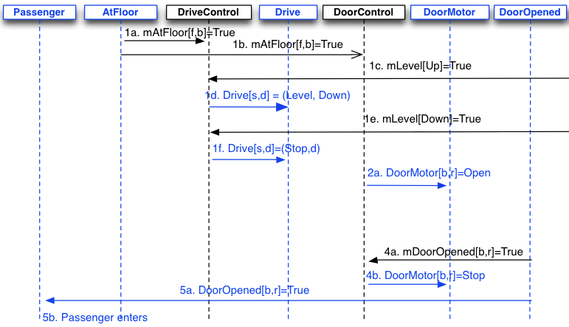
Sequence Diagram 3A
6 Group 17 Speaker: Collin Buchan

Slide 7
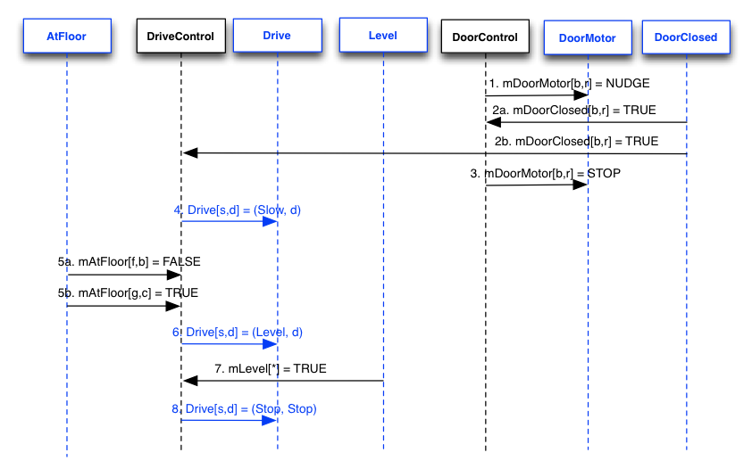
Sequence Diagram 8A
7 Group 17 Speaker: Collin Buchan

Slide 8
Requirements: DriveControl
Major considerations:
Outputs: Drive, mDrive, mDriveSpeed
DriveControl levels the elevator.
Must know direction to command the Drive at all times:
  mDesiredFloor.d does NOT tell the controller what direction to level in => calculate internally.
Constraints:
Set Drive to Stop for:
  Overweight car
  Emergency brake
  Doors open
Our requirements followed naturally from these considerations and the constraints.
8 Group 17 Speaker: Jessica Tiu

Slide 9
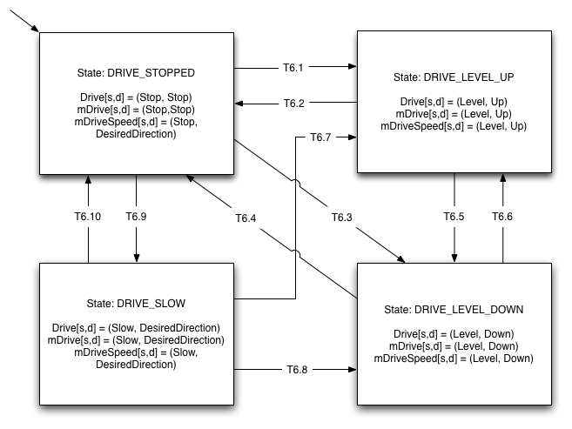
Statechart: Diagram
--Original: one DRIVE_LEVEL state.
--New: split into UP and DOWN states for transparency.
9 Group 17 Speaker: Jessica Tiu

Slide 10
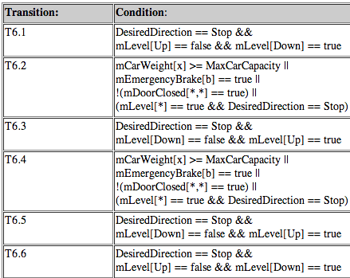
Statechart: Transitions
10 Group 17 Speaker: Jessica Tiu

Slide 11
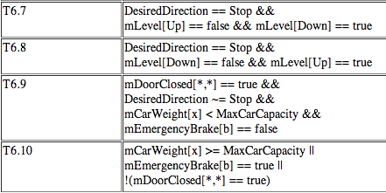
Statechart: Transitions
11 Group 17 Speaker: Jessica Tiu

Slide 12
Lessons Learned & Open Issues
DesiredDirection macro is very important
  Make sure behaviors of macro are correct
  Initial value of DesiredDirection
State chart designed to easily expand to a smart elevator drive
Much easier to work in-person with groups
Use google site search on course page
Communicate in addition to version control
Biggest challenge from here: fault-protection and error tolerance!
12 Group 17 Speaker: Jesse Salazar

Slide 13
Questions?
Group 17
13 Group 17 Speaker: Jesse Salazar

