Slide 1
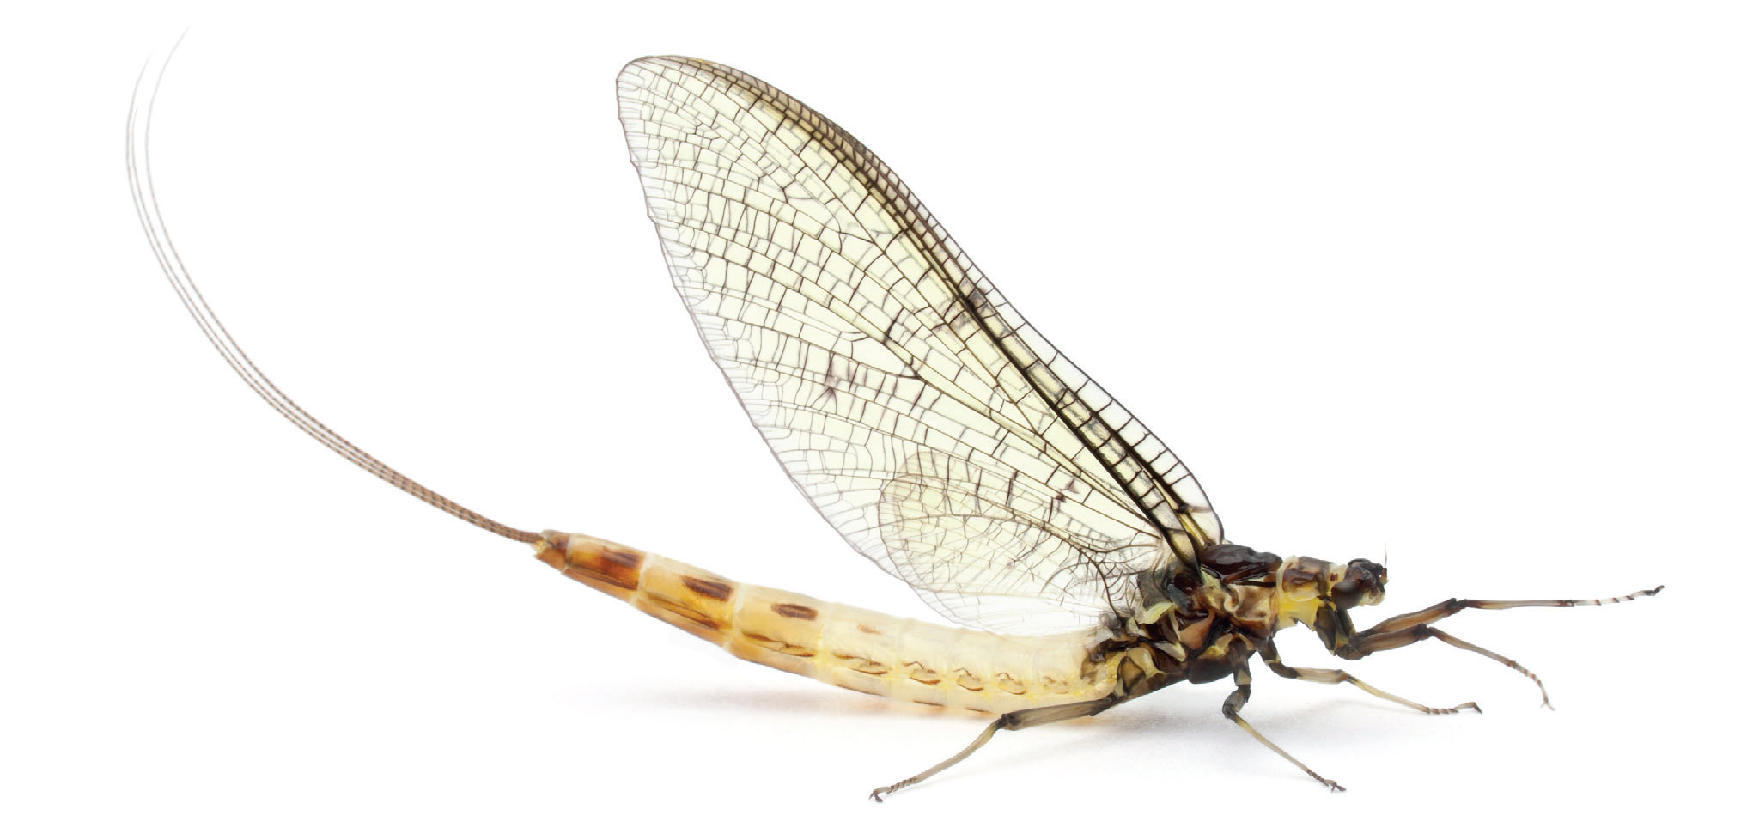




Mayfly
Reproducible Research in Minutes

Slide 2

Reproducible Research is the new paradigm
And more graphics should be interactive
So, why don’t people do it?
Never learned how
It’s a hassle
No consistent platform
So:
Create platform for reproducible research
Hosted by OSDC
Step 1: Configure Environment
IPython
R
Dropbox
Dropbox Publisher
Configures Dropbox
Mayfly

Slide 3

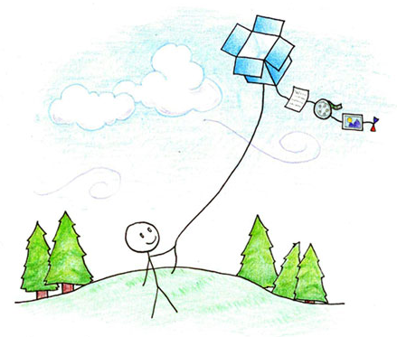
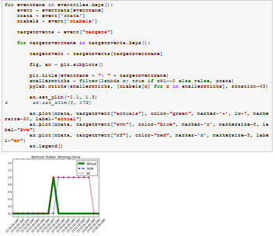

Step 2: Research!
Data
Mayfly

Slide 4

Why is this a good idea?
Document your research
Share code, charts, and images
Host interactive visuals!
Code is already written

Slide 5
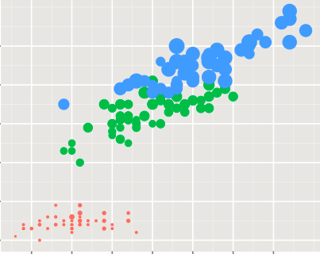
Usage case
So,
Mary wants to investigate iris flowers
Needs computational power
Wants visualizations
Thinks that reproducible research is good
Runs setup program
Points to Python script
…
And is given a dropbox link to her report
Shares with coworkers, gets feedback, spots a coding mistake by her RA…
IPython
R
Dropbox
Dropbox Publisher
Configures Dropbox
Mayfly

