Slide 1

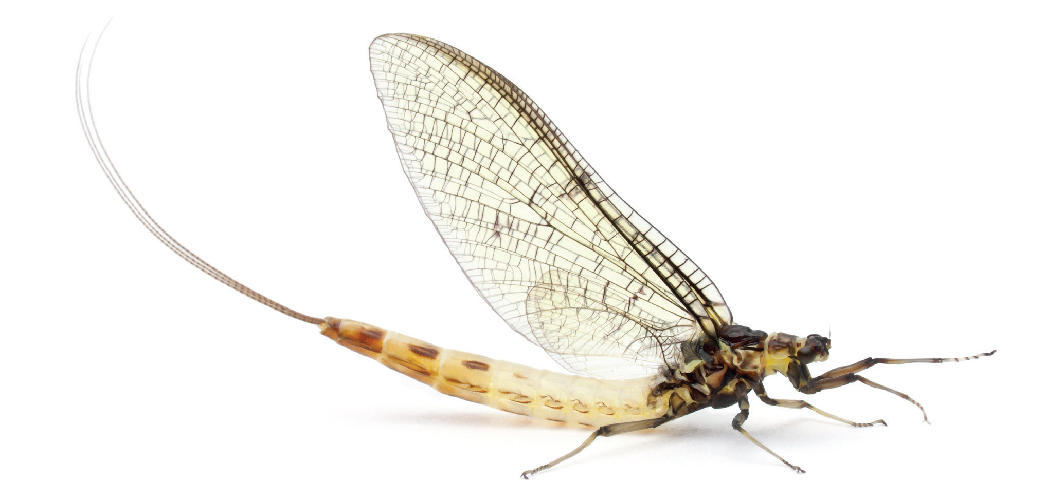


Mayfly
Reproducible Research in Minutes

Slide 2
New Research Paradigm
Reproducible Research
Data Visualization
Easy-to-share data visualization

