Slide 1
Embedded Analytics

Slide 2
Goals of Embedded-Analytics Platform
Identify the right platform and technologies that will allow source analytics to be aggregated on same page (medium)
Evaluate the proposed platform and technologies for Guardian specific environment
Create a blueprint that will outline the design of the platform
Implement this blueprint by creating real case embedded pages to be used in Guardian targets
Most leading data analytics and business intelligence platform offer the capability to be embedded in a foreign environment. However, the platform identified in our project has the capability to aggregate them together, on the same hosting page (medium), making it available to further use in various "targets" specific to Guardian.

Slide 3
Guardian BI Source Platforms
The following data analytics and business intelligence systems currently used by Guardian were considered as sources to be embedded in the future embedded-analytics platform:
Tableau
Microsoft Reporting Services
SAP Business Objects
Microsoft PowerBI

Slide 4
Source Platforms Embedding Capabilities
 | Security Considerations | Embedding Capabilities | Special Key Points
Tableau | Requires every user consuming reports must be a licensed Tableau user, including embedded reports | Offers SharePoint webpart for embedding, including the source code.
SSRS | Authorization of users is done at the server level and it can be configured to be on behalf of a server user | Does not offer snippets of embedding in the native UI, but they are highly documented. Microsoft offers SSRS WebPart visualizer for SharePoint
PowerBI |  |  | Ability to produce insights generated using AI algorithms. Insights can be embedded too Offers NLP search capabilities.
SAP BO | Require generating of a short-lived authentication token that must be attached to the call. | Embedding is done through iframes through a single point: Open Document Offers special site collection template for embedding with SharePoint
QuickSight | Security is handled entirely through IAM roles assigned to the calling entity. |  | Ability to produce insights generated using AI algorithms. Insights can be added to visualizations and embedded. Connected with Alexa for business offers NLP search

Slide 5
Embedded Analytics Platform Election Process
During our project we analyzed numerous technologies to be used as an embedded analytics platform for Guardian. These included SharePoint, Third-party Vendors and Inhouse Solutions.
We also gathered information and consulted with other Cognizant teams that handled projects similar with ours, as well as with external teams that worked on embedded-analytics.
Criteria used in evaluation:
Ability to co-exist on the same page (rendering medium) with all other reporting sources
Loading time - page responsiveness - for initial (uncached) and subsequent (cached) access
Failure capture mechanism of source reports - ability to capture notification and relay
Support for single-sign-on authenticationx
Support for oauth authentication
Support for public users
Ability to embed Tableau
Ability to embed SSRS and PowerBI
Ability to embed Business Objects
Ability to be embedded in other systems
Ability to capture comments on same medium
Ability to communicate to embedded objects through an event mechanism
Sensitive tokens and authentication code exposure
Support for auto-refresh
Support for branding
Initial learning curve, training required for Developer User
Time and effort for initial implementation of the platform
Time and effort for implementing individual dashboard.
Price of the out of the box solution (if applicable)
Requirements for hosting environment. Technology Stack
Ability to scale to high traffic demand
Ability to scale to higher complexity of the source reports
Amount of maintenance required
Ability to be distributed and exported

Slide 6
Embedded Analytics Platform Considered
Microsoft SharePoint 2013, 2016 or 2019
AWS Hosted - Plot.ly Dash Platform
AWS Hosted - R Shiny Apps Platform

Slide 7

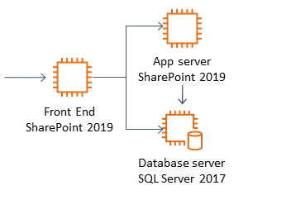
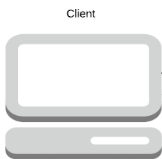
SharePoint as Embedded Analytics Platform
High Level AWS SharePoint Hosting Architecture
Technology Stack:
AWS EC2
AWS VPC, NAT Gateway
AWS CloudFormation
SharePoint 2019
AWS Cloud
Pros:
Relatively lower cost of implementation (1 – 2 weeks)
No programming skills required
Tableau, SSRS, PowerBI and BO offer out of the box webparts for embedding in SharePoint.
Easy to embed other types of content such as comments.
Cons:
Relatively higher cost of SP Farm maintenance.
Relatively higher cost of operations.
Hard to adapt for new complexities in reports embedding.
Low perception

Slide 8
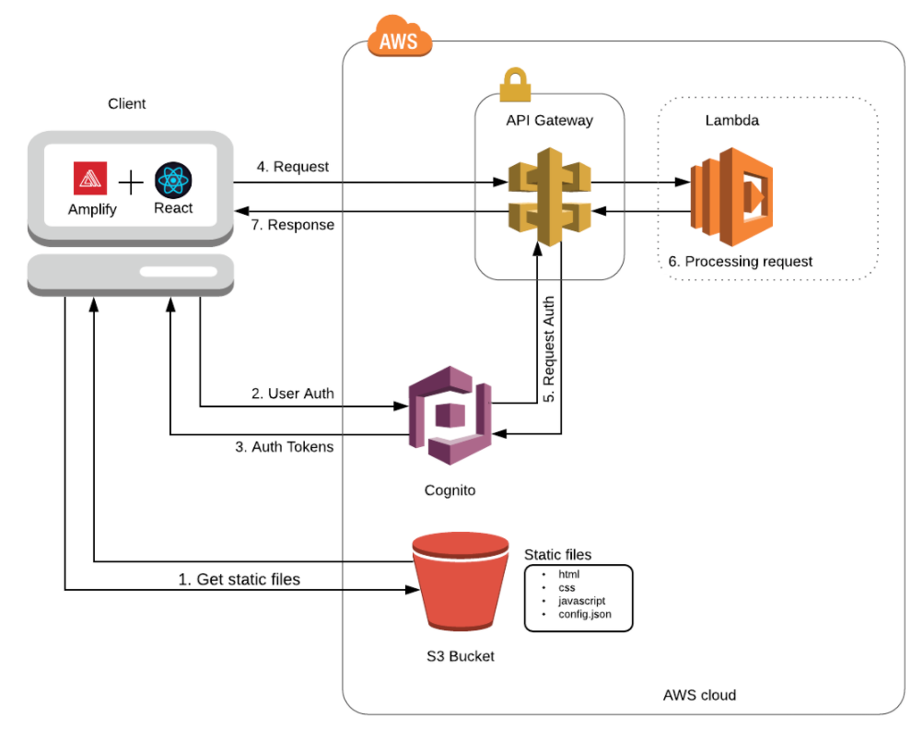
Pltot.ly Dash as Embedded Analytics Platform
High Level AWS Serverless Hosting Architecture
Technology Stack:
AWS S3
AWS Lambda
AWS API Gateway
AWS Amplify
AWS Cognito
AWS CloudFront
AWS CloudFormation
Plot.ly Dash libraries
React, Python
Plot.ly Dash Framework
Pros:
Relatively lower cost of operations
Flexible for high complex reports
Fast response time
Highly scalable on demand
Cons:
Relatively higher cost of implementation ( 1 – 3 months)
Require programming skills with Plot.ly, Dash
Steeper learning curve

Slide 9
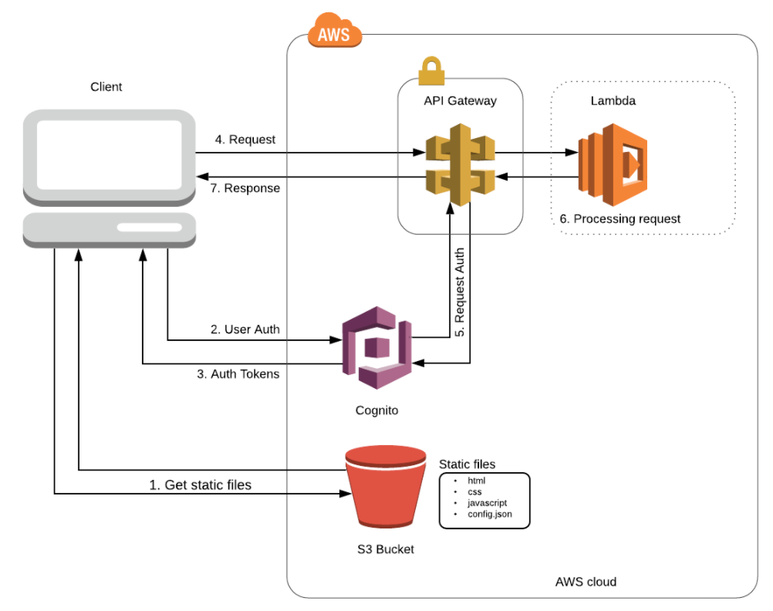
R Shiny Apps as Embedded Analytics Platform
High Level AWS Serverless Hosting Architecture
Technology Stack:
AWS S3
AWS Lambda
AWS API Gateway
AWS Cognito
AWS CloudFront
AWS CloudFormation
R Shiny Apps
R Studio
R Shiny Apps Libraries
Pros:
Relatively lower cost of operations
Flexible for high complex reports
Fast response time
Highly scalable on demand
Cons:
Relatively higher cost of implementation ( 1 – 3 months)
Require programming skills with R, Shiny apps
Steeper learning curve

Slide 10
Detailed Evaluation Matrix
Criteria | Importance | SharePoint 2019 | Plot.ly Dash Framework | R Shiny Apps Framework
Ability to co-exist on the same page (rendering medium) with all other reporting sources | Critical | Yes. Can also embed many other types of content | Yes | Yes
Loading time - page responsiveness - for initial (uncached) and subsequent (cached) access | Important | High loading time. Can be adjusted by an admin | Low latency ~300ms | Low latency ~300ms
Failure capture mechanism of source reports - ability to capture notification and relay | Important | There is some degree of gracefully capturing errors. | Possible. Must be coded | Possible. Must be coded
Support for single-sign-on authenticationx | Critical | OOB Feature | Yes. Through Cognito | Yes. Through Cognito
Support for oauth authentication | Critical | OOB Feature | Yes. Through Cognito | Yes. Through Cognito
Support for public users | Less Important | Yes. Can be added as a customization. | Yes. Through Cognito | Yes. Through Cognito
Ability to embed Tableau | Critical | Yes. Using WebParts provided by Tableau | Yes. Using iframes or JS. | Yes. Using iframes or JS.
Ability to embed SSRS and PowerBI | Critical | Yes. Using WebParts provided by Microsoft | Yes. Using iframes or JS. | Yes. Using iframes or JS.
Ability to embed Business Objects | Critical | Yes. Using WebParts provided by SAP or iframe. | Yes. Using iframes. | Yes. Using iframes.
Ability to be embedded in other systems | Less Important | Dificult. Doesn’t play well being embedded. Must be customized. | Easy | Easy
Ability to capture comments on same medium | Important | Yes. Using OOB webparts. Can be synched with external systems through custom code. | Possible. Must be designed and coded. | Possible. Must be designed and coded.
Ability to communicate to embedded objects through an event mechanism | Less Important | OOB feature communicate between SSRS or PowerBI reports. Difficult for other reports. | Possible. Must be designed and coded. | Possible. Must be designed and coded.

Slide 11
Detailed Evaluation Matrix
Criteria | Importance | SharePoint 2019 | Plot.ly Dash Framework | R Shiny Apps Framework
Sensitive tokens and authentication code exposure | Critical | Safe | Safe | Safe
Support for auto-refresh | Less Important | Yes. Would need a special webpart. | Yes. Needs to be coded. | Yes. Needs to be coded.
Support for branding | Important | Can be branded using templates. | Can be branded using templates. | Can be branded using templates.
Initial learning curve, training required for Developer User | Important | No development required. | Relatively high skills required for: Plot.ly Dash, Python, React | Relativelly high skills required for: R Shiny, JavaScript
Time and effort for initial implementation of the platform | Important | Initial deployment can be fast through AWS templates provided by Microsoft | Significant effort. Must be planned, designed and implemented. | Significant effort. Must be planned, designed and implemented.
Time and effort for implementing individual dashboard. | Important | Relatively fast and low cost for each dashboard. | Relatively medium effort. | Relatively medium effort.
Price of the out of the box solution (if applicable) | Important
Requirements for hosting environment. Technology Stack | Important | AWS EC2, VPC | AWS Aplify, Lambda, Cognito, S3 | AWS Lambda, Cognito, S3
Ability to scale to high traffic demand | Important | Must be configured | Can be pre-configured in AWS architecture | Can be pre-configured in AWS architecture
Ability to scale to higher complexity of the source reports | Important | Difficult to scale on higly complex reports. | Relatively low effort. | Relatively low effort.
Amount of maintenance required | Important | Relatively medium effort. | Once deployed it can be planned for low maintenance. | Once deployed it can be planned for low maintenance.
Ability to be distributed and exported | Important | OOB sharing pages mechanism. | Must be designed and coded. | Must be designed and coded.

