Slide 1
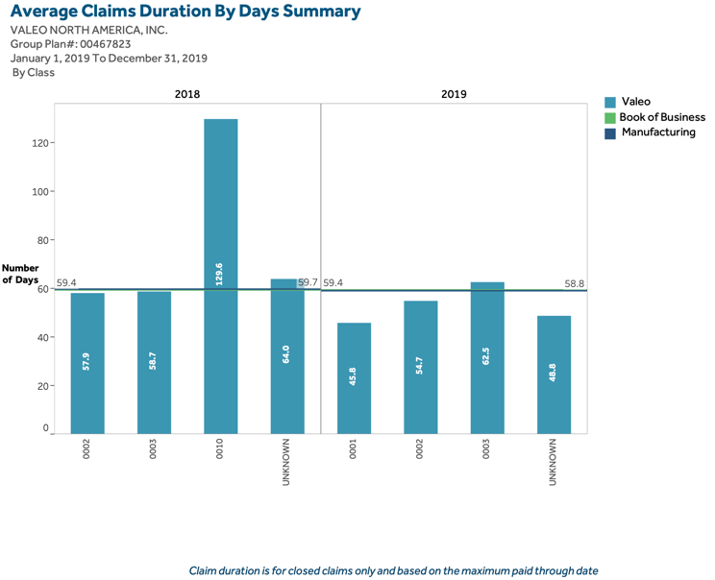
Short Term Disability Utilization Overview for 2020
15:Text Placeholder 5
1:Content Placeholder 2
subtitle for 2020
14:Text Placeholder 4

