Slide 1
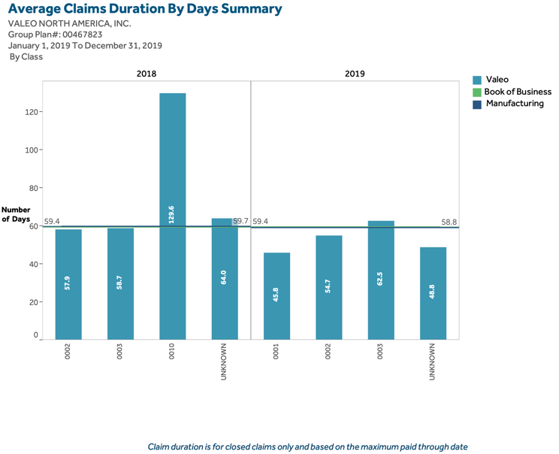
Short Term Disability Utilization Overview for 2020
subtitle for 2020
1:Content Placeholder 2
13:Content Placeholder 3
14:Text Placeholder 4

