Slide 1
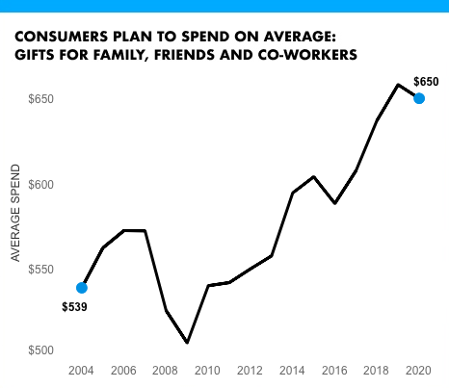
sdsadad 2020
sadsadsadsa
1:Content Placeholder 2
14:Text Placeholder 4

