Slide 1
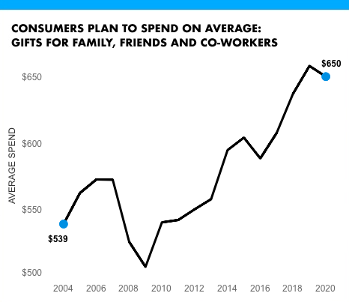
Some analysis about 2020
This is a subtitle about {curent year}
1:Content Placeholder 2
14:Text Placeholder 4

