Slide 1
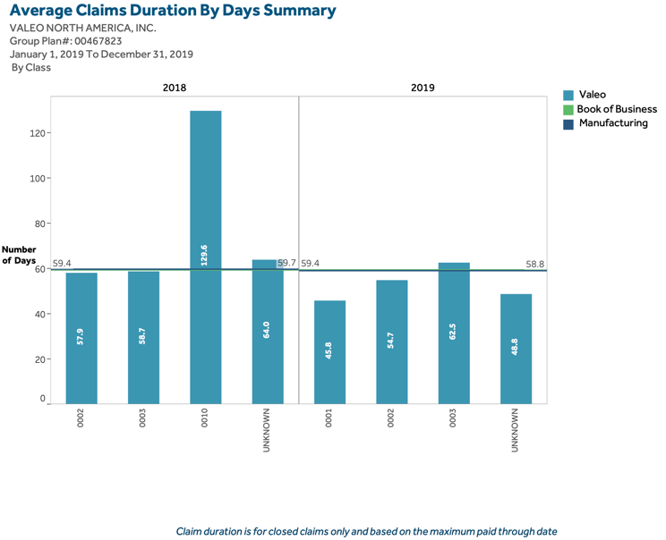
Some analysis about 2020
This is a subtitle about 2021
1:Content Placeholder 2
14:Text Placeholder 4

