Slide 1
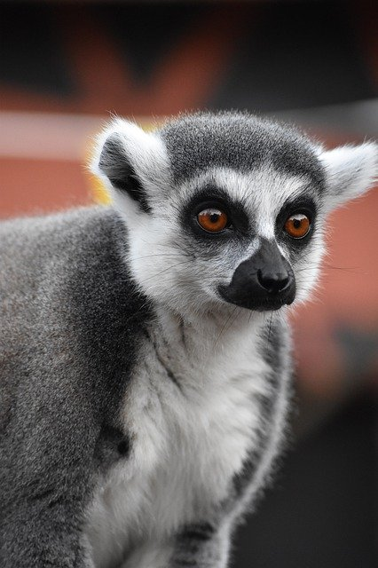
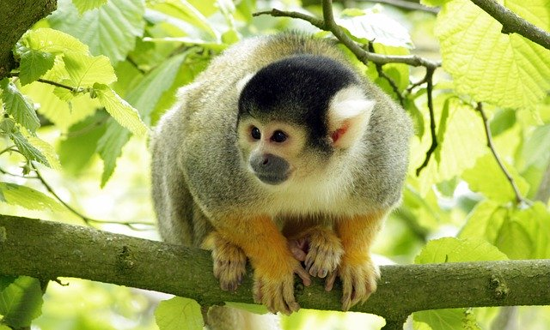
Monk
Monkeys are the best!
Created with a trial version of Syncfusion Essential Presentation
Created with a trial version of Syncfusion Essential Presentation
Created with a trial version of Syncfusion Essential Presentation

