Slide 1
Weather Map App
Team TURING: Noah Parker, CHRIS BURNSIDE, Andrew GETTZ

Slide 2
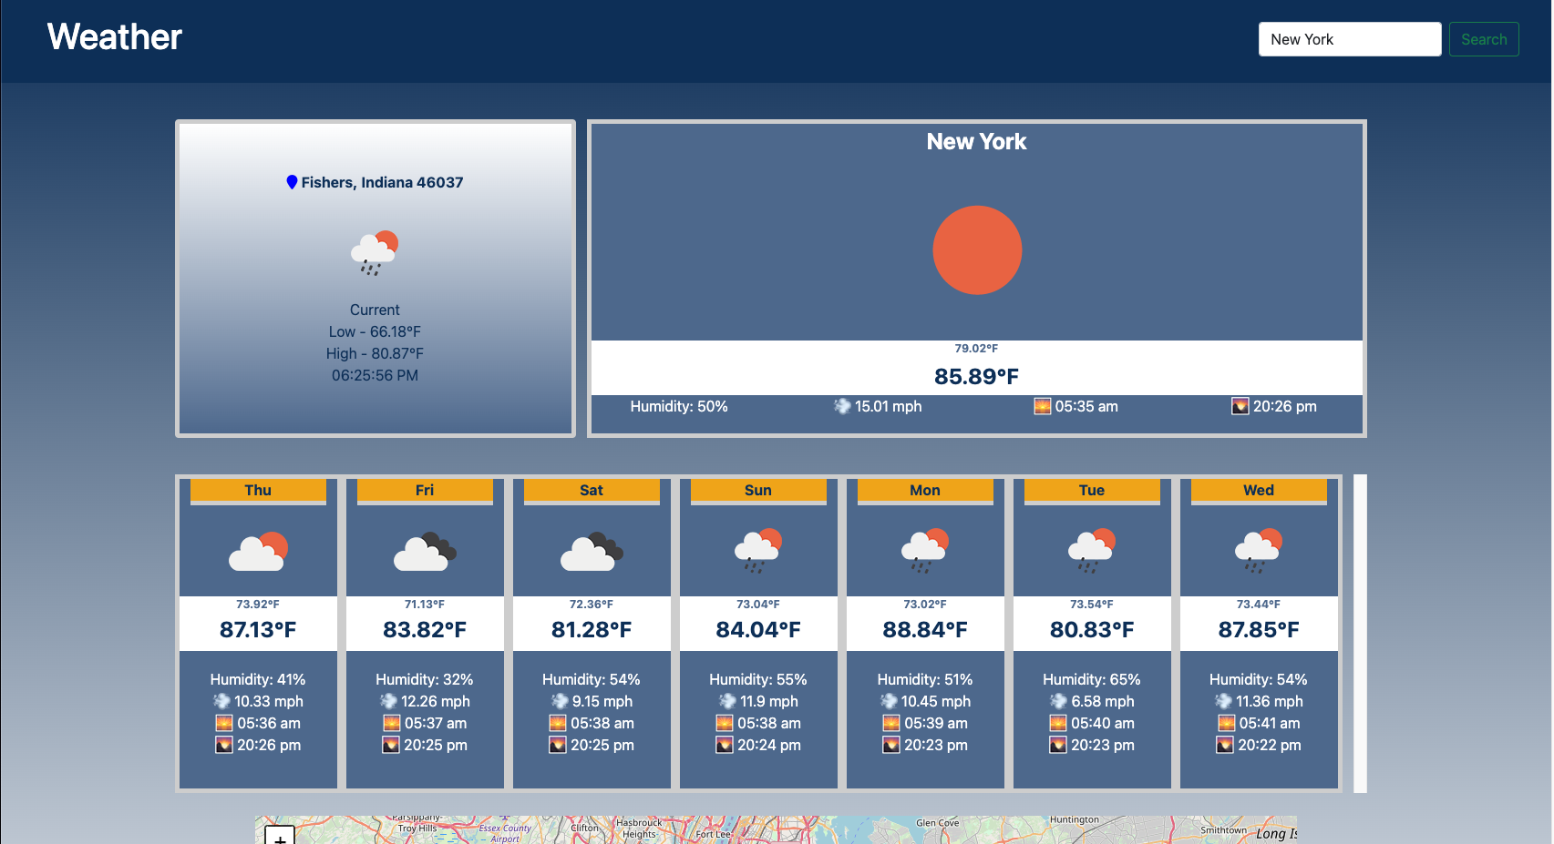
The Pitch -

Slide 3
The Concept
The all-in-one weather app. We use this robust weather and mapping api to display your current locations weather while pulling up a map of the near by area.
When would you use this?
Work in a different city?
Seeing a concert in the next town over?
Planning your honeymoon?

Slide 4
The Process
Map – MapTiles API, Weather – OpenWeather, Convert the Geo Location - GeoLocation DB
JSON
AJAX
TAILWIND
BOOTSTRAP
HTML
CSS
JS
Tasks and Roles
Andrew – Weather API and Presentation
Noah – Map API, Project Manager, Readme.
Chris - GeoLocation API and Design

Slide 5
The Process
Challenges
Search functionality for the Geo Location
Tying 3 APIs together
Displaying the current location and search for alternate locations.
Successes
Overcoming each of the challenges
Finding APIs for free
Communication

Slide 6
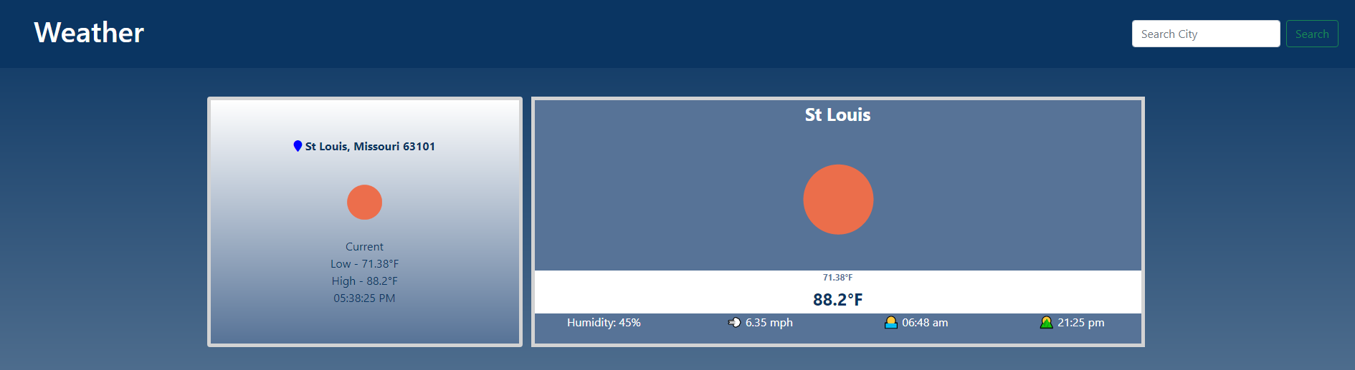
Demo

Slide 7
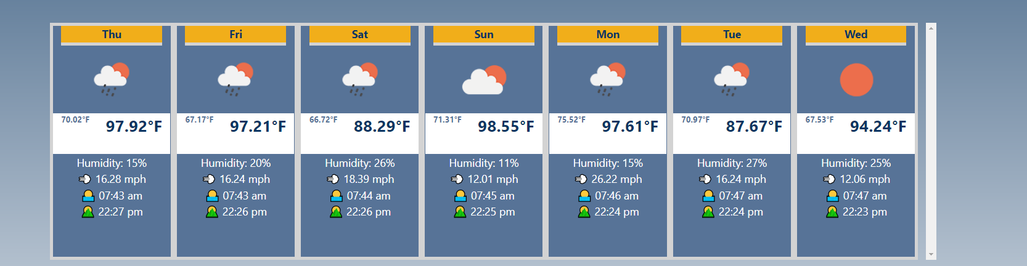
Demo

Slide 8
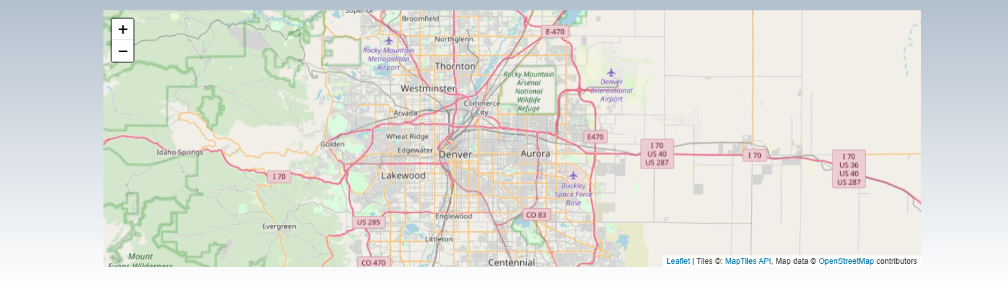
Demo

Slide 9
Future Initiatives
Add autocomplete to the search bar
Additional map interactions (display local amenities)
Weather upgrades – Solar mapping
Weather upgrades – Weather Emergency Updates

Slide 10
Links
https://github.com/NTParker/Weather-Map-App/issues
https://ntparker.github.io/Weather-Map-App/

Slide 11
Q & A
Questions…?

