Slide 1

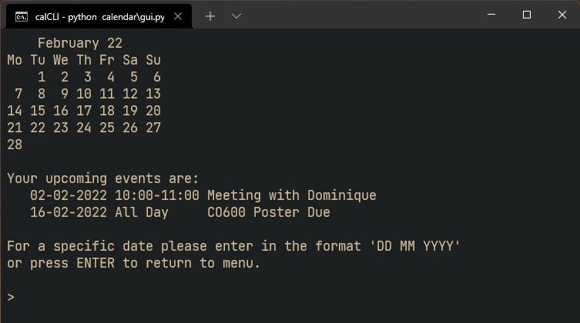
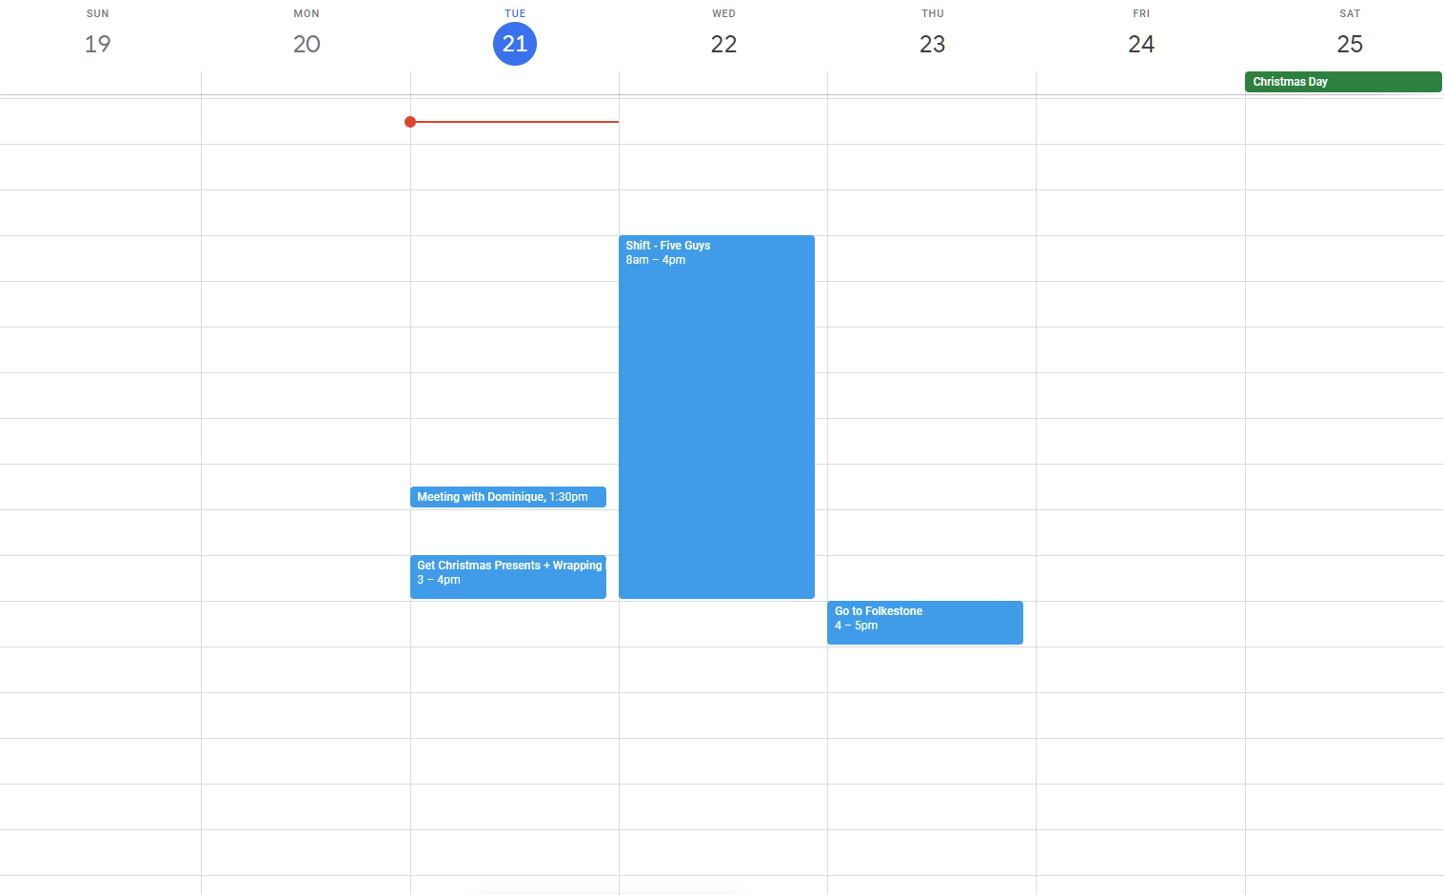
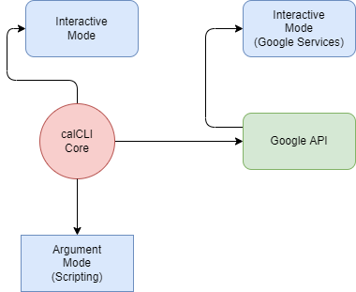
calCLI $> A modern CLI calendar app
C. J. Burton cb883@kent.ac.uk
Manage your time and track your commitments all from the terminal! A sleek, step-by-step Terminal User Interface (TUI) makes planning events and checking your schedule easy.
Diverse Functionality: calCLI has multiple modes and features, Google Calendar integration allows cloud scheduling across other devices. Alternatively run it without and use a local copy of your events.
Always Up-to-date:
Syncing with Google Calendar is always done on start up and a prompt to delete past events makes it easy to manage your tasks.
Scriptable and Extensible: calCLI’s core features work without any dependency on Interactive mode, calCLI can be wrapped and included in status bars and widgets.

