Slide 1


PCF Operations Workshop -
Platform & Application Scaling
Chris Busch, Sr. Platform Architect
Jennifer McLaughlin, Sr. Platform Architect
Notes:
Good afternoon everyone and thank you for taking the time to meet with me to discuss how Pivotal is helping companies build modern software

Slide 2
PCF Introduction
Platform Installation & Setup
Services Overview
Role Based Access Control
Platform & Application Scaling
Platform & Application Health
Patching & Updates
Authentication and Authorization
Operations Workshop Agenda

Slide 3
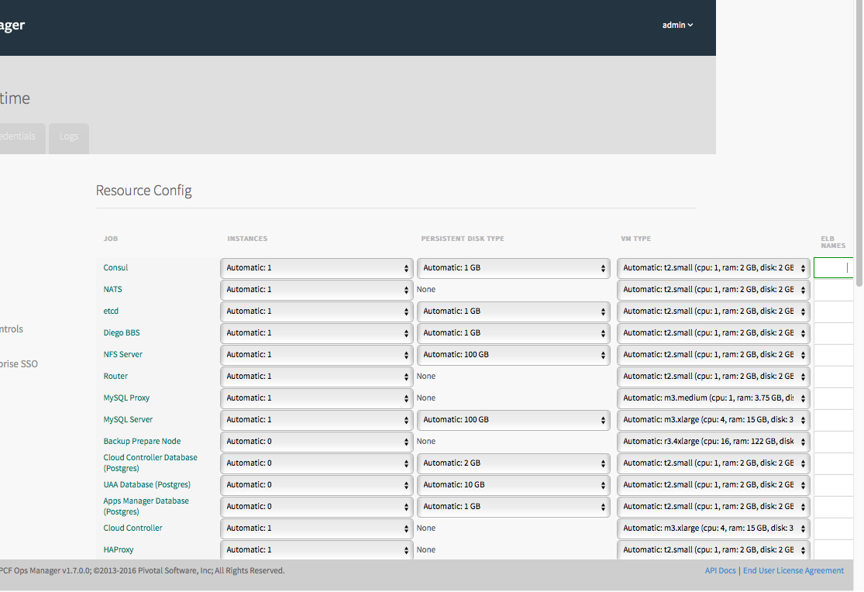
Platform Scaling
Ops Manager allows administrators to quickly and easily scale PCF components using the “Resource Config” workflow of the Elastic Runtime tile
Administrators can select machine sizes for their components
Additional information can be located at the following URL: http://docs.pivotal.io/pivotalcf/1-9/concepts/high-availability.html#availability
Notes:
Discuss how to scale ERT components via Ops Manager

Slide 4
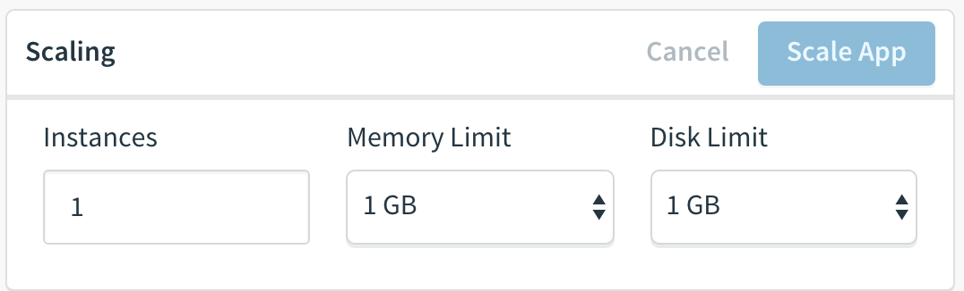
Applications - Vertical Scaling
Cloud Foundry enables vertical scaling of instances
Users can modify Memory and Disk limits via:
  Apps Manager console
  cf CLI
  manifest.yml
Notes:
Discuss how to vertically scale applications

Slide 5
Applications - Horizontal Scaling
Cloud Foundry enables rapid horizontal scaling of applications via containers
Users can modify the number of instances via:
  App Autoscaler tile
  Apps Manager console
  cf CLI
  manifest.yml
Notes:
Discuss why containers enable rapid scaling (compare vs VMs…speed, etc)

Slide 6
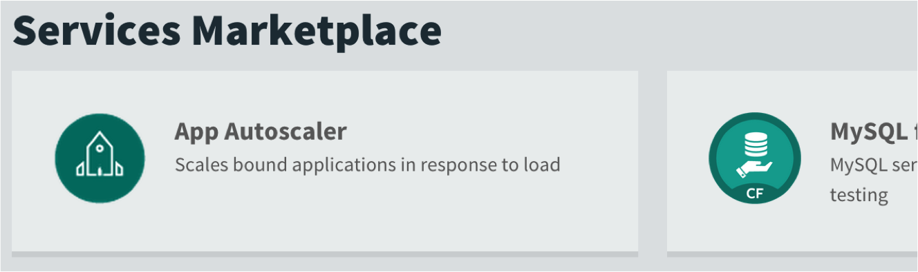
App Autoscaler
CPU usage or time-based schedule can be used to scale application instances
It is a service in the marketplace
Notes:
Discuss the app autoscaler

Slide 7
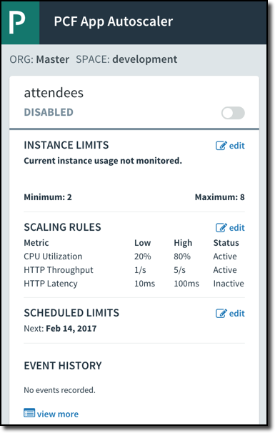
App Autoscaler Service – Steps
Create a service instance in for the space (if necessary)
Bind to an application
Set the desired scaling parameters
  Add instance whenever high CPU threshold is reached
  Subtract instance whenever low threshold is reached
  HTTP Throughput and HTTP Latency also available (v1.9)
Notes:
Discuss the steps needed to use the autoscaler

Slide 8
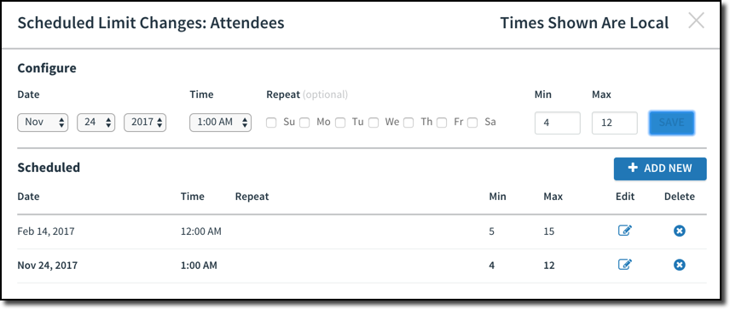
App Autoscaling – Scheduling
Autoscaling events can be scheduled
Changes autoscaling behavior on the
given date / time
May be a single
or recurring event
2
5
Notes:
When you set up an autoscaling event, essentially the min/max settings described take over from that point forward, until the next scaling event happens.
All scaling events are single events UNLESS you have checked one of the day checkboxes, then they recur every week.
So if a movie reservation business wanted to, they could scale up at the beginning of the weekend, then scale down on mondays. The date / time would affect when the schedule would take effect.

Slide 9
Autoscaling – Moving Average
Scaling activity based on moving averages
  Softens effect of temporary spikes
Manual scaling disables autoscaling
Spikes do not
trigger auto-scaling
Moving average exceeds
threshold, add instances
80%
Moving average drops
remove instances
CPU
20%
Notes:
This is a moving average of all application instances. One instance with a spike in activity usually won't cause scaling to occur.
When the moving average of all instances exceeds the threshold, a new instance is added. When the moving average of all instances is lower than the minimum threshold, then instances are removed until minimum # of instances reached. NOTE: the new instance is not necessarily the last one started as this illustration may imply.
If you manually scale, then you disable the autoscaling feature, so you need to remember to re-enable it.
The interesting footnote here is the stopping of a perfectly healthy instance by CF. Re-enforce that apps should be stateless and should handle a 'crash' at any time.

Slide 10
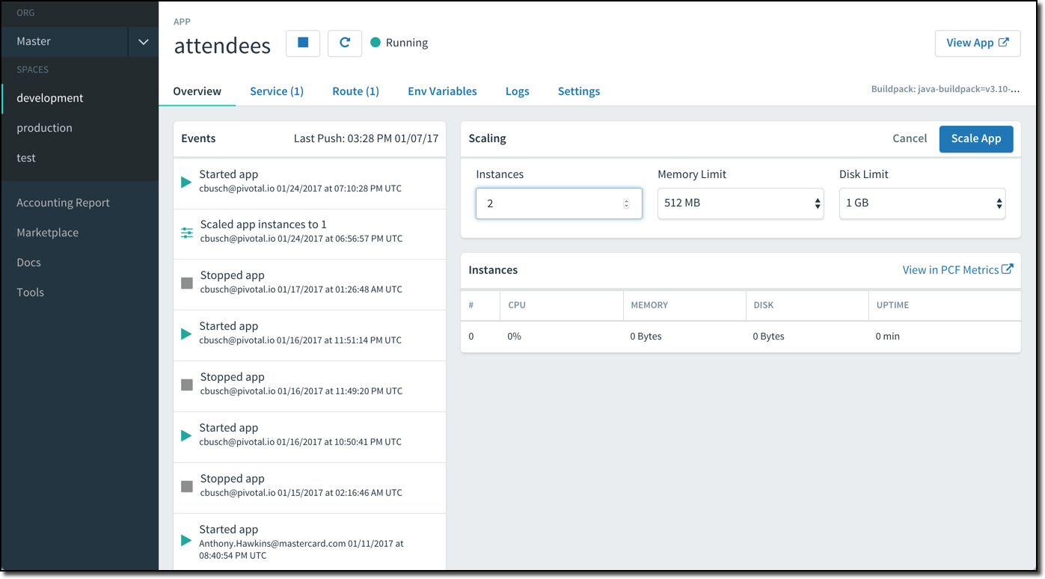
Apps Manager Scaling
Notes:
Notice that you are pushing an application name, not a file. The index.php file inside of the directory will automatically get uploaded when you cf push the application
Discuss the Apps Manager scaling feature

Slide 11
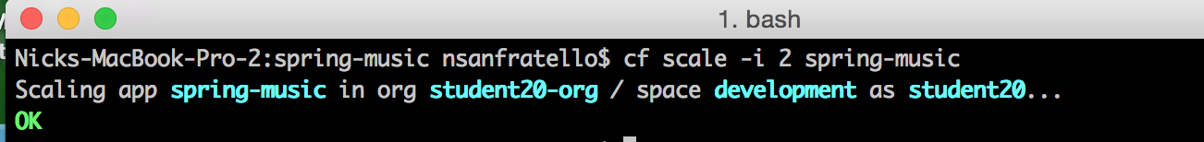
CLI Scaling
cf scale -i 2 “my-application-name”
Notes:
Notice that you are pushing an application name, not a file. The index.php file inside of the directory will automatically get uploaded when you cf push the application
Discuss how to scale a application via the CLI

Slide 12
Manifest Scaling
---
applications:
- name: spring-music
memory: 64M
instances: 5 # <-- Increase
host: myspringmusic
domain: example.com
# comment
- name: nextapp
memory: 256M
...
Notes:
Discuss how to scale applications via the manifest

Slide 13
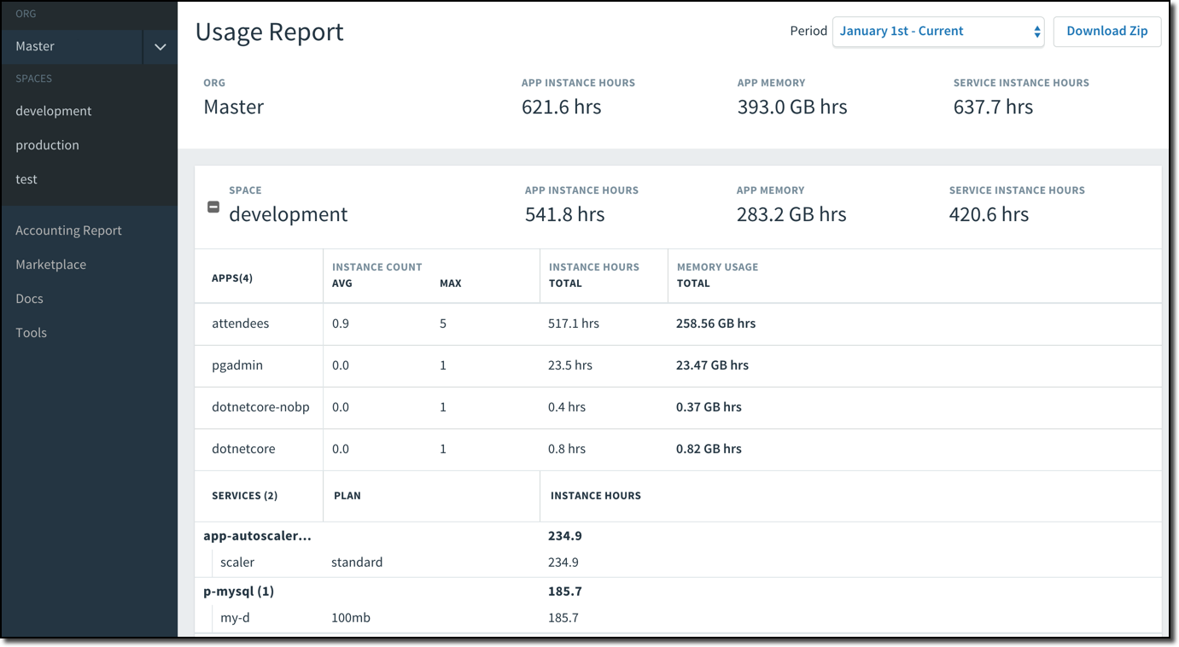
Platform Consumption & Chargeback
Download ZIP
Notes:
Discuss how the usage report provides administrators with information on what apps are consuming resources

